Slide 1

Cosmic Distance Ladder
The Return of Kush
16th February 2024

Slide 2

Today, it is journey time.
Due to extremely bad time management, this set of slides is coming into existence at the time shown below. At the end, I will put how long it took to finish.
The Return of Kush
16th February 2024
If you have any issues with the aesthetics of these slides, do not tell me and keep your opinions to yourself.
(The slides are a bit dry)

Slide 3
The Return of Kush
16th February 2024
Usually, I give you guys the menu, not today.
Today, just listen.

Slide 4
Section 1
I do not know the answer
The Return of Kush
16th February 2024

Slide 5

What is Time?
The Return of Kush
16th February 2024

Slide 6
Section 2
Time Travel
The Return of Kush
16th February 2024

Slide 7



What is ‘NOW’?
The Return of Kush
16th February 2024

Slide 8
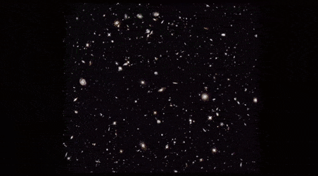
Look-back Distance
The Return of Kush
16th February 2024
The further away you look, the further back in time you go.

Slide 9
The Return of Kush
16th February 2024
How do you measure these humongous distances?
Using the Cosmic Distance Ladder

Slide 10
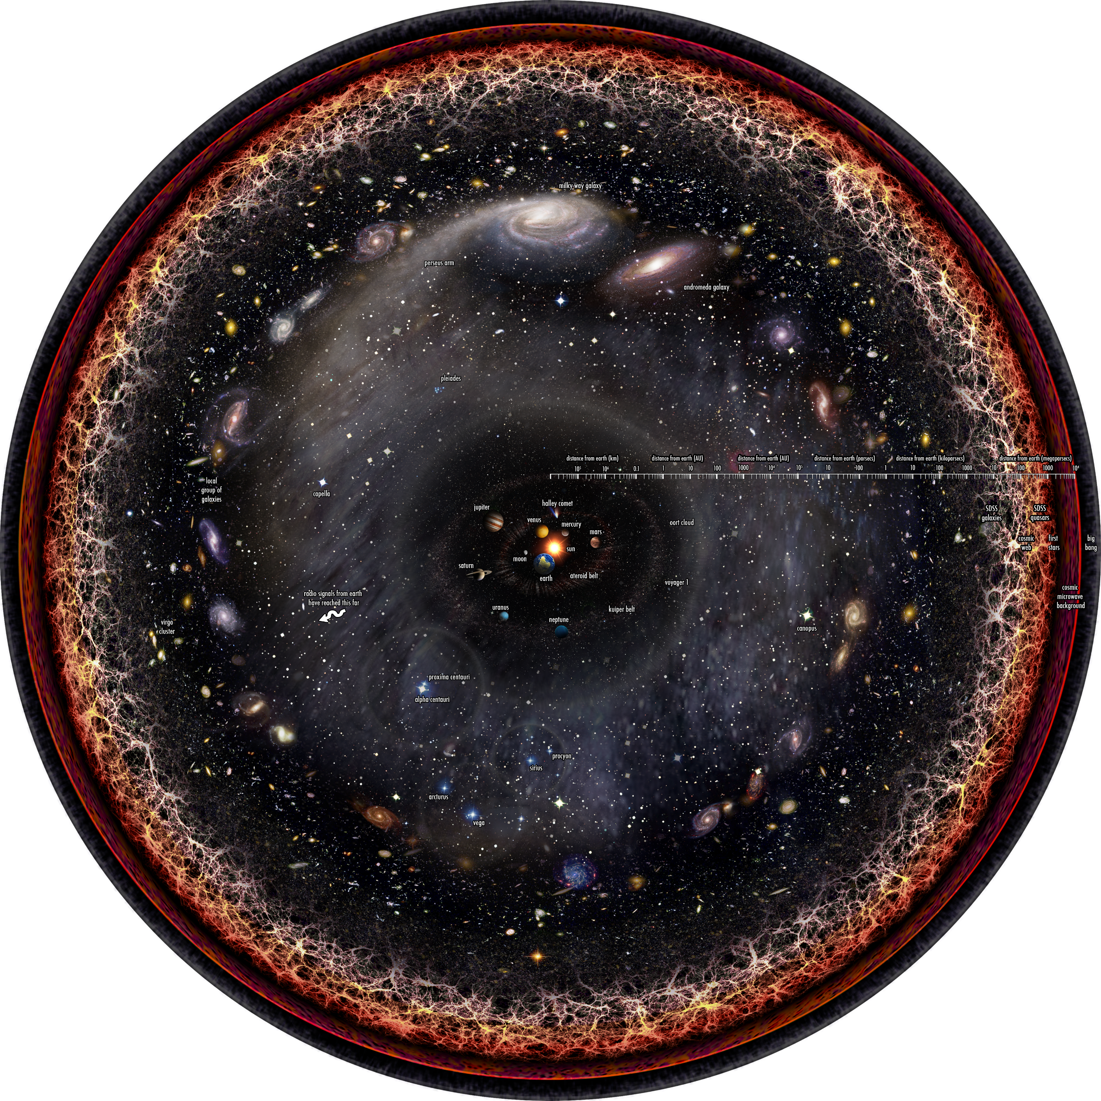
The Return of Kush
16th February 2024
Let us start small with,
The Solar System

Slide 11
Rung 1
RADAR
The Return of Kush
16th February 2024

Slide 12


RAdio Detection And Ranging
The Return of Kush
16th February 2024

Slide 13


RAdio Detection And Ranging
The Return of Kush
16th February 2024

Slide 14

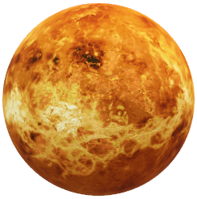
RAdio Detection And Ranging
The Return of Kush
16th February 2024

Slide 15

RAdio Detection And Ranging
The Return of Kush
16th February 2024
$$d=c×\frac{t}{2}$$

Slide 16
RADAR Limitations
The Return of Kush
16th February 2024
Intensity and Fragility

Slide 17
The Return of Kush
16th February 2024
Let’s zoom out

Slide 18
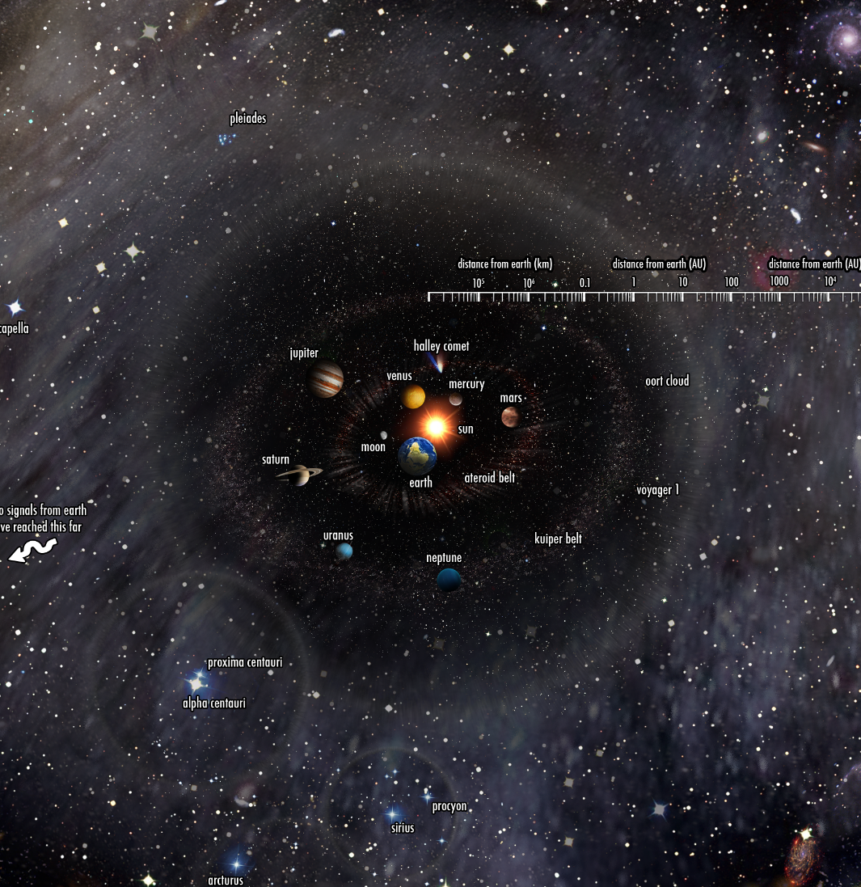
The Return of Kush
16th February 2024
Let’s zoom out,
To the nearby stars

Slide 19
Rung 2
Trigonometric Parallax
The Return of Kush
16th February 2024

Slide 20
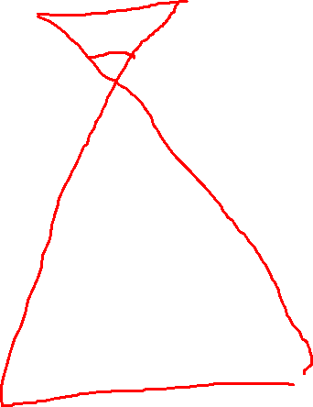
Best Demonstration Ever
The Return of Kush
16th February 2024
I need … a volunteer.

Slide 21
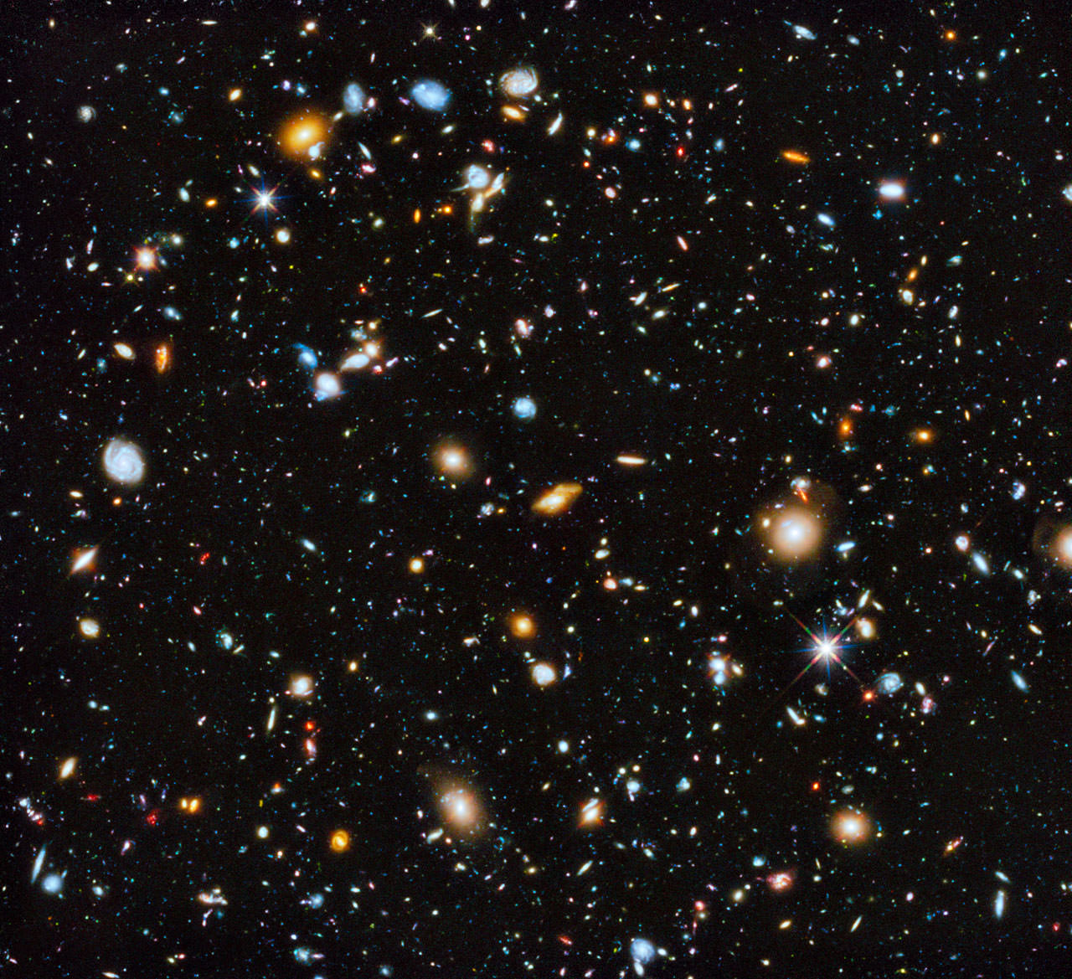



Trigonometry
Now
The Return of Kush
16th February 2024

Slide 22

Trigonometry
6 months later
The Return of Kush
16th February 2024

Slide 23



Trigonometry + Parallax
The Return of Kush
16th February 2024
Parallax angle
$$Aω$$
$$d≈\frac{1}{ω}$$
1 parsec is the distance of an object which has a parallax angle of 1 arcsecond

Slide 24
Limitations?
Precision
Gaia’s precision ~ 0.1mas
Furthest Distance ~ 10⁴ parsec ~ 32615 lightyears
Diameter of Milky Way ~ 90000 lightyears
The Return of Kush
16th February 2024

Slide 25
The Return of Kush
16th February 2024
How do we see beyond this?

Slide 26
Small Detour
Distance Modulus
The Return of Kush
16th February 2024

Slide 27
The Magnitude System
Apparent Magnitude (m)
The Return of Kush
16th February 2024
us
d

Slide 28
The Magnitude System
Absolute Magnitude (M)
The Return of Kush
16th February 2024
us
10 parsecs

Slide 29

m – M distance modulus
The Return of Kush
16th February 2024
$$m−M=5 \log{(\frac{d}{10})}$$

Slide 30
The Return of Kush
16th February 2024
Should we cover the

Slide 31
The Return of Kush
16th February 2024
Should we cover,
Our complete galaxy?

Slide 32
Rung 3
Main Sequence Fitting
(Spectroscopic Parallax)
The Return of Kush
16th February 2024

Slide 33
Surprising fact…
The Return of Kush
16th February 2024
IT HAS ABSOLUTELY NOTHING TO DO WITH TRIGNOMETRIC PARALLAX.

Slide 34
HR-Diagram
The Return of Kush
16th February 2024
Absolute Magnitude
Colour/Temperature

Slide 35

HR-Diagram
Known Cluster Main Sequence
The Return of Kush
16th February 2024
Absolute Magnitude
Colour/Temperature

Slide 36


HR-Diagram
Known Cluster Main Sequence
The Return of Kush
16th February 2024
Absolute Magnitude
Apparent Magnitude
Unknown Cluster Main Sequence
Colour/Temperature

Slide 37
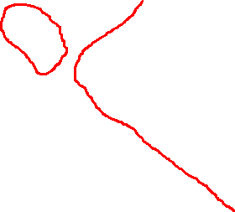


HR-Diagram
Known Cluster Main Sequence
The Return of Kush
16th February 2024
Absolute Magnitude
Apparent Magnitude
m-M
Unknown Cluster Main Sequence
Colour/Temperature
$$m−M=5 \log{(\frac{d}{10})}$$

Slide 38
Limitations?
The Return of Kush
16th February 2024
Features of the cluster (Age, blue stragglers, etc)

Slide 39
The Return of Kush
16th February 2024
Time to move out,

Slide 40
The Return of Kush
16th February 2024
Time to move out,
Out of our galaxy.

Slide 41
Rung 4
Standard Candles
The Return of Kush
16th February 2024

Slide 42
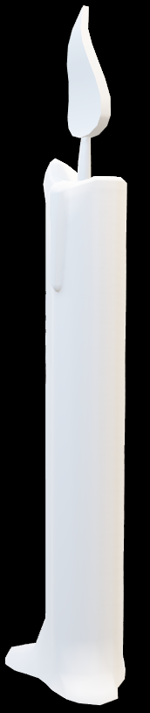
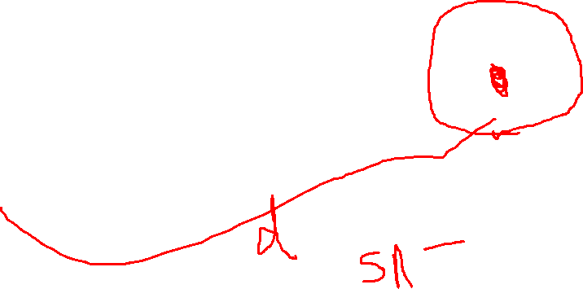
Standard what?
The Return of Kush
16th February 2024
Another short demonstration

Slide 43
Standard Candles
The Return of Kush
16th February 2024
An object of known magnitude/luminosity.

Slide 44
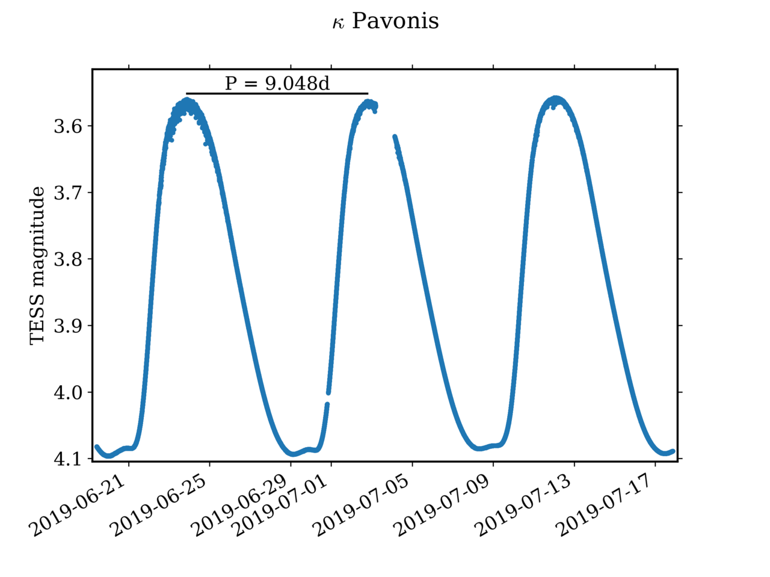
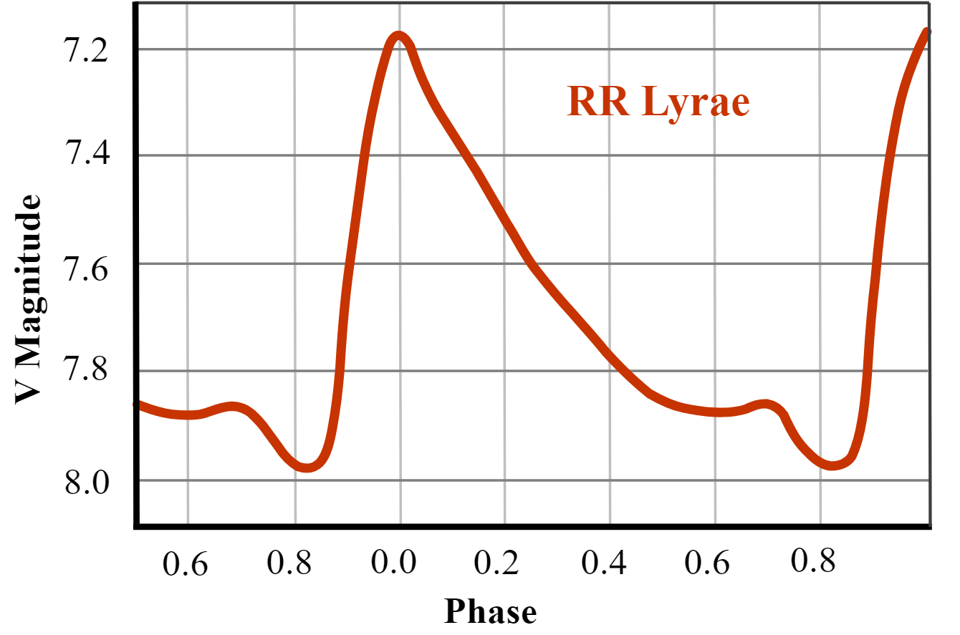
Standard Candles: Variable Stars
The Return of Kush
16th February 2024
Cepheid Variables
RR Lyrae

Slide 45
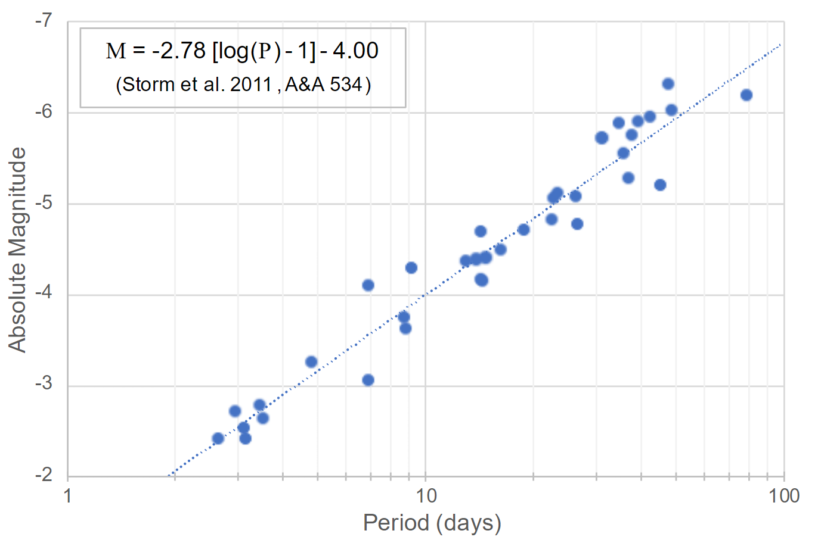
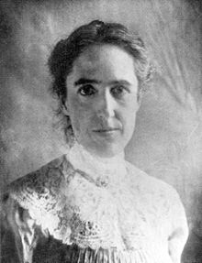
Standard Candles: Cepheid Variable
The Return of Kush
16th February 2024
Period-Luminosity Relation
Henrietta Swan Leavitt

Slide 46
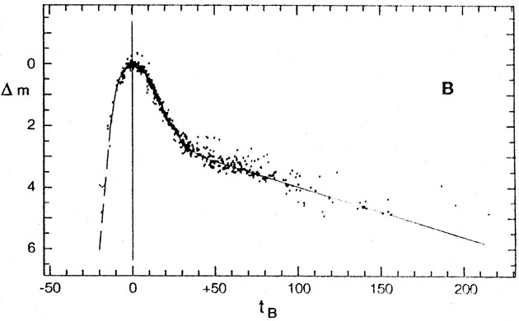
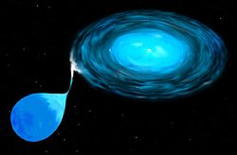
Standard Candles: Type Ia Supernova
The Return of Kush
16th February 2024
Light Curve
(Peak Absolute Magnitude)
White dwarf accretion

Slide 47
Limitations?
The Return of Kush
16th February 2024
Again, exceptions (and magnitude measurements)

Slide 48
The Return of Kush
16th February 2024
Time to look at,
Even distant galaxies.

Slide 49
Rung 5
Galactic Empirical Relations
The Return of Kush
16th February 2024

Slide 50
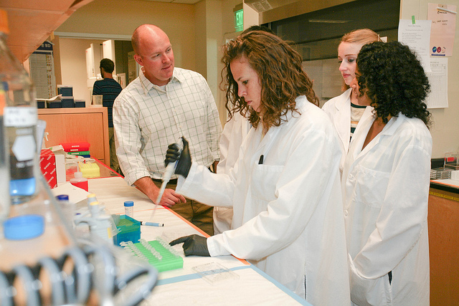





What’s Empirical?
The Return of Kush
16th February 2024
Human do experiment
Human create theory

Slide 51
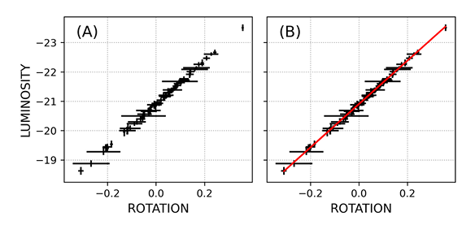

Tully-Fisher Relationship
Relation between rotational velocity of spiral galaxies and luminosity
$$L ∝V^{4}$$

Slide 52
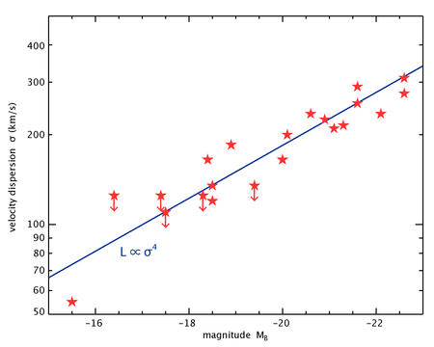

Faber-Jackson Relationship
Relation between velocity dispersion of elliptical galaxies and luminosity
$L ∝σ^{γ}$, $γ≈4$

Slide 53
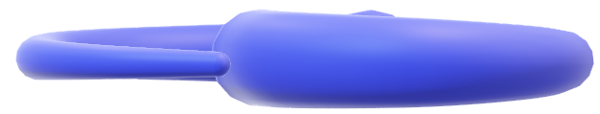
Limitations?
The Return of Kush
16th February 2024
Edge-on view of a galaxy

Slide 54
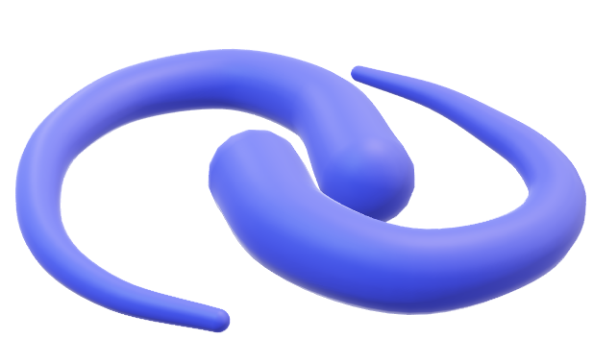
Limitations?
The Return of Kush
16th February 2024
Inclination of 45 degrees

Slide 55

Limitations?
The Return of Kush
16th February 2024
Face on view of the galaxy

Slide 56
The Return of Kush
16th February 2024
Time to look at,
Even further distances.

Slide 57
The Return of Kush
16th February 2024
Time to look at,
The whole universe.

Slide 58
Rung 6
Hubble’s Law
The Return of Kush
16th February 2024

Slide 59
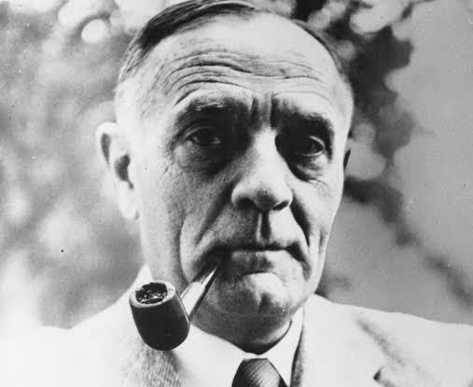
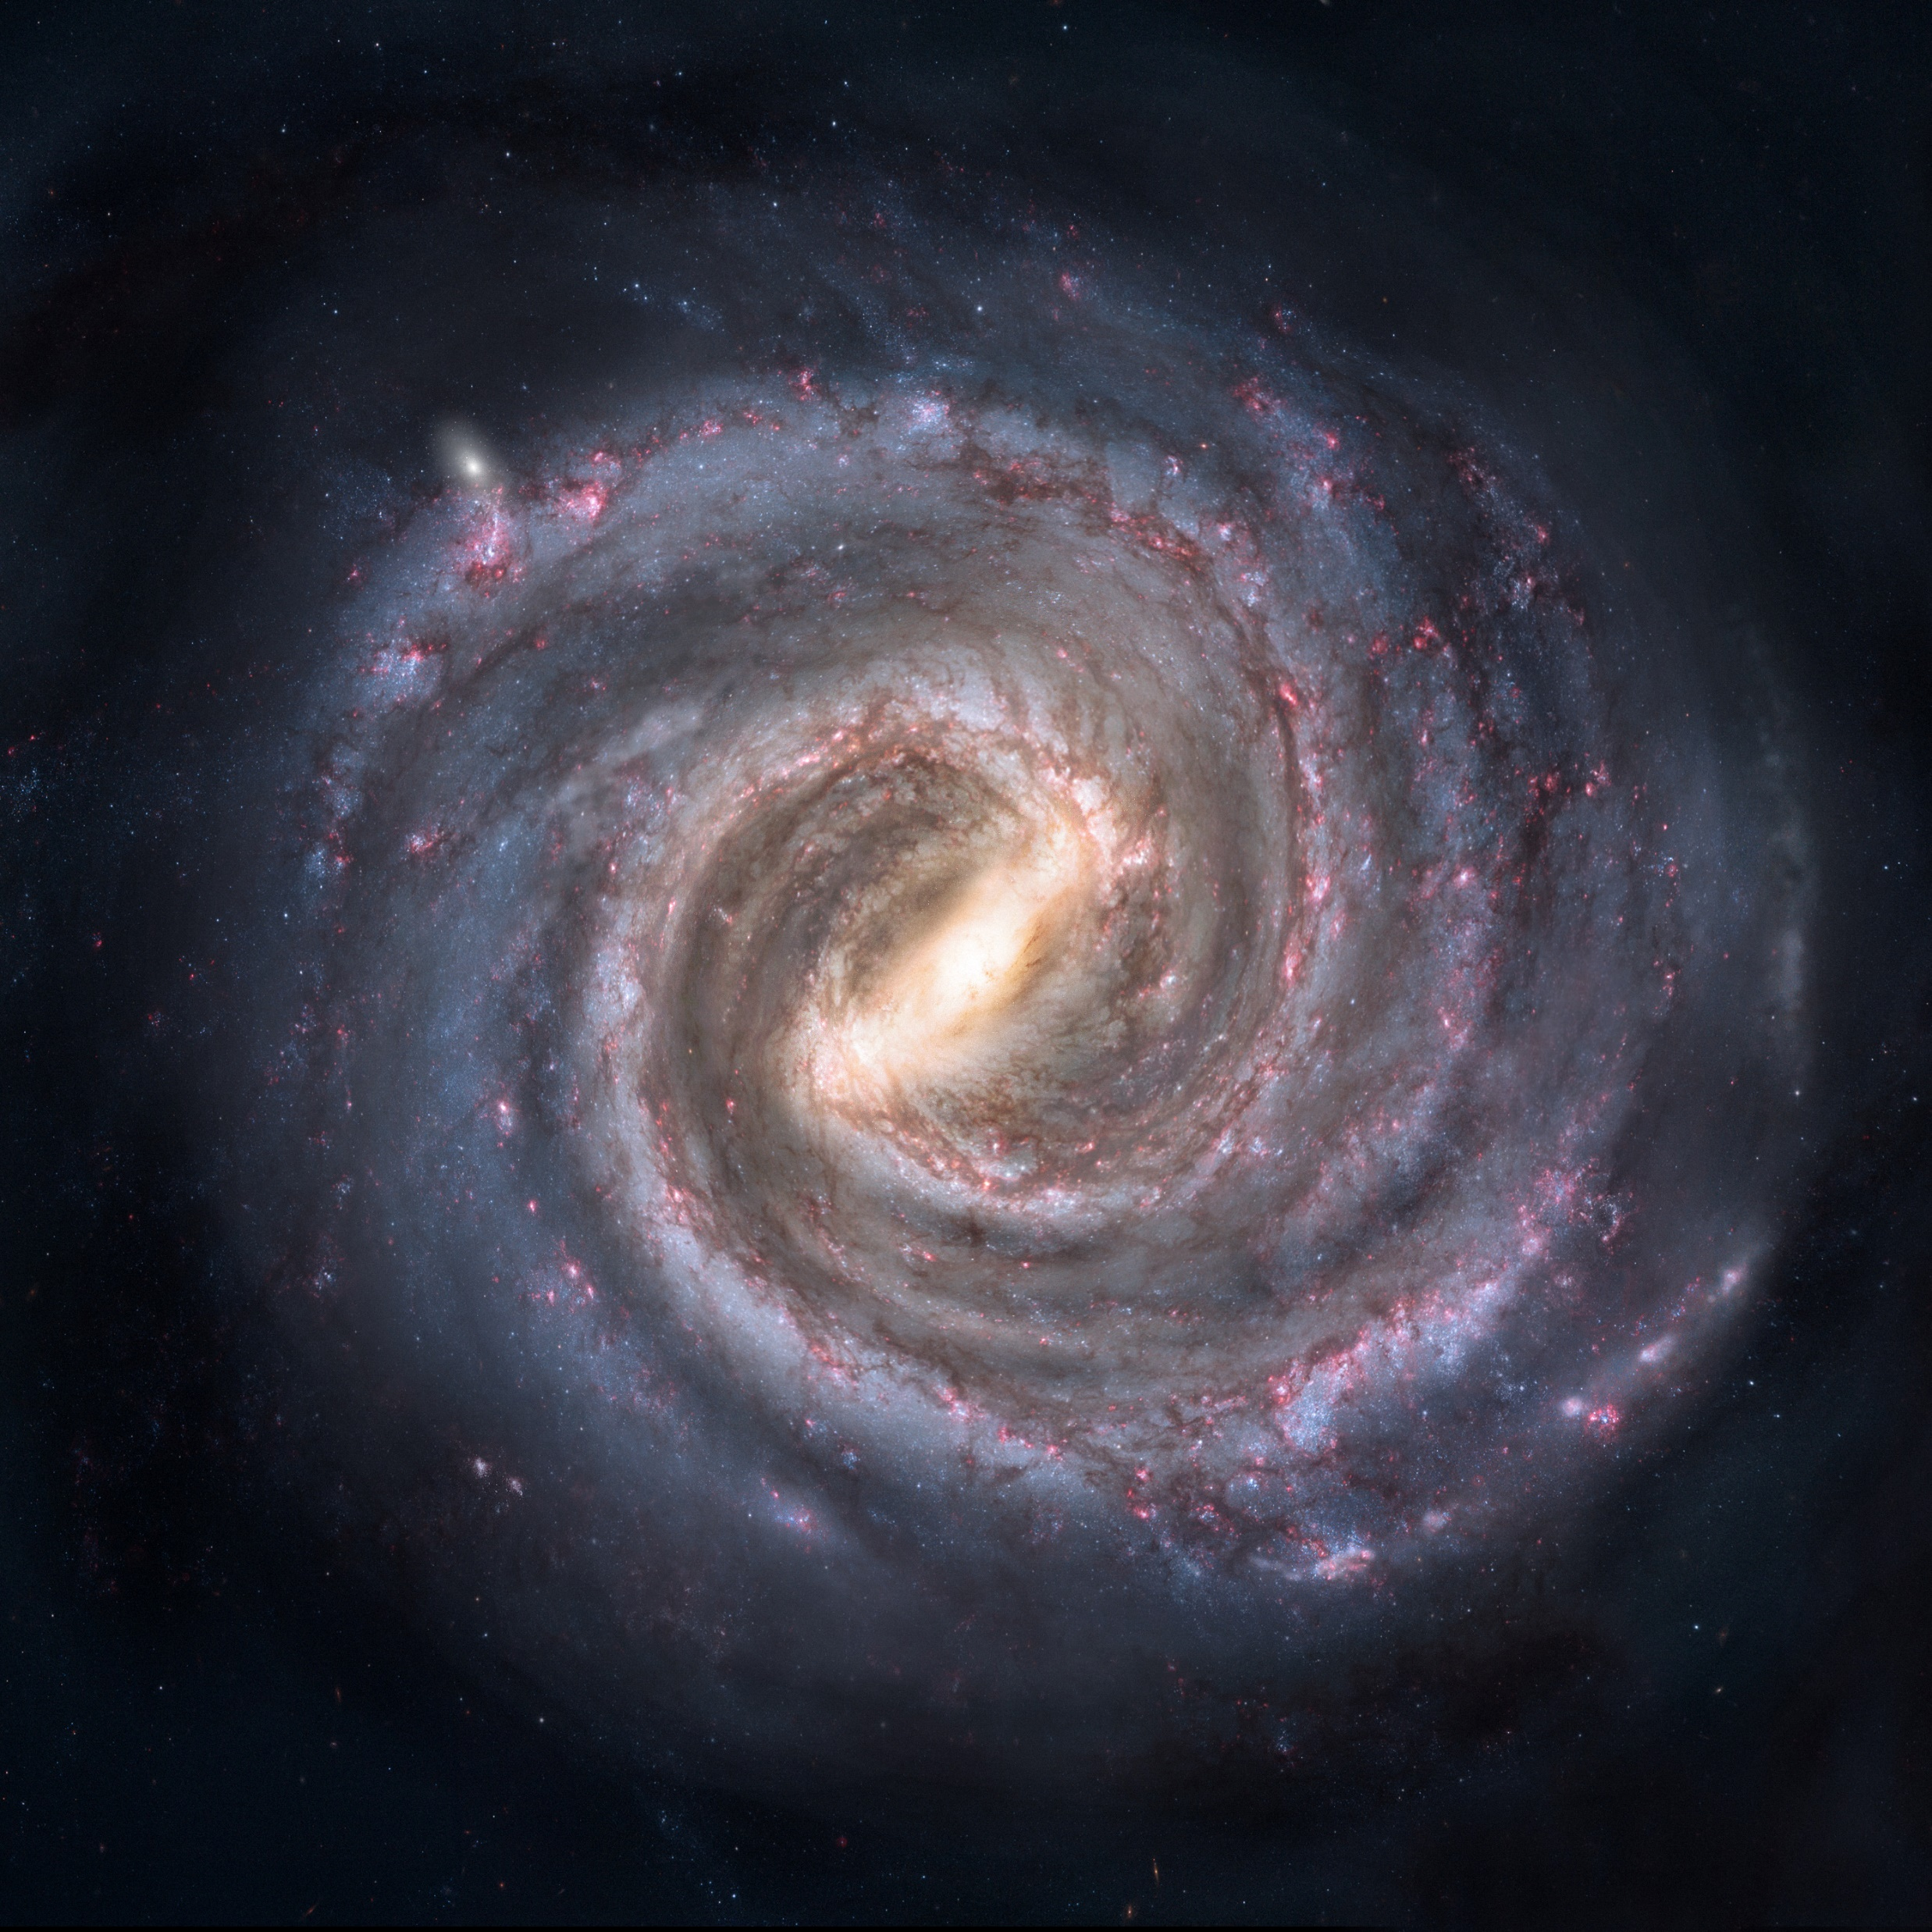
This guy sure loved his galaxies,
The Return of Kush
16th February 2024
Edwin Hubble
A random galaxy I cannot bother finding the name for

Slide 60
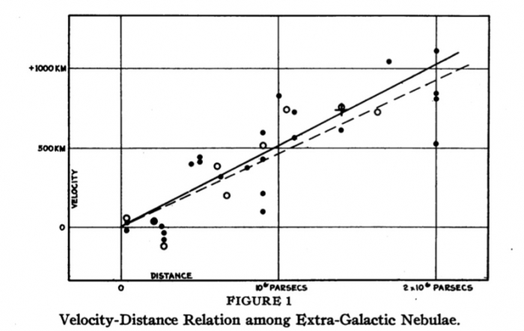
Hubble’s Law
Edwin Hubble’s first mention of the Hubble’s Law: Using Nebulae
The Return of Kush
16th February 2024
$$v=H\left(t\right)d$$

Slide 61
Why H(t) and not H₀?
The Return of Kush
16th February 2024
H(t) is predicted to change, and thus not constant.
$H\left(t\right)$ = Hubble’s Parameter

Slide 62
The Return of Kush
16th February 2024
Recap

Slide 63
Solar System
The Return of Kush
16th February 2024
RADAR

Slide 64
Solar System
Close inside our Galaxy
The Return of Kush
16th February 2024
Trigonometric Parallax
RADAR

Slide 65
Solar System
Close inside our Galaxy
Our Entire Galaxy
The Return of Kush
16th February 2024
Main Sequence Fitting
Trigonometric Parallax
RADAR

Slide 66
Solar System
Close inside our Galaxy
Our Entire Galaxy
Close by Galaxies
The Return of Kush
16th February 2024
Galactic Empirical Relationships
Cepheid Variables
Main Sequence Fitting
Trigonometric Parallax
RADAR

Slide 67
Solar System
Close inside our Galaxy
Our Entire Galaxy
Close by Galaxies
The ‘Entire’ Universe
The Return of Kush
16th February 2024
Hubble’s Law
Galactic Empirical Relationships
Cepheid Variables
Main Sequence Fitting
Trigonometric Parallax
RADAR

Slide 68
The Return of Kush
16th February 2024
Just one more thing before we leave…

Slide 69
The Return of Kush
16th February 2024
Everything we learnt today might be…

Slide 70
The Return of Kush
16th February 2024
Everything we learnt today might be…
totally incorrect.

Slide 71
Food for thought
Crisis in Cosmology /
Hubble Tension
The Return of Kush
16th February 2024

Slide 72
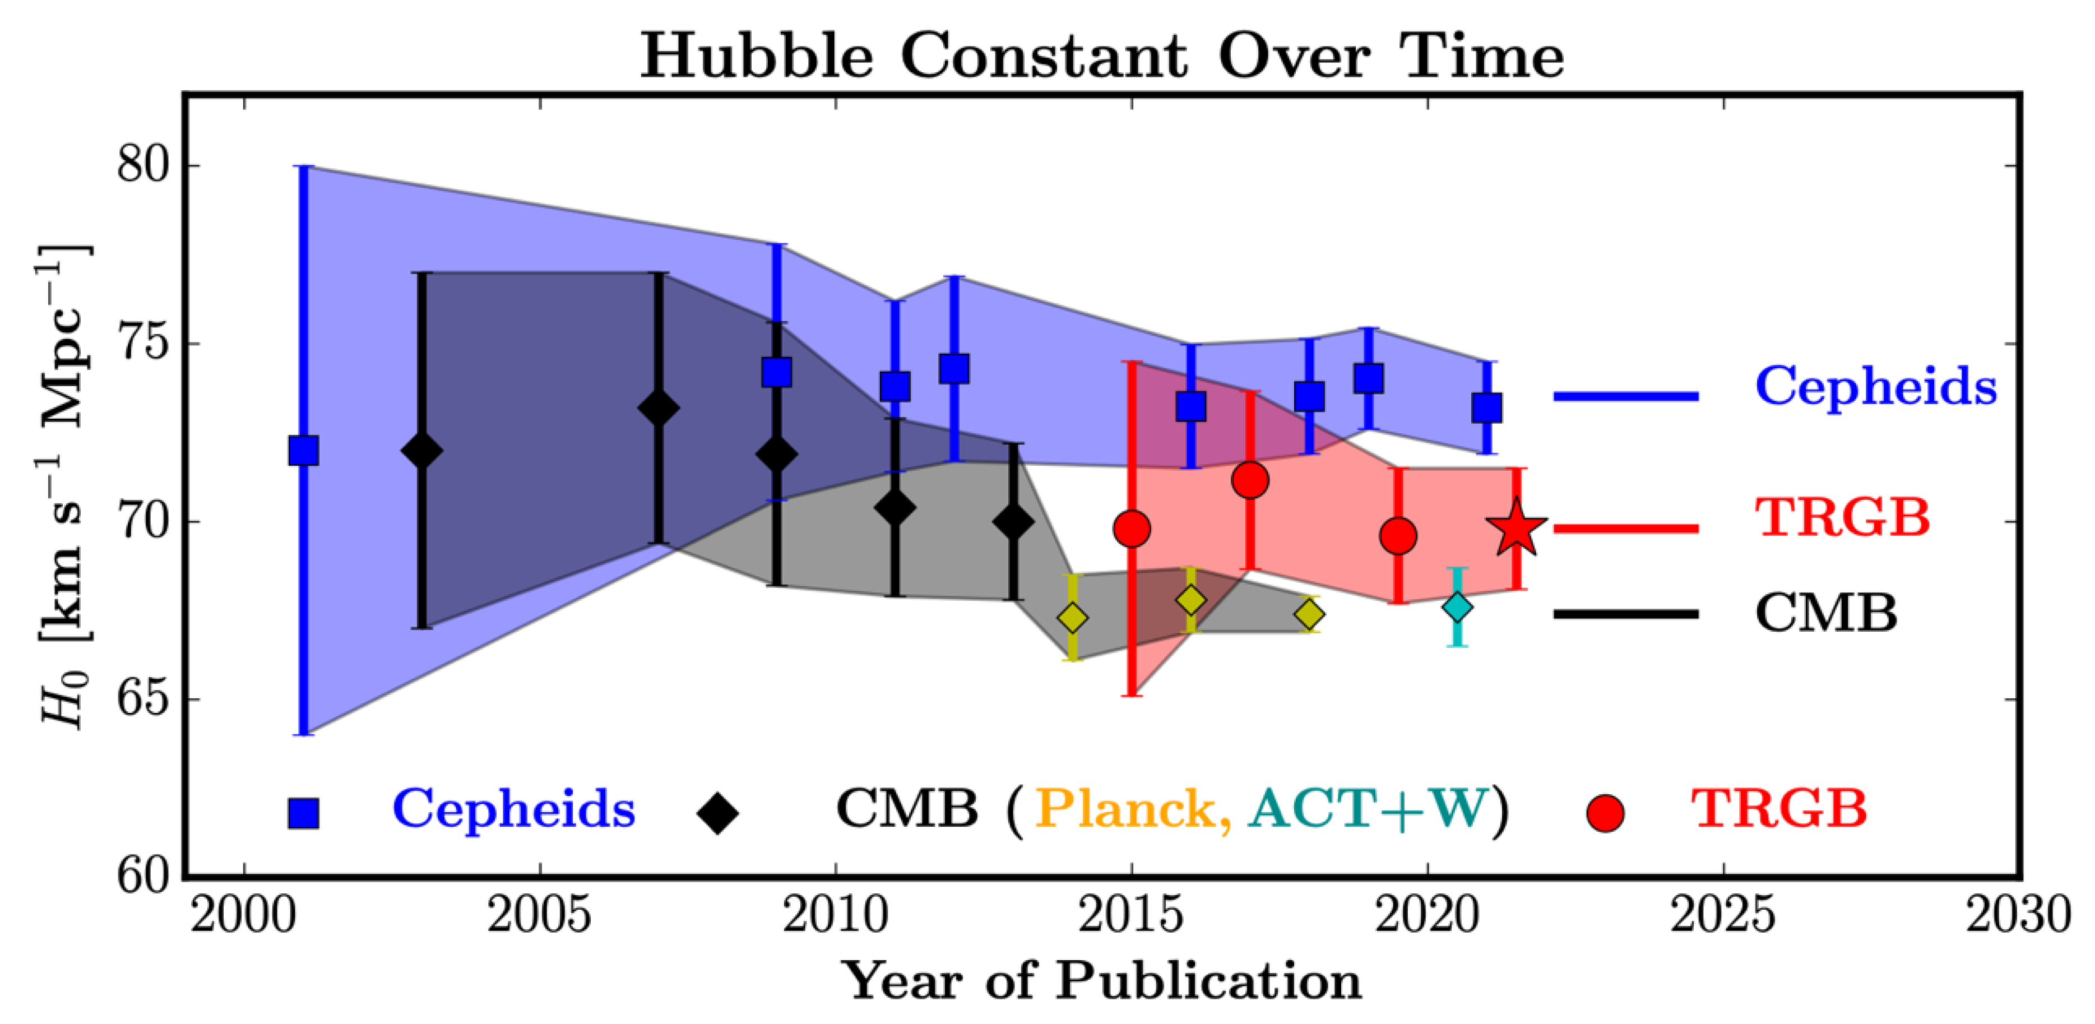
Crisis in Cosmology / Hubble Tension
The Return of Kush
16th February 2024

Slide 73
Solutions?
The Return of Kush
16th February 2024
Our Cosmic Distance Ladder distance measurements are all wrong.
The fundamental principles behind cosmology are all incorrect.

Slide 74

*Funny ending text*
Thank you for listening!
The slides were done by,

