Slide 1
Data, Graphs, and Pickering.
The historical roleplay no one ever asked for.
Kushagra Shrivastava, CDLKO’24

Slide 2
Disclaimer
I am testing a new format of a workshop today. If you have suggestions about the execution, content, flow, etc of the workshop, please inform me. However, if you have any issue with the artistic choice of my workshop, keep your opinion to yourself.

Slide 3
Part 0: The Background
Before we begin the actual stuff…

Slide 4
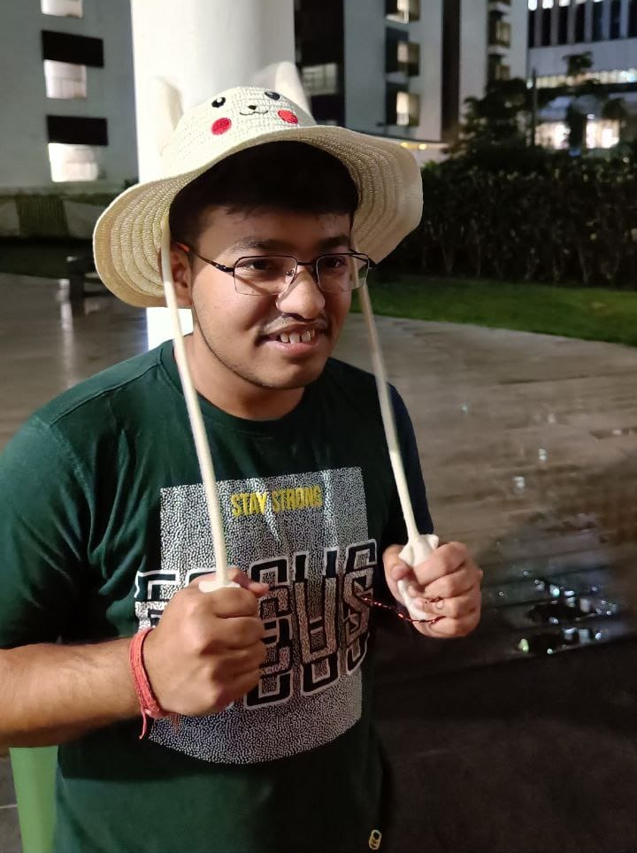
Me?
Tolerates computer science, because it is important for physics.
BSc. (Honours) in Physics, with specialisation in Astrophysics. Minor in Computer Science. (Also enrolled in interdisciplinary science program, and a liberal arts program).
TL;DR Nerd.

Slide 5
Pre-story instructions
Divide yourself into groups of 4.

Slide 6
Pre-story instructions
Each group must have
1x sheet of SMC Variable Star Data
2x sheets of blank graph paper
2x sheets of blank A4 paper
2x pencils
1x eraser
1x ruler
1x sharpener
Mobile phones (to be used as calculators)

Slide 7
Let the story, begin …

Slide 8
Part 1: “Better than men”
Once upon a time in a land far far away …

Slide 9
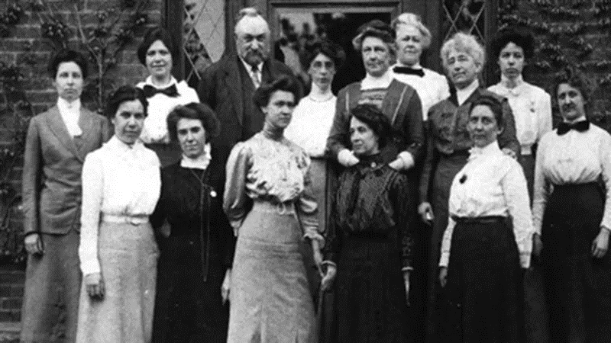
1881

Slide 10
1881
ANMH ‘Harvard Computers’: Women who analyzed the night sky: AMNH, American Museum of Natural History. Available at: https://www.amnh.org/explore/news-blogs/news-posts/the-harvard-computers (Accessed: 08 July 2024).

Slide 11
Not a mere mortal…
ANMH ‘Harvard Computers’: Women who analyzed the night sky: AMNH, American Museum of Natural History. Available at: https://www.amnh.org/explore/news-blogs/news-posts/the-harvard-computers (Accessed: 08 July 2024).

Slide 12
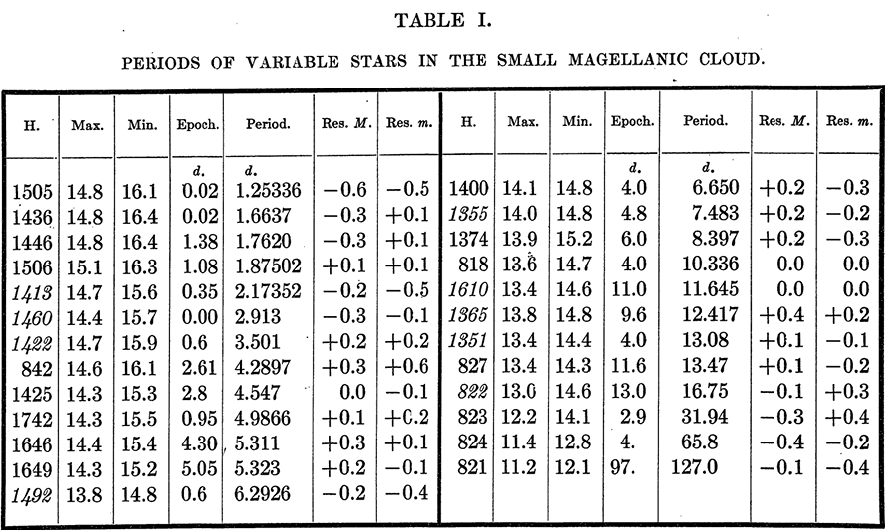
The real stuff …
Leavitt, H. S., & Pickering, E. C. 1912, Harvard College Observatory Circular, 173, 1. https:// ui.adsabs.harvard.edu/abs/1912HarCi.173....1L

Slide 13
Part 2: We all is her
It is your time to show-off your (drawing) skills.

Slide 14
Focus on me.

Slide 15
Part 3: SHOW-TIME
Get ready humans

Slide 16
Focus on others.

Slide 17
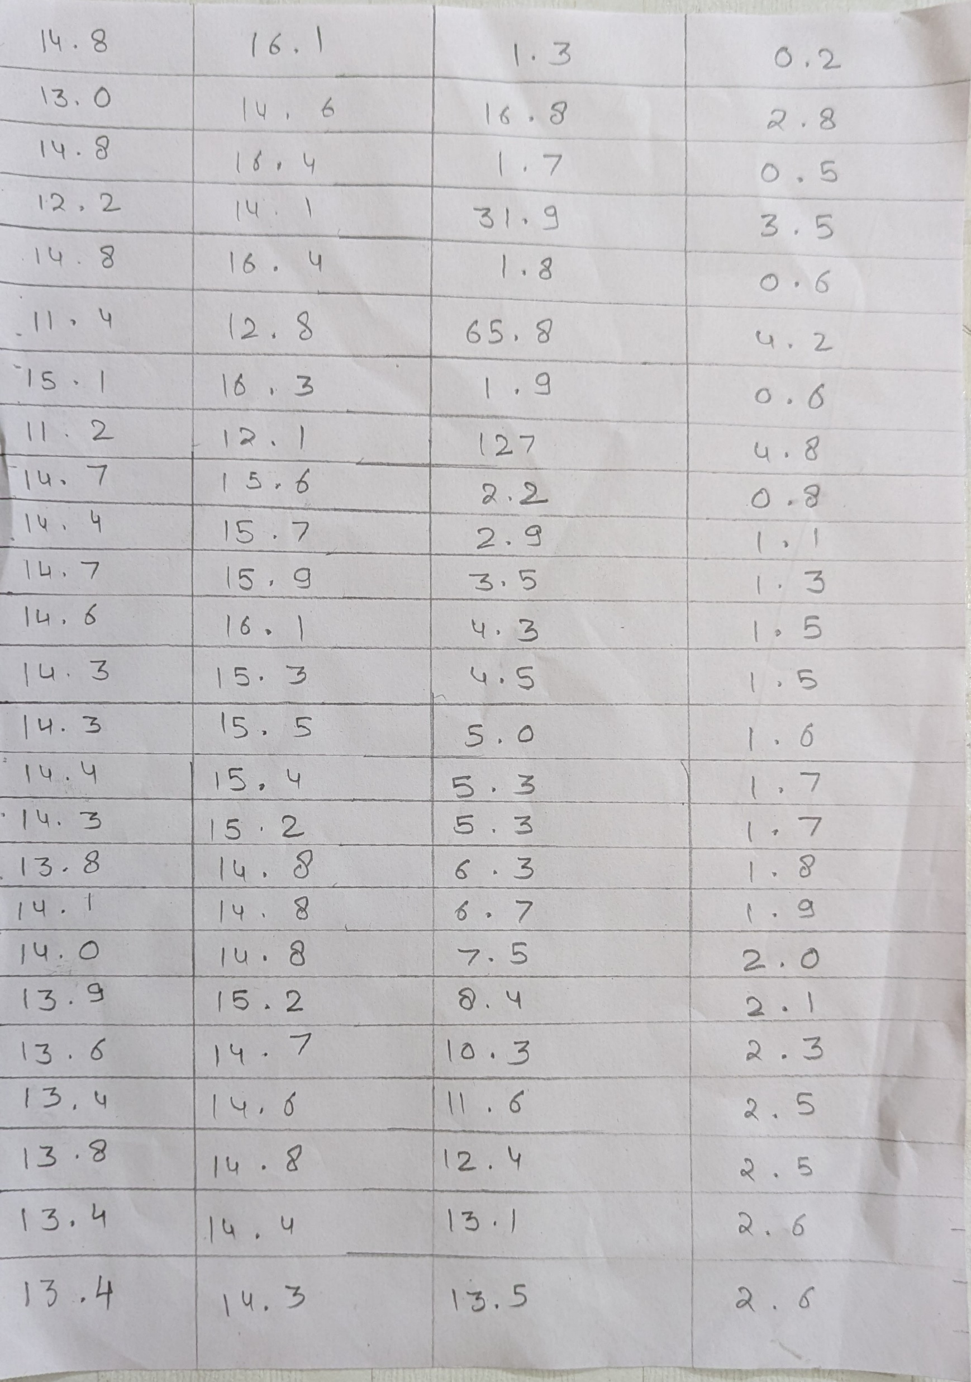
My Attempt – Mathematical Wonders
days → ln(days)

Slide 18
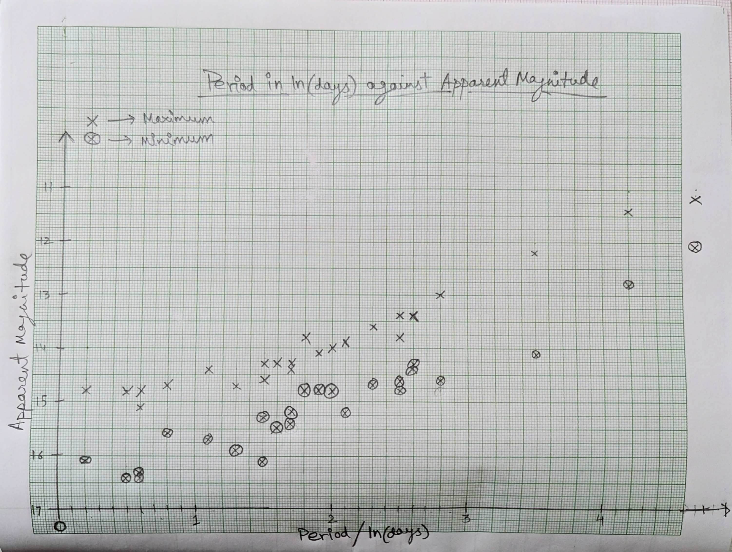
My Attempt – Mathematical Wonders

Slide 19
Part 4: The implication
Let us pull everything together.

Slide 20
Magnitude
Live demonstration

Slide 21
The issue with Magnitude
Another live demonstration

Slide 22
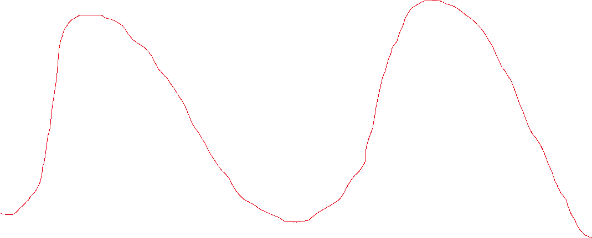
Period
Best drawing fr
Magnitude
Time
1 period

Slide 23
The climax
Which you guys will tell me …

Slide 24
Part 5: Real computers
Makes life much easier

Slide 25
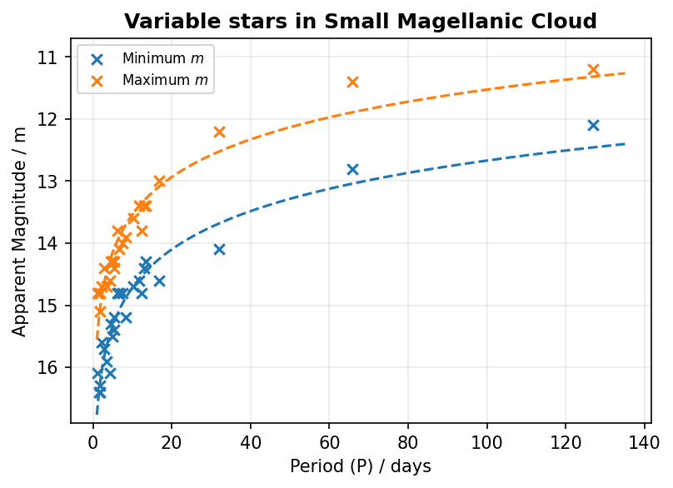
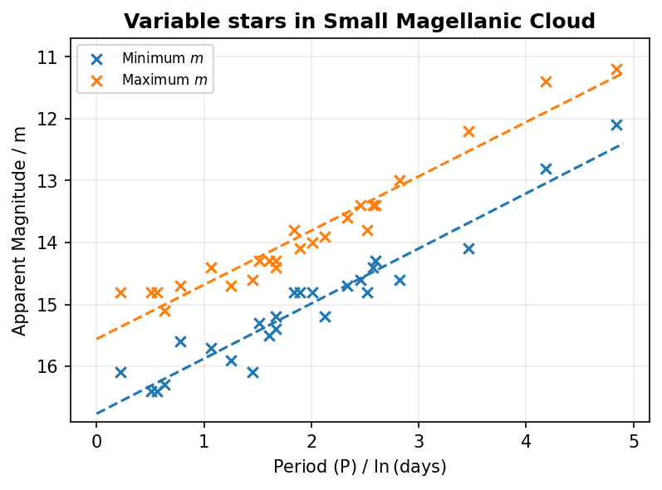
Easy game

Slide 26
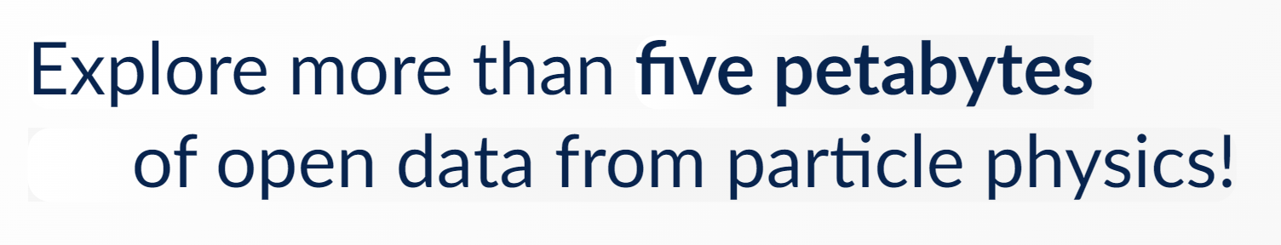
Necessity
Screenshot from: https://opendata.cern.ch/ (Accessed on 8/7/2024).

Slide 27
If nothing else …
Empirical Science
Computational power

Slide 28
The uncovered stuff…
PHYSICS?
Come talk to me after this workshop if interested.
Otherwise, help yourself and google “Kappa Mechanism”.

Slide 29
Thank you for not running away :D
If you want to follow me on my socials, find me yourself.

