Slide 1
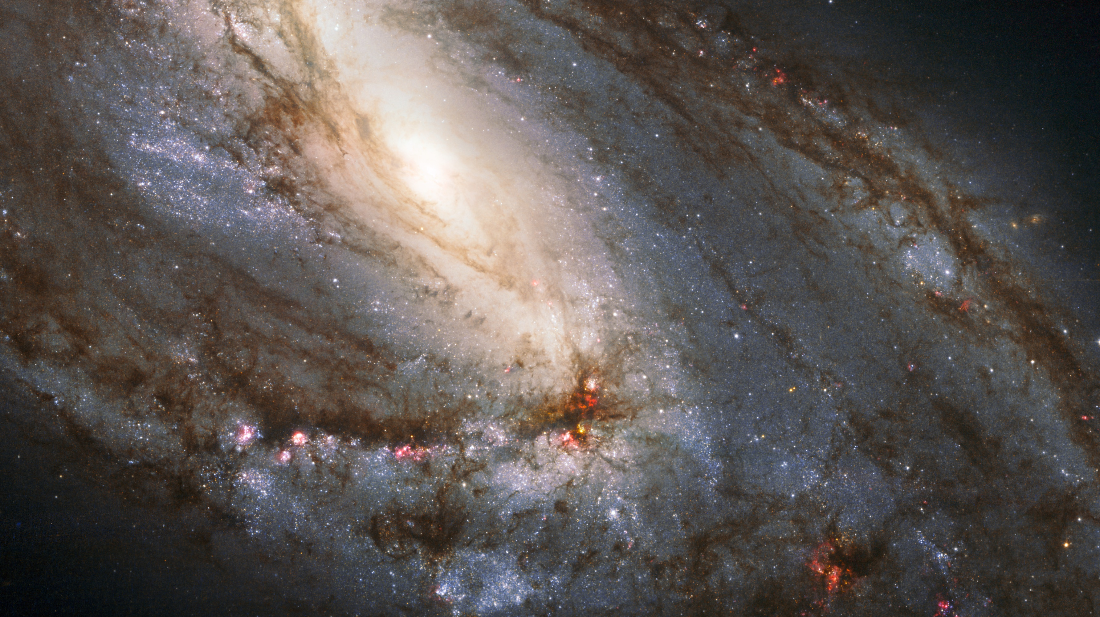
Galaxy Season:
The Spring Night Skies
The Last Session of the AY by yours truly,
Kush :D

Slide 2
Before we do anything interesting, let us have a recap

Slide 3
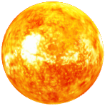

Why are there seasonal skies?
Slide borrowed from 26th Jan 2024’s session, The Winter Hexagon Time
This is not to scale at all. Heavy Exaggeration of dimensions for illustrative purpose.

Slide 4

Why are there seasonal skies?
Slide borrowed from 26th Jan 2024’s session, The Winter Hexagon Time
This is not to scale at all. Heavy Exaggeration of dimensions for illustrative purpose.

Slide 5
Why are there seasonal skies?
Slide borrowed from 26th Jan 2024’s session, The Winter Hexagon Time
This is not to scale at all. Heavy Exaggeration of dimensions for illustrative purpose.

Slide 6

Why are there seasonal skies?
Slide borrowed from 26th Jan 2024’s session, The Winter Hexagon Time
This is not to scale at all. Heavy Exaggeration of dimensions for illustrative purpose.

Slide 7
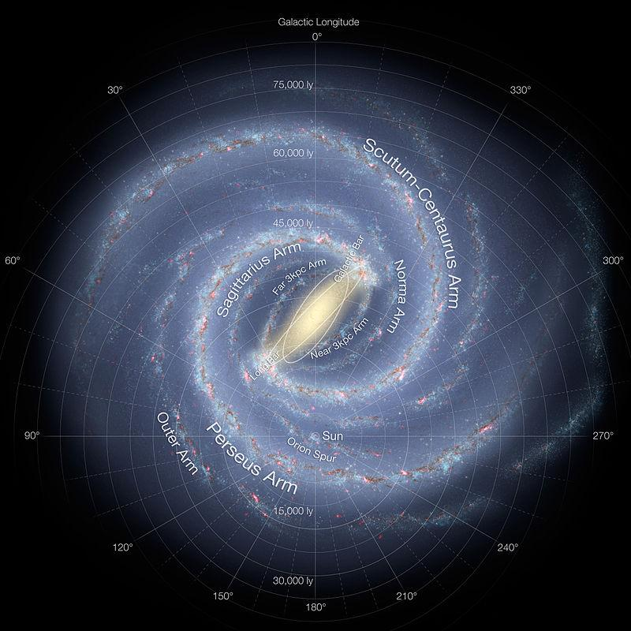
Where are we?
Summer
Fall
Spring
Slide borrowed from 26th Jan 2024’s session, The Winter Hexagon Time
Winter

Slide 8
Now, what exactly counts as the Spring Skies?

Slide 9
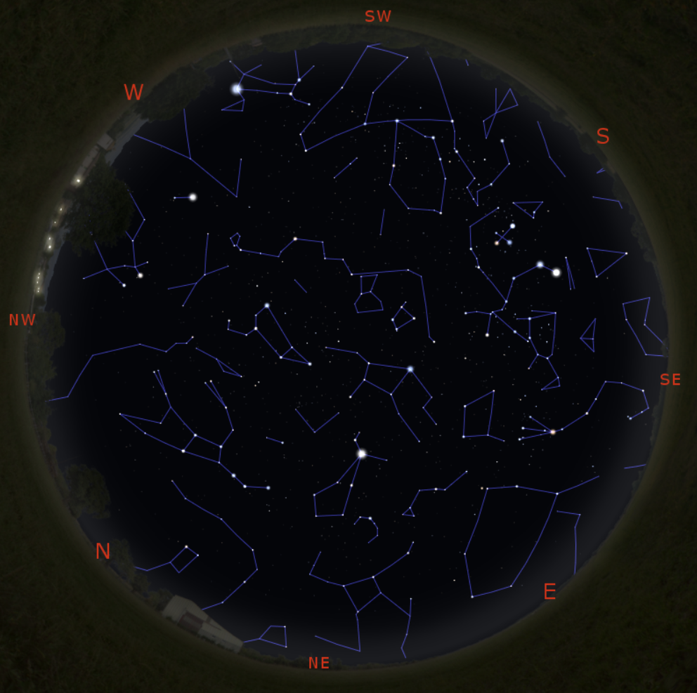

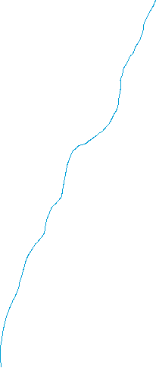
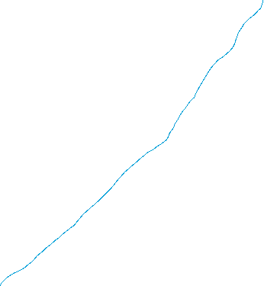
Winter skies
Summer skies

Slide 10
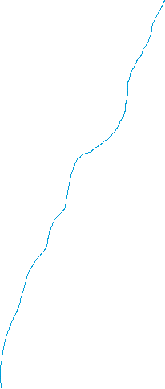

Why is this the Galaxy Season?

Slide 11

Why is this the Galaxy Season?

Slide 12
Nice.
Now we can dive deep in the details.

Slide 13
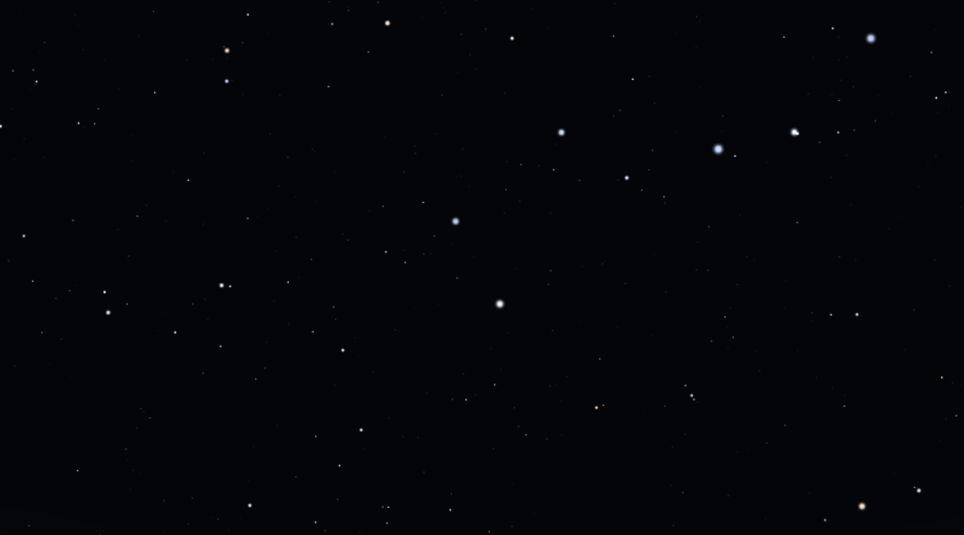
Ursa Major

Slide 14
Complete Constellation
Greek Mythology: Callisto and Arcus’ vs Zeus and Hera

Slide 15
Asterism: Big Dipper

Slide 16
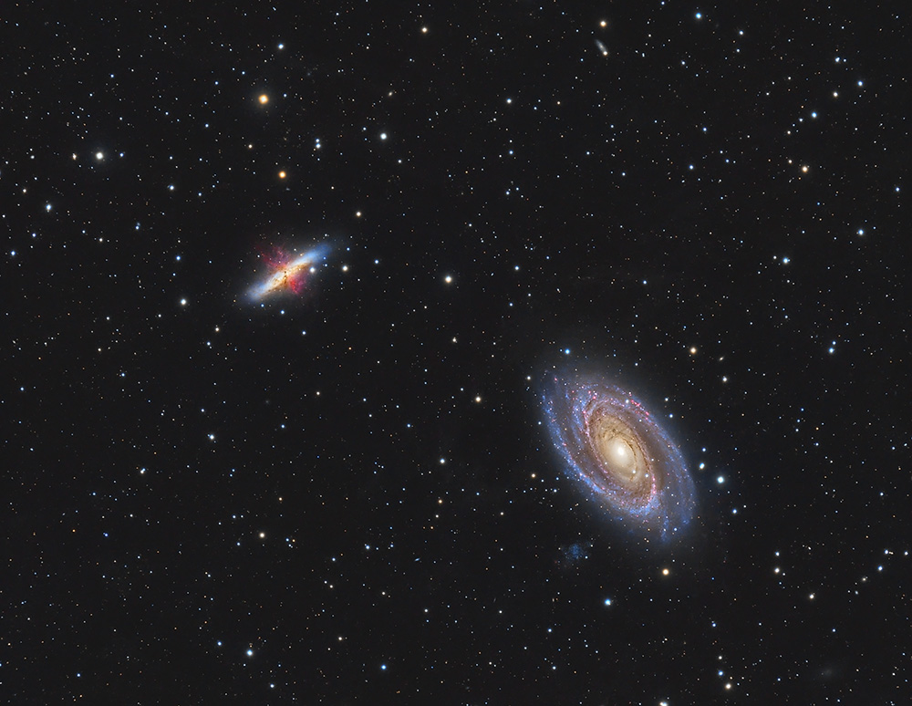
DSOs
Phecda
Dubhe
M81: Bode Galaxy
M82: Cigar Galaxy

Slide 17
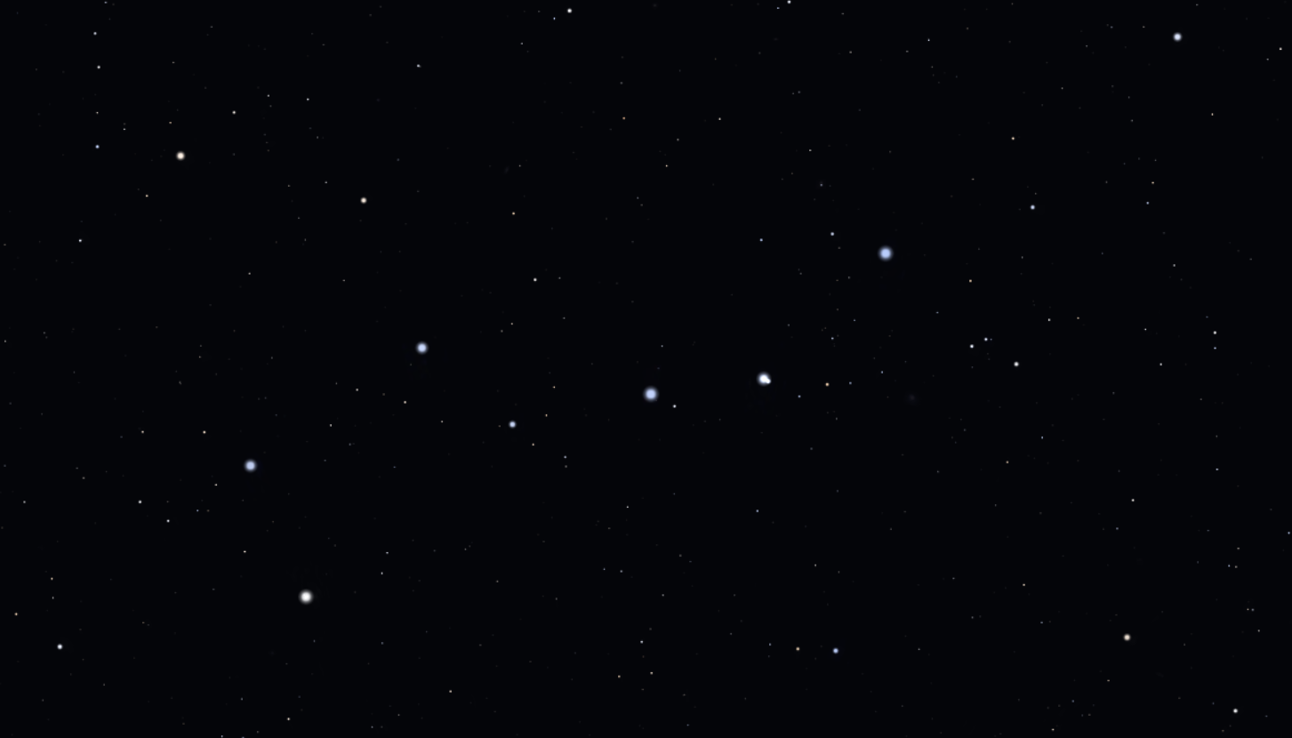
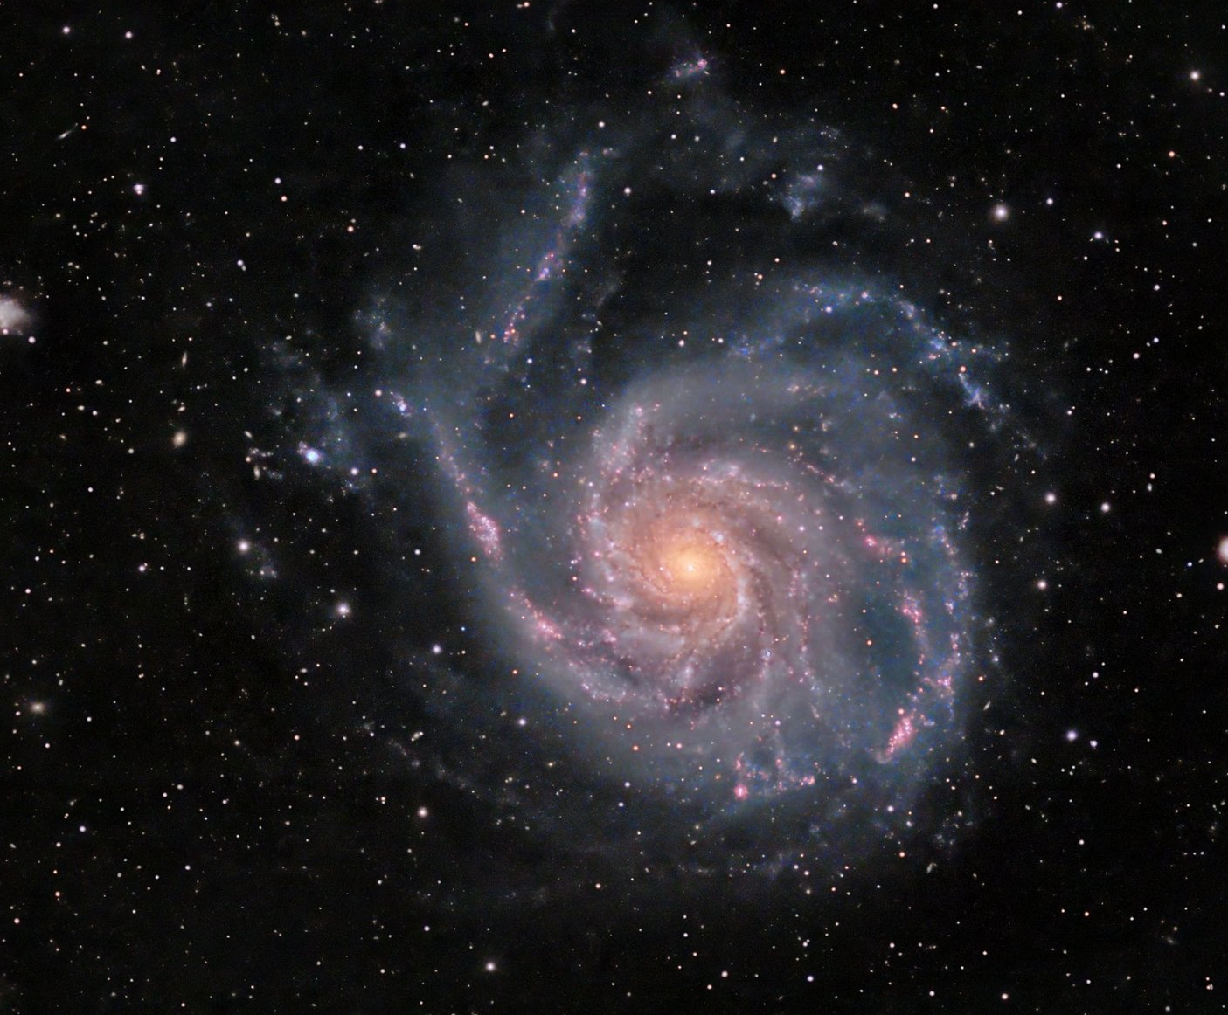
DSOs
Alkaid
Mizar
M101: Pinwheel Galaxy

Slide 18
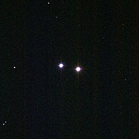
DSOs
Phecda
Megrez
M40: Winnecke 4

Slide 19
All Messier Objects
M109 Vacuum Cleaner galaxy
M101
M97 Owl Nebula
M40
M108 Surfboard Galaxy
Galaxy
Nebula
M81 and M82
Double Star

Slide 20
Cool Facts: Finding your North Star
Merak
Dubhe

Slide 21
Cool Facts: Eye-Sight and Indian Astronomy
Mizar and Alcor

Slide 22
The Arc

Slide 23
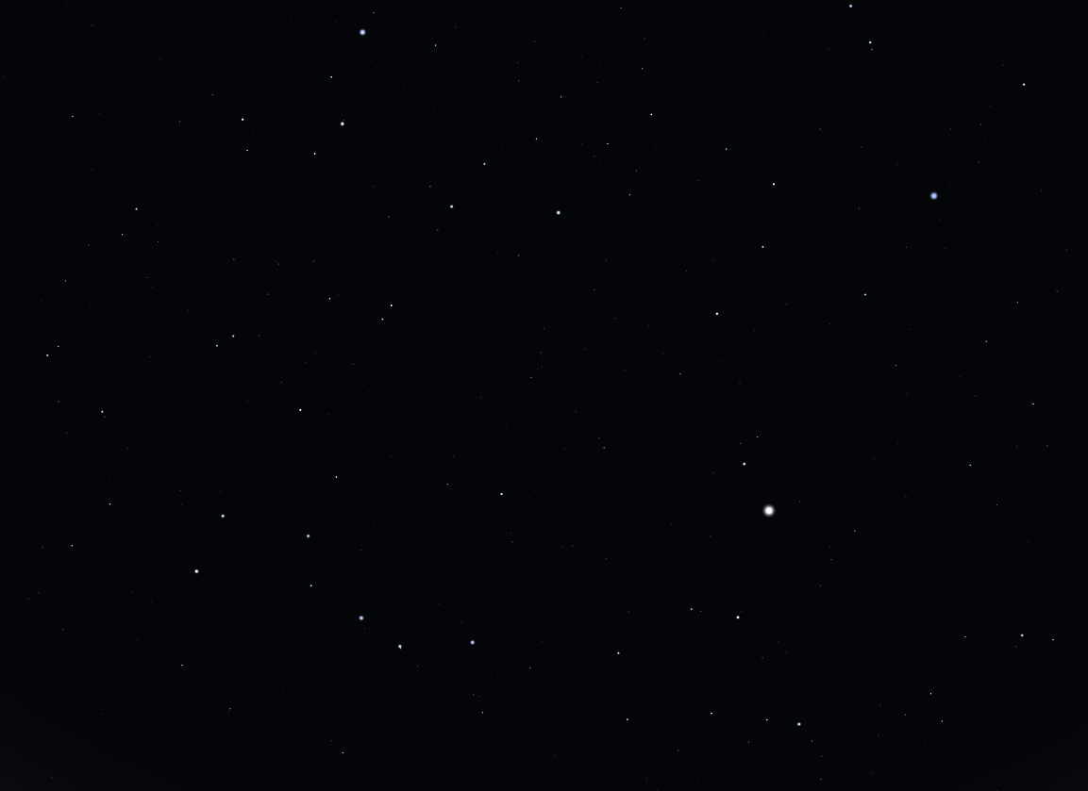

Slide 24
Arcturus
Arc to Arcturus

Slide 25
Spica
Spike to Spica
Arcturus
Arc to Arcturus

Slide 26
Denebola
Spica
Arcturus

Slide 27
Denebola
Spica
The Spring Triangle
Arcturus

Slide 28
Denebola
Spica
Cor Caroli
Arcturus

Slide 29
Denebola
Spica
The Great Diamond
Cor Caroli
Arcturus

Slide 31
Greek Mythology: Bootes and his Dogs

Slide 32
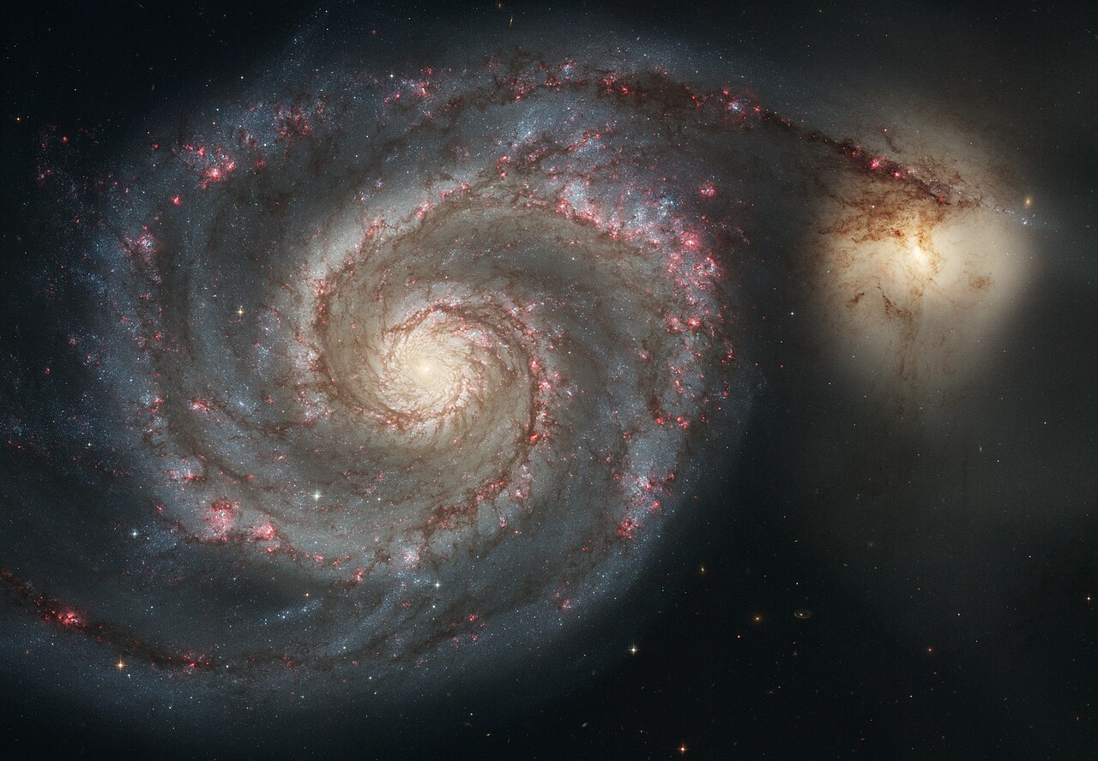
M51 Whirlpool Galaxy

Slide 33
M3 Globular Cluster

Slide 34
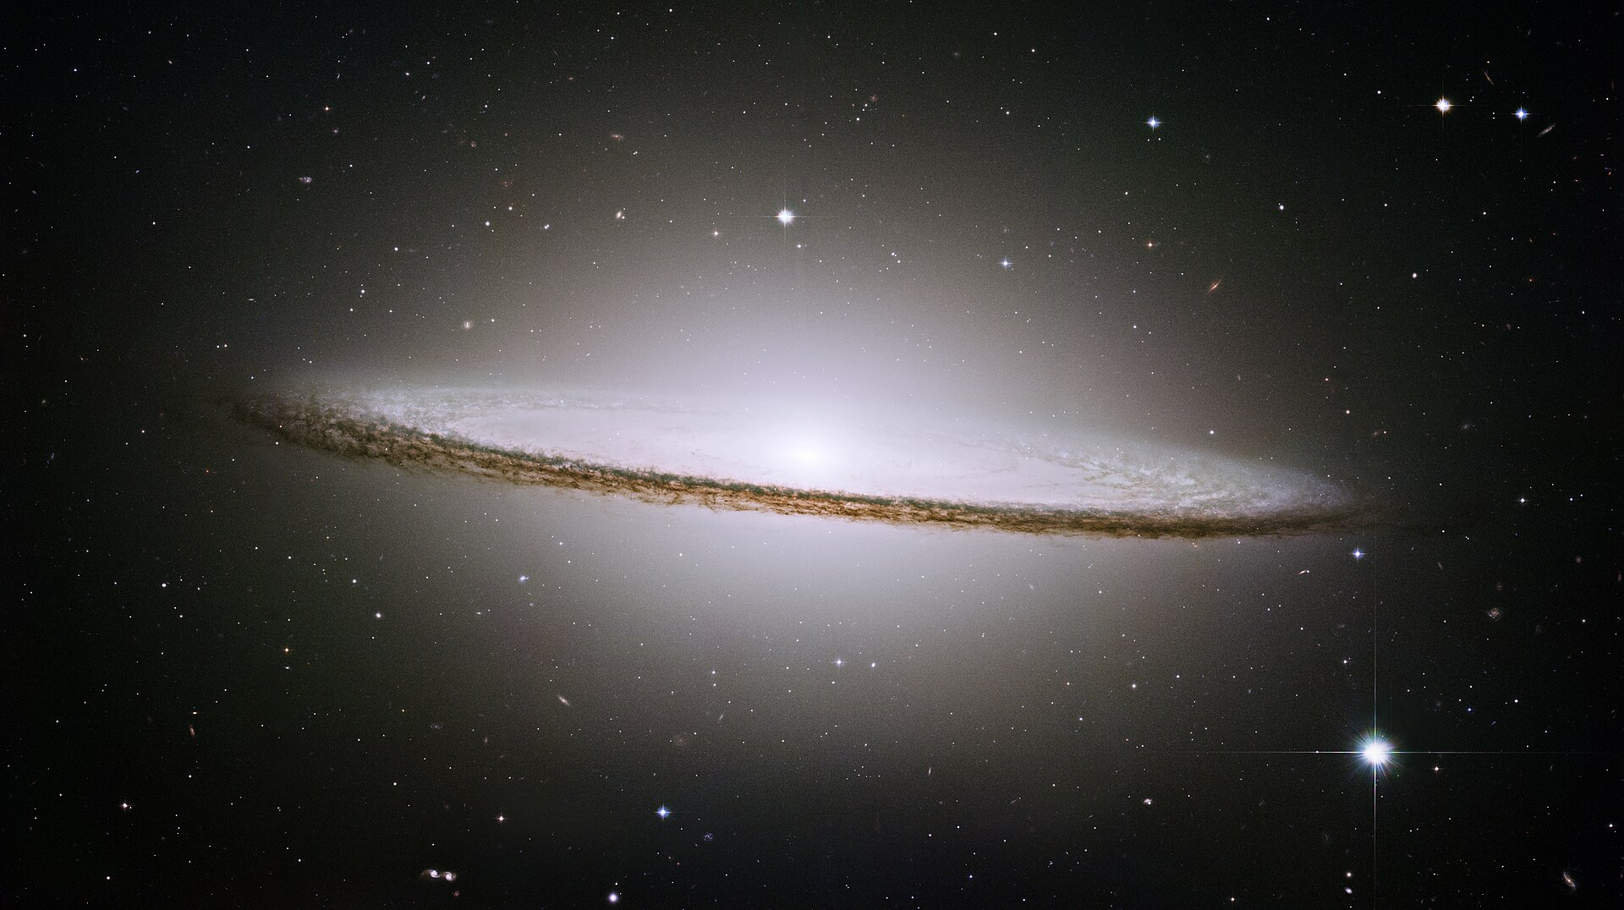
M104 Sombrero Galaxy

Slide 35
A LOT OF STUFF

Slide 36
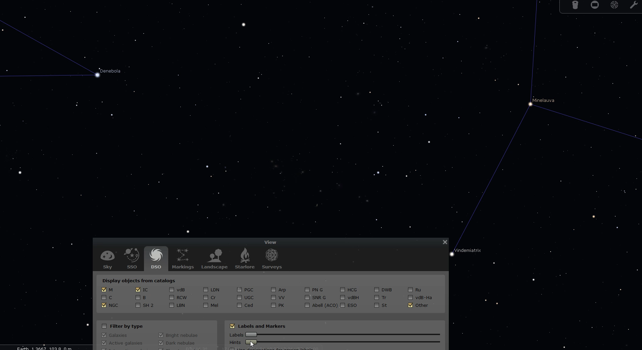

Slide 37
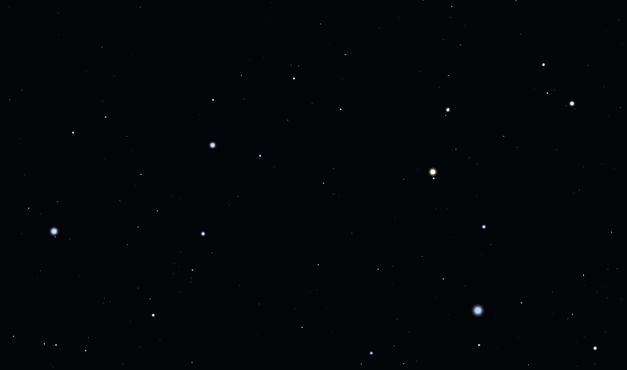
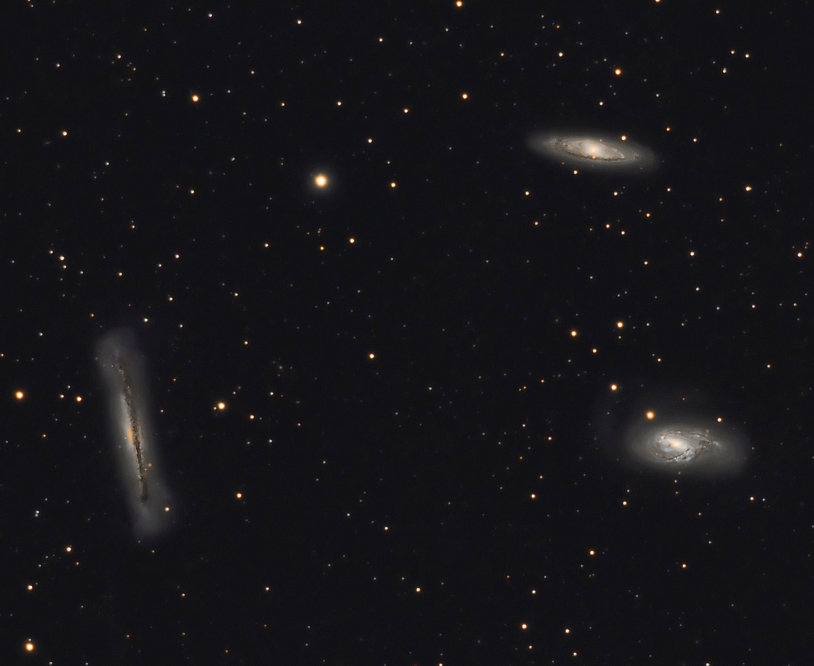
Leo
M65, M66, NGC3628
Leo’s Triplet

Slide 38
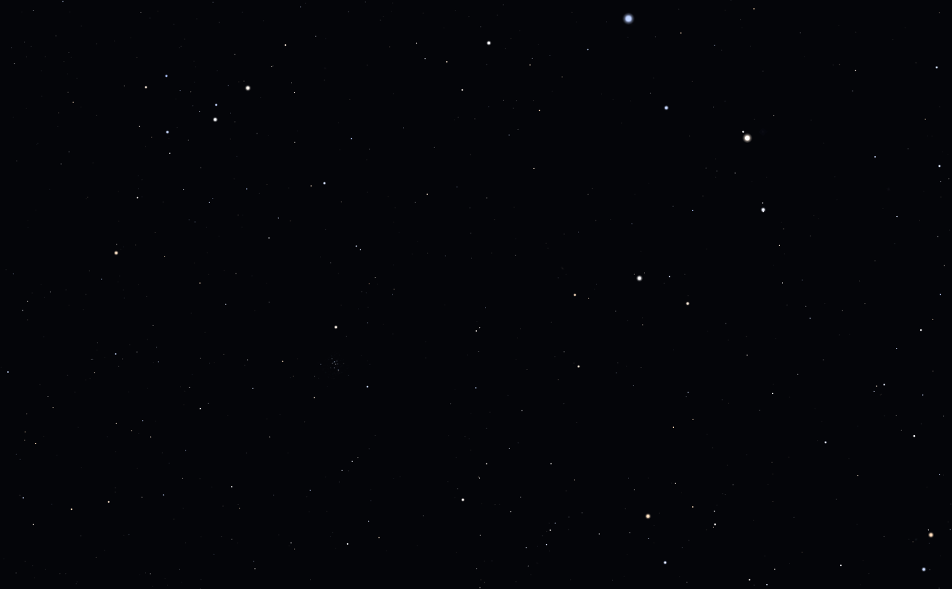
Cancer

Slide 39
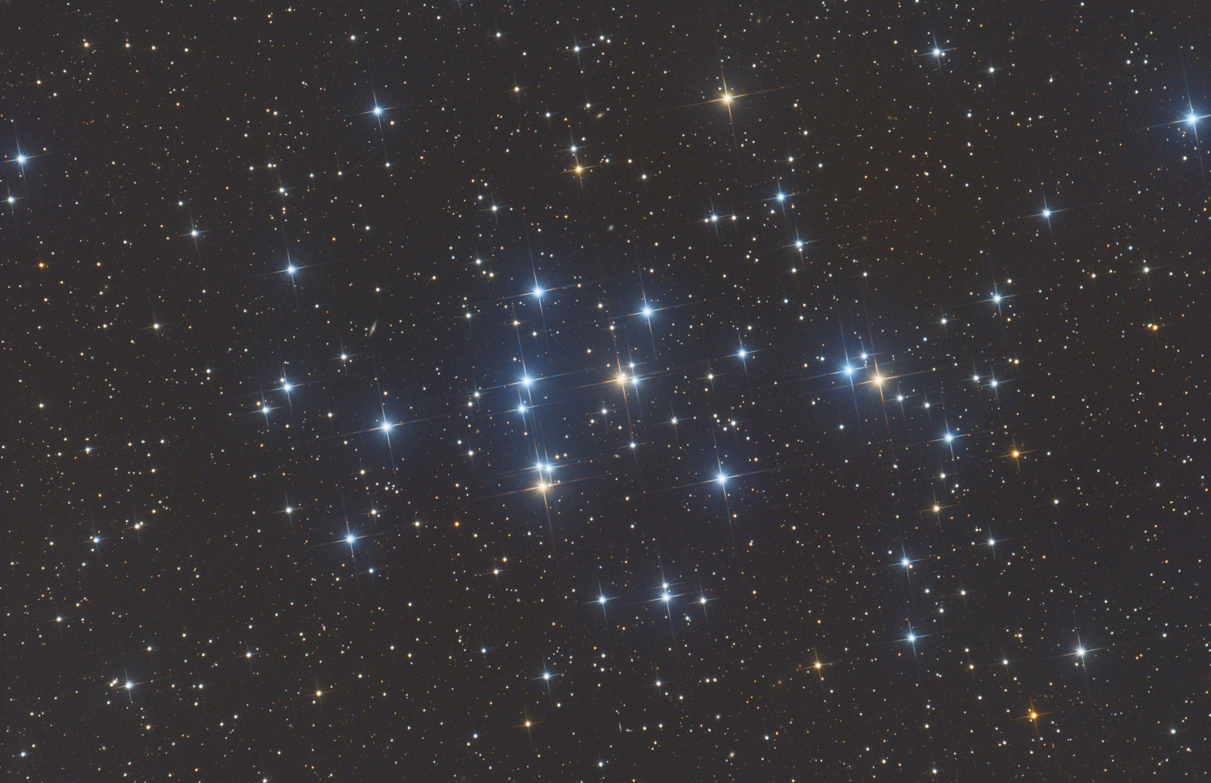
Cancer
M44 Beehive Cluster

Slide 40
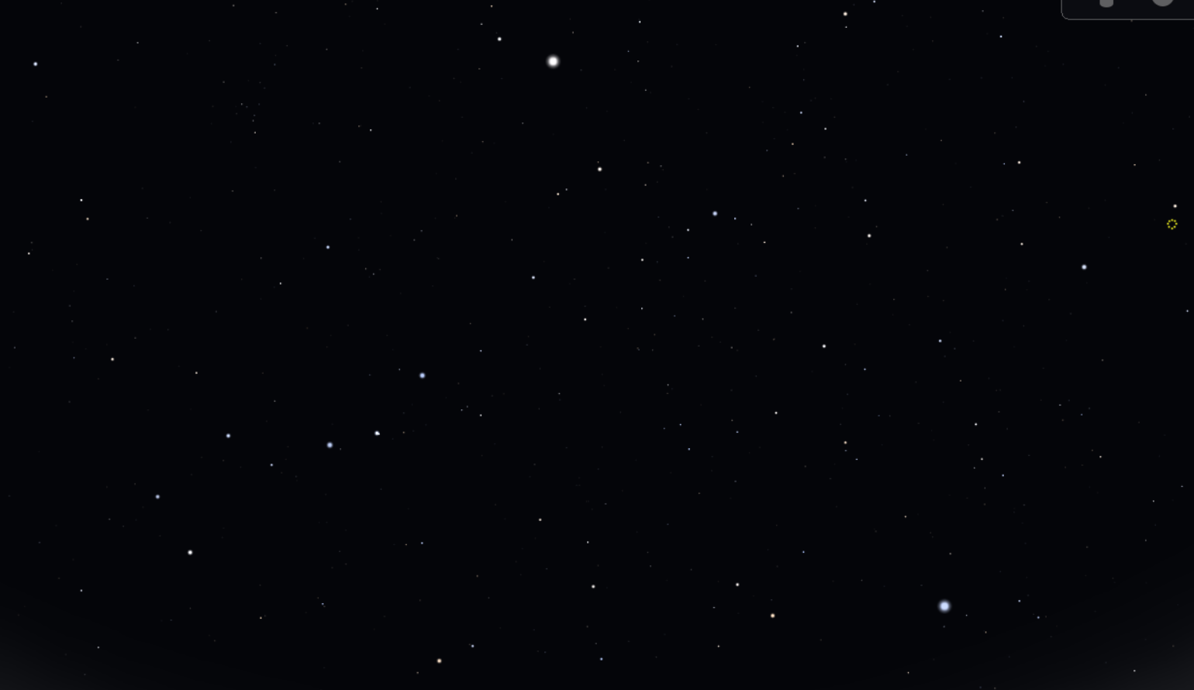

Slide 43
The Keystone

Slide 44
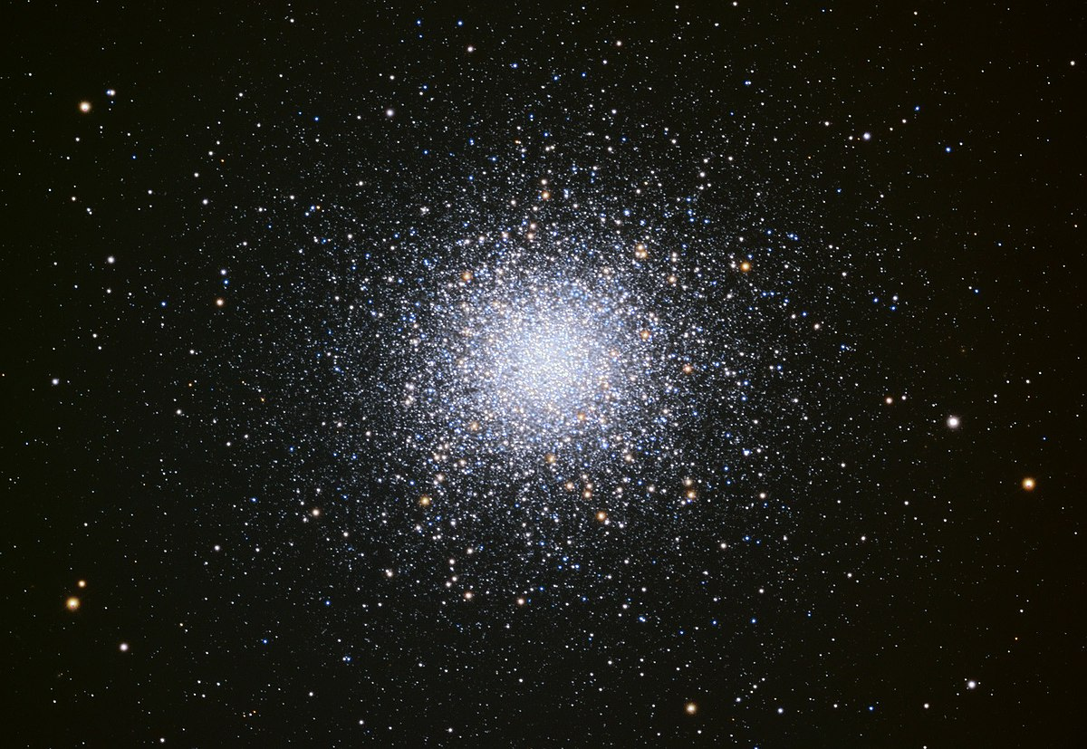
The Keystone
M13
Great Star Cluster in Hercules

Slide 45
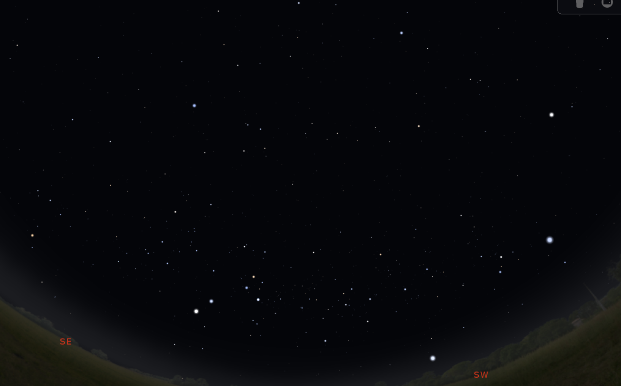
Spica
Spring
Winter
Summer

Slide 46
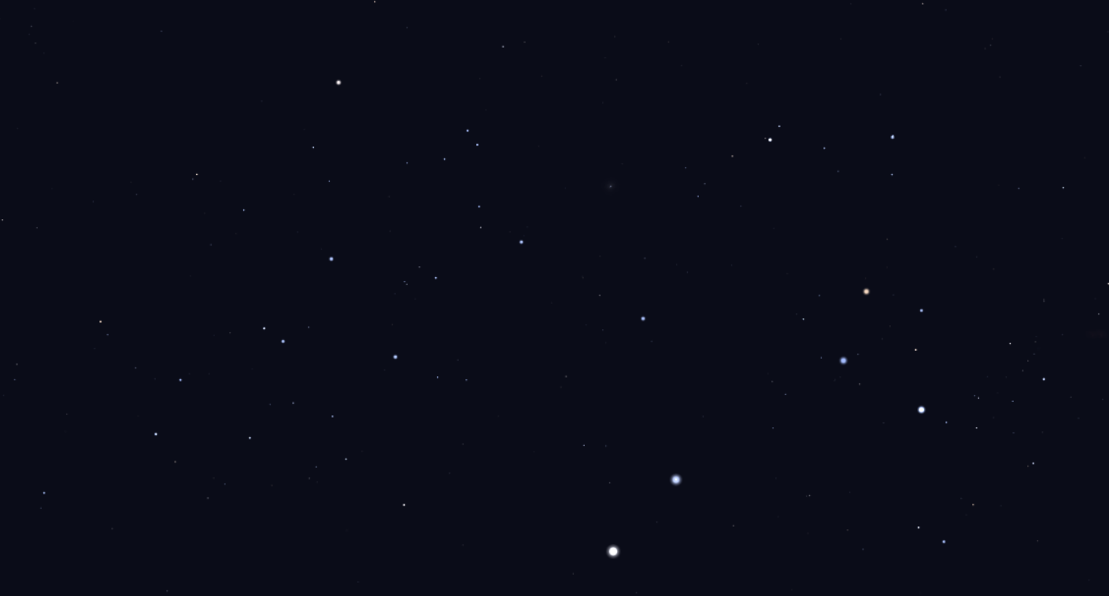
Hadar
Rigil Kentaurus

Slide 47
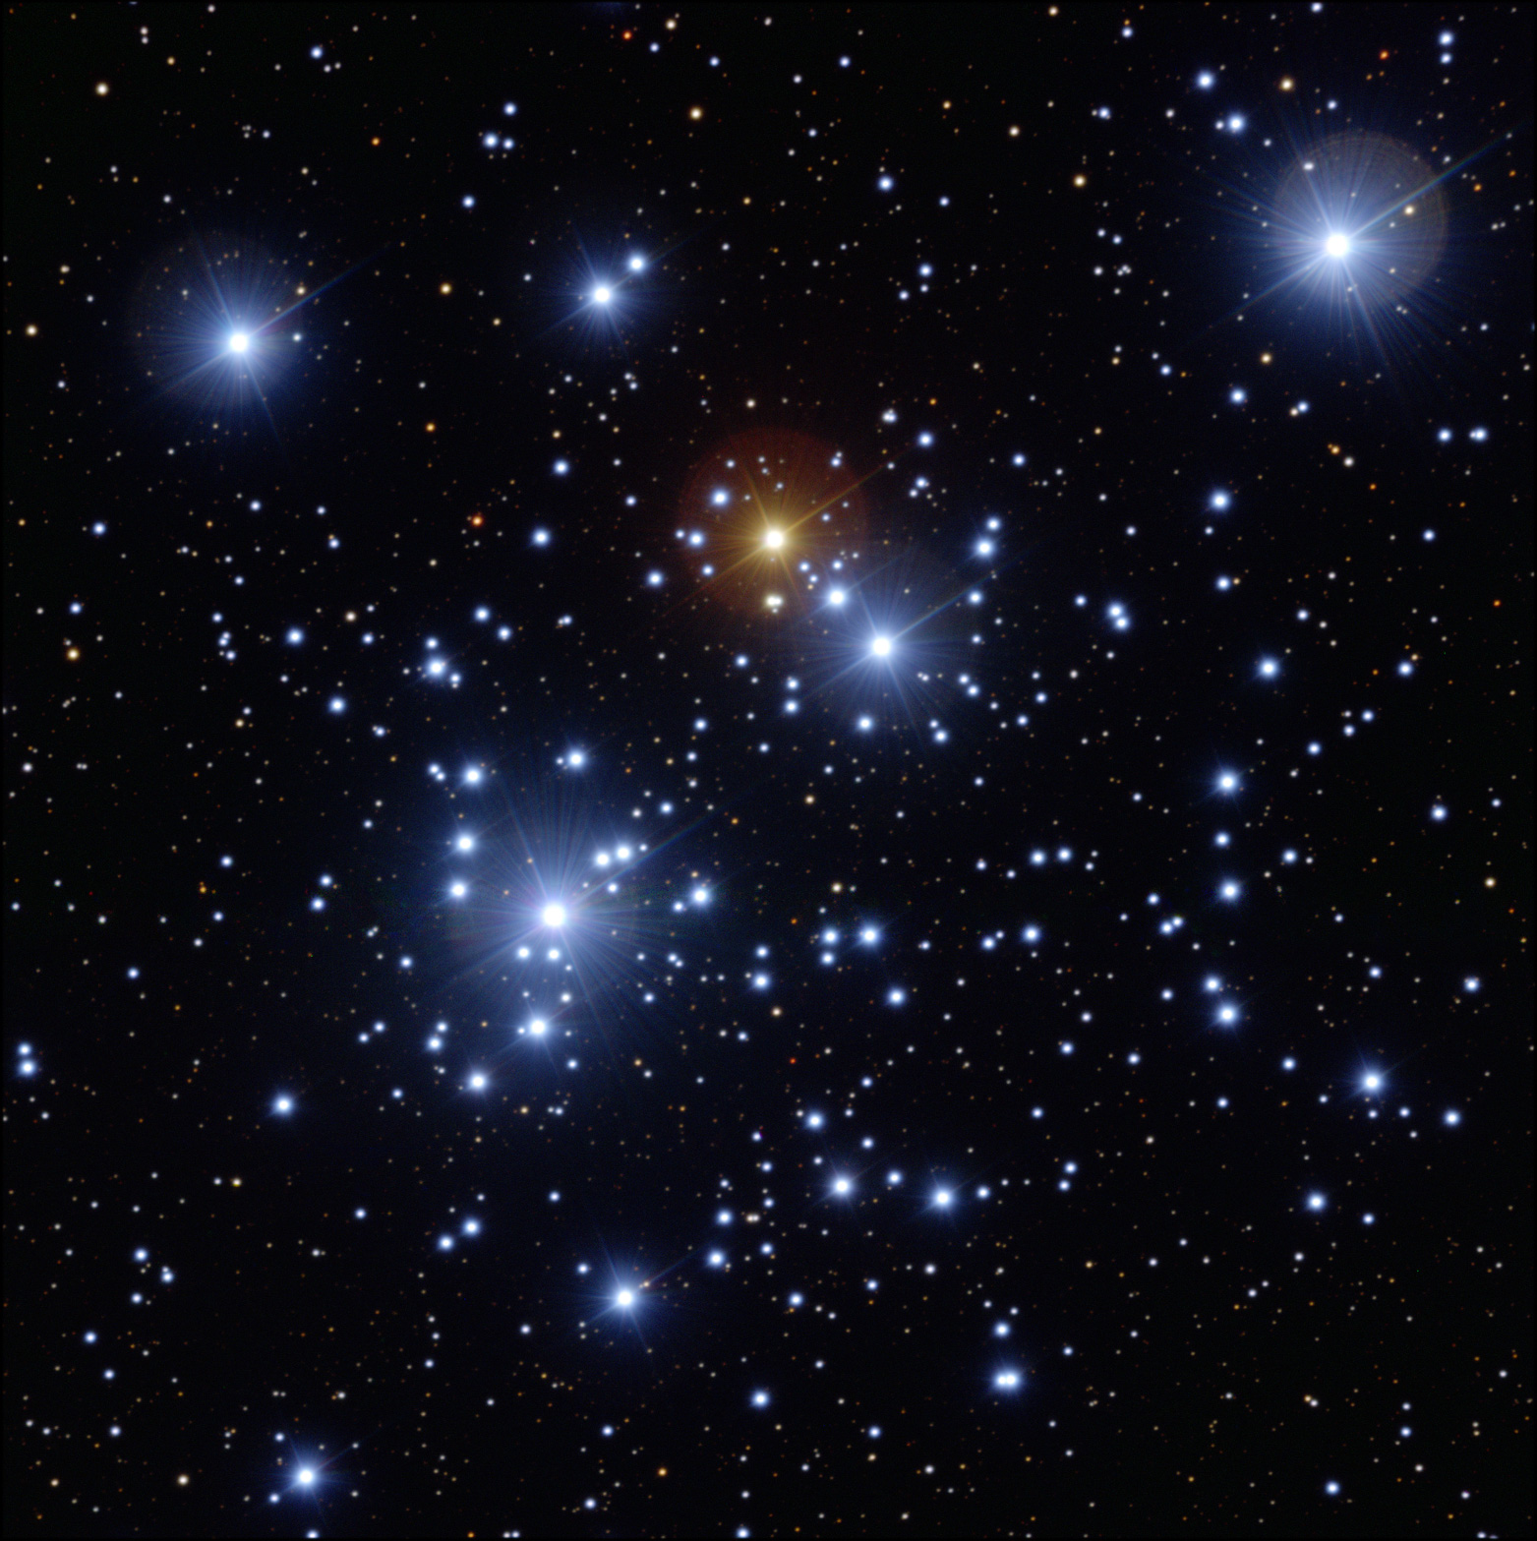
Gacrux
Imai
Mimosa
C94
Jewel Box
Acrux
Hadar
Rigil Kentaurus

Slide 48
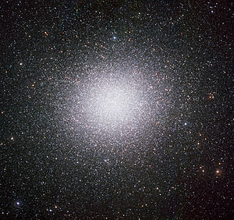
C80
Omega Centauri
Gacrux
Imai
Mimosa
Acrux
Hadar
Rigil Kentaurus

Slide 49
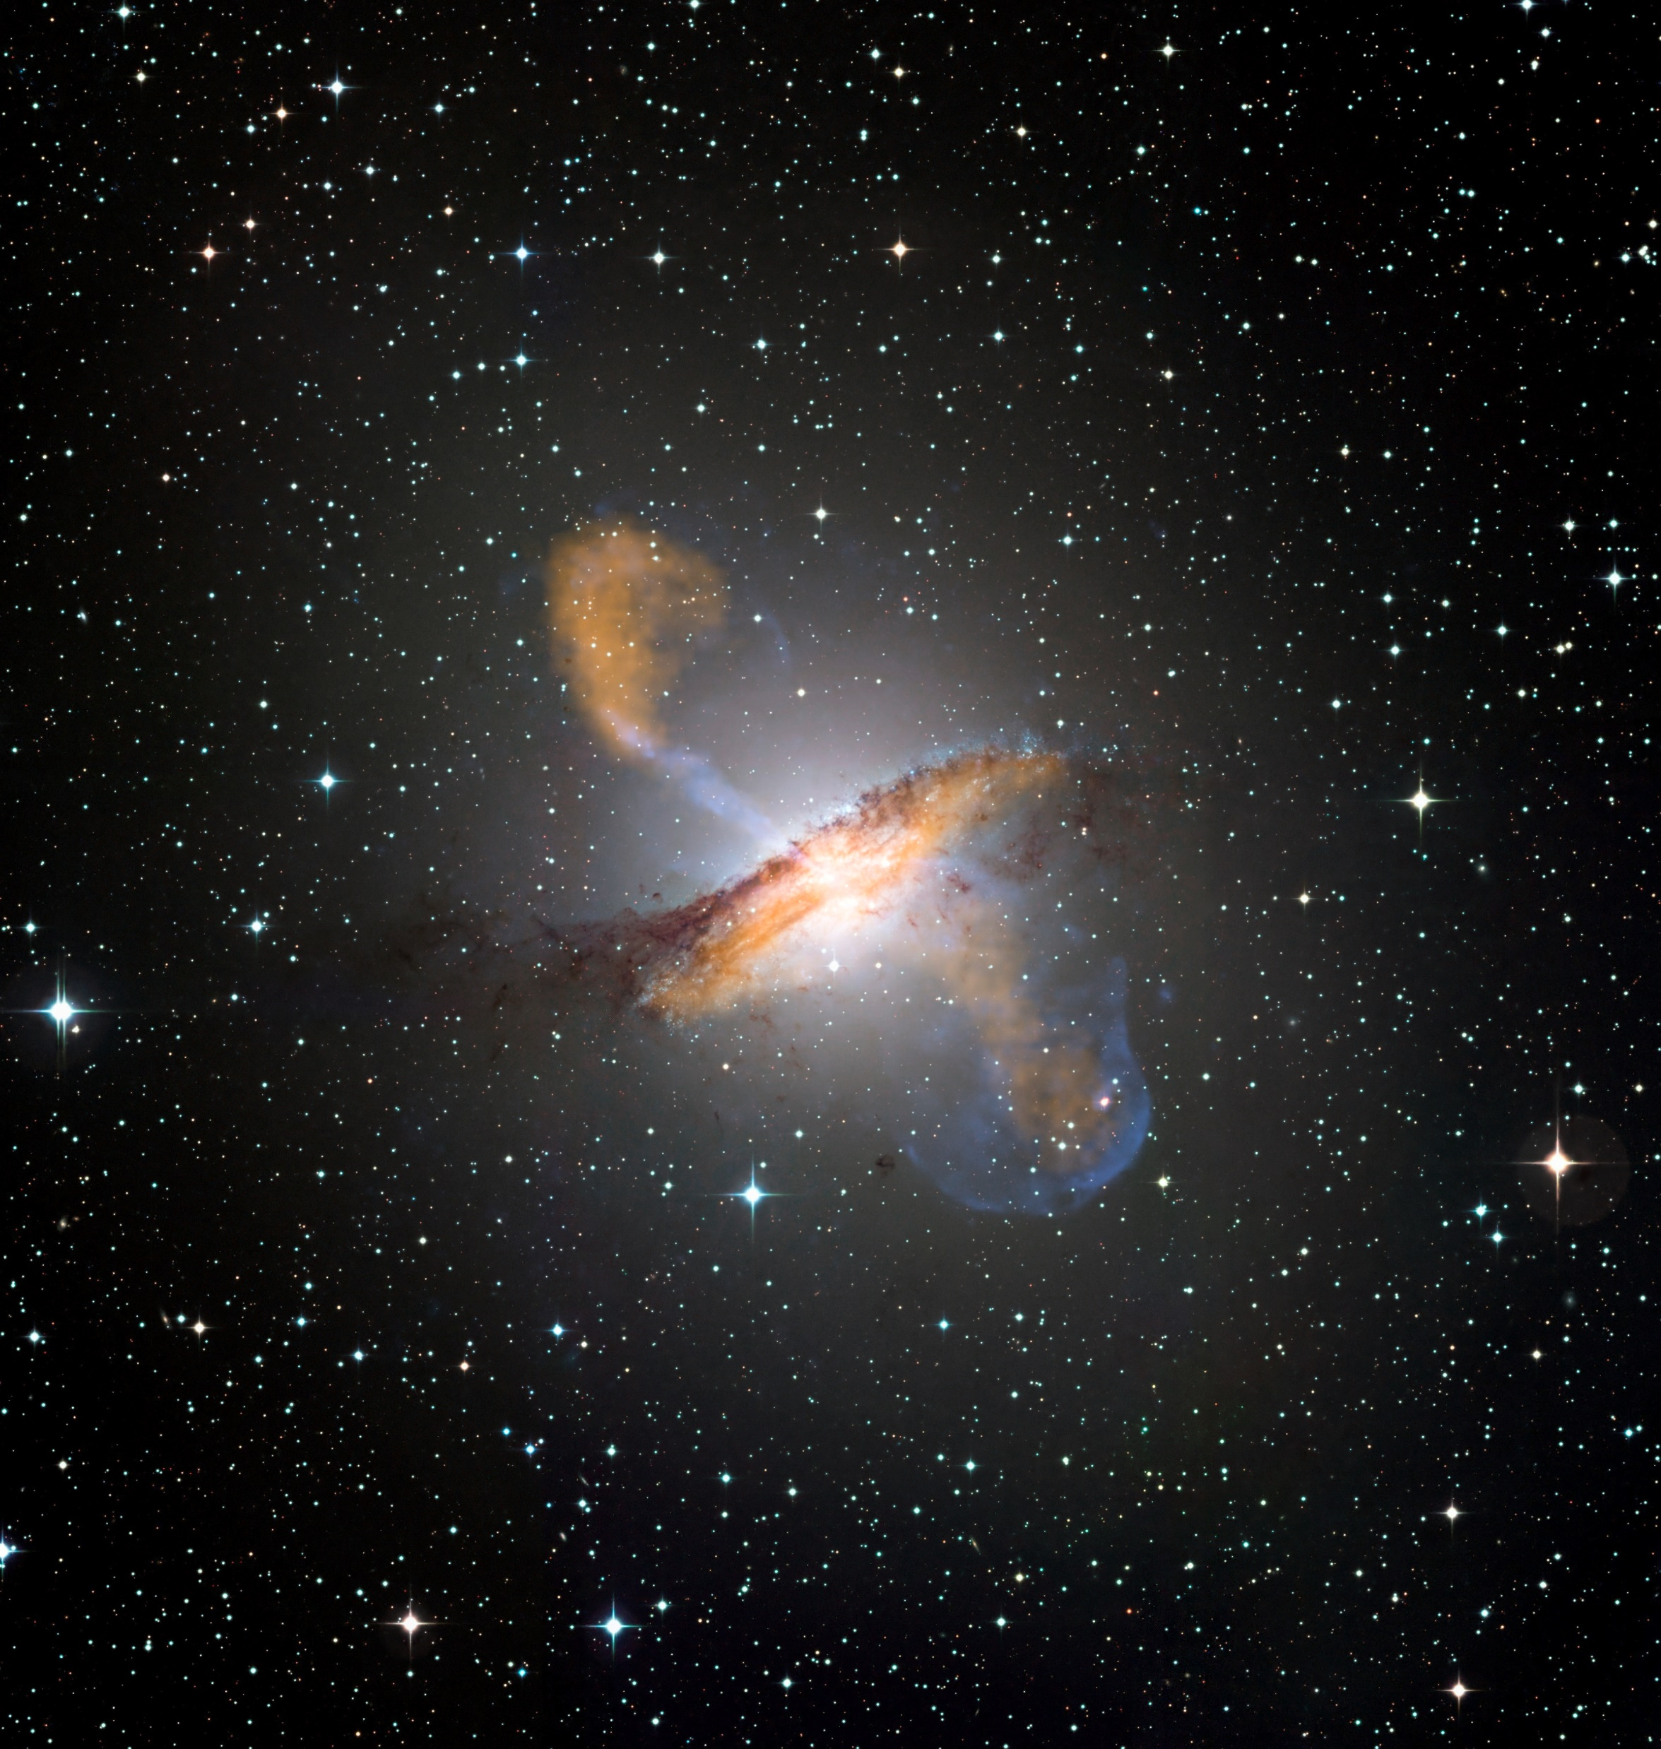
C77
Centaurus A
The Hamburger Galaxy
Gacrux
Imai
Mimosa
Acrux
Hadar
Rigil Kentaurus

Slide 50
Gacrux
Imai
Mimosa
Acrux
Hadar
Rigil Kentaurus
South Celestial Pole

Slide 51
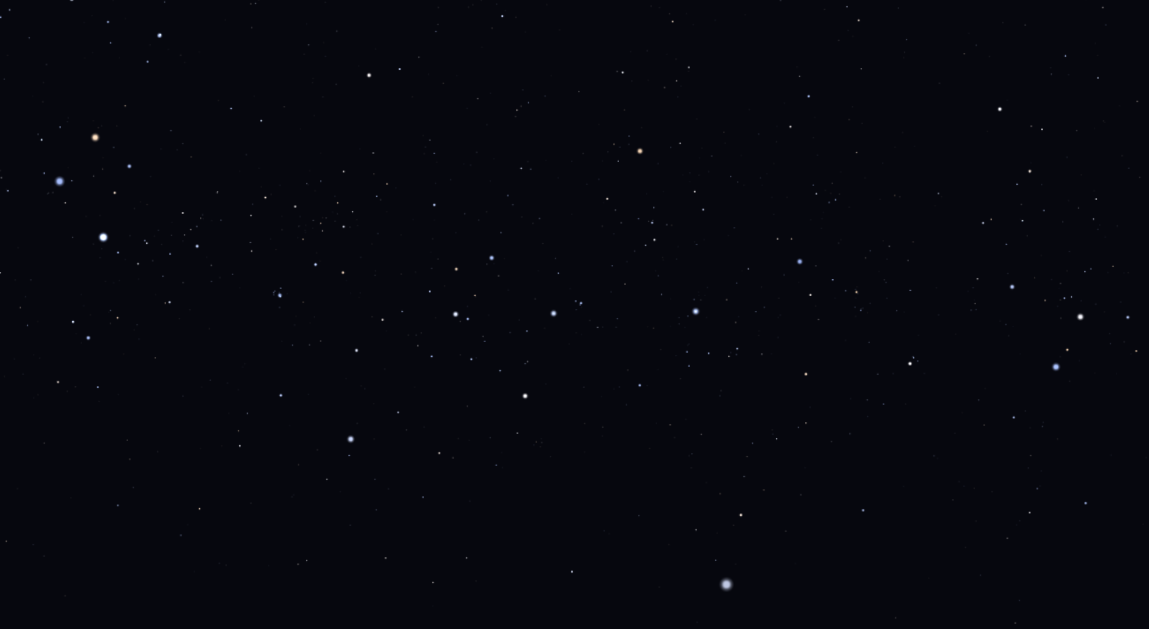
Vela
Puppis
Carina

Slide 52
The Argo Navis

Slide 53
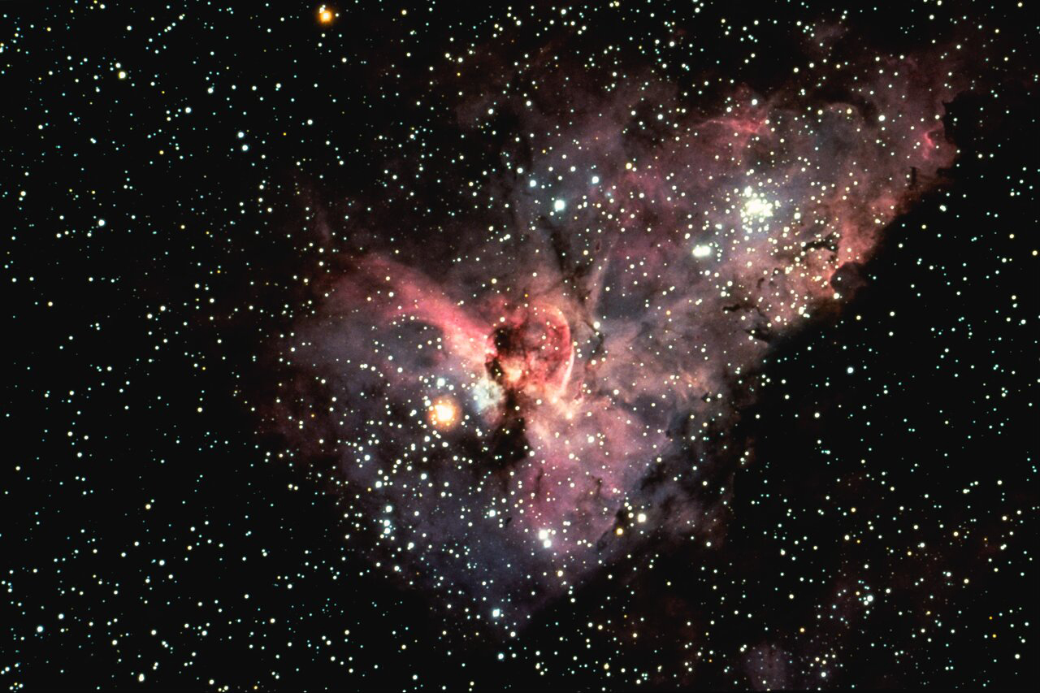
C92
Eta Carinae Nebula

Slide 54
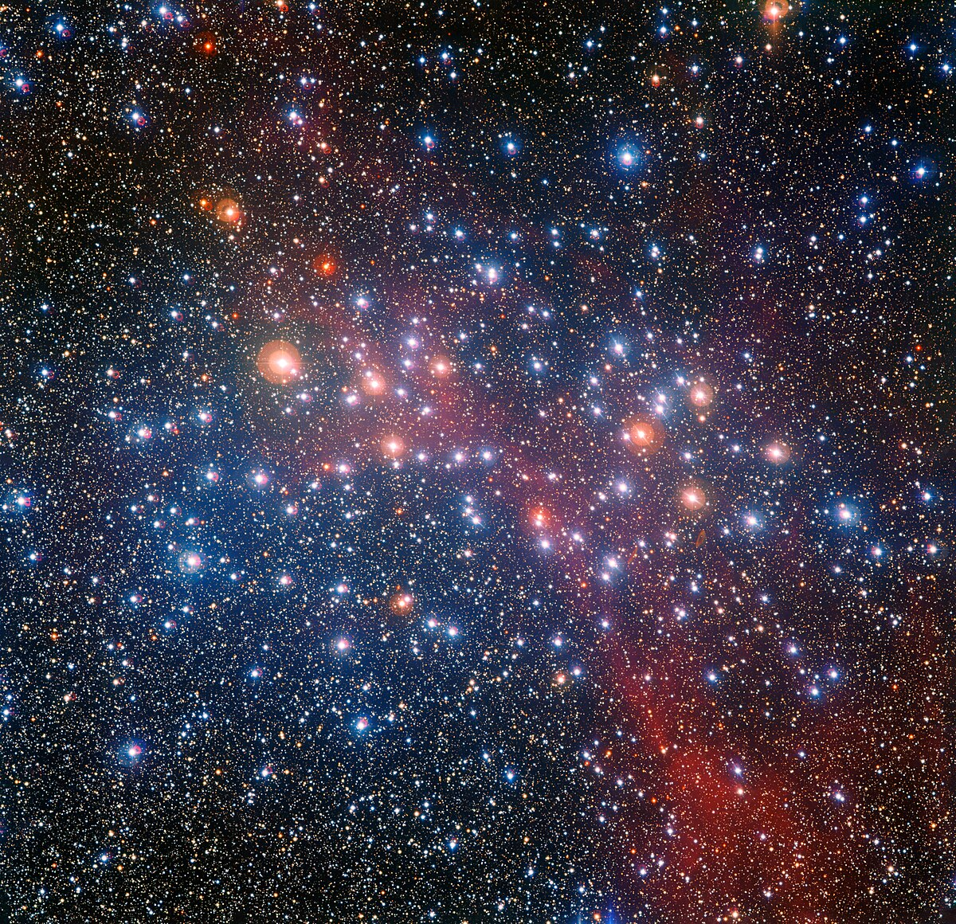
C91
Wishing Well Cluster

Slide 56
Crux
False Cross
Diamond Cross

Slide 57
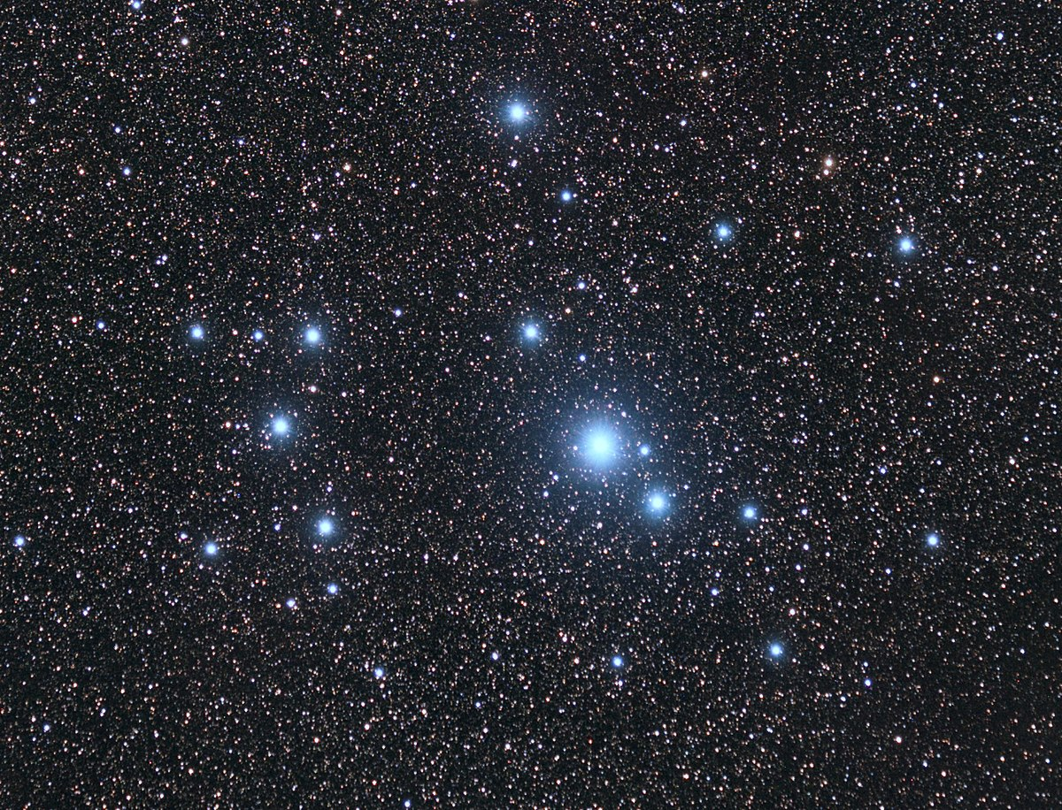
Crux
C102
Southern Pleiades
False Cross
Diamond Cross

Slide 58
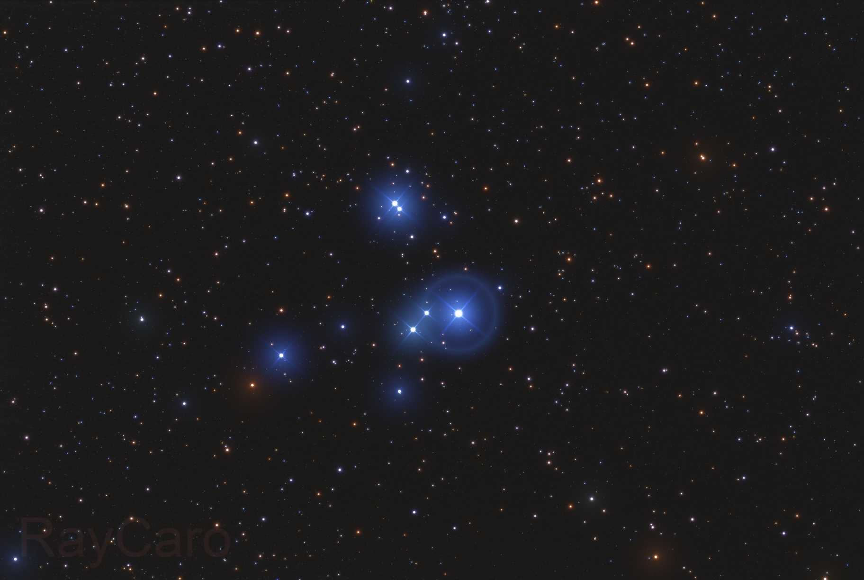
Crux
False Cross
C85
Omicron Velorum
Diamond Cross

Slide 59
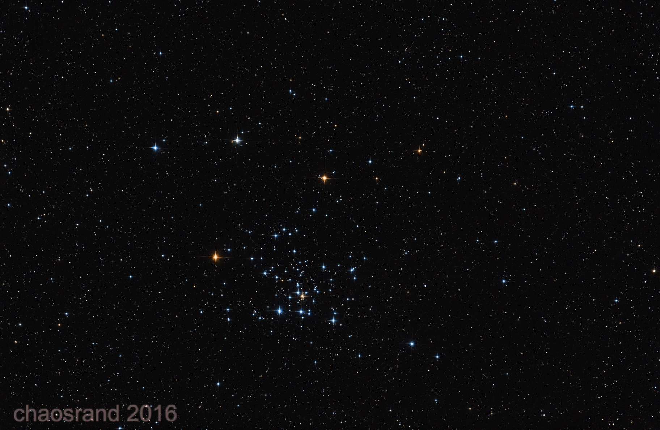
Crux
False Cross
Diamond Cross
C96
Sprinter Cluster
Southern Beehive

Slide 60
Ladies and Gentlemen,
It is Game Time

Slide 61
Almost* Standard Rules Apply
COMMON Named Star
1 Point
Constellation
2 Points
Asterism
2 Points
DSOs [Any works ;)]
3 Points
Hemisphere of the Image
1 Point
Anything Funny
1 Point

Slide 62
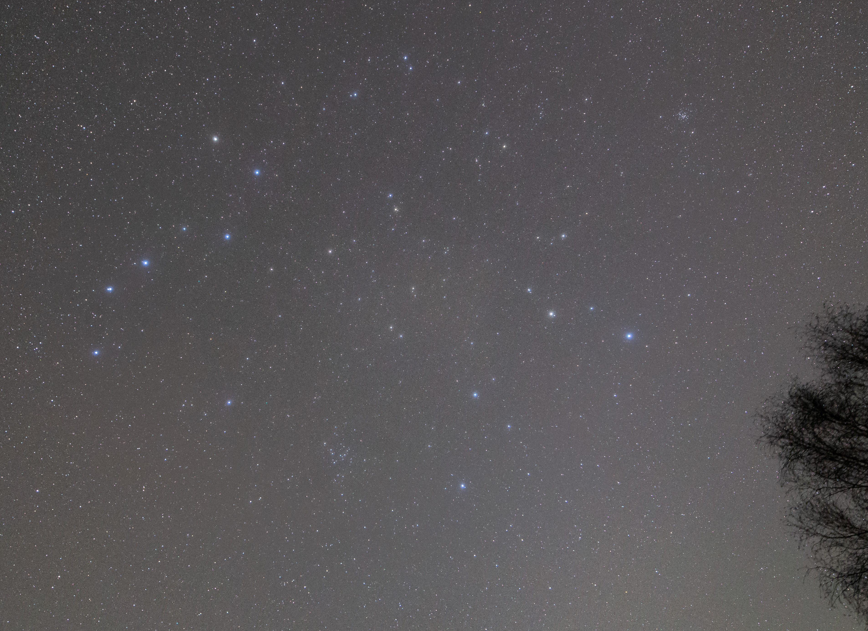
Let us start easy

Slide 63
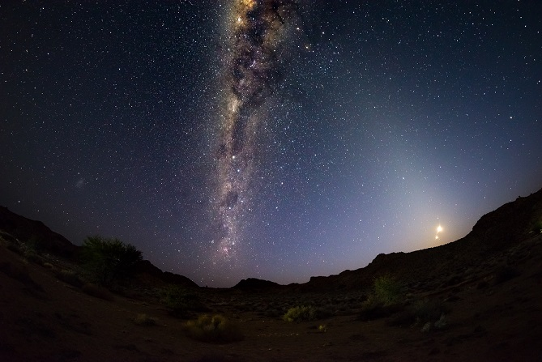
Let us start easy

Slide 64
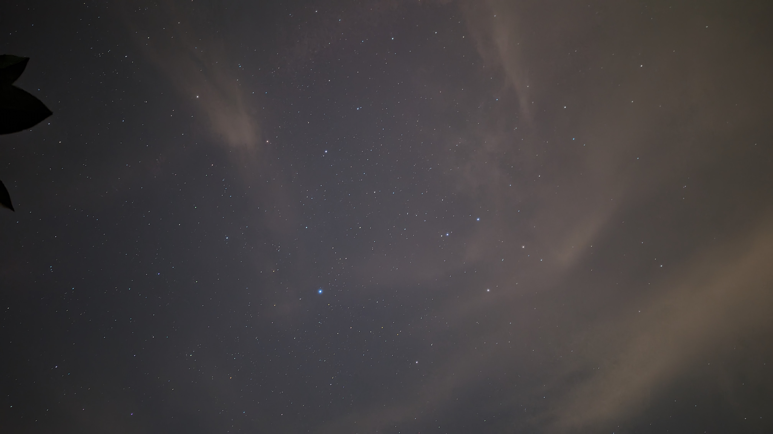
Let us start easy

