Slide 1















Light Tubes
Kush, 14 March 2025

Slide 2

What is a star in a telescope?
$$I=I_{0}{\left[\frac{2}{x}\sum_{m=0}^{∞}{\left(\frac{{\left(−1\right)}^{m}}{m!Γ\left(m+2\right)}{\left(\frac{x}{2}\right)}^{2m+1}\right)}\right]}^{2}$$

Slide 3
The main idea
Important: you MUST KNOW

Slide 4

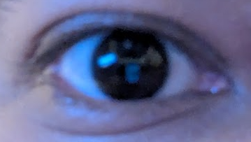
Understand seeing (Normal Light)

Slide 5


Understand seeing (High Light)
Squinting eyes in bright sun

Slide 6

Understand seeing (Low Light)

Slide 7
How wide can your eye be?
NOT WIDE ENOUGH SADLY

Slide 8
















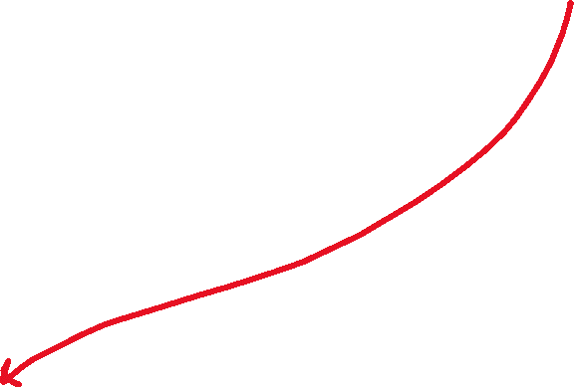











What is a telescope?

Slide 9
The basic numbers
Important measurements

Slide 10







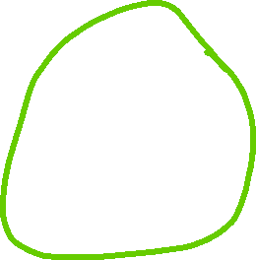












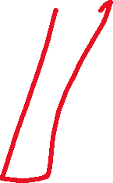




What really is a telescope?
A bunch of shits amalgamed to focus light in our shit eyes.

Slide 11










How to describe an OTA?
Optics
Focal Length
ApertureC

Slide 12





































How to describe an OTA?: Optics

Slide 13





































How to describe an OTA?: Optics
Why are all these rays parallel to each other?
The object is placed at infinity!

Slide 14








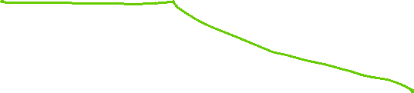
How to describe an OTA?: Focal Length

Slide 15


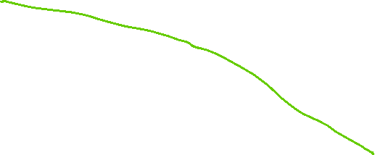







How to describe an OTA?: Focal Length

Slide 16


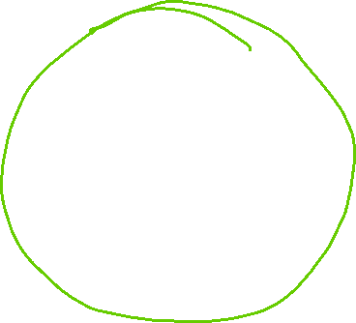



How to describe an OTA?: Focal Length
Illuminance J (How bright the image looks)

Slide 17



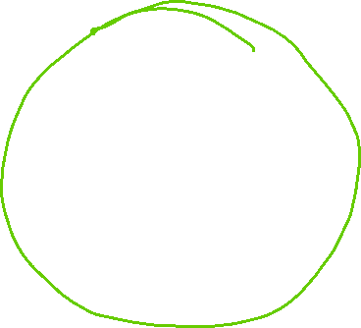





How to describe an OTA?: Focal Length
Illuminance J (How bright the image looks)

Slide 18
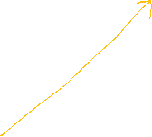















How to describe an OTA?: Aperture

Slide 19



















How to describe an OTA?: Aperture

Slide 20






How to describe an OTA?: Illuminance

Slide 21











How to describe an OTA?: F/ratio

Slide 22





How to describe an OTA?: F/ratio
In the same amount of time, a telescope with lower f/ratio will create a brighter image.
Therefore, telescopes with lower f/ratio are called fast and larger, slow.

Slide 23
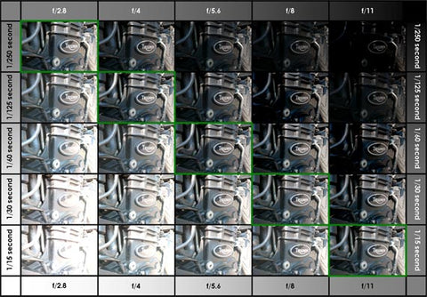
How to describe an OTA?: F/ratio
Does a lower f/ratio always mean a better telescope?

Slide 24
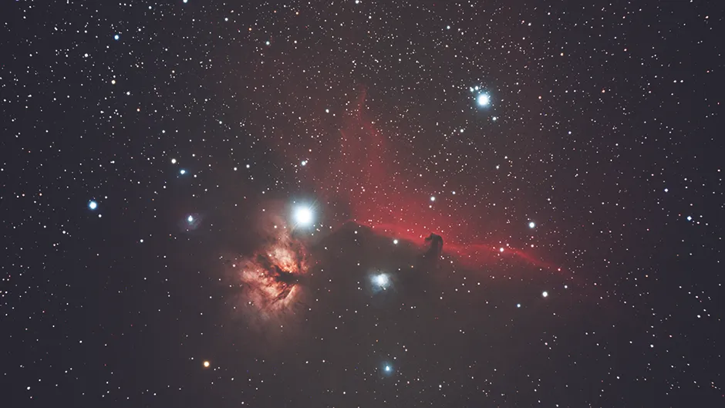

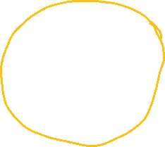

How to describe an OTA?: Vignetting
Darker edges

Slide 25




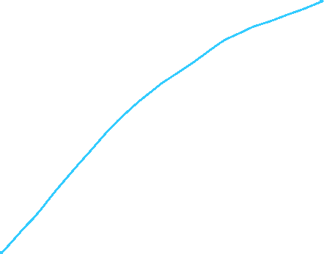




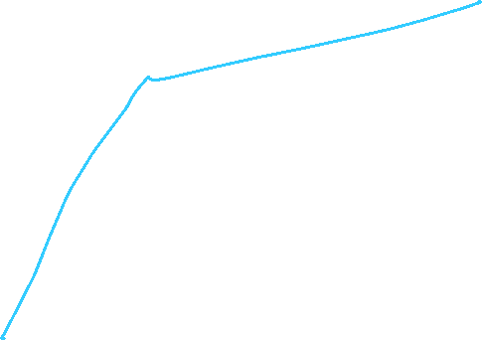


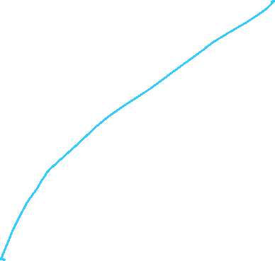





How to describe an OTA?: Vignetting
Darker edges

Slide 26
OTA recap
If you know the optics, focal length and aperture of an OTA, you know enough about the telescope.

Slide 27


What really is a telescope?
Focal Length
Exit Pupil
AFOV

Slide 28






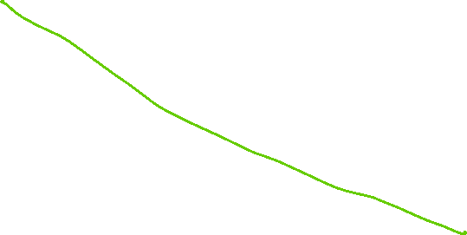

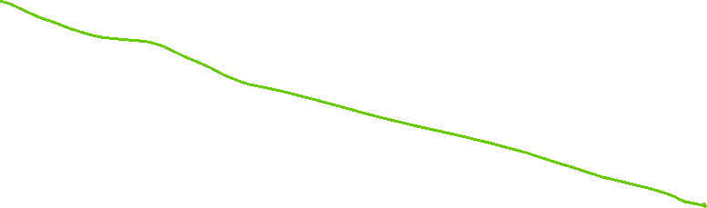
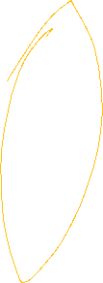



How to describe an eyepiece?: Focal Length

Slide 29





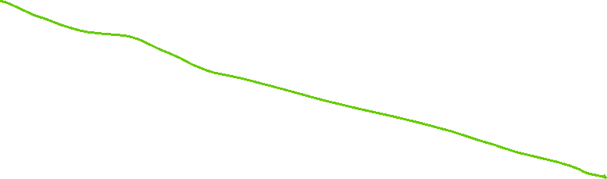
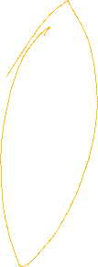









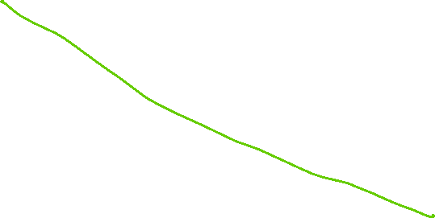
How to describe an eyepiece?: Magnification

Slide 30








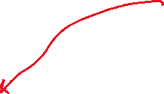









How to describe an eyepiece?: Exit Pupil
Bigger exit pupil, brighter image

Slide 31










How to describe an eyepiece?: Eye Relief

Slide 32


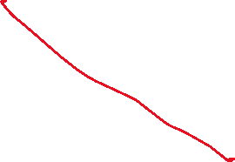

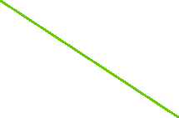







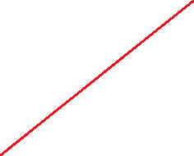
How to describe an eyepiece?: AFOV and Field Stop

Slide 33
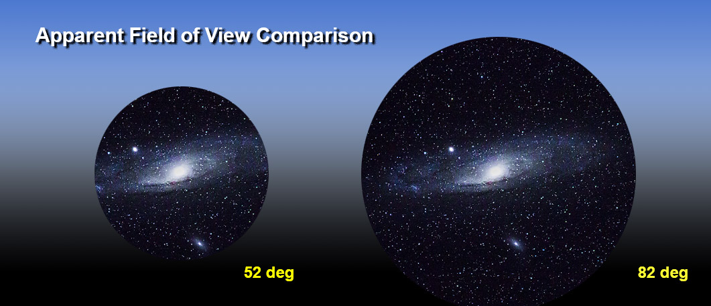


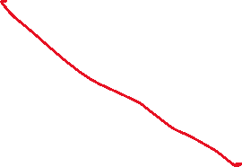






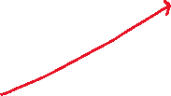
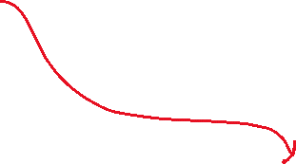

How to describe an eyepiece?: AFOV and Field Stop

Slide 34


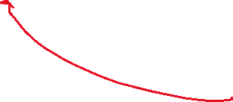
How to describe an eyepiece?: Eye Relief Again

Slide 35







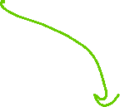


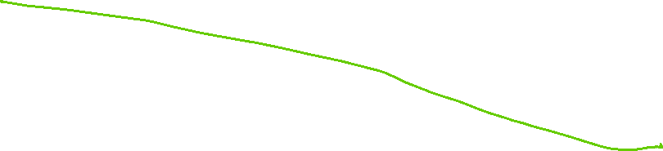

How to describe an eyepiece?: TFoV

Slide 36
Issues with scopes
Nothing is perfect

Slide 37
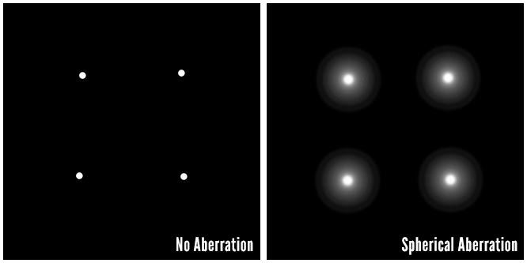


Spherical Aberration

Slide 38





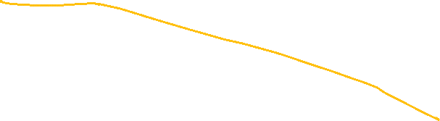
Spherical Aberration

Slide 39

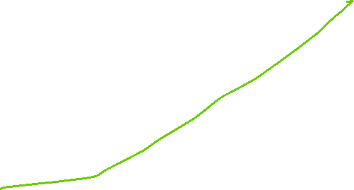




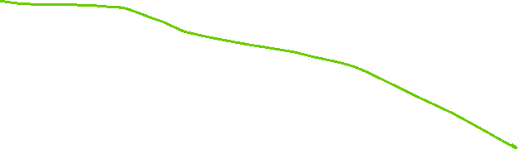


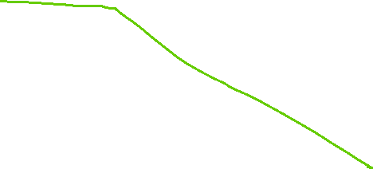



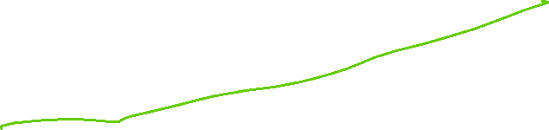

Spherical Aberration

Slide 40
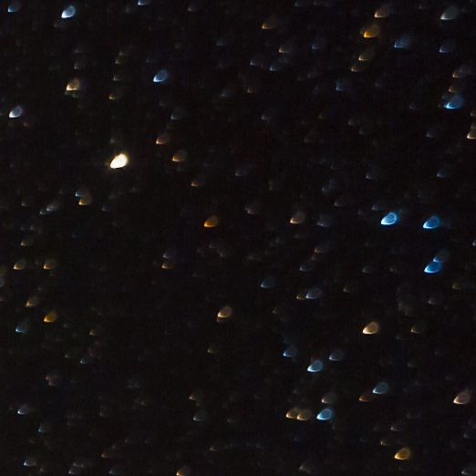
Comatic Aberration

Slide 41

Comatic Aberration

Slide 42
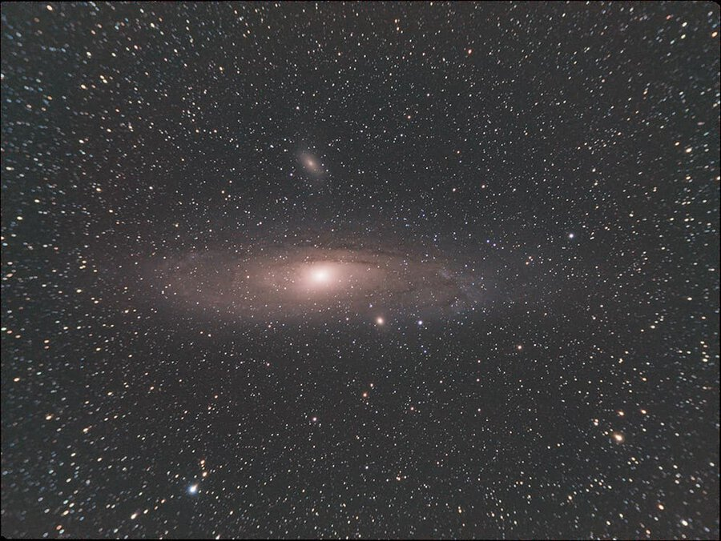
Field Curvature

Slide 43

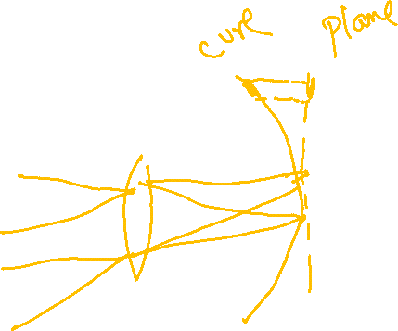
Field Curvature

Slide 44
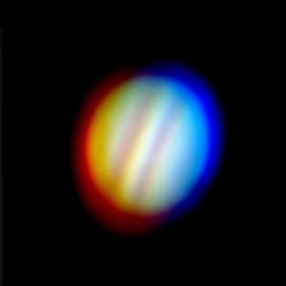
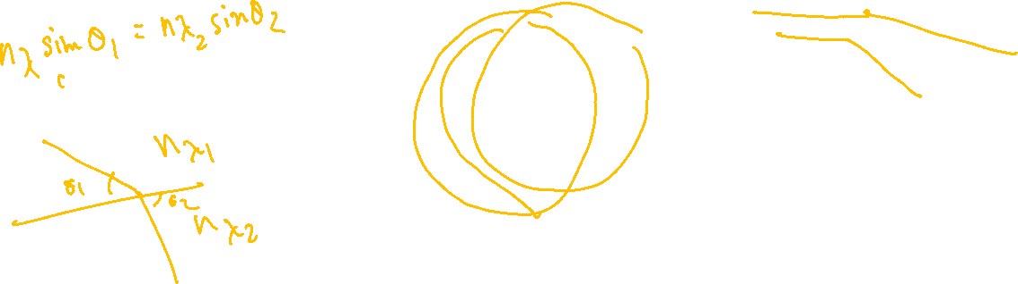
Chromatic Aberration

Slide 45



Chromatic Aberration

Slide 46


Diffraction

Slide 47

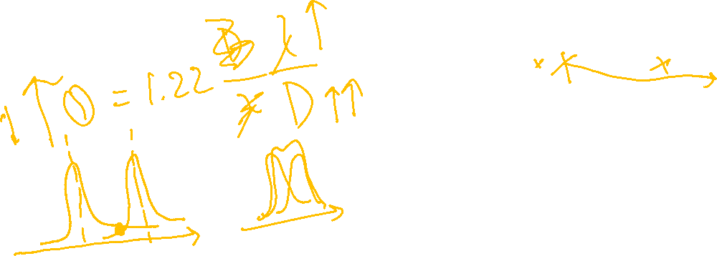



Diffraction
$$I=I_{0}{\left[\frac{2}{x}\sum_{m=0}^{∞}{\left(\frac{{\left(−1\right)}^{m}}{m!Γ\left(m+2\right)}{\left(\frac{x}{2}\right)}^{2m+1}\right)}\right]}^{2}$$

Slide 48
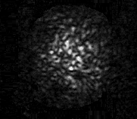






Seeing

Slide 49
Empirical stuff
Max useful magnification = (Aperture in mm) x 2
Max seeing magnification < 250x

Slide 50
Now, to break the telescope

