Slide 1
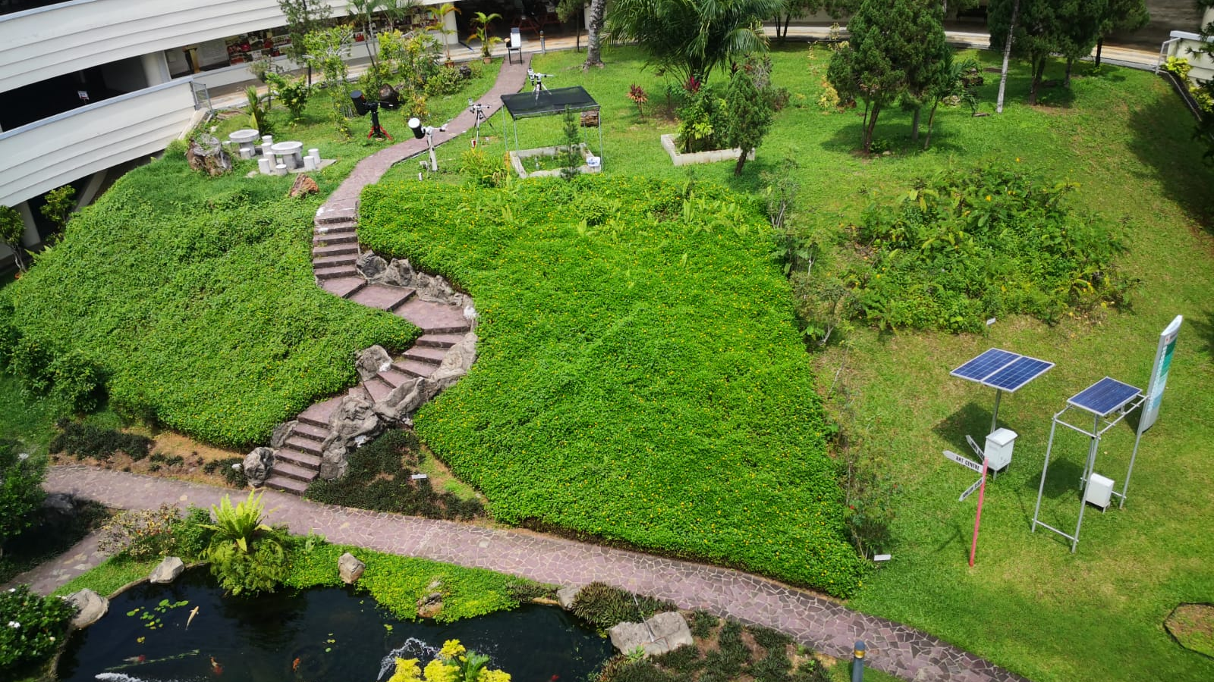
National Junior College’s
High-Resolution Solar Research Observatory

Slide 2
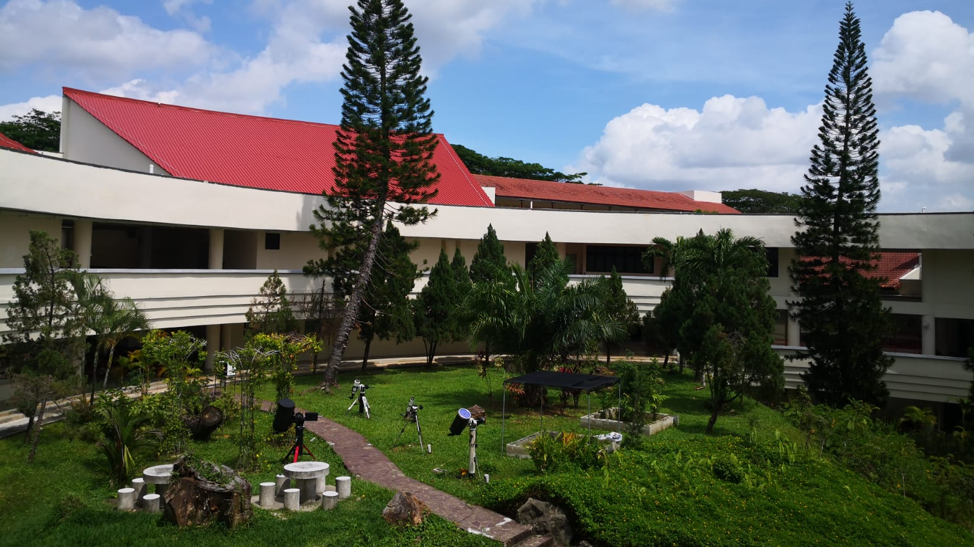
Largest amateur Solar Observatory in South-East Asia
Assembled by NJC using parts from various countries
Can be accessed remotely by our partner schools anywhere in the world
Hosted various local and foreign guests

Slide 3

Solar flare
23 May 2021

Slide 4
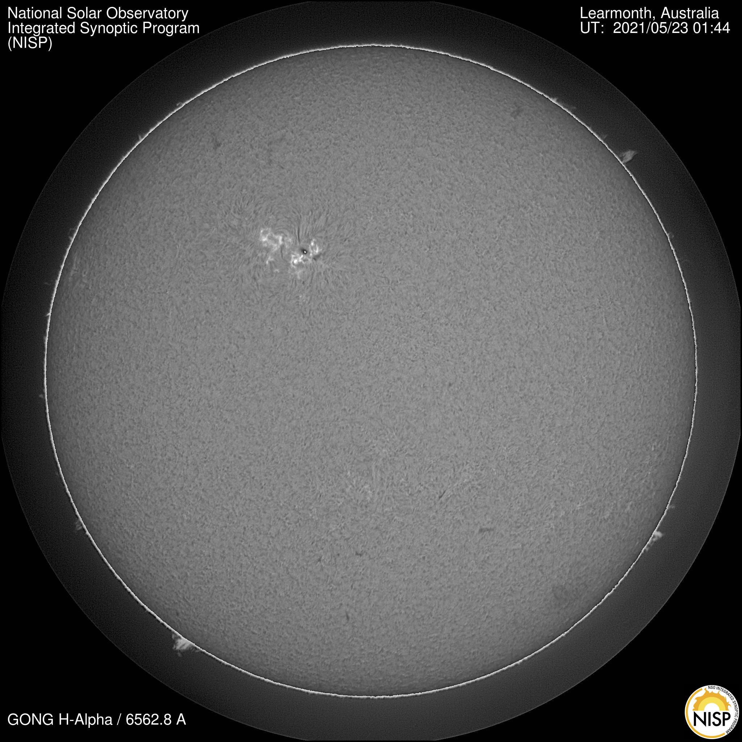

Slide 5
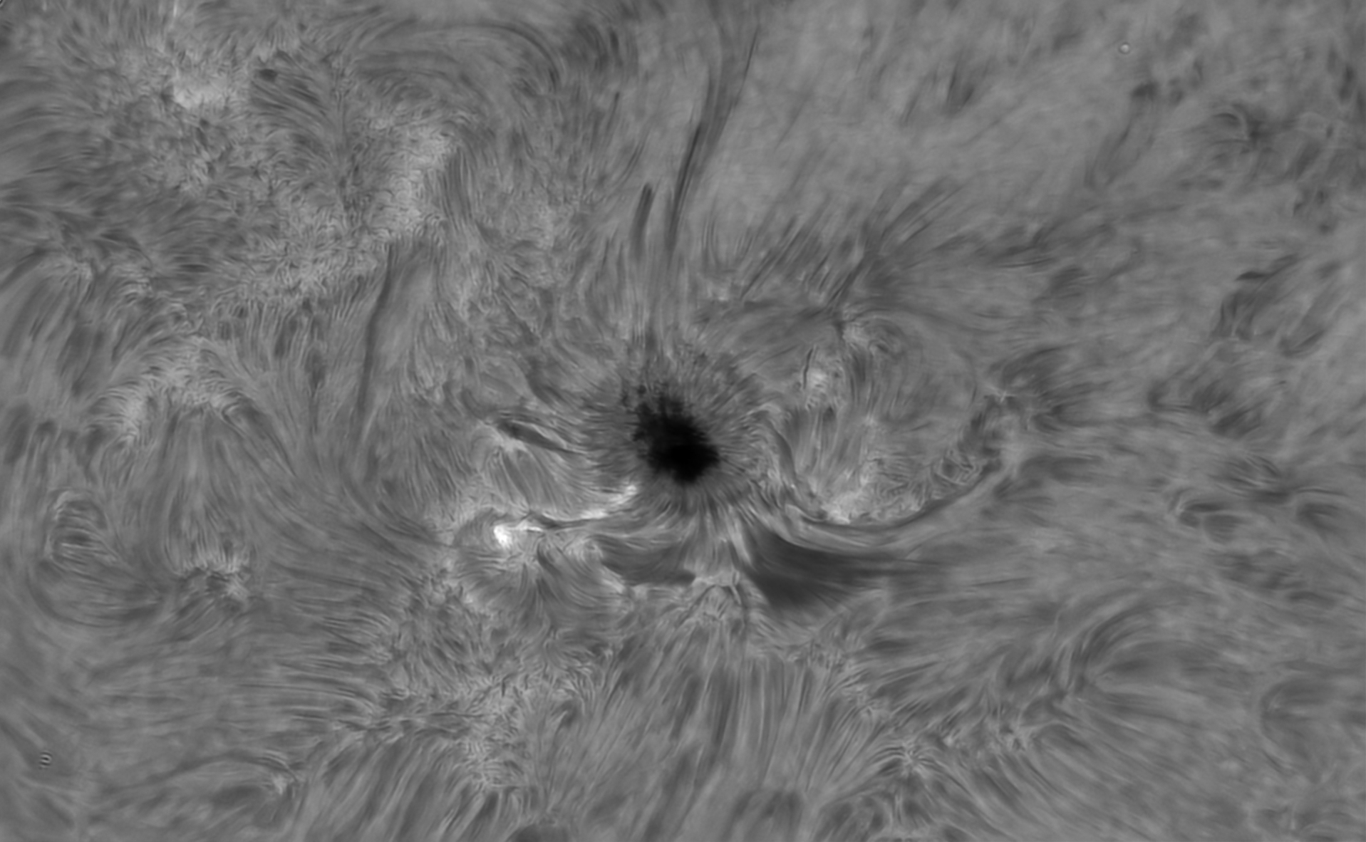
Solar flare caught at NJC Hi-Resolution Research Observatory (HISRO)

Slide 6
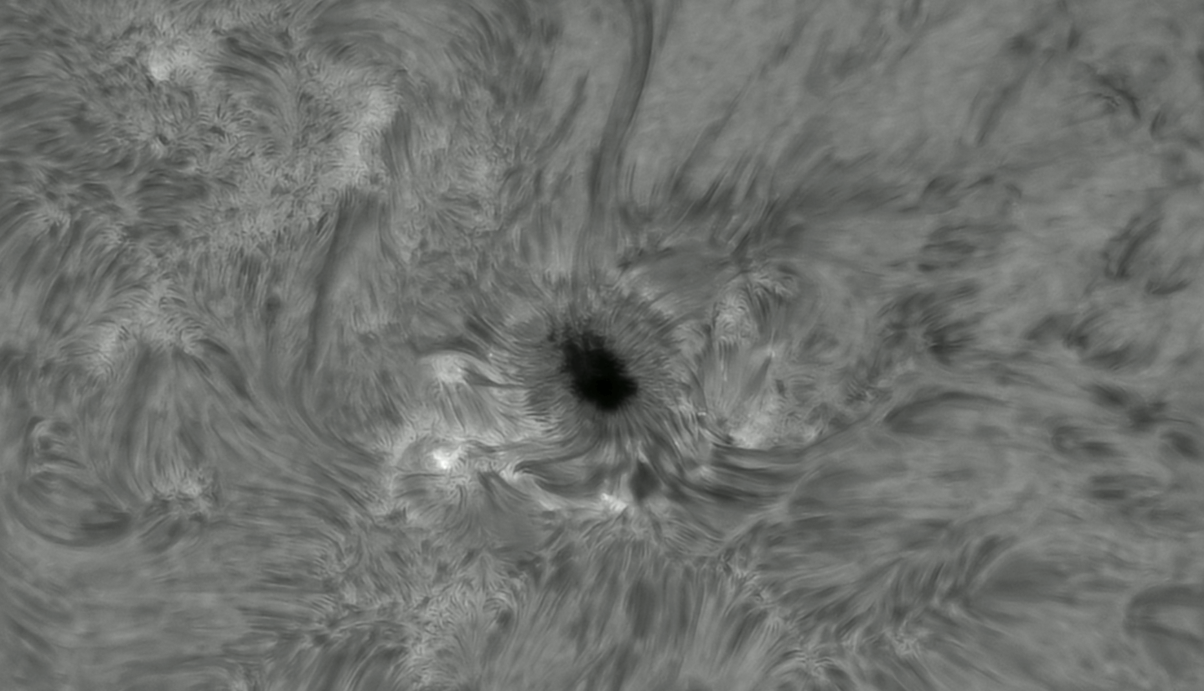
40 minute timelapse of the flare

Slide 7

Ocean of plasma waves
13 Jan 2022

Slide 8
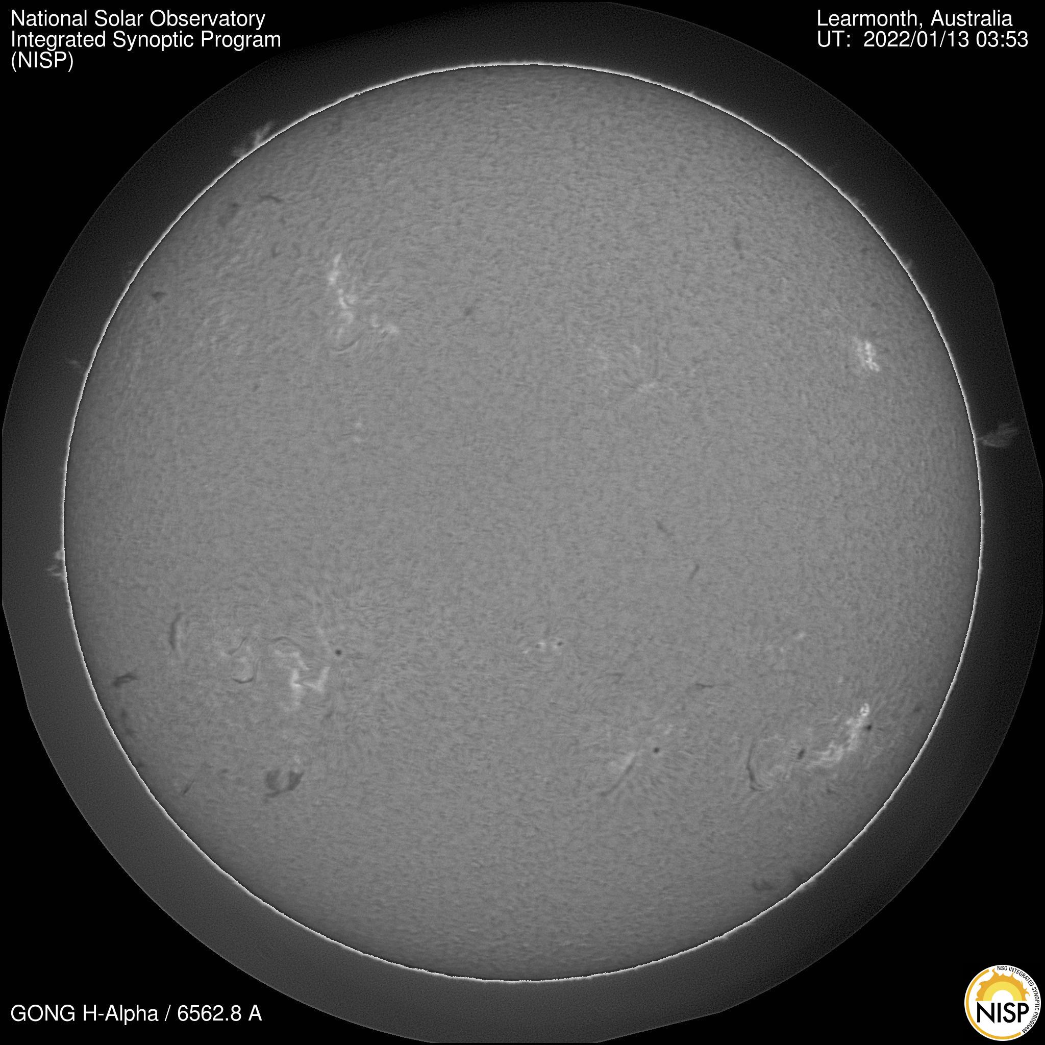

Slide 9
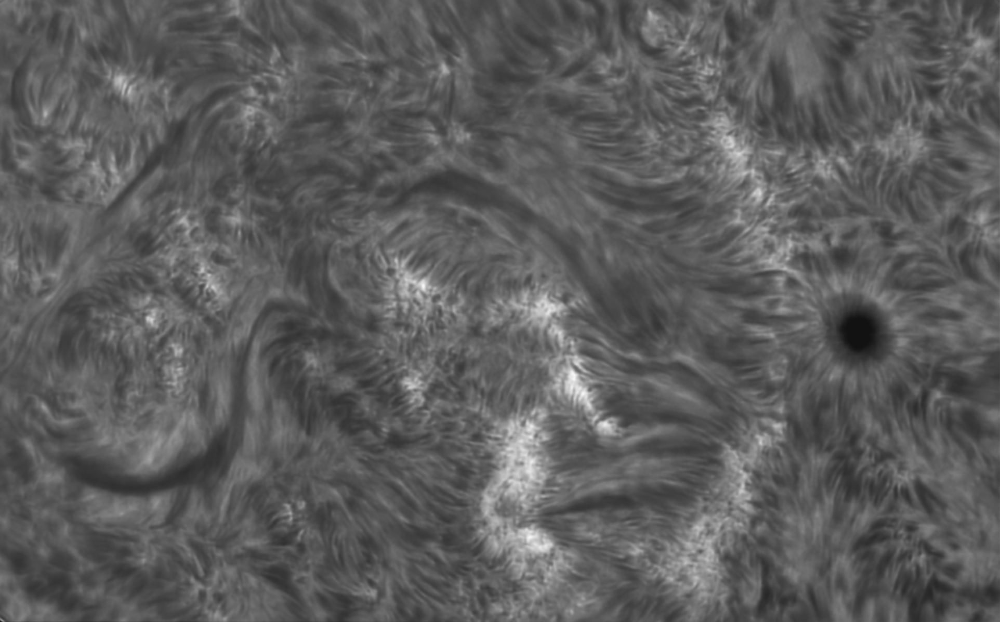
Closeup on the sunspot

