Slide 1
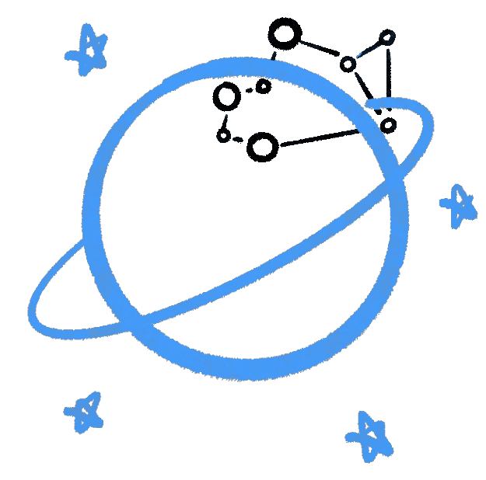

No Prakash,
I cannot read your hand.
A weird introduction to Astronomy and other fun stuff
By Kushagra Shrivastava, Founder Cosmic Cup

Slide 2
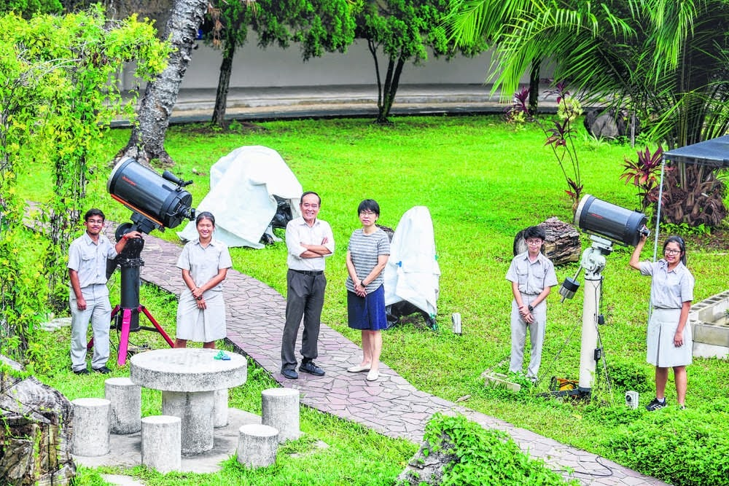
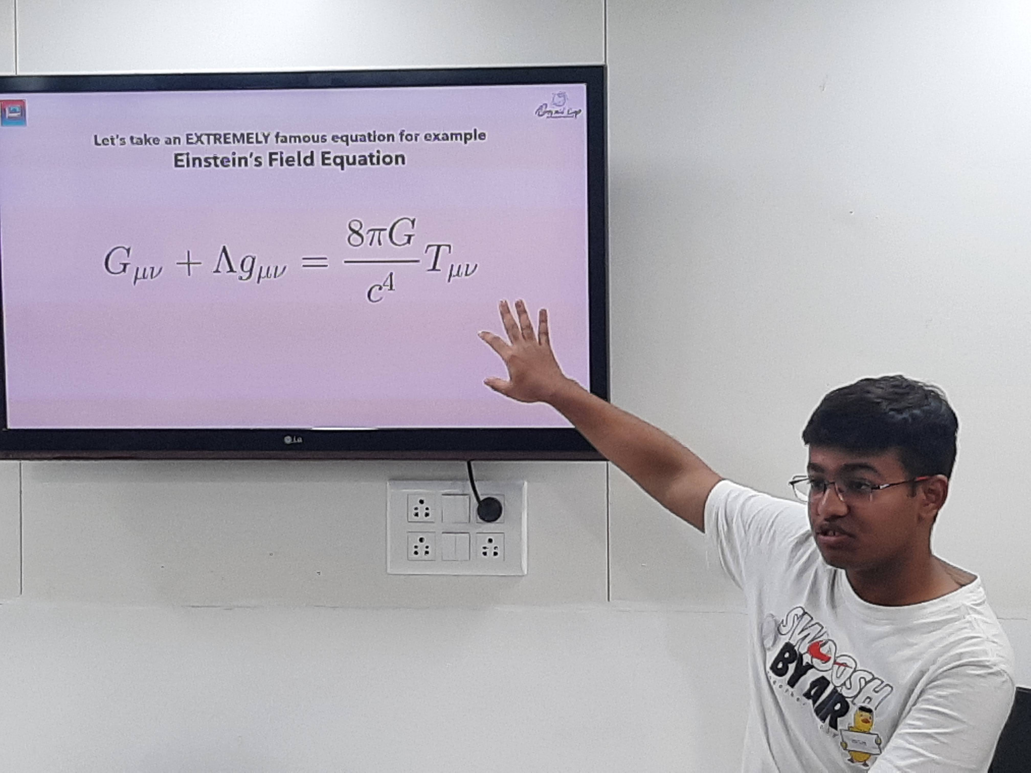
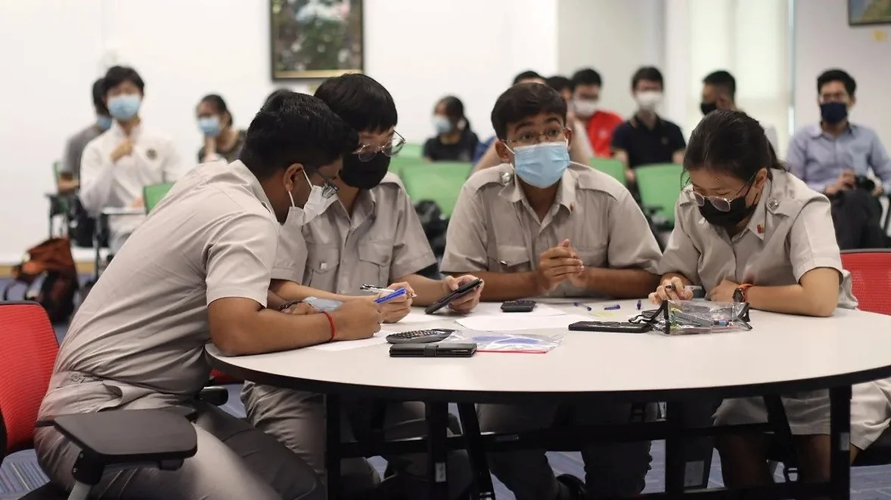
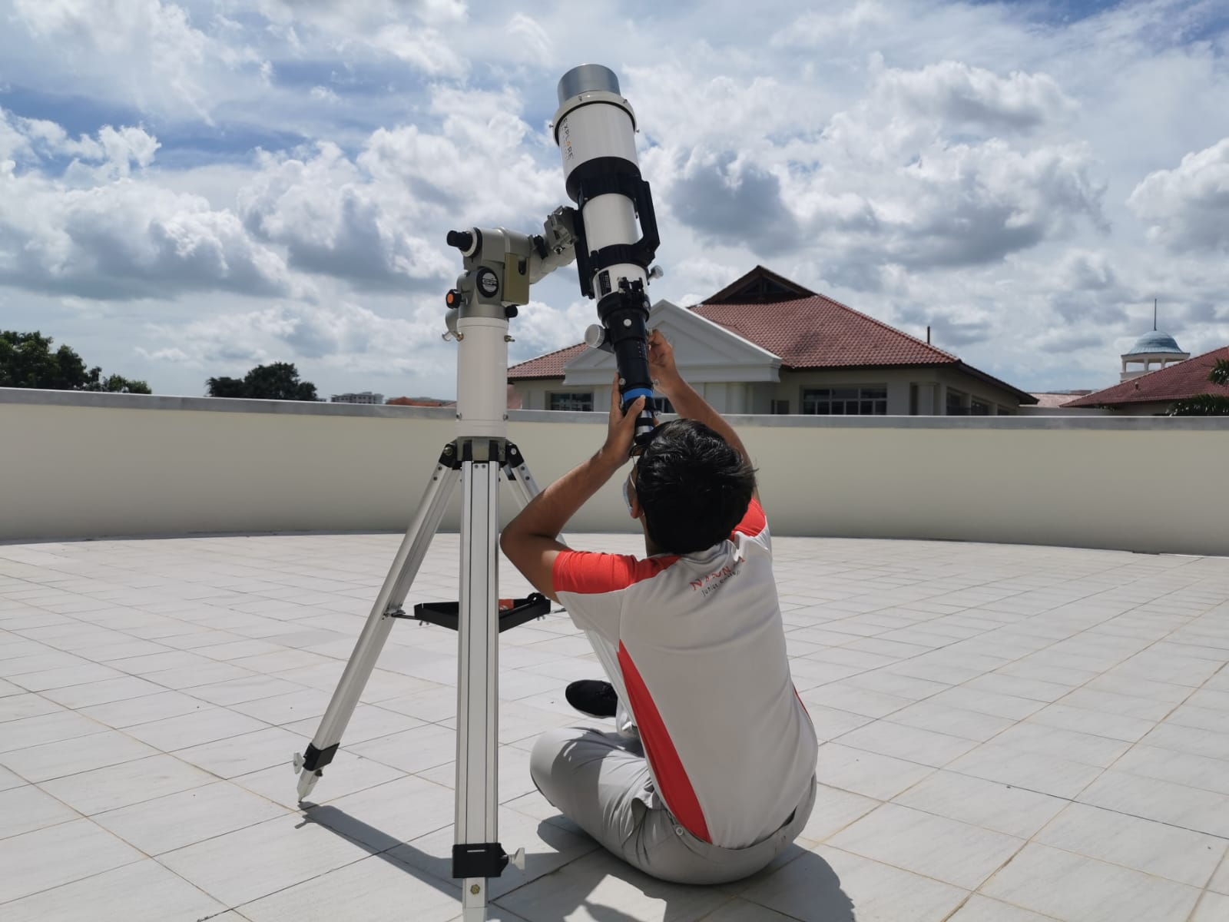
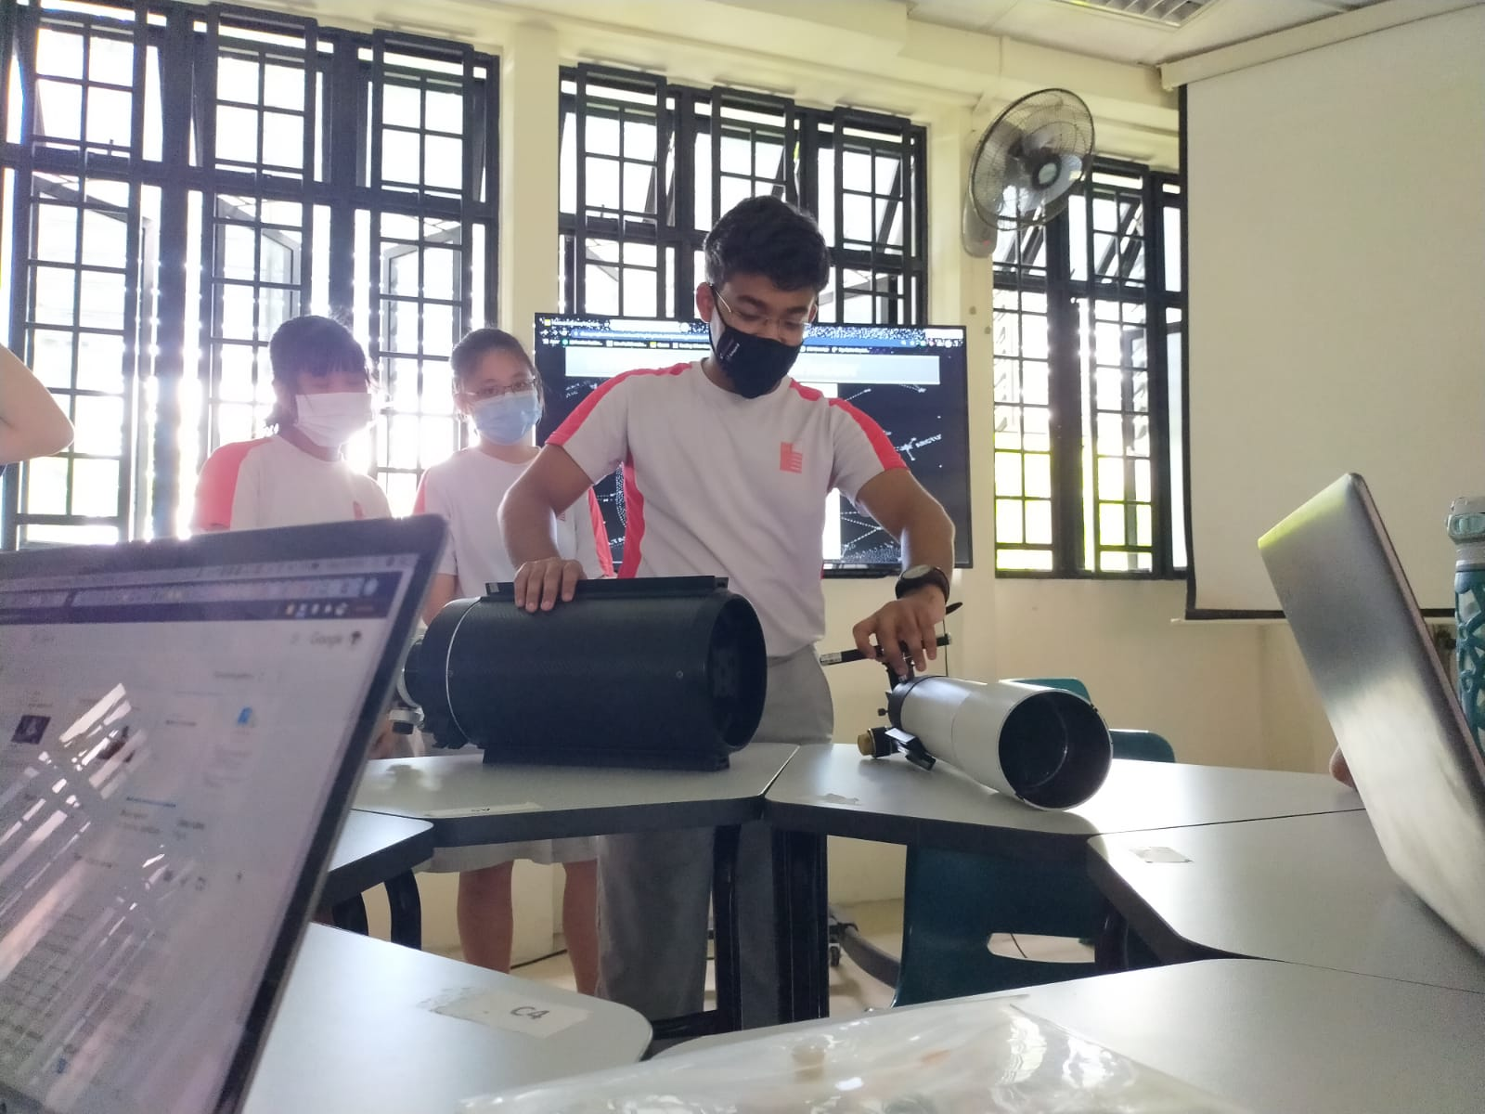
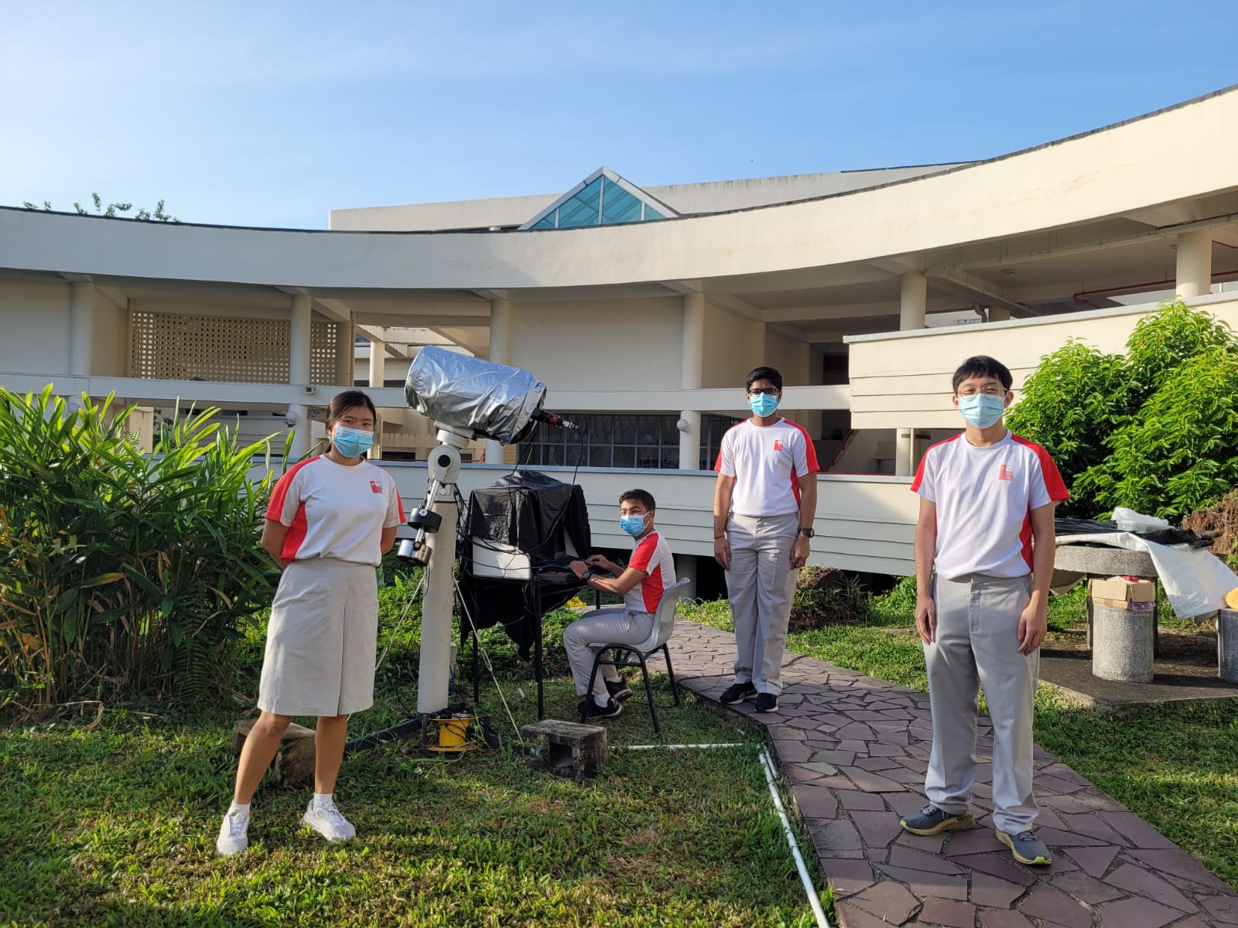
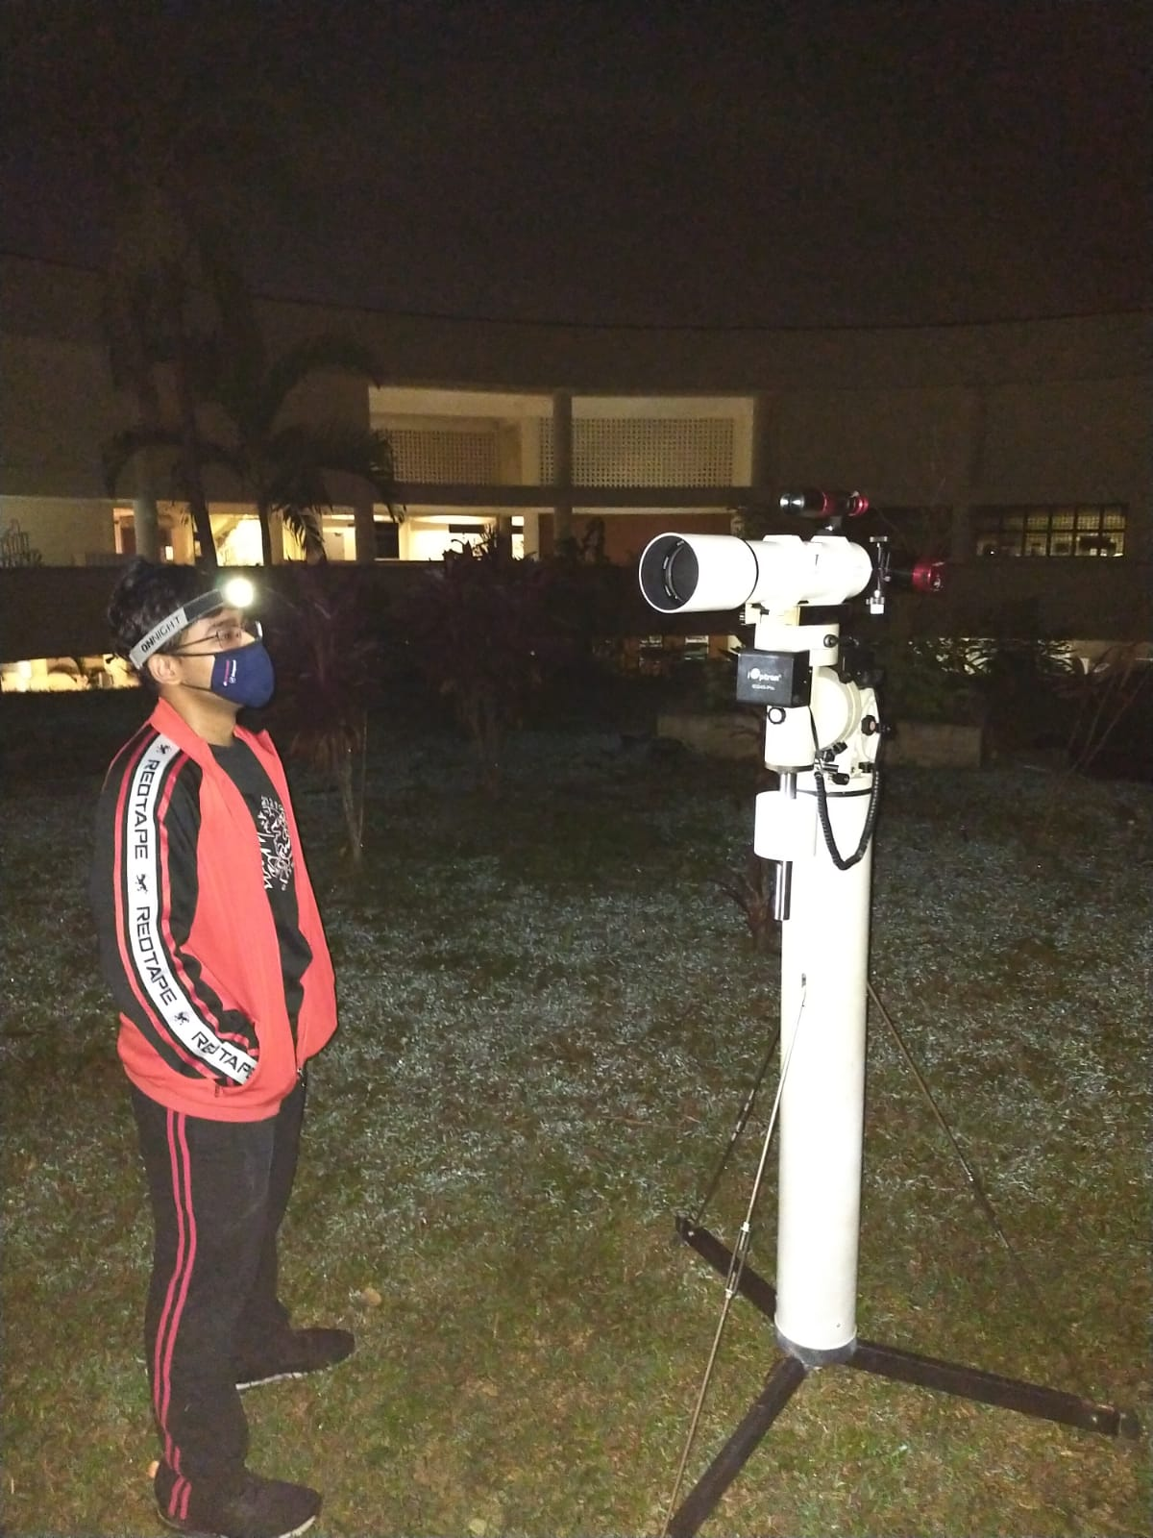
Who am I?

Slide 3


Slide 4
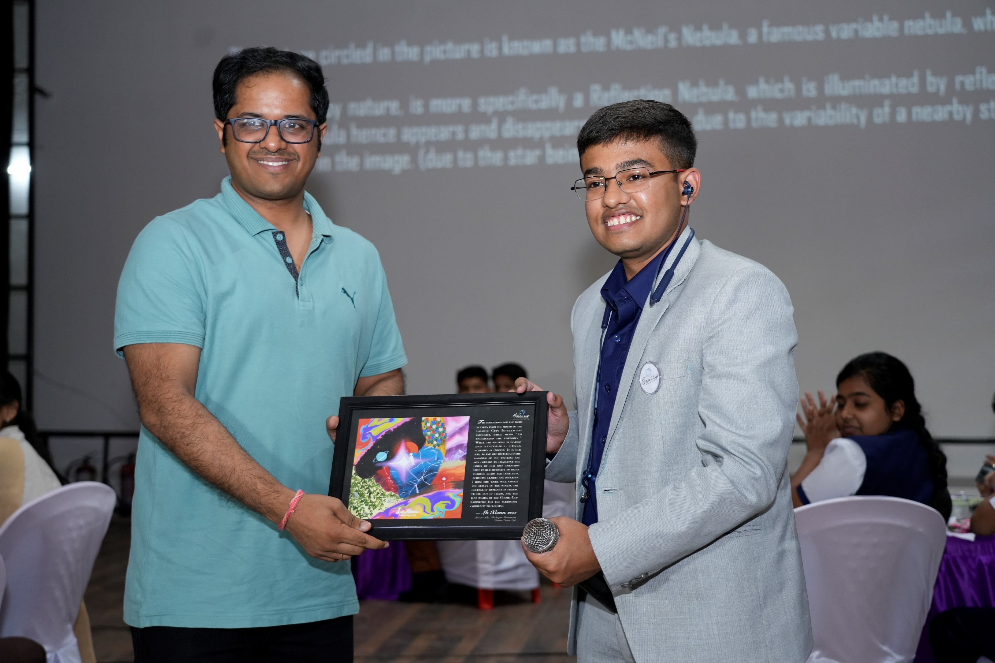
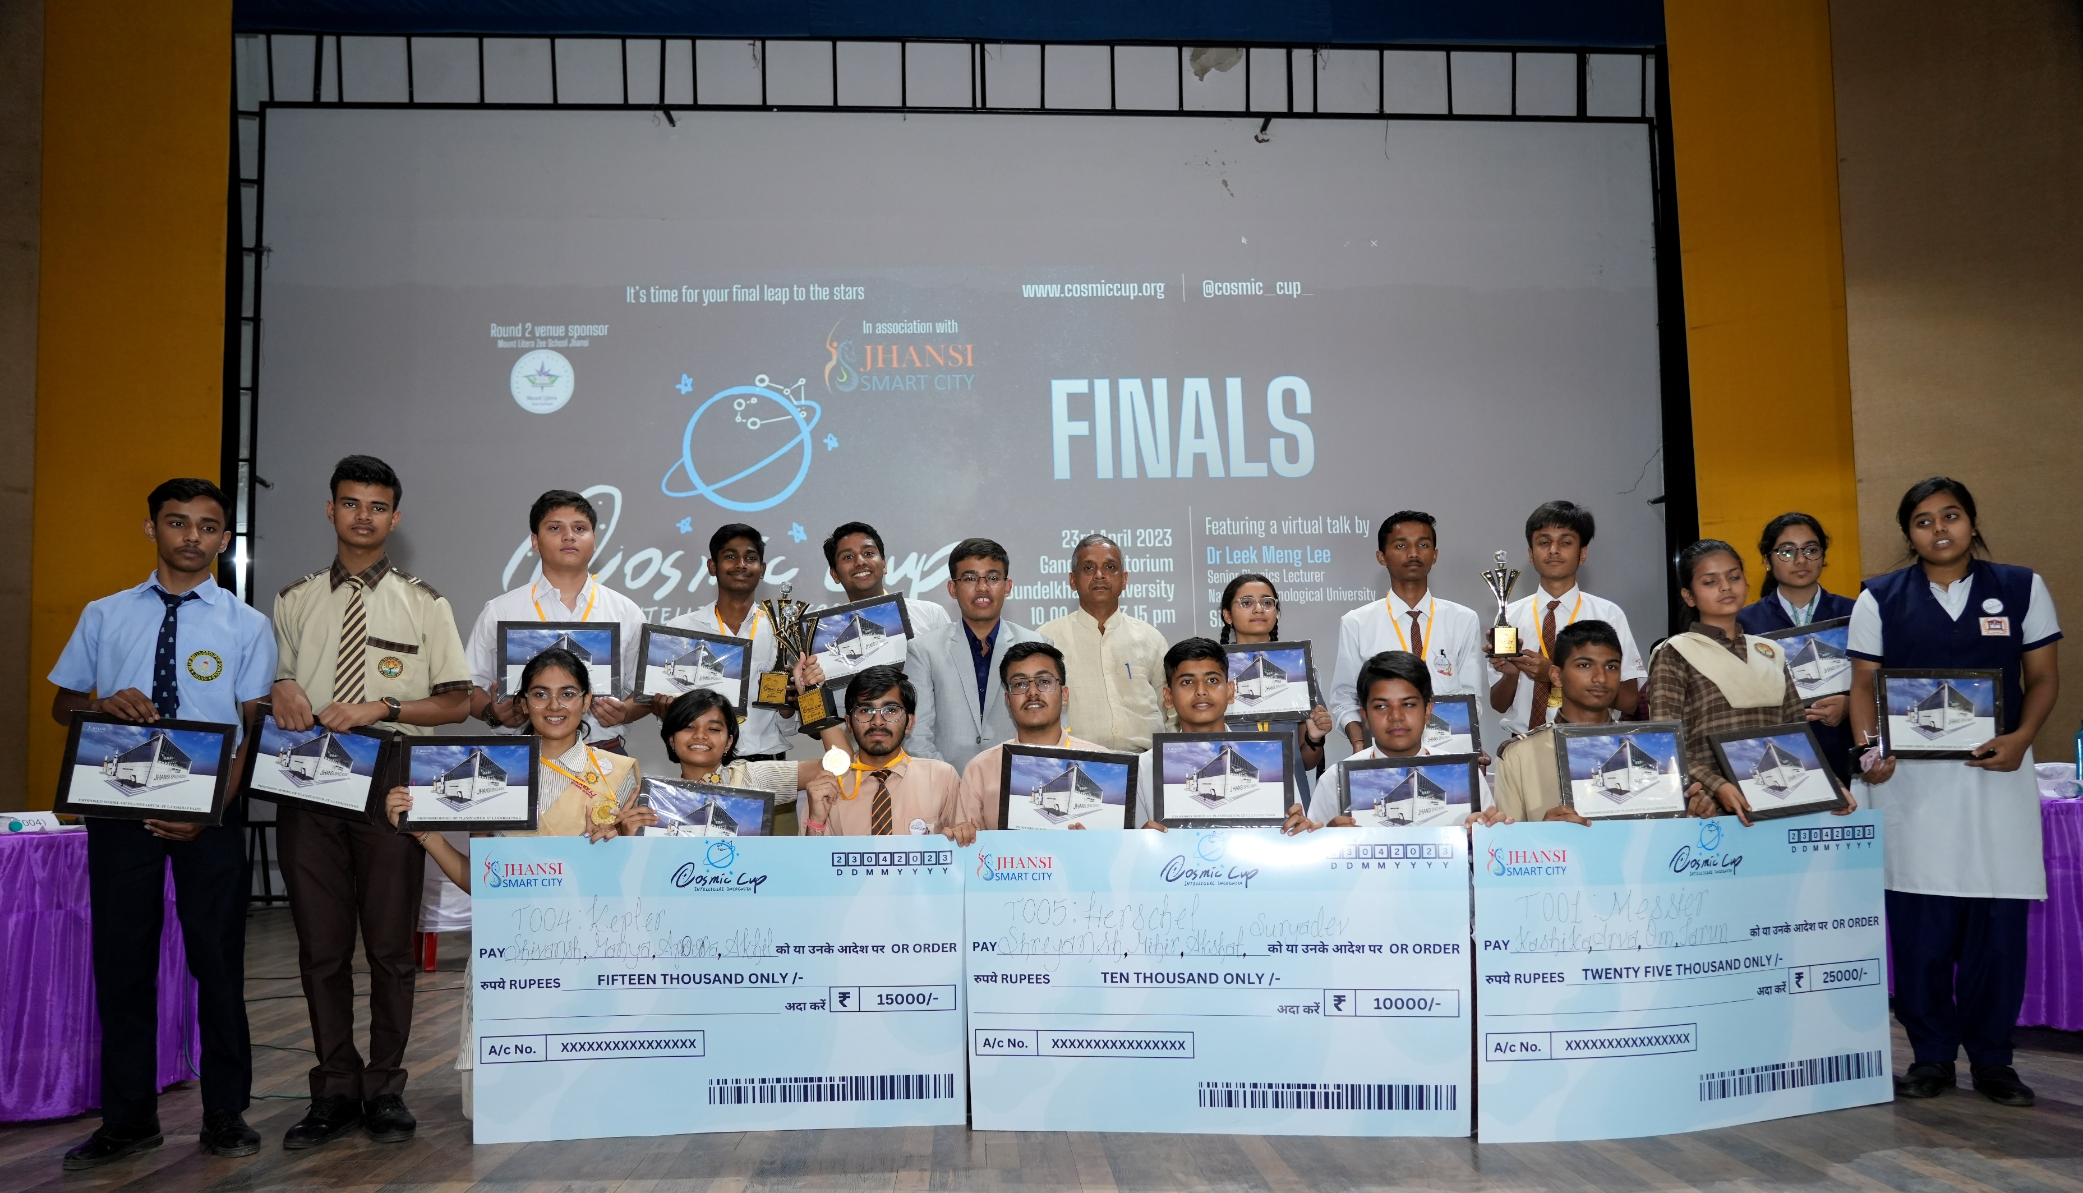
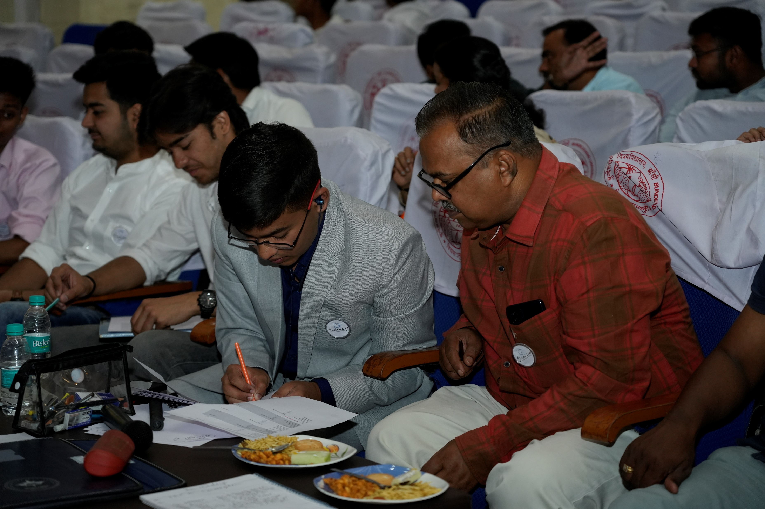
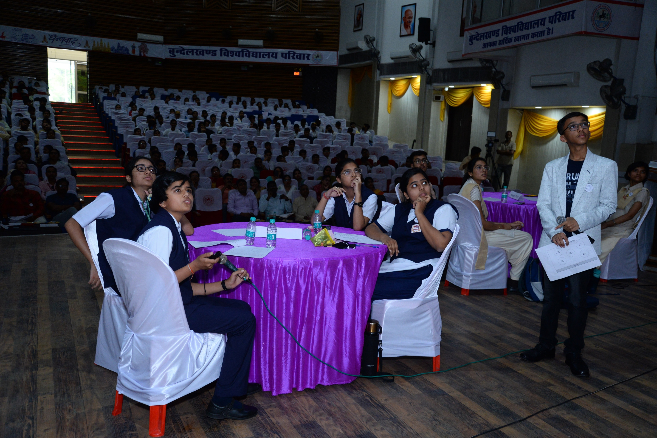
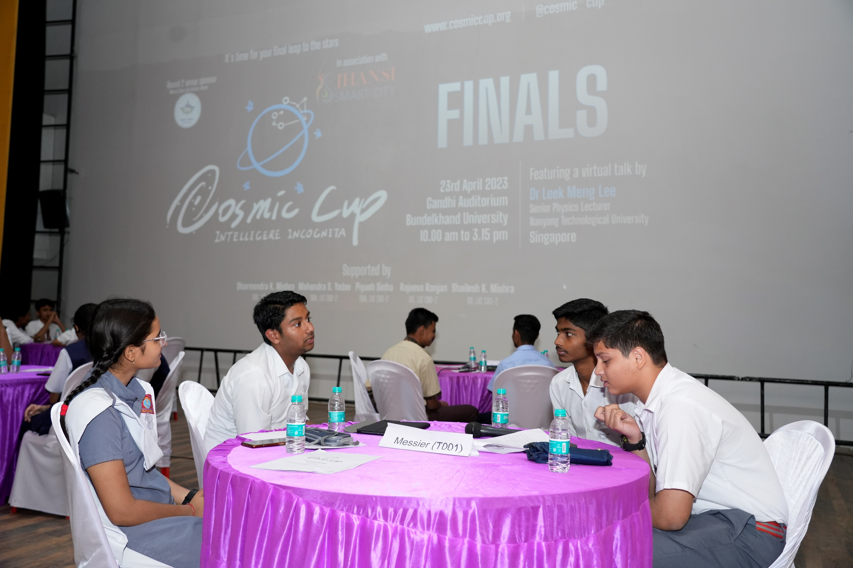

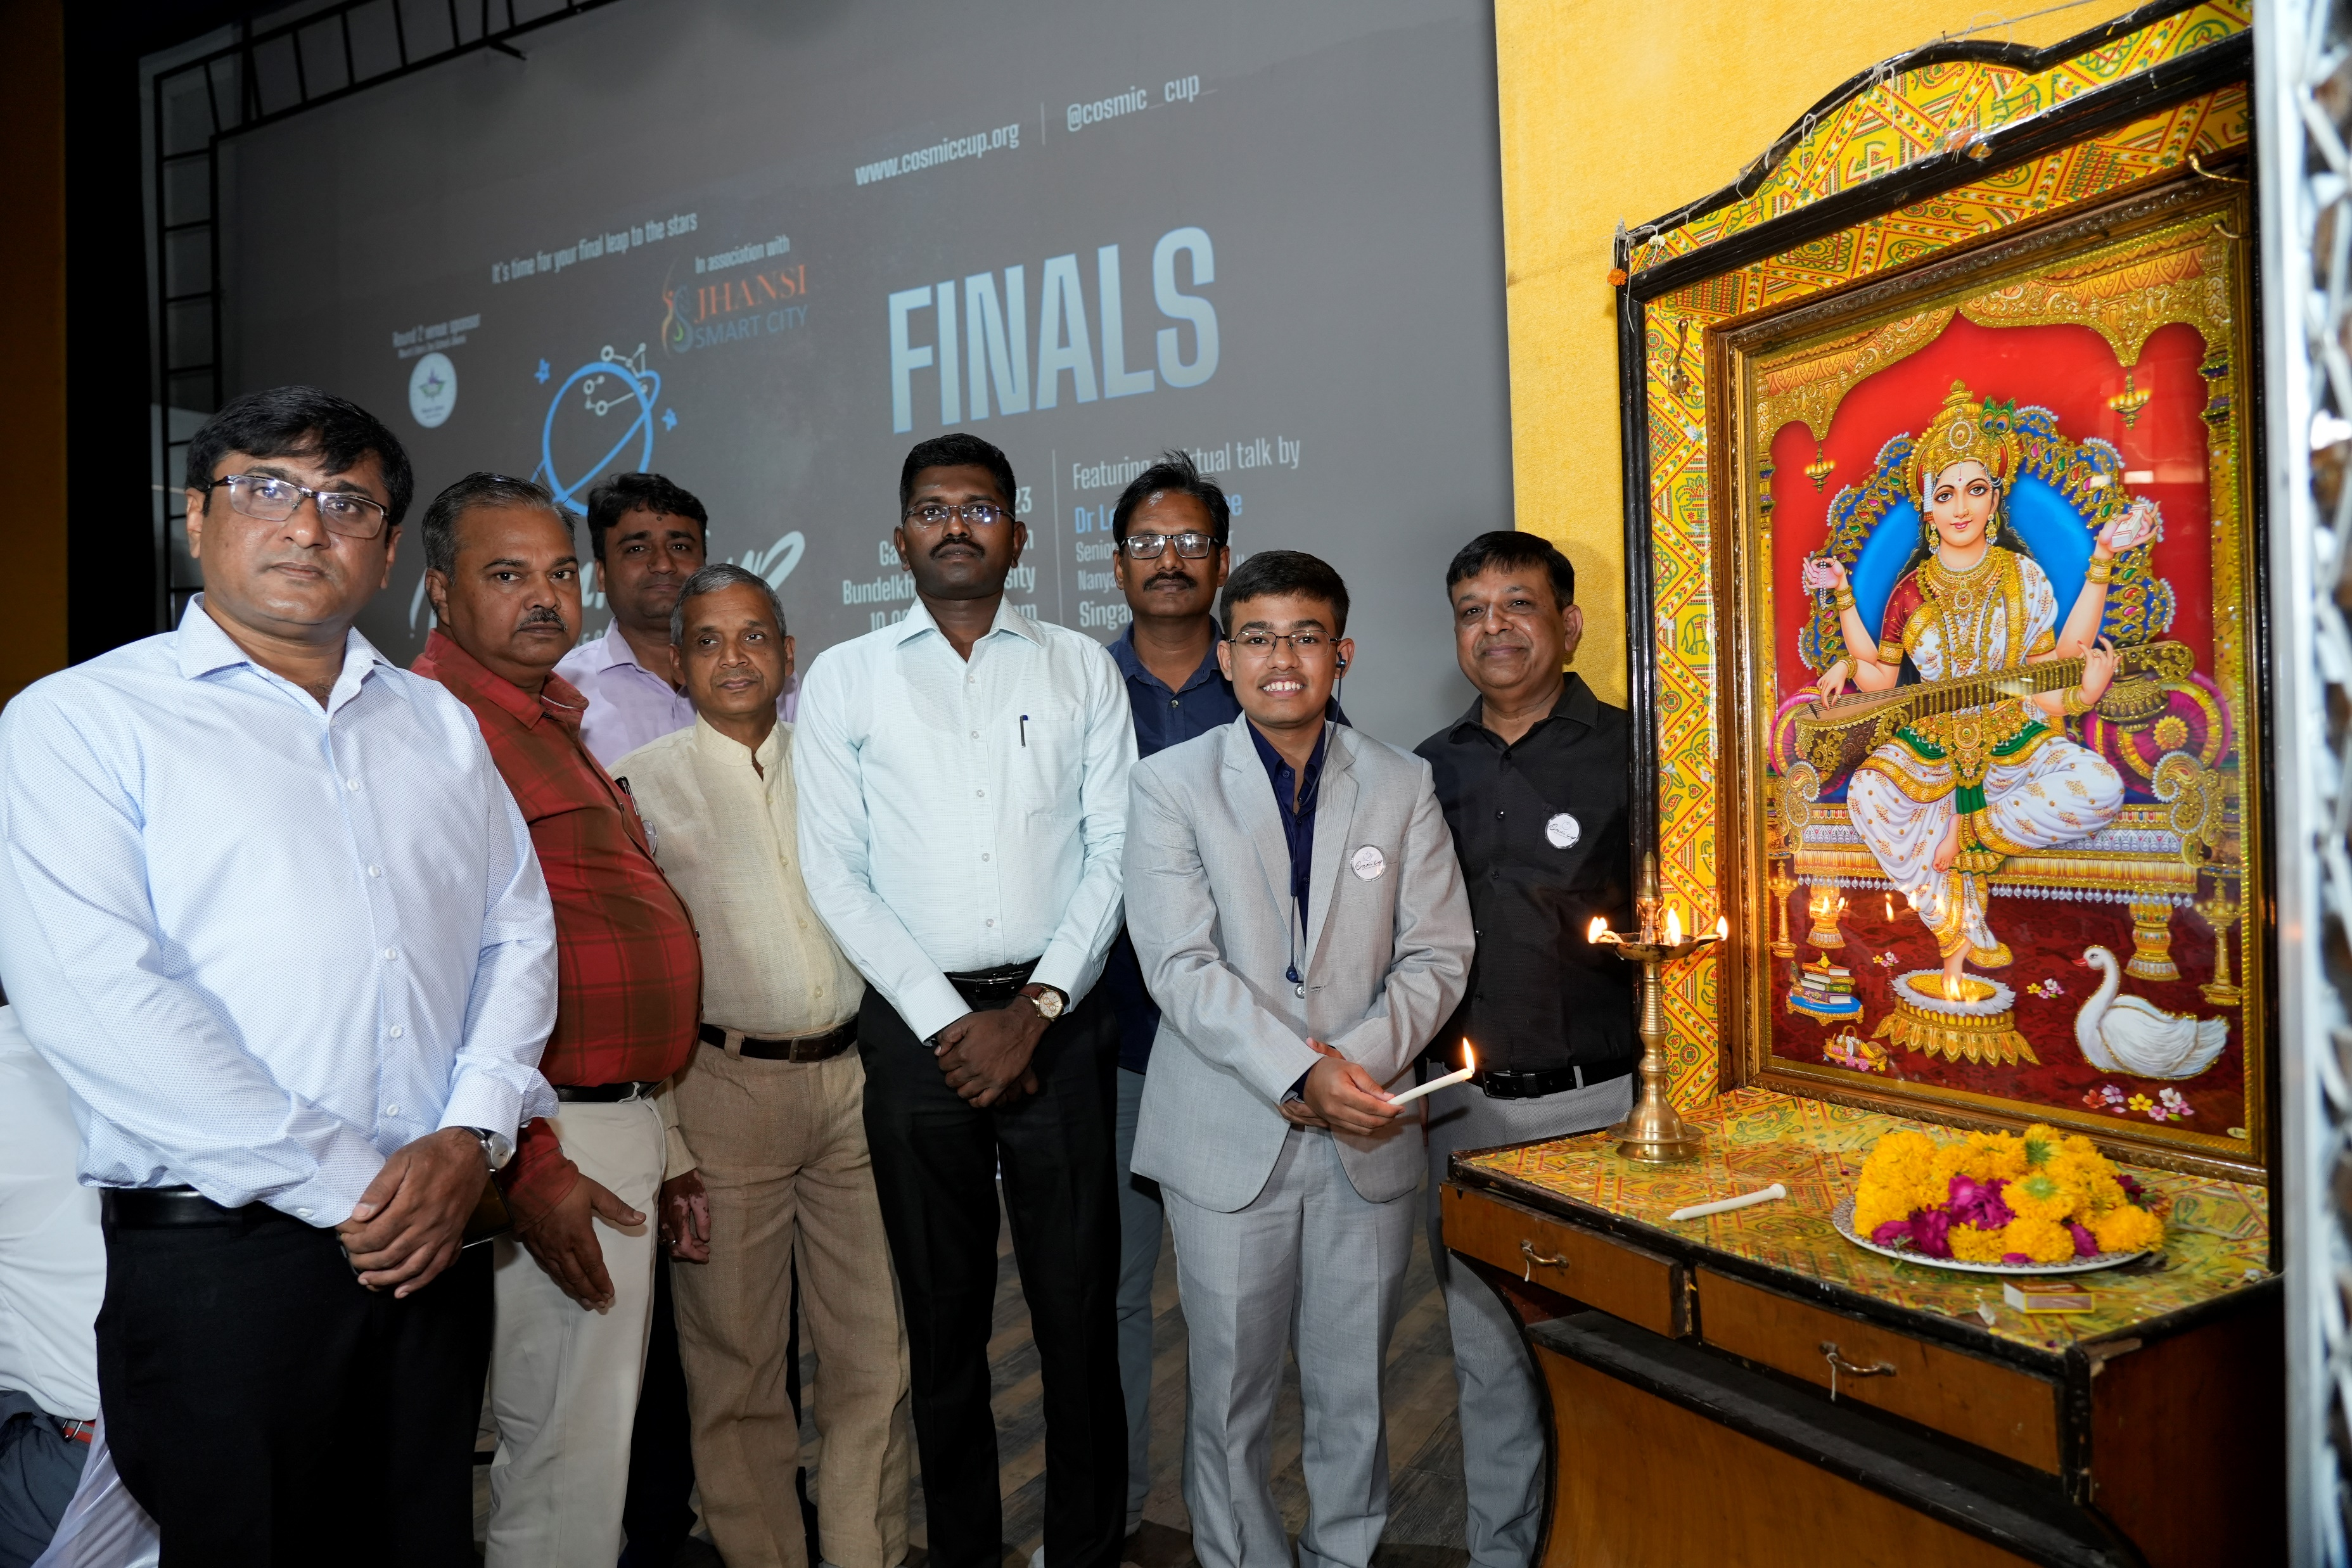
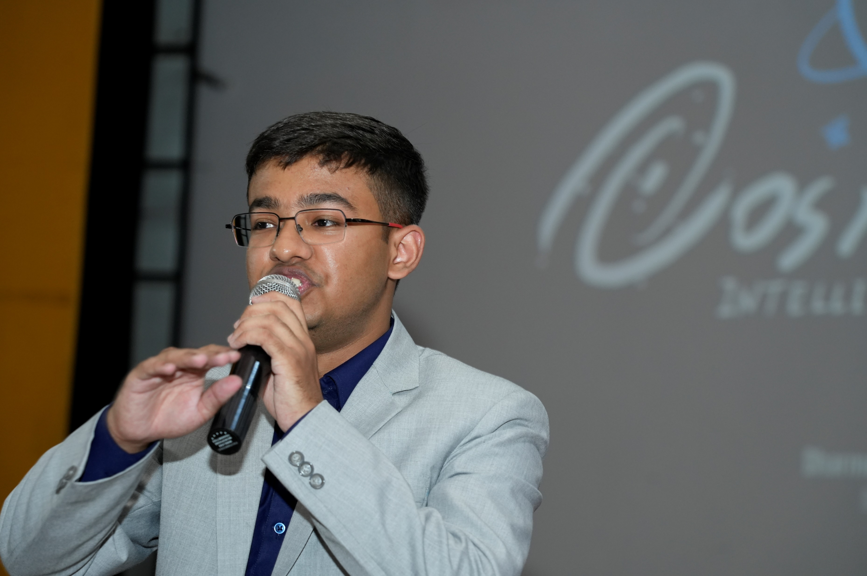
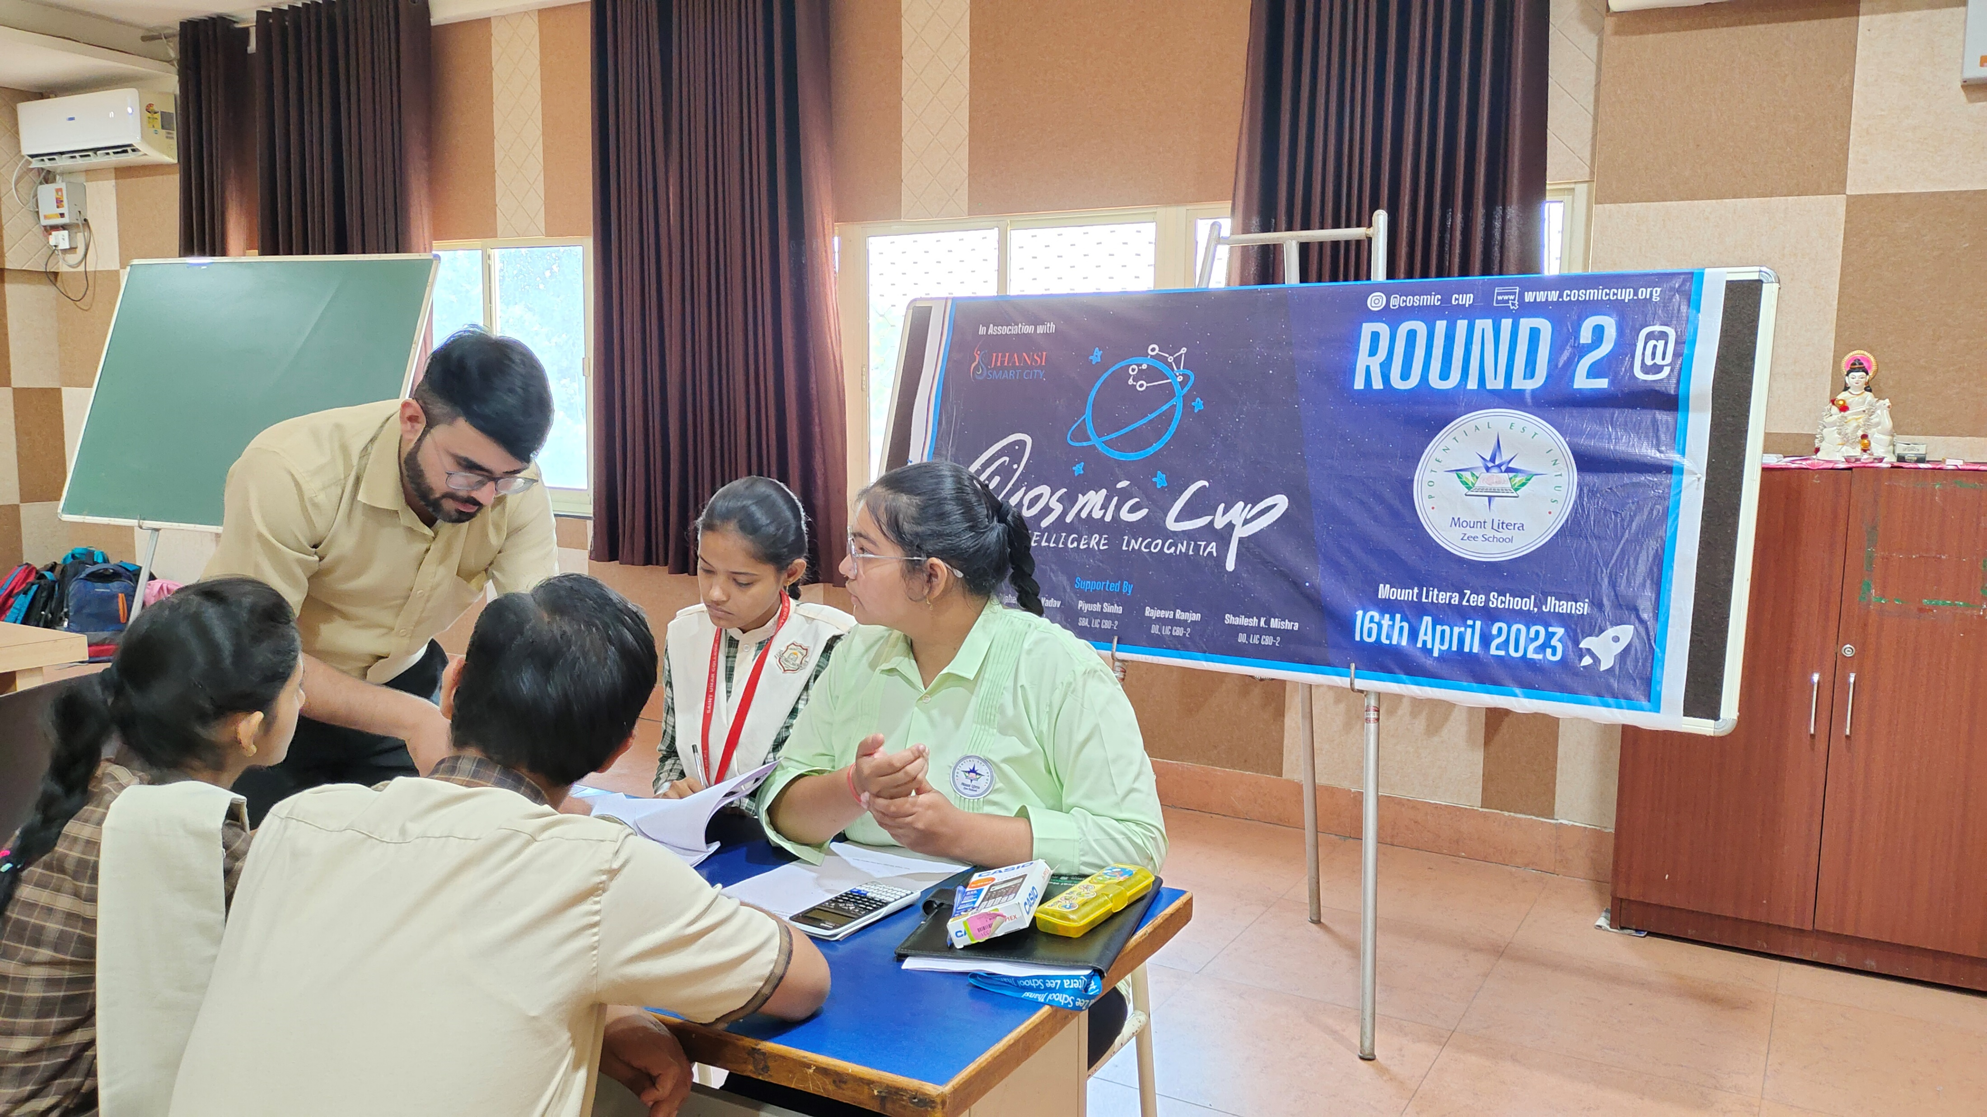
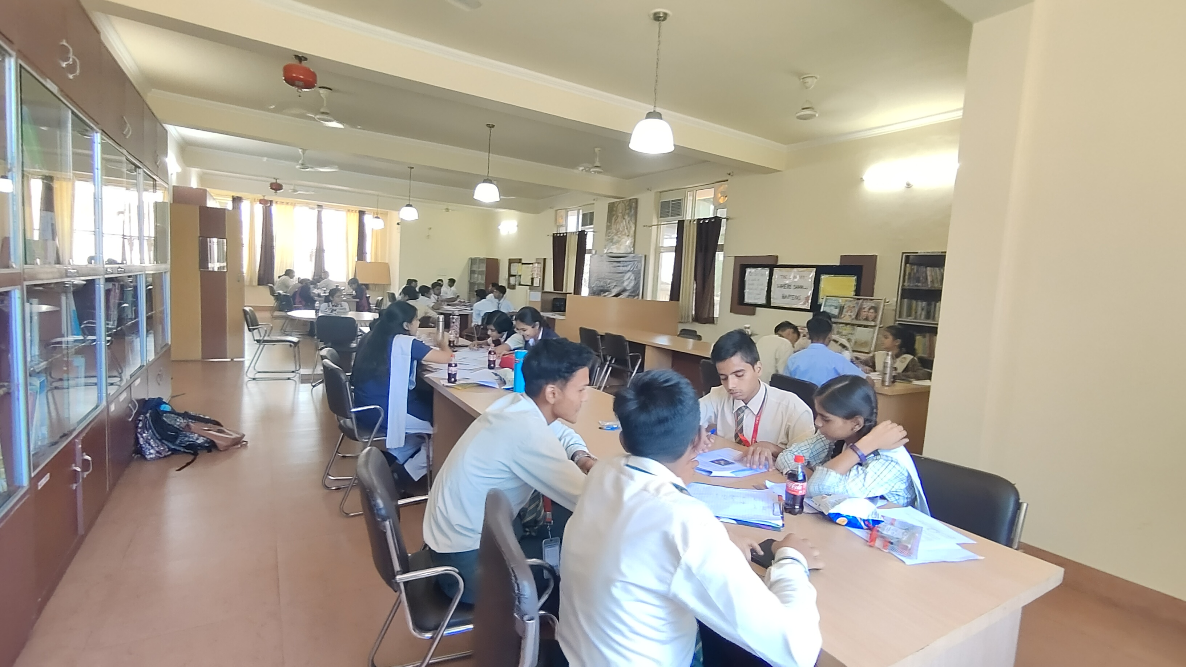

Slide 5
One-word Discussion
What is astronomy to you?

Slide 6
Hot Take
Astronomy:
The most interdisciplinary field

Slide 7
Astronomy’s need today,
Computer Scientists

Slide 8
Today's Menu
Are you okay, Night Sky?
Cosmos always looks brighter on the other side
Do we trust Asaram Bapu? (Optional: only if time allows)

Slide 9
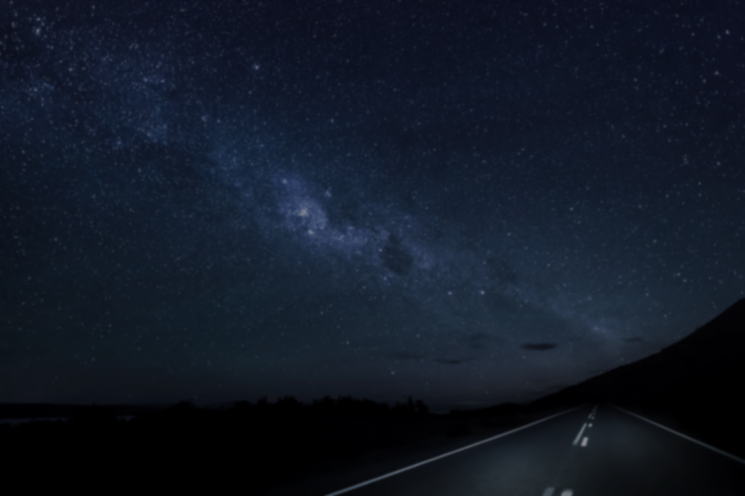
Section 1
Are you okay, Night Sky?

Slide 10

Data Visualization
Download the folder, and run the code to obtain a scatter plot
www.tinyurl.com/cdbglstars

Slide 11
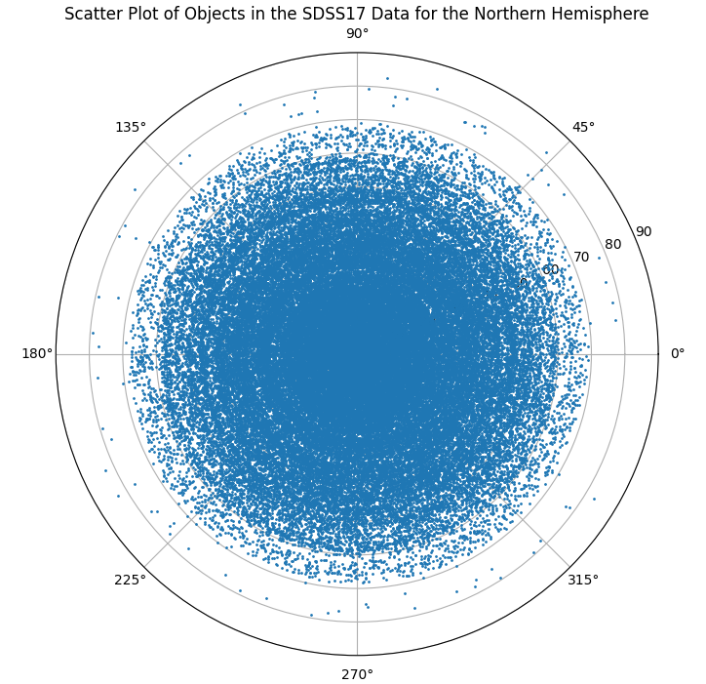
The Output
Center of the Circle ≈ North Pole
Circumference ≈ Equator

Slide 12
Olber's Paradox
If there are SO MANY STARS, why is the night sky dark?

Slide 13
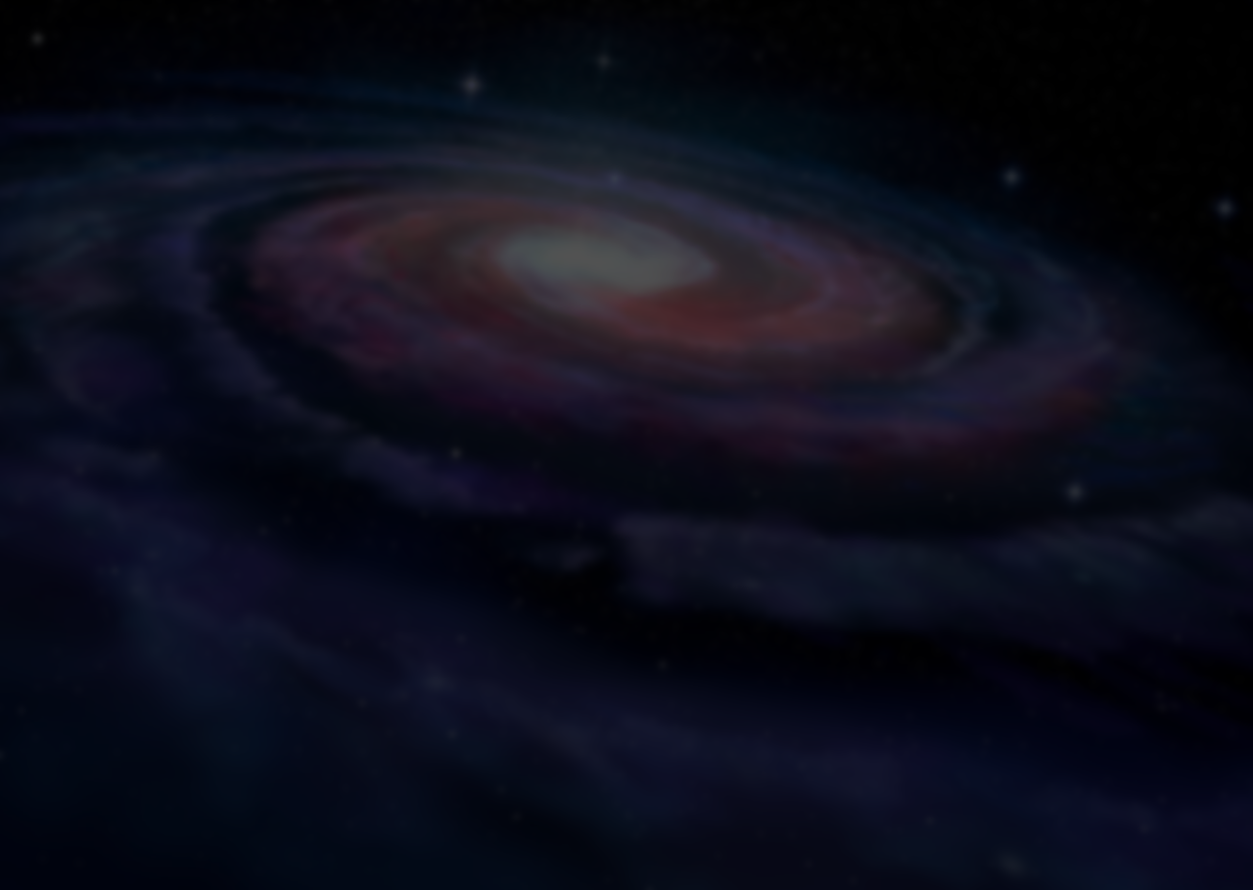
Section 2
Cosmos always looks brighter on the other side

Slide 14
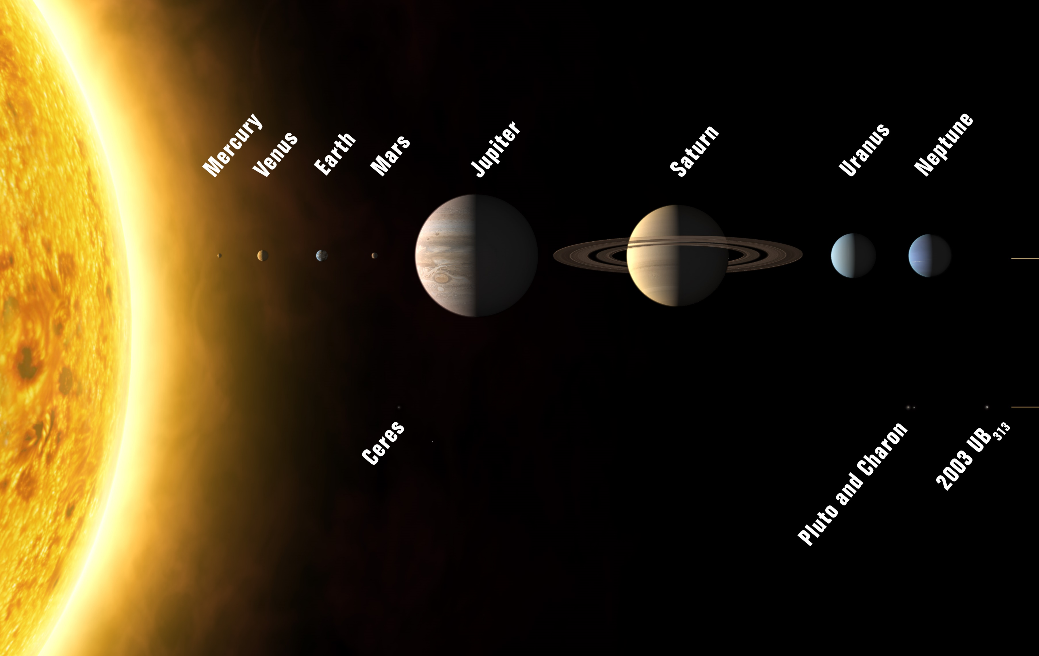
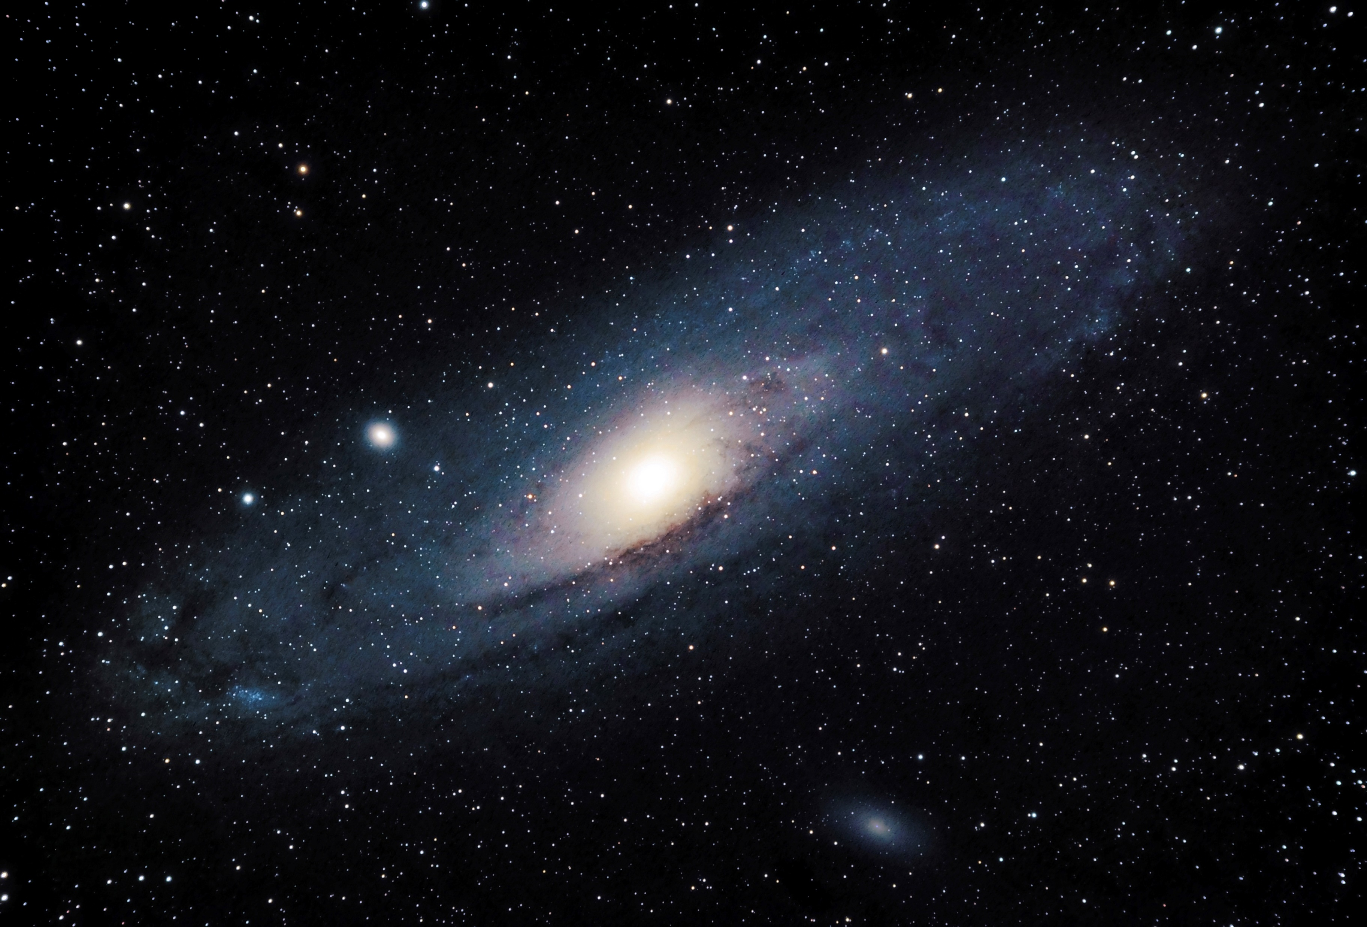
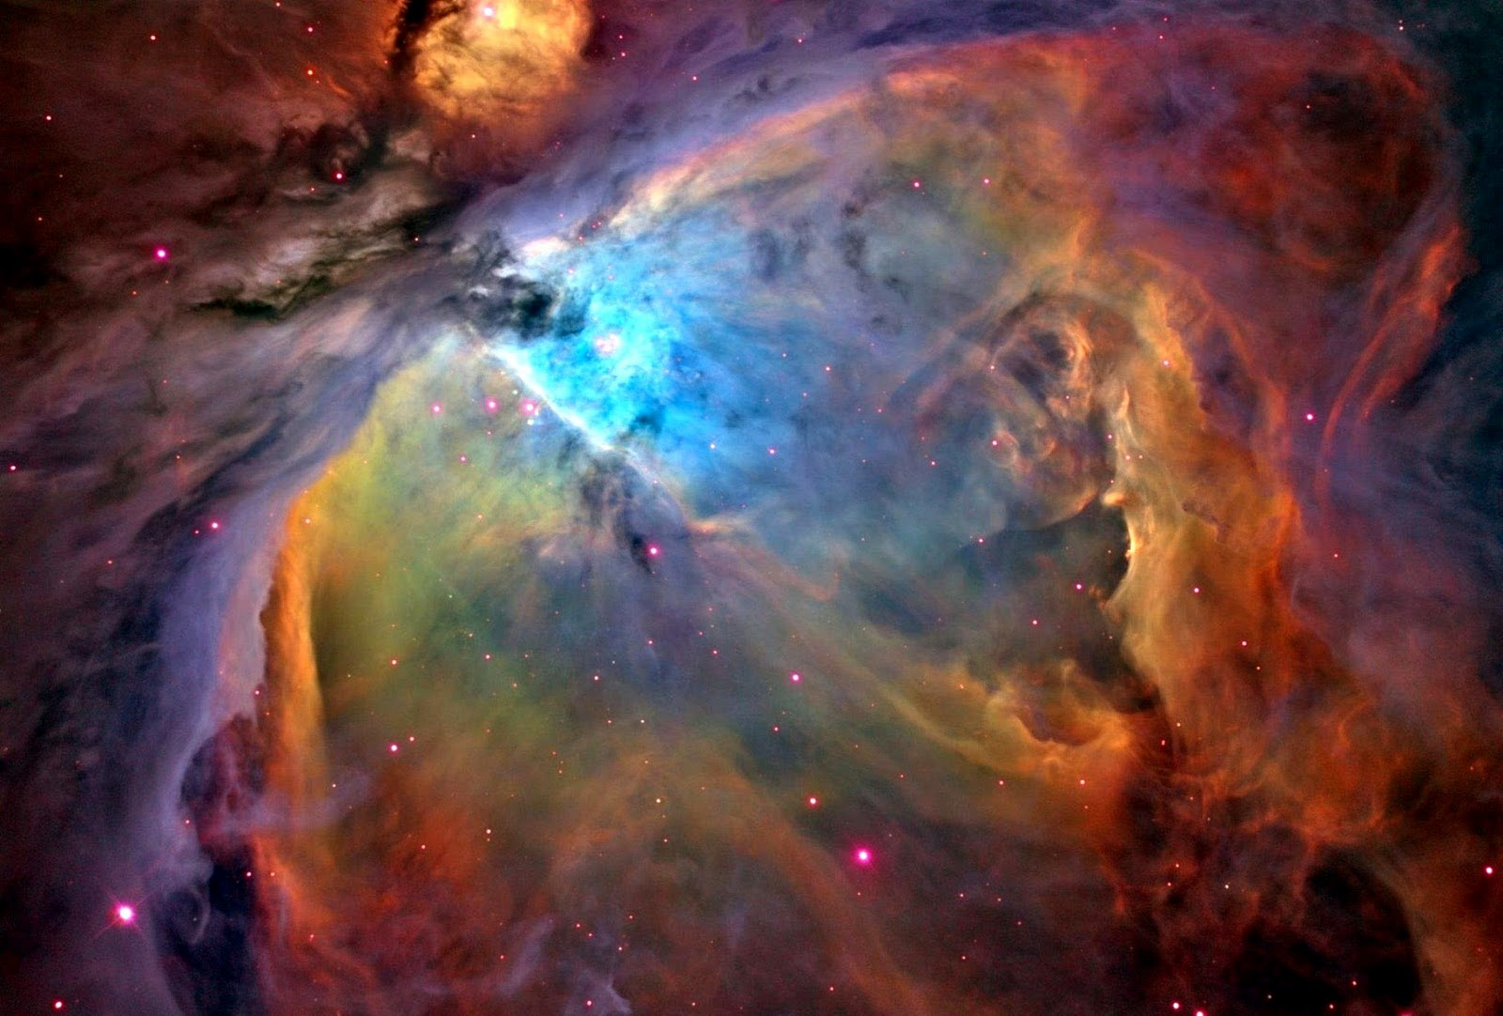
We generally talk about
Solar system
Galaxies
Nebulae
Not today!

Slide 15
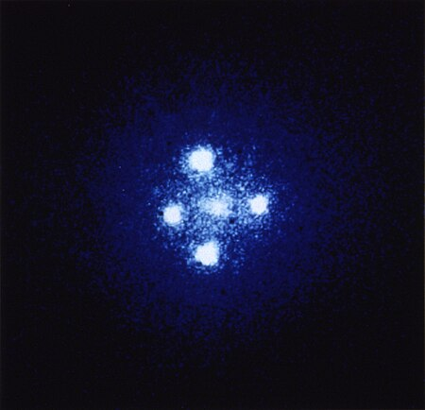
Einstein's Cross
Quasars
Q2237+030

Slide 16
Einstein's Cross
Same Spectrographic Signature?
Q2237+030

Slide 17
Gravitational Lensing
Newtonian Gravitation
General Relativity
Star
Telescope
Galaxy (acting as lens)
Galaxy Visible
Galaxy + 2 images of the Star Visible

Slide 18
Physical Demonstration Time!!

Slide 19
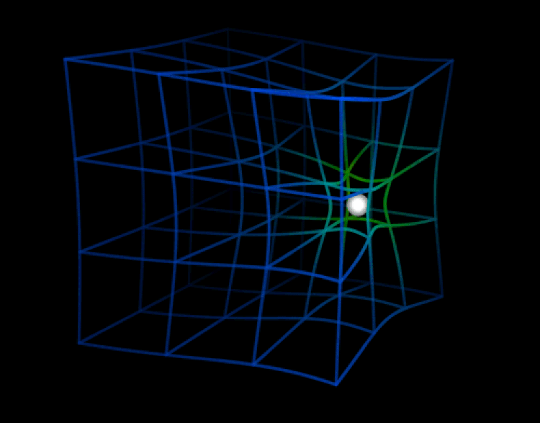
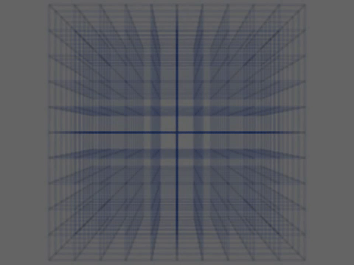
Other Visualizations
In both cases, the space time fabric is being “pulled” towards the object

Slide 20
Therefore,
General Relativity is a mathematical framework, a set of rules that describe spacetime and its interaction with other entities.
Einstein DID NOT give us a way to visualize it.

Slide 21
ACTING TIME!
Do the following:
  Group yourself
  You can use the internet/ChatGPT/any thing that you want
  Prepare a short skit explaining “What the hell is a Black hole?” (not more than 1 minute)
  The most comedic + scientifically accurate skit wins
You have 6 minutes to prepare
Click here to start the 6 minutes timer

Slide 22
I am not going to make slides for this section cause lecture style BORING
So what actually is a black hole?

Slide 23

Section 3
Do we trust Asaram Bapu?

Slide 24
Astrology?

Slide 25
Astrology?
VEDIC Astrology

Slide 26
Pseudo(science)
PREDICTIONS

Slide 27
Pseudo(science)
DATA
Religion
PREDICTIONS
Stories
The (usually) accurate position of celestial bodies
About the future, could be literally anything: from how well you perform in you know what to when will the world end

Slide 28
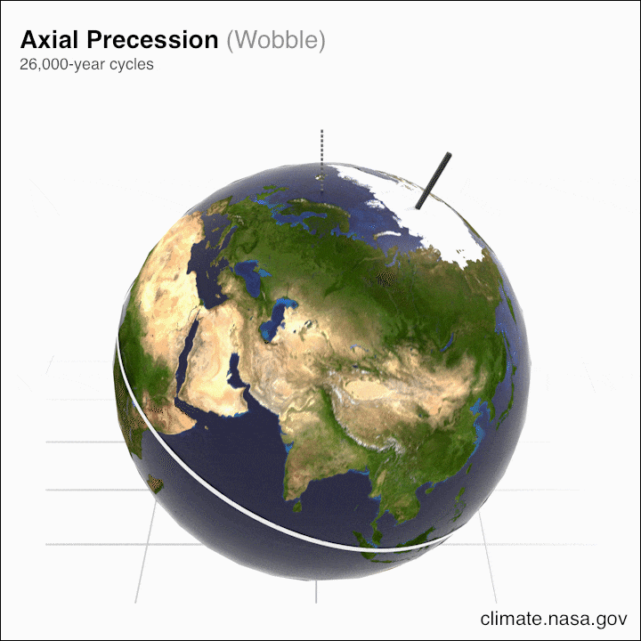
Pseudo(science)
PRECESSION
The (usually) accurate position of celestial bodies

Slide 29
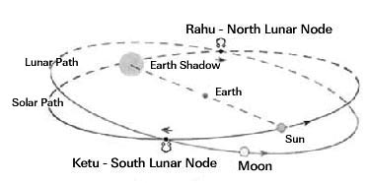
Pseudo(science)
Rahu & Ketu
(Lunar Nodes, NOT planets)
The (usually) accurate position of celestial bodies

Slide 30

Wanna make a Kundli?
GO TO www.cosmiccup.org/resources and look at Round 2’s Last Question
AND download STELLARIUM from www.stellarium.org to explore the night sky!

Slide 31
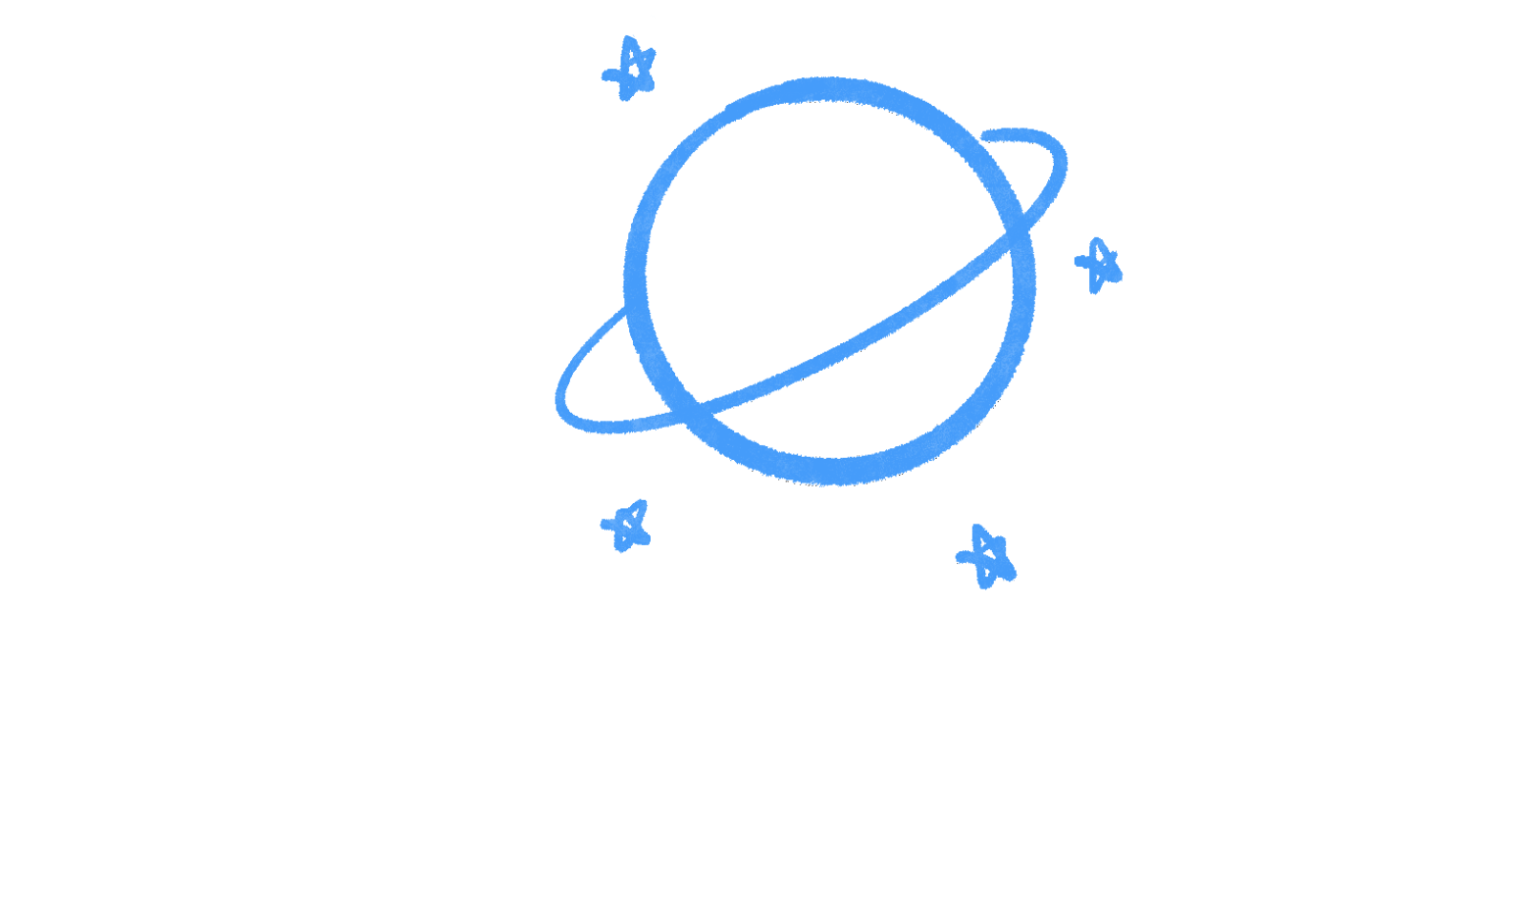



Thank you
CodeDay ® Bengaluru
for partnering up!
www.cosmiccup.org
@cosmic_cup_
My Socials (so we can stay connected)
@kushnotblocked
www.linkedin.com/in/kushagra7shrivastava

