Slide 1
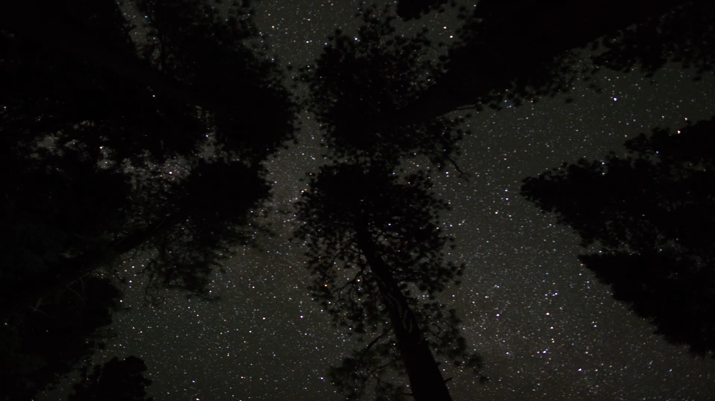
Summer Vibes
The Summer Night Sky
Kush, 30 August 2024

Slide 2
Part I
Why are there seasonal skies?
Cause the Earth go round-n-round-n-round-n-round…

Slide 3


Why are there seasonal skies?
Slides taken from Winter Highlights talk.
This is not to scale at all. Heavy Exaggeration of dimensions for illustrative purpose.

Slide 4

Why are there seasonal skies?
Slides taken from Winter Highlights talk.
This is not to scale at all. Heavy Exaggeration of dimensions for illustrative purpose.

Slide 5
Why are there seasonal skies?
Slides taken from Winter Highlights talk.
This is not to scale at all. Heavy Exaggeration of dimensions for illustrative purpose.

Slide 6

Why are there seasonal skies?
Slides taken from Winter Highlights talk.
This is not to scale at all. Heavy Exaggeration of dimensions for illustrative purpose.

Slide 7
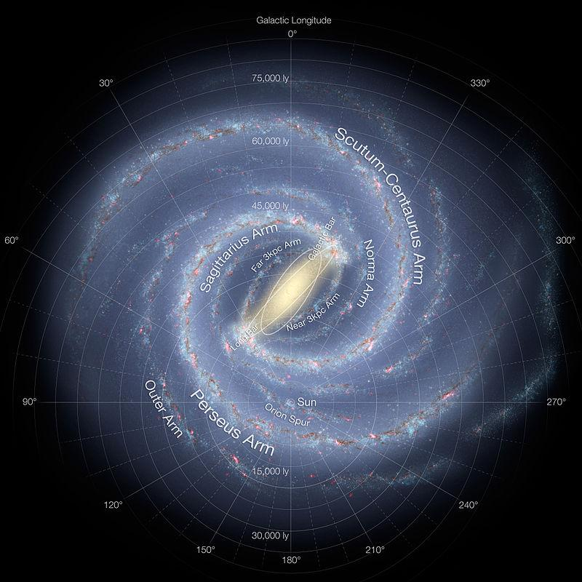
Where are we?
Summer
Fall
Spring
Slides taken from Winter Highlights talk.
Winter

Slide 8
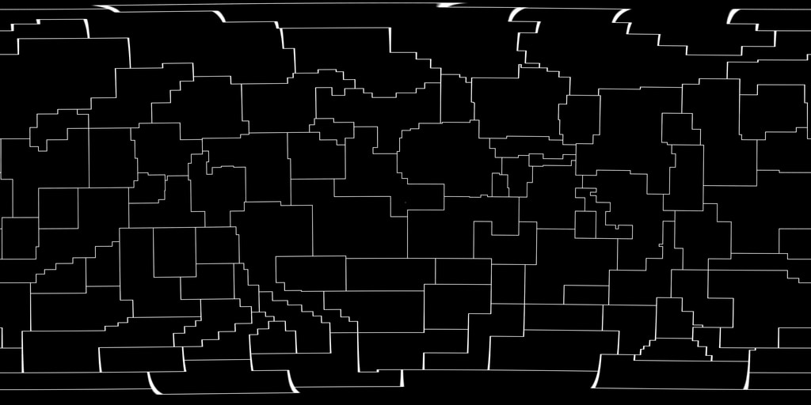
Constellations vs Asterisms
Slides taken from Winter Highlights talk.

Slide 9
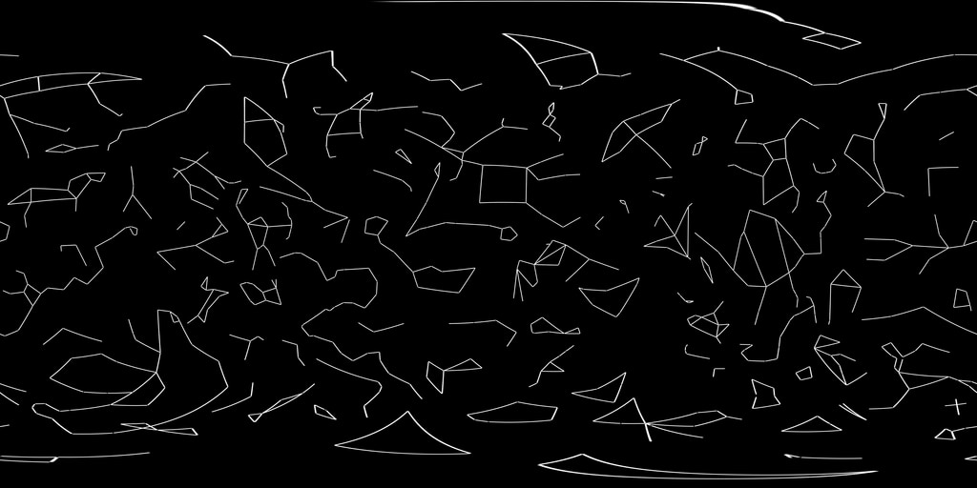
Constellations vs Asterisms
Slides taken from Winter Highlights talk.

Slide 10
Constellations vs Asterisms
88
Officially Recognised
Representation is not very representative
Unfixed Number
Not Officially Recognised
Representation is very representative
Slides taken from Winter Highlights talk.

Slide 11
Part 2
How do I define summer skies?
Kinda arbitrary ngl (Northern hemisphere supremacy)

Slide 12
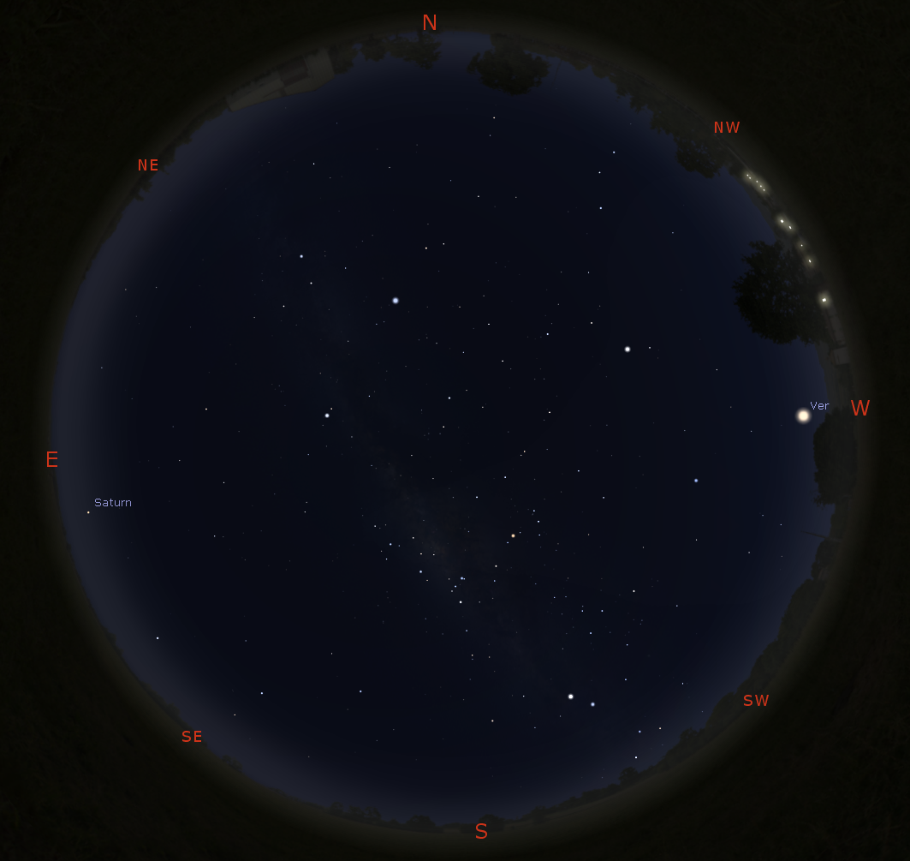
Singapore Night Sky
8PM, 30 August 2024
WAIT MILKY WAY?? IN SINGAPORE??

Slide 13
Singapore Night Sky
8PM, 30 August 2024
The Spring and Autumn Skies

Slide 14
Summer Triangle
Singapore Night Sky
8PM, 30 August 2024
Big Markers
Scorpio-Saggitarius

Slide 15
Part 3
Scorpio-Saggitarius Region
Galactic Centre

Slide 16
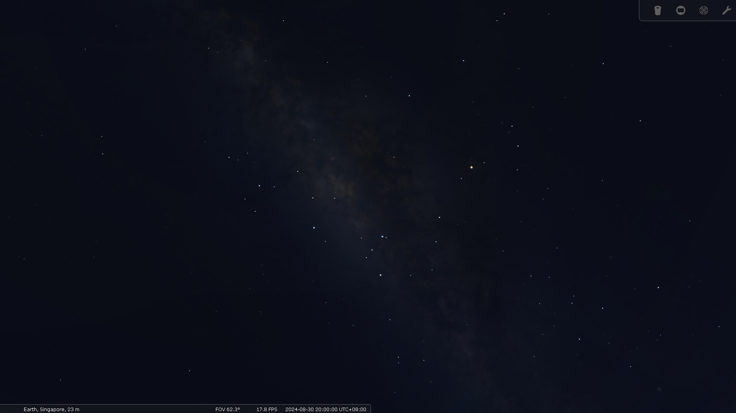

Slide 17
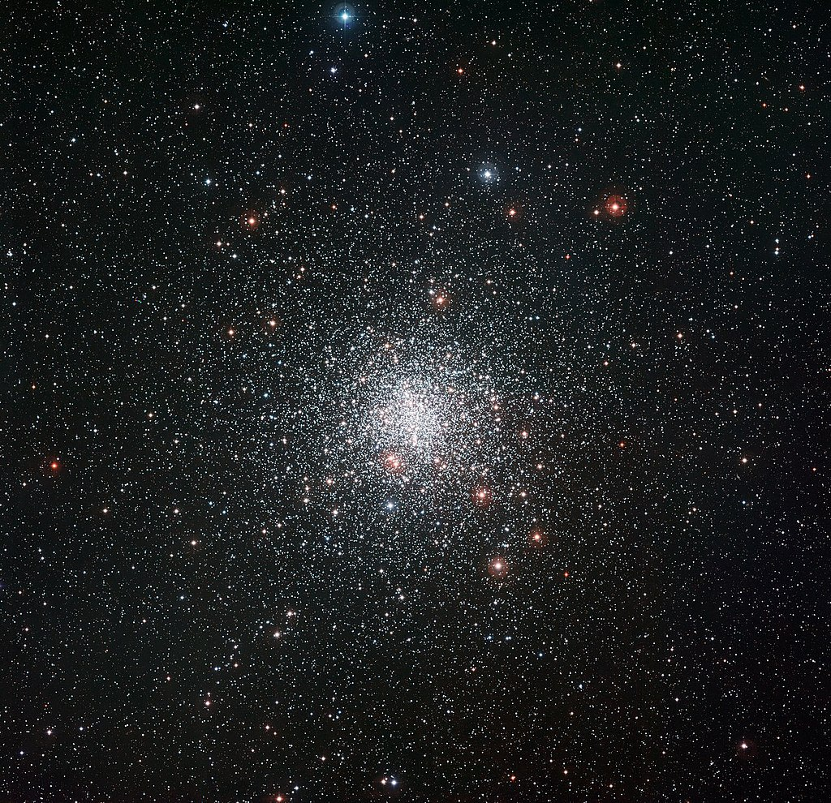
M4 Globular Cluster

Slide 18
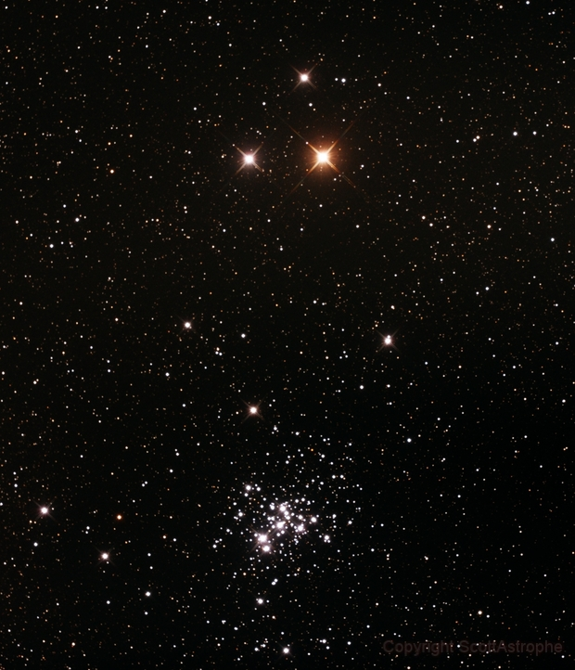
M4
C76 False Comet

Slide 19
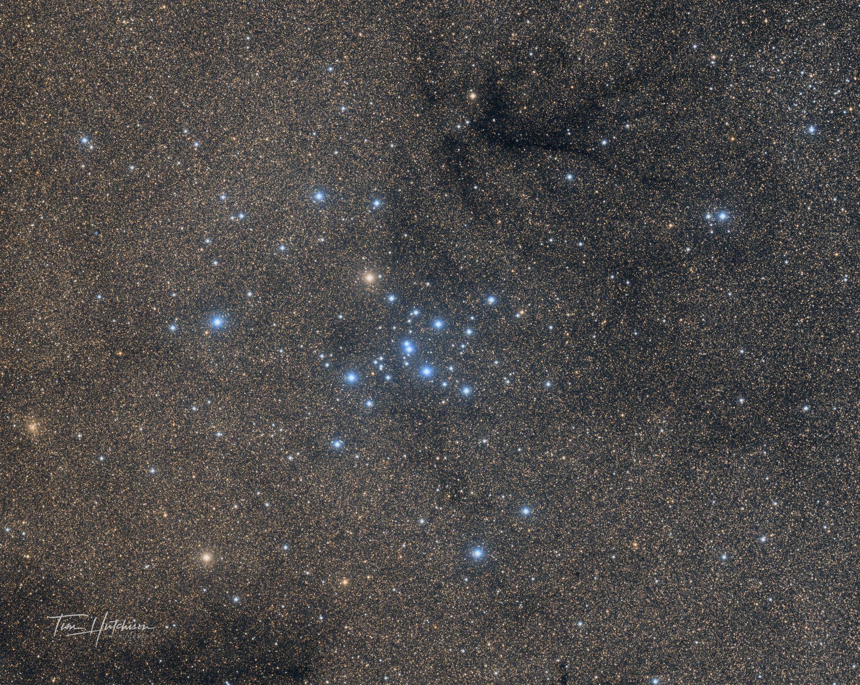
M4
C76
M7 Ptolemy Cluster

Slide 20
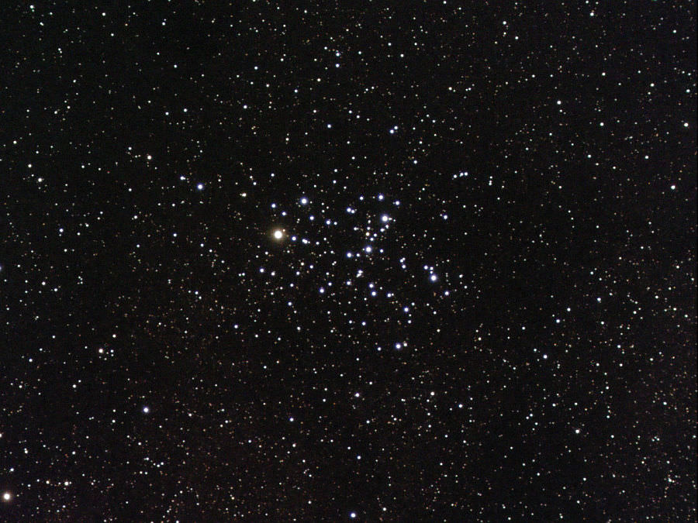
M6 Butterfly Cluster
M4
M7
C76

Slide 21
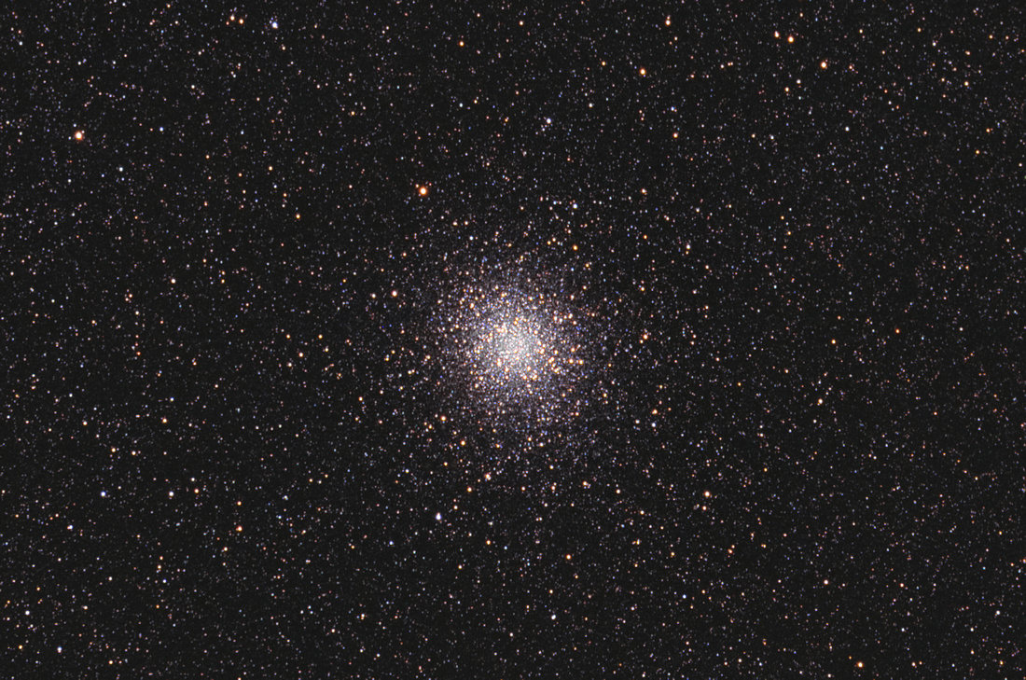
M4
M22 Globular Cluster
M6
M7
C76

Slide 22
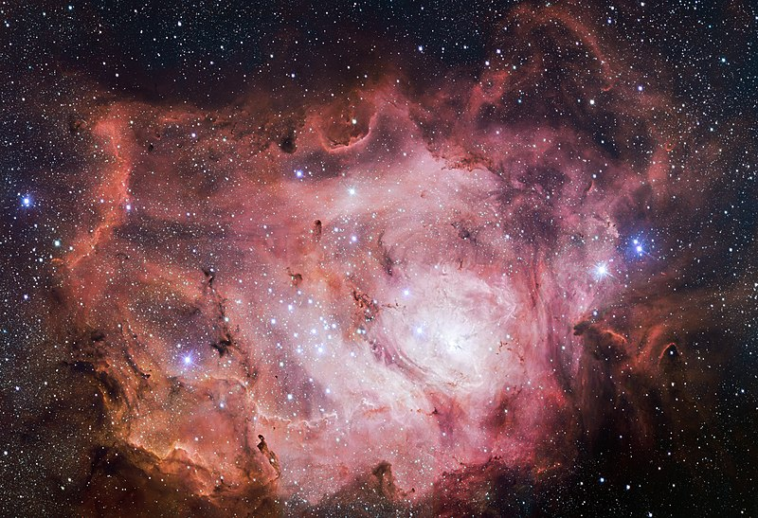
M22
M4
M6
M8 Lagoon Nebula
M7
C76

Slide 23
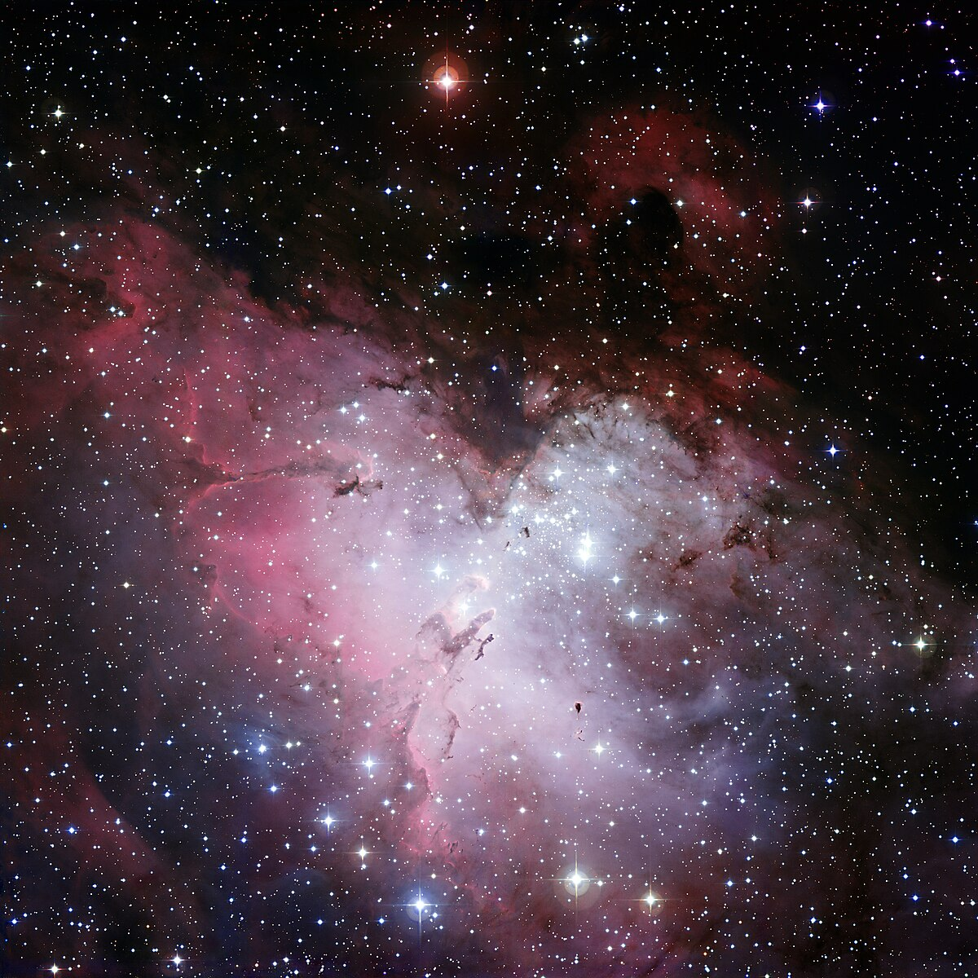
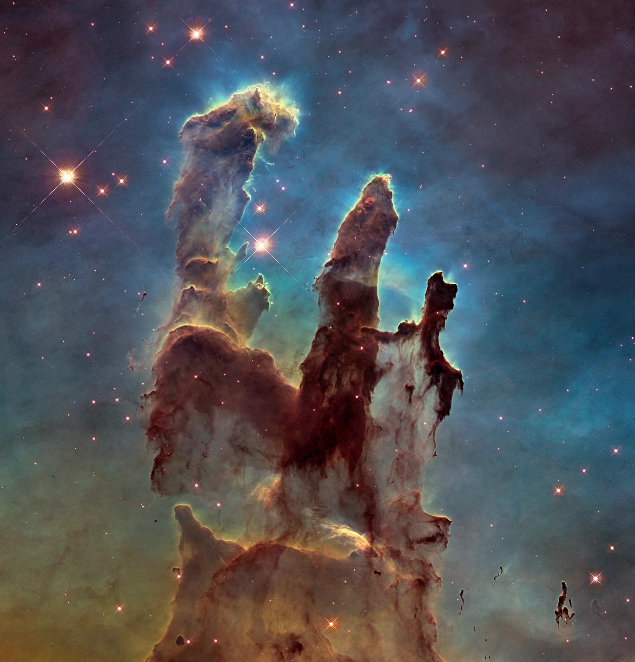
M16 Eagle Nebula
M22
M8
M4
M6
Pillars of Creation
M7
C76

Slide 24
Part 4
The Summer Triangle
Galactic Centre

Slide 25
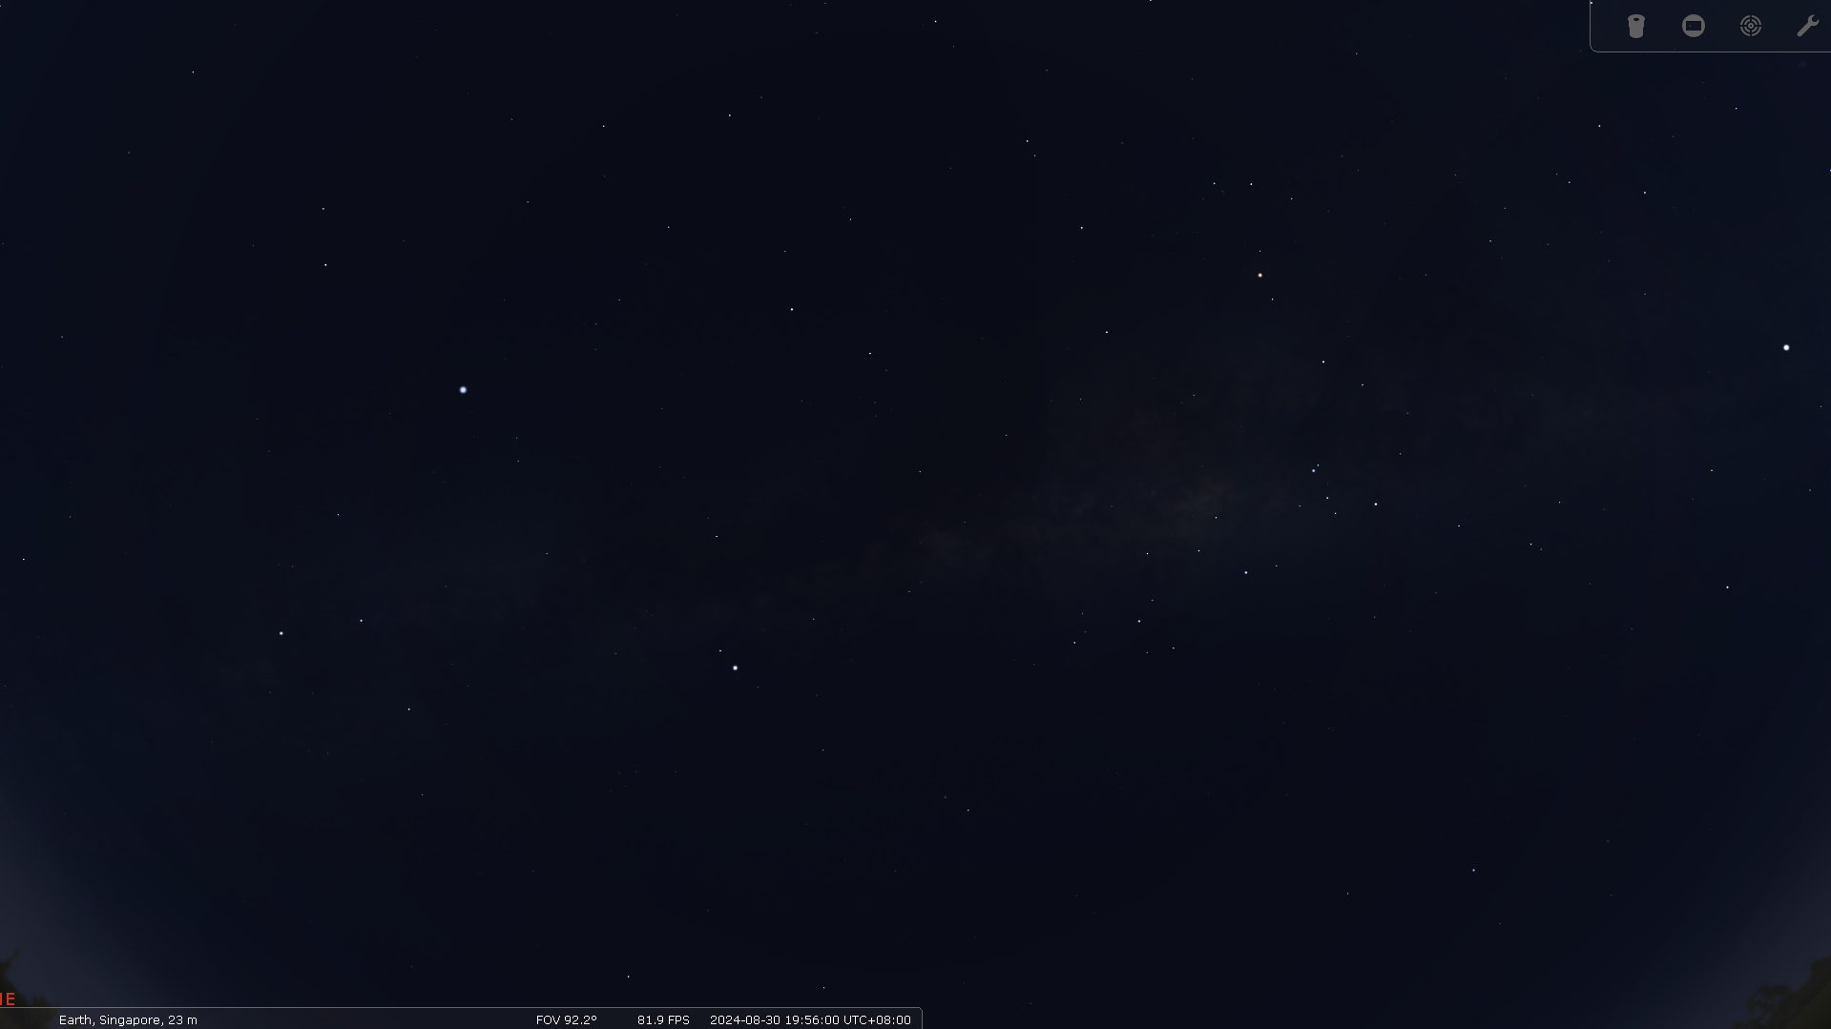

Slide 26
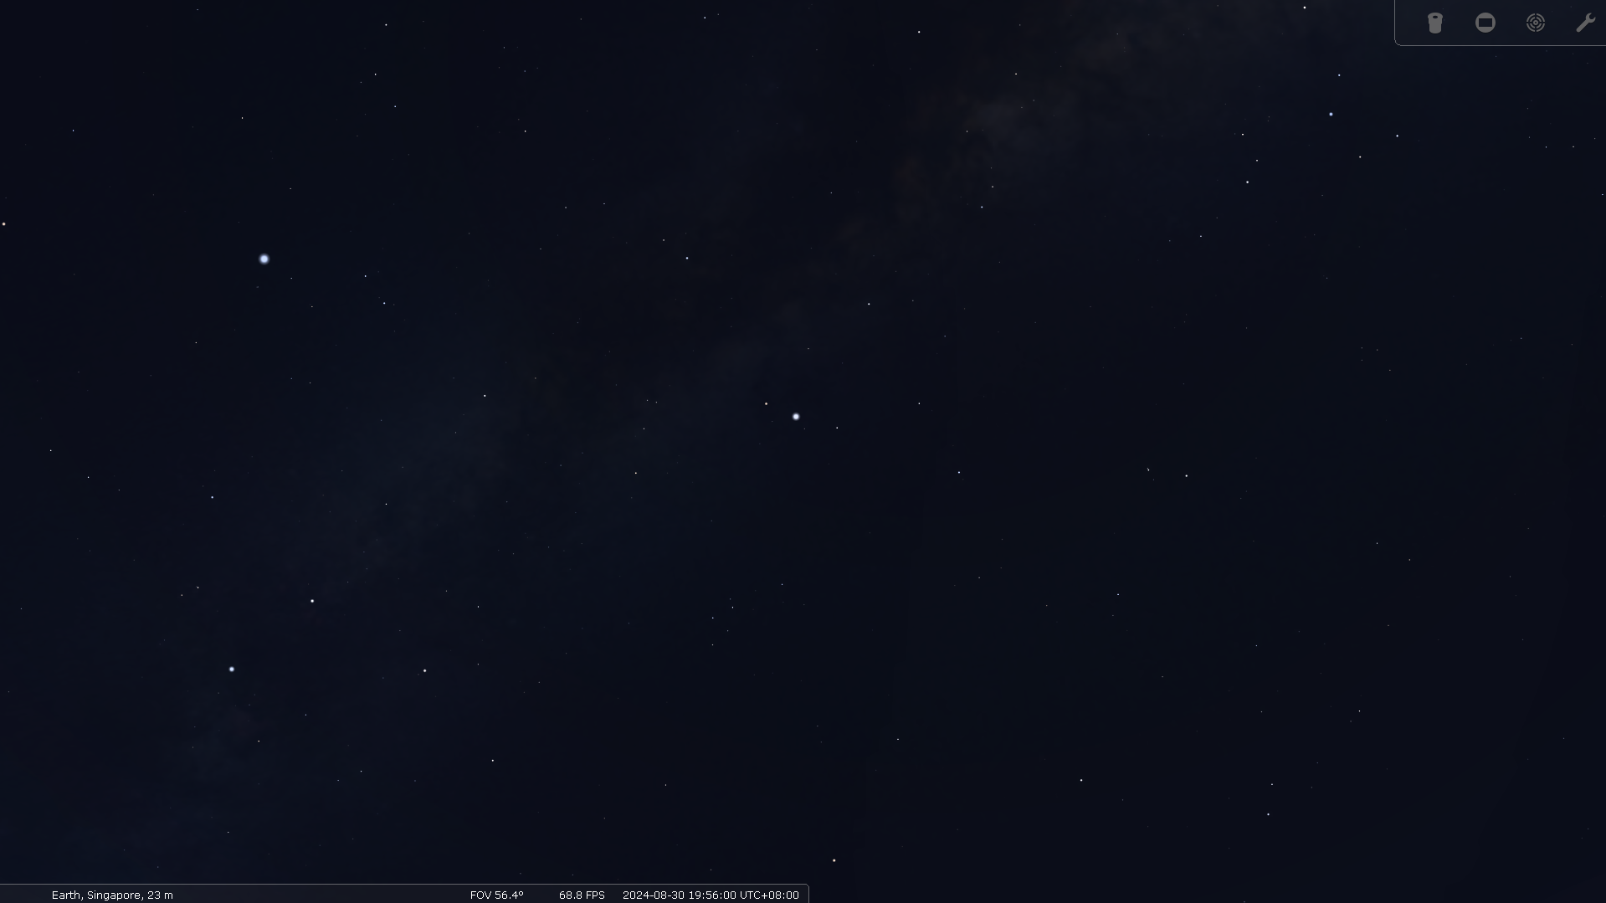

Slide 27
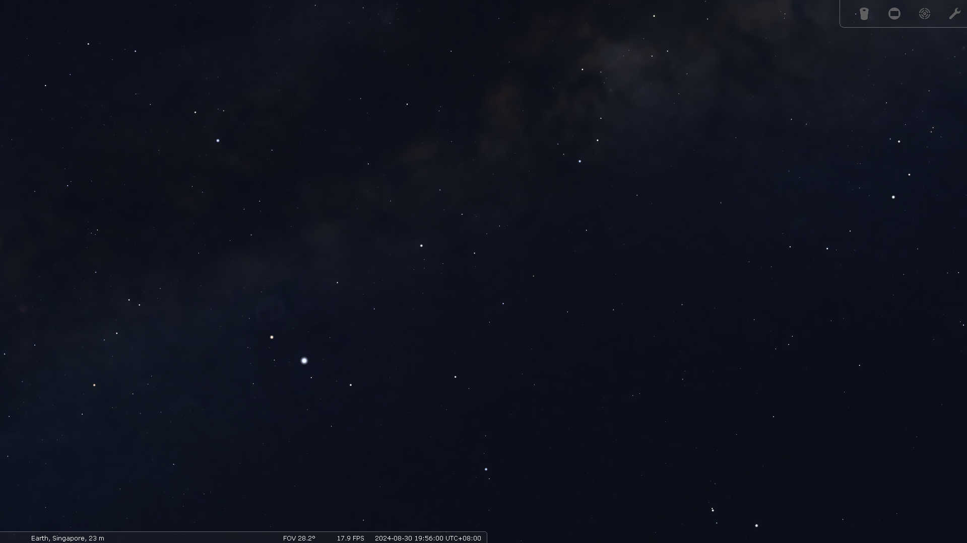
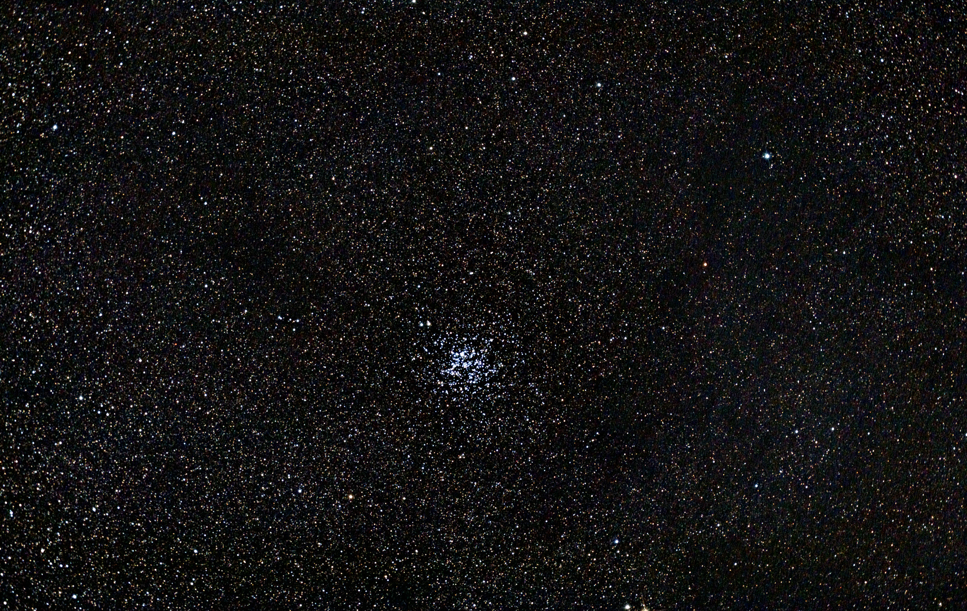
M11 Wild Duck Cluster

Slide 28
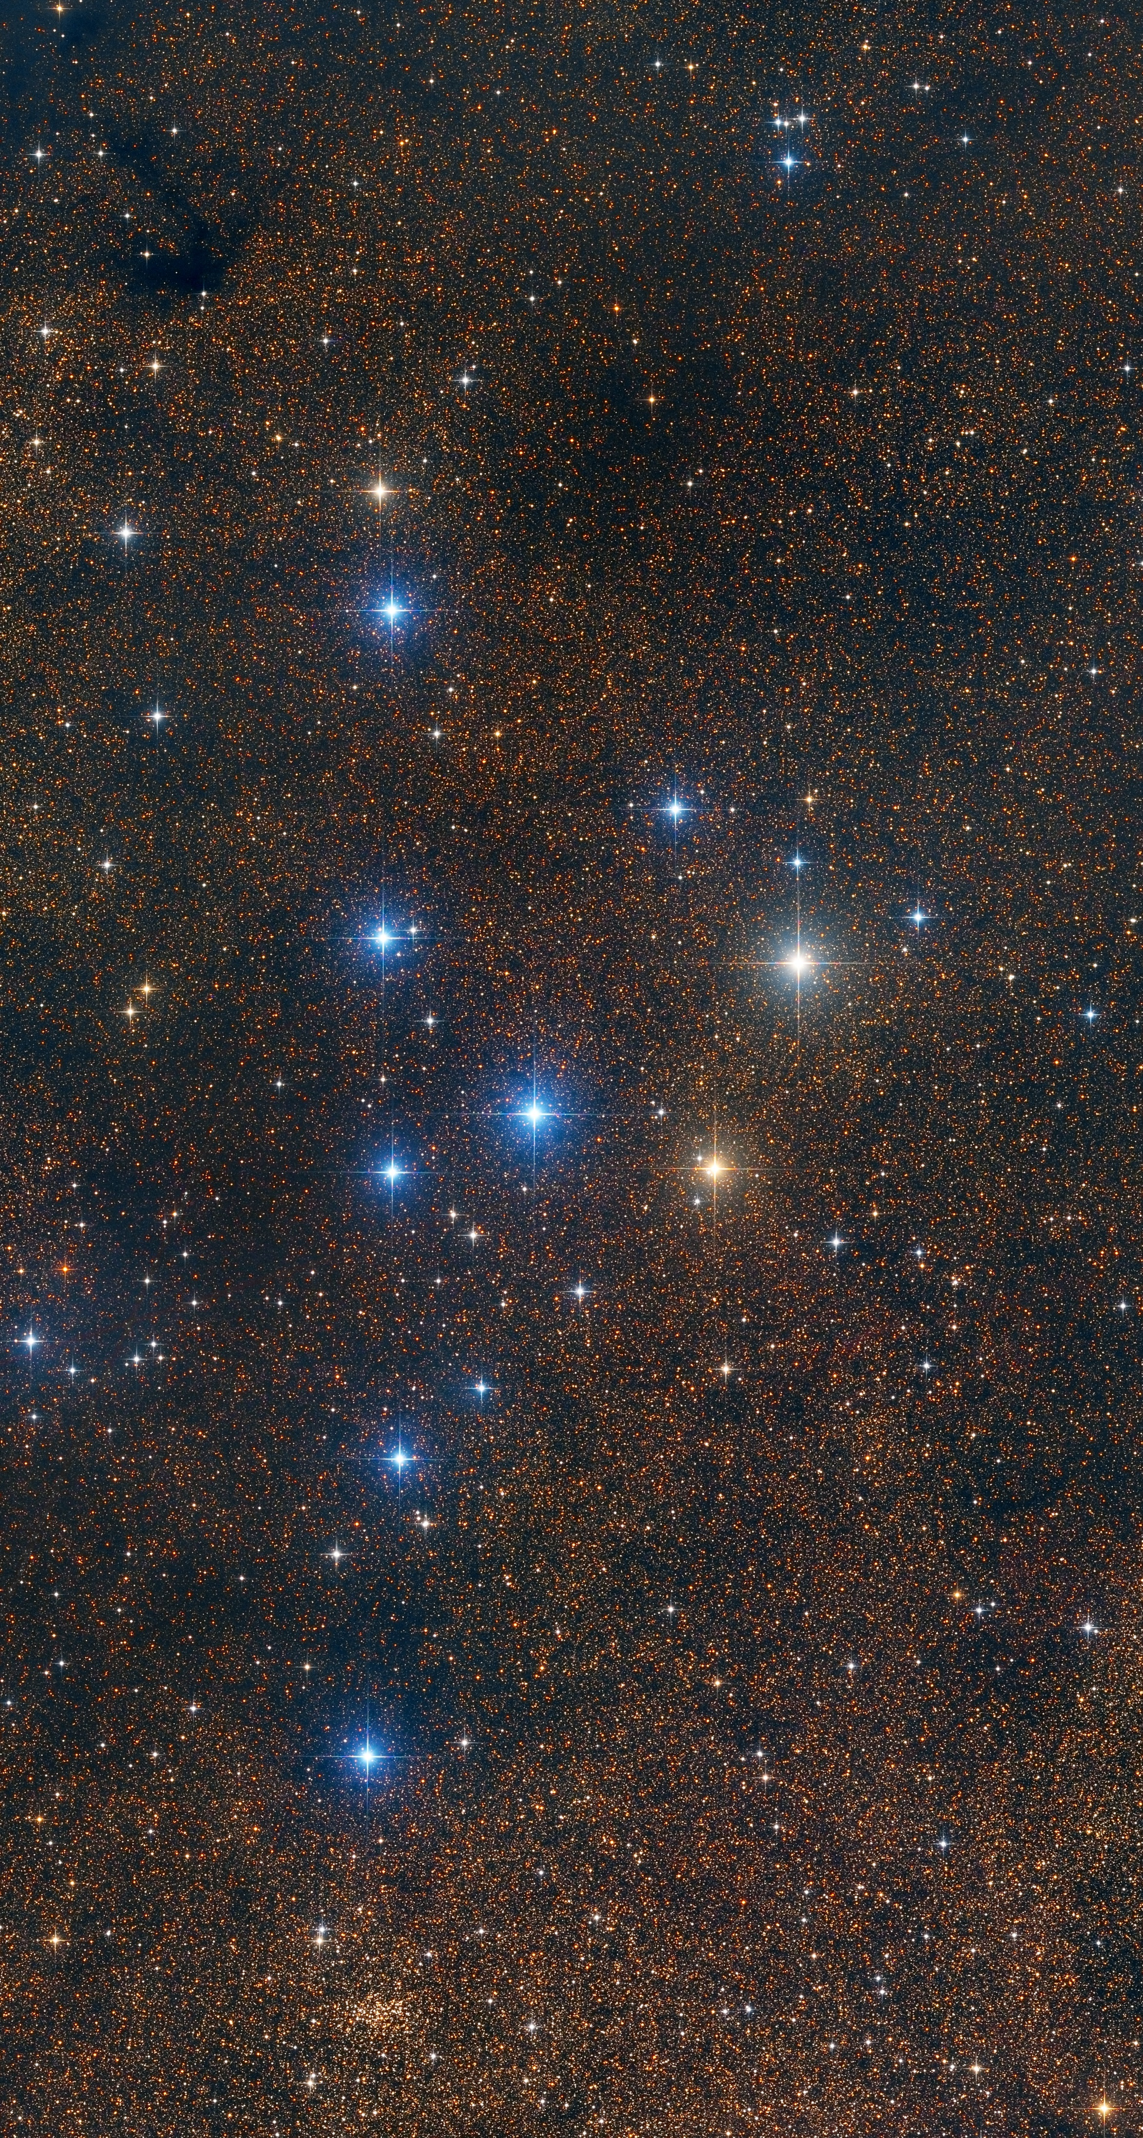
M11
Coathanger Asterism

Slide 29
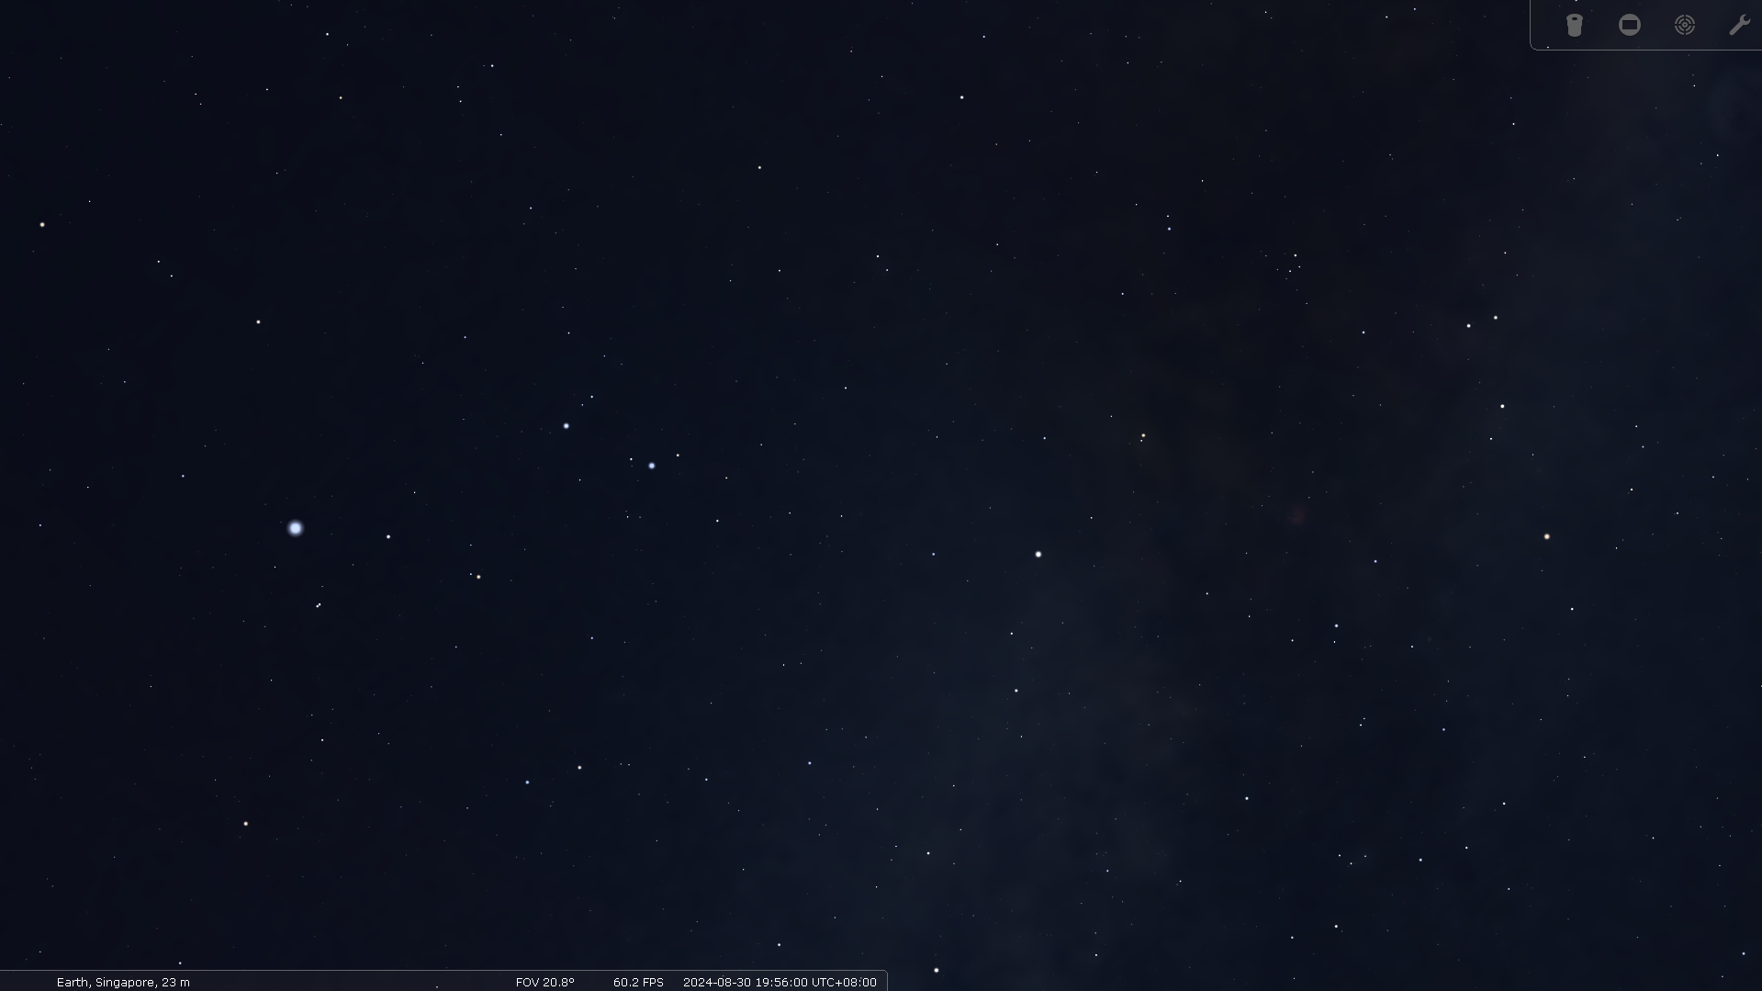
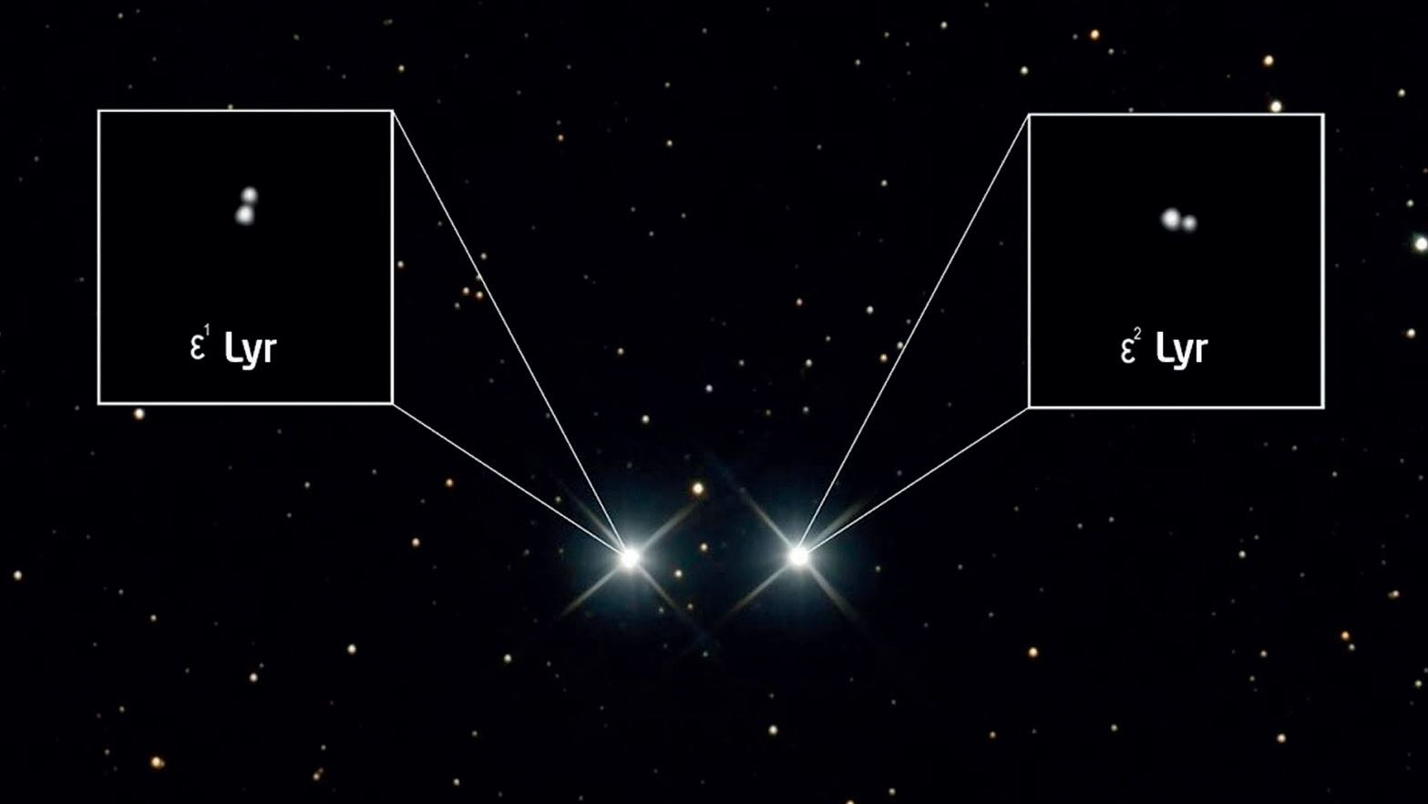
Coathanger
Epsilon Lyrae / Double-Double

Slide 30
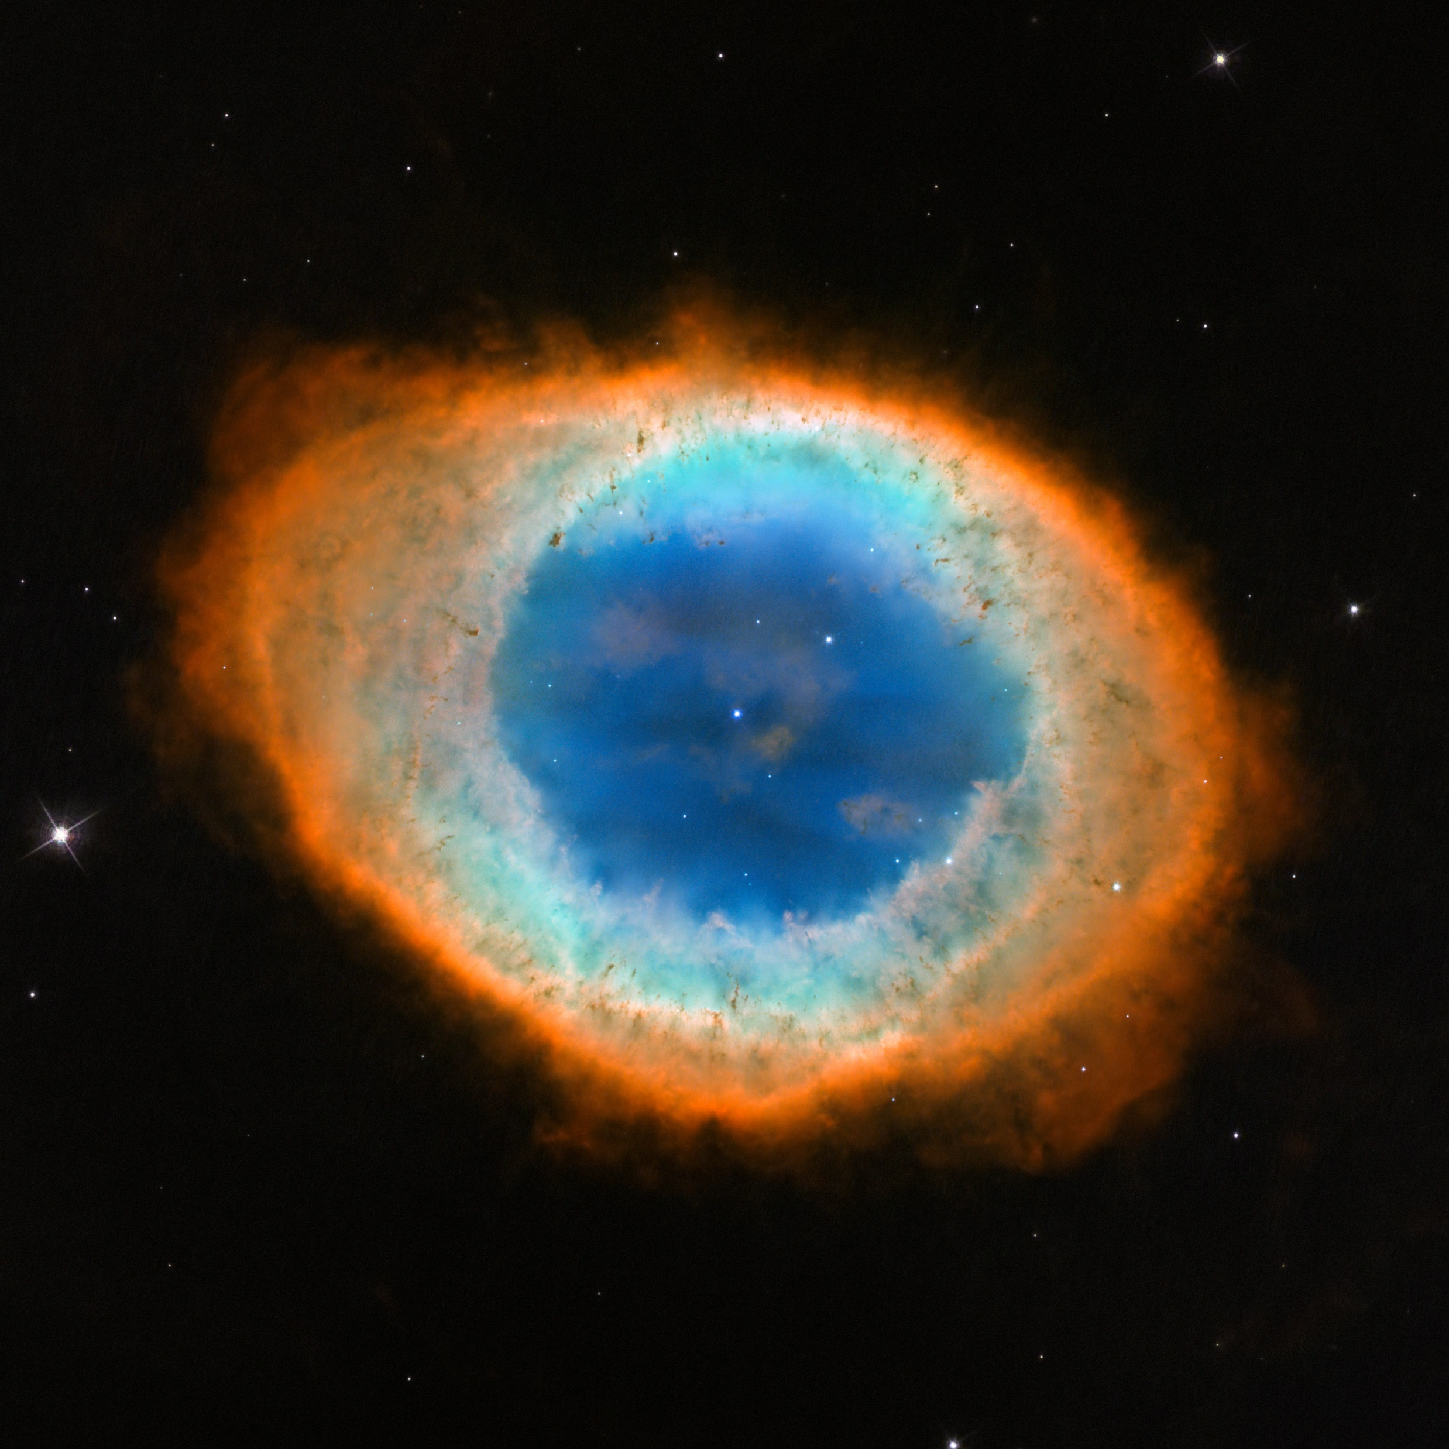
Coathanger
Epsilon Lyrae
M57 Ring Nebula

Slide 31
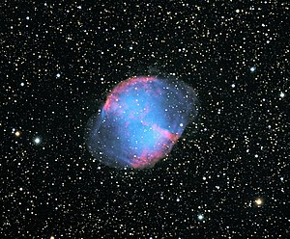
Coathanger
M57
Epsilon Lyrae
M27 Dumbbell Nebula

Slide 32
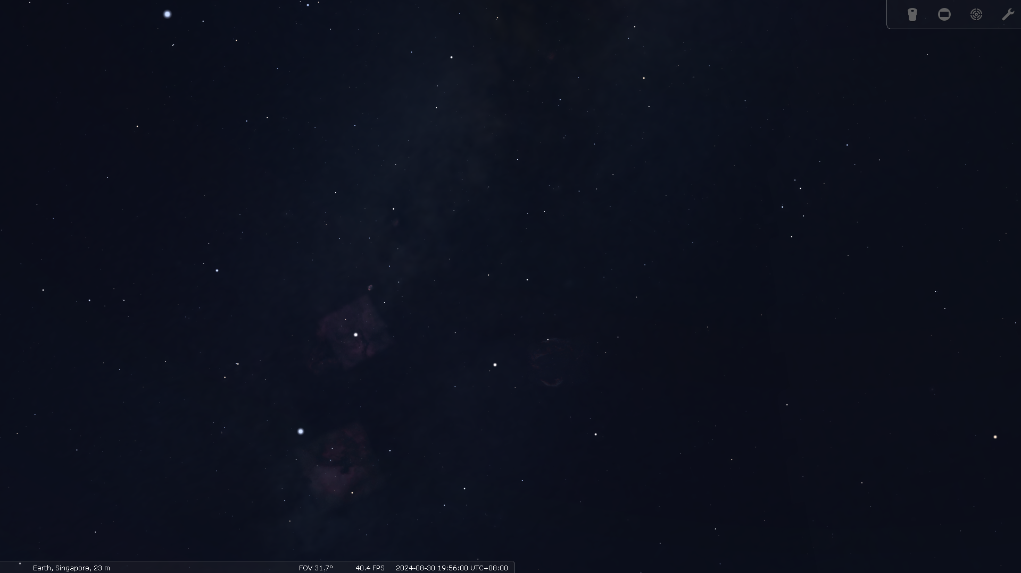
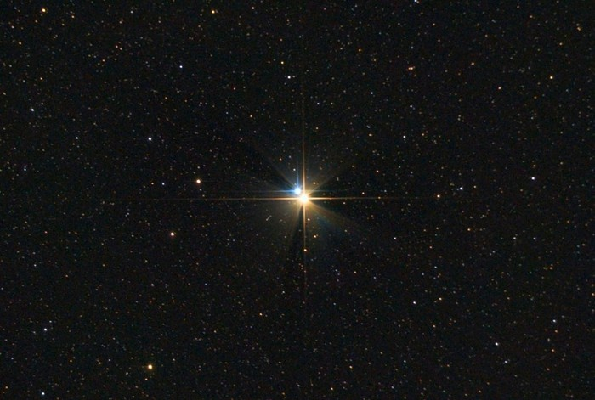
Alberio

Slide 33
Part 5
Memories of the Spring
YADAYADA YOOOOOOOOOOO

Slide 34
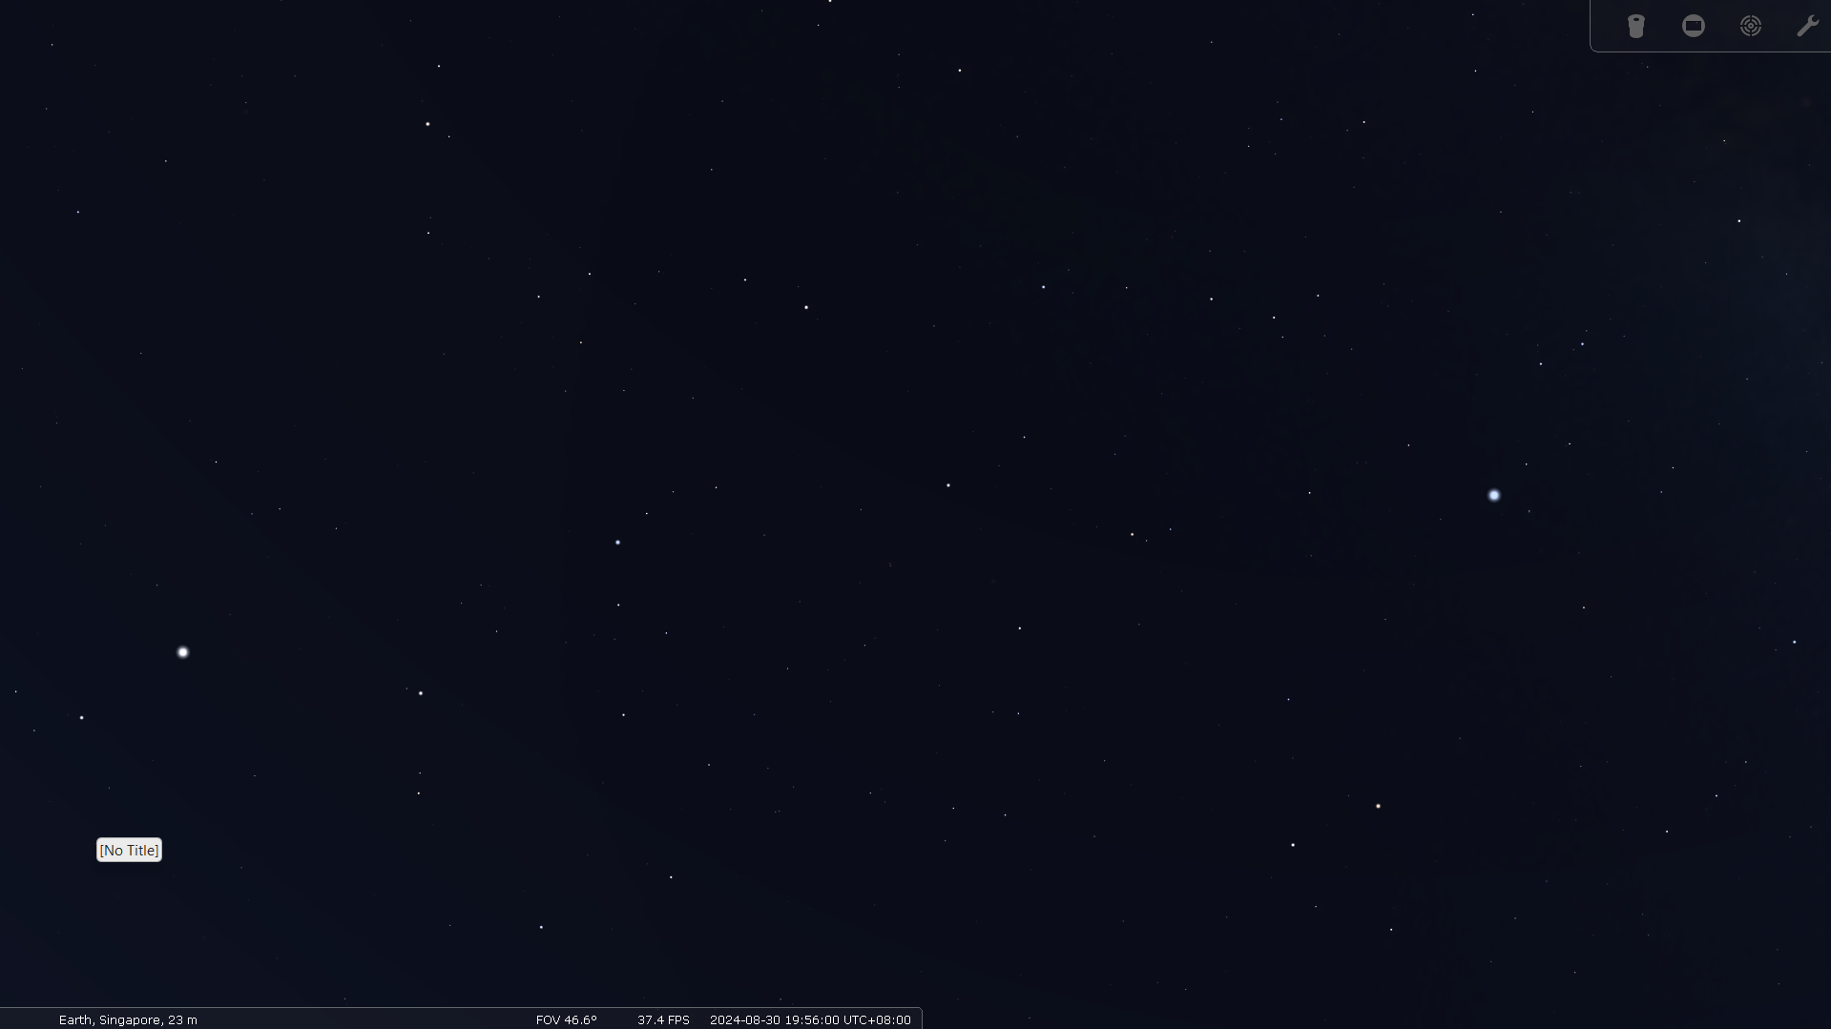

Slide 35
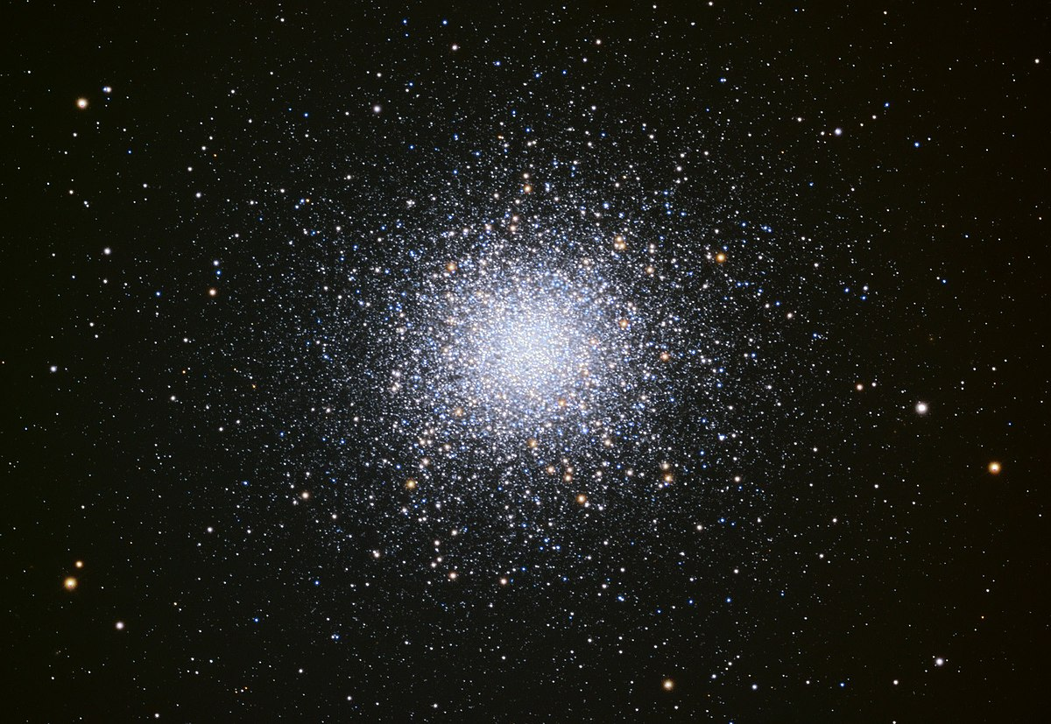
M13 Great Hercules Globular Cluster

Slide 36
Part 6
GAME TIME LADS
PRIZES TO BE WON

Slide 37
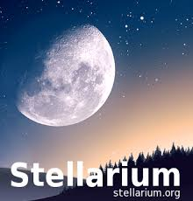
DOWNLOAD STELLARIUM

Slide 38
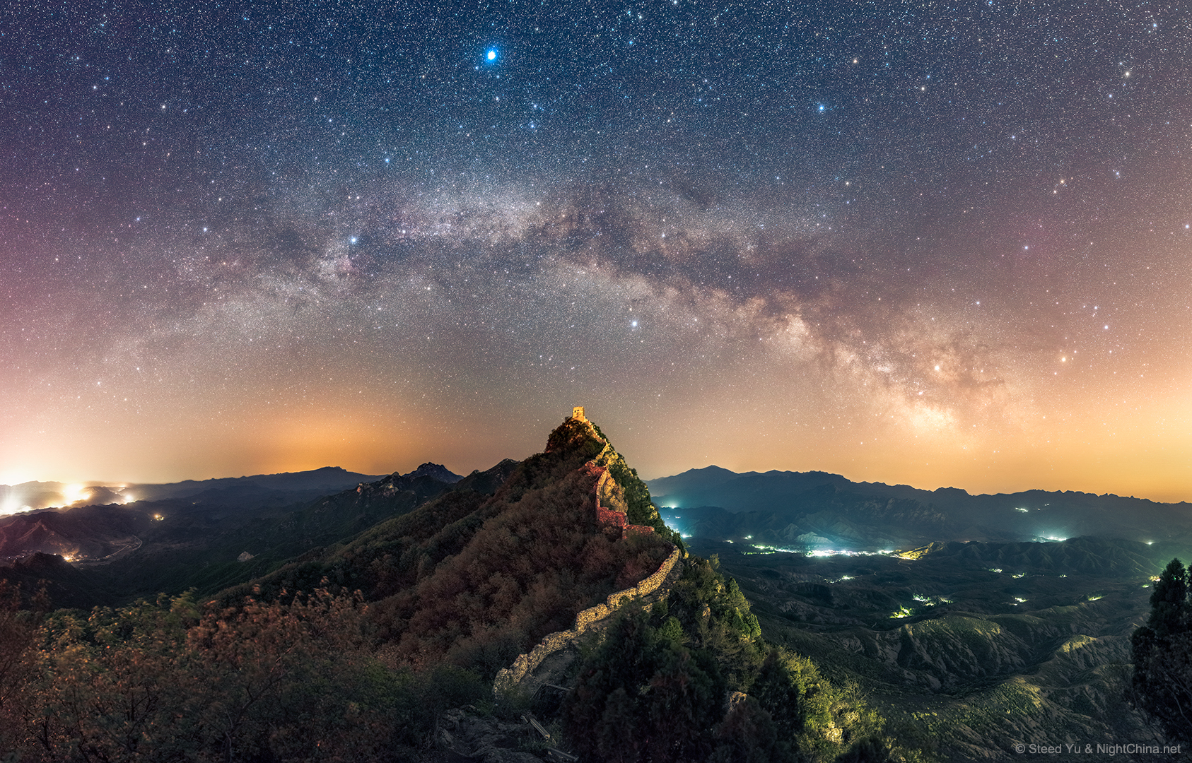
Example

Slide 39
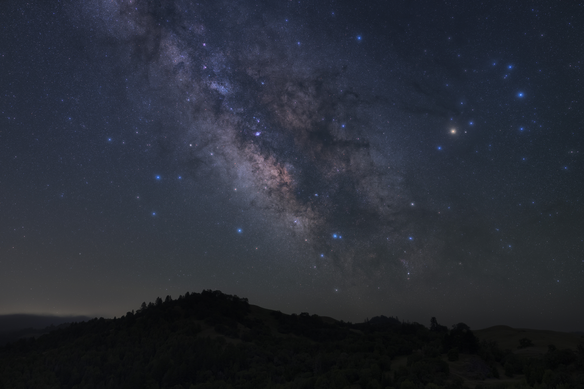
Photo Credit: fksr (Flicker)
Common star name: 1 point
DSO: 3 points
Anything else: 2 points

Slide 40
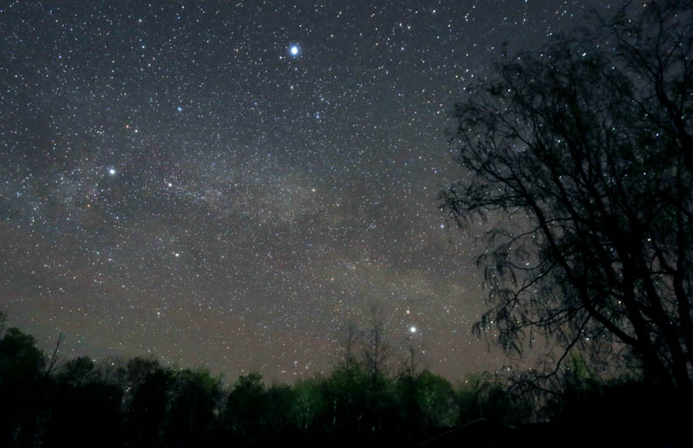
Photo Credit: BBC
Common star name: 1 point
DSO: 3 points
Anything else: 2 points

Slide 41
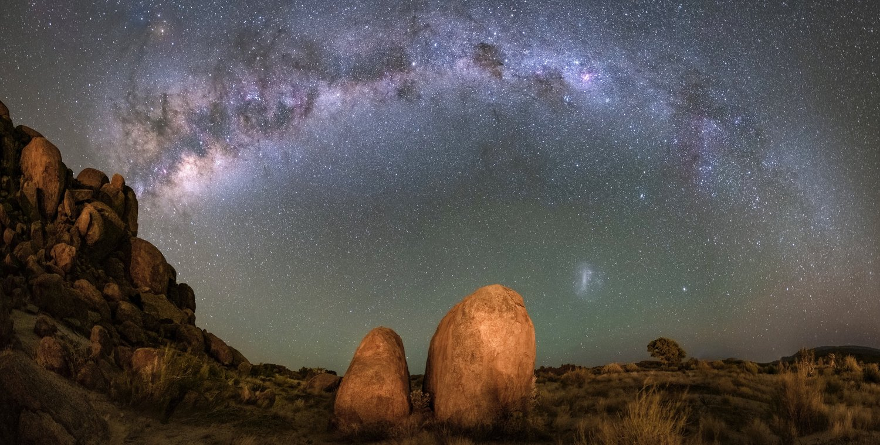
Photo Credit:
Florian Kriechbaumer
Common star name: 1 point DSO: 3 points Anything else: 2 points

Slide 42
THANK YOU FOR COMING, ONTO WEI ZHONG.

