Slide 1
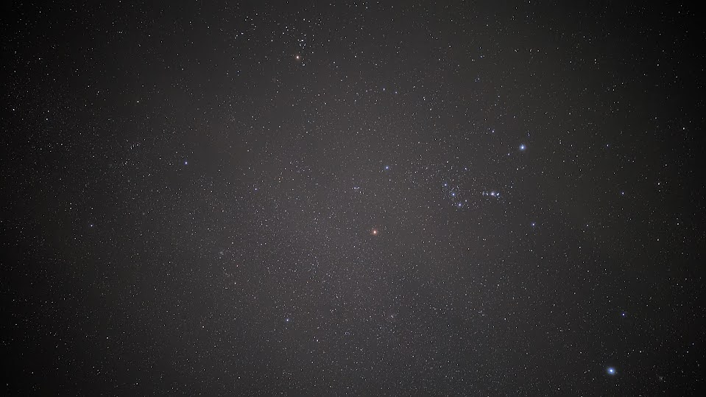
The Winter Hexagon Time
Kush (Returns)
26th January 2024

Slide 2
Today’s Menu
Some Recap
Stellarium Night Sky Tour
GAMEEEEEEEEEEEEEEE (WITH PRIZESSSSSSSSSSSSSSSSSSSSSSS)

Slide 3
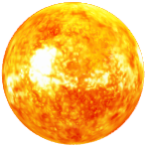

Why are there seasonal skies?
This is not to scale at all. Heavy Exaggeration of dimensions for illustrative purpose.

Slide 4

Why are there seasonal skies?
This is not to scale at all. Heavy Exaggeration of dimensions for illustrative purpose.

Slide 5
Why are there seasonal skies?
This is not to scale at all. Heavy Exaggeration of dimensions for illustrative purpose.

Slide 6

Why are there seasonal skies?
This is not to scale at all. Heavy Exaggeration of dimensions for illustrative purpose.

Slide 7
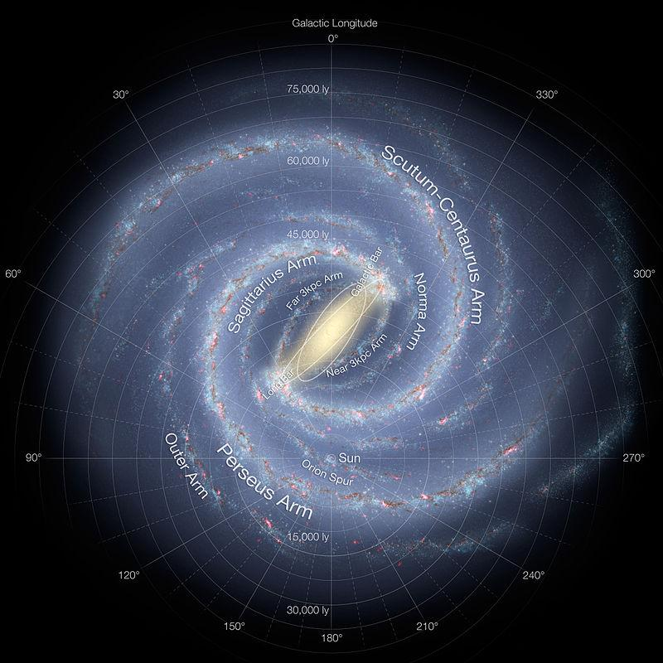
Where are we?
Summer
Fall
Spring
Winter

Slide 8
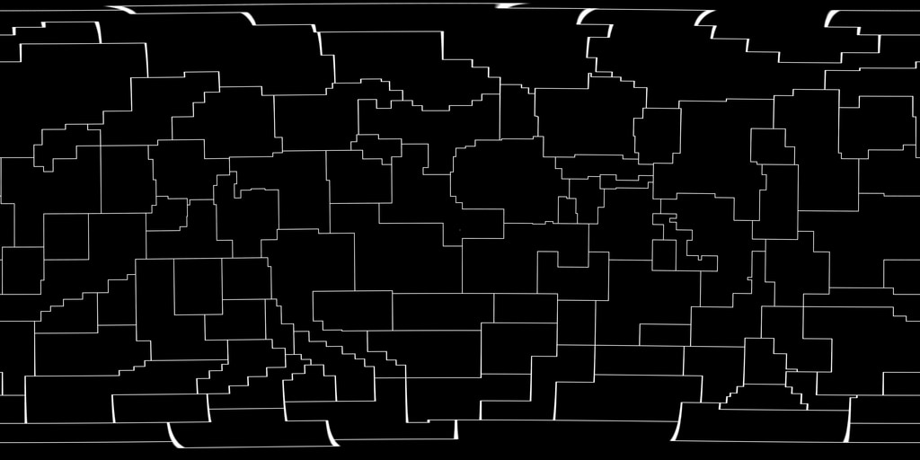
Constellations vs Asterisms

Slide 9
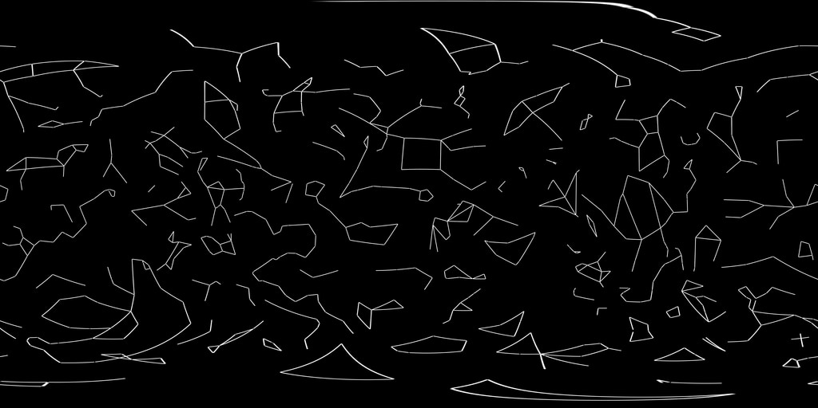
Constellations vs Asterisms

Slide 10
Constellations vs Asterisms
88
Officially Recognised
Representation is not very representative
Unfixed Number
Not Officially Recognised
Representation is very representative

Slide 11
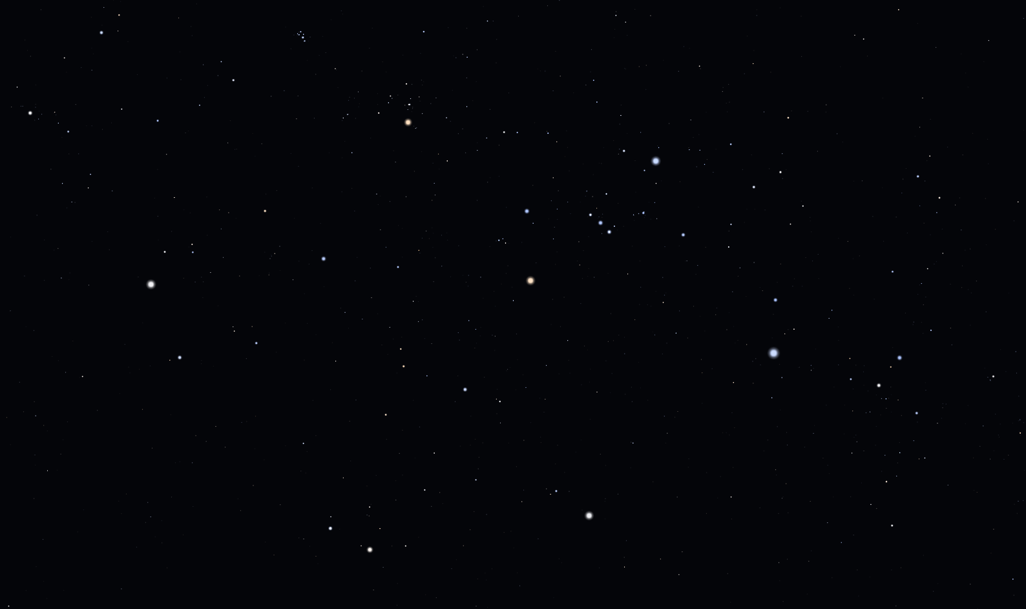
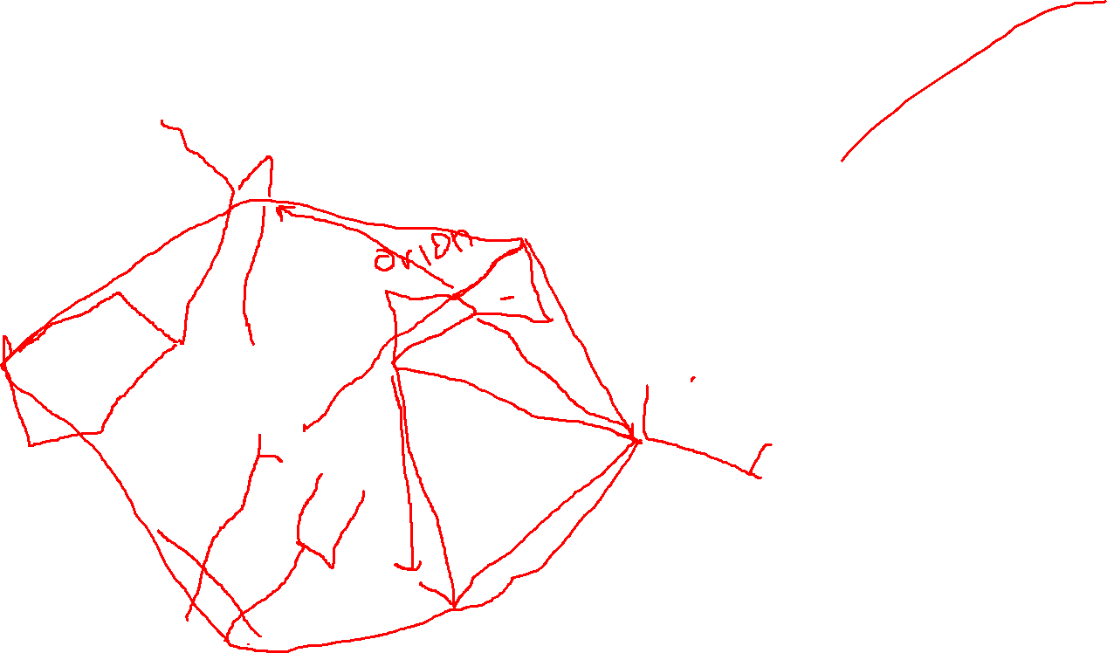
The main constellations

Slide 12
The main asterisms

Slide 13
For DSOs and other stuff, we visit Stellarium

Slide 14
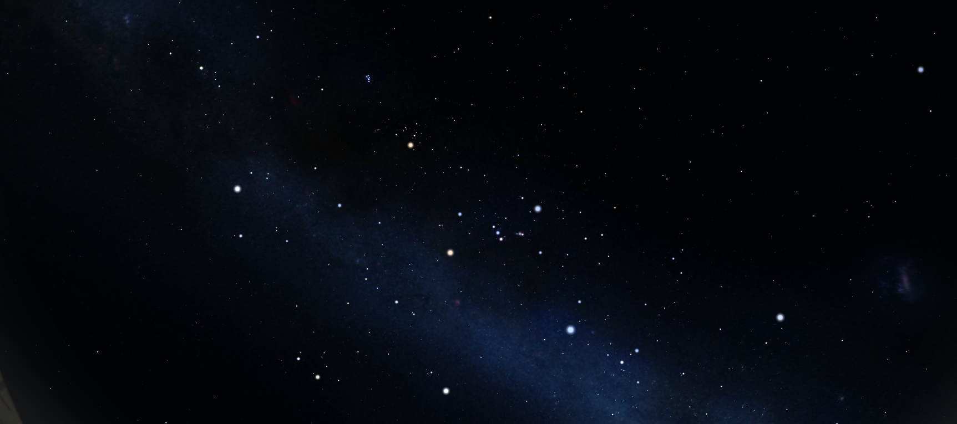
Game Time (Easy)
Constellation – 3, Star Name (Common Name) – 1, Asterism – 2, DSO – 4, anything else - 1

Slide 15
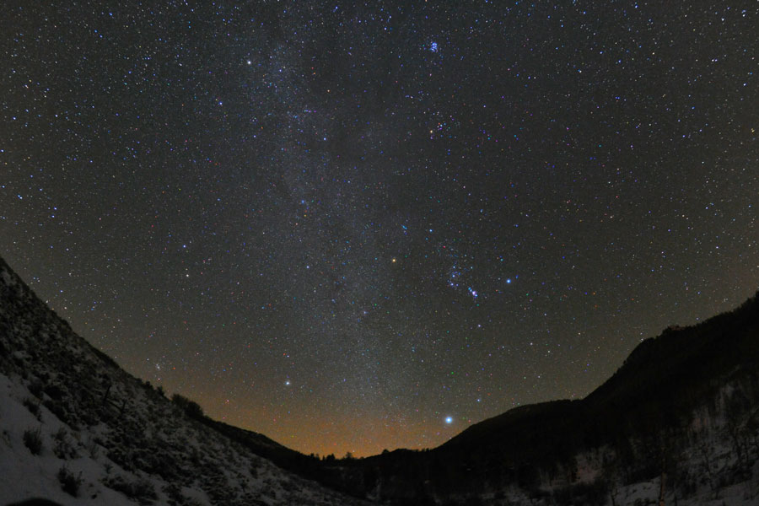
Game Time (Medium)
Constellation – 3, Star Name (Common Name) – 1, Asterism – 2, DSO – 4, anything else – 1 Marks Deducted for styupidity

Slide 16
Constellation – 3, Star Name (Common Name) – 1, Asterism – 2, DSO – 4, anything else - 1
Game Time (Choose the Season)
My Favourite DSO
Orion’s Nemesis
Do not choose this option

Slide 17
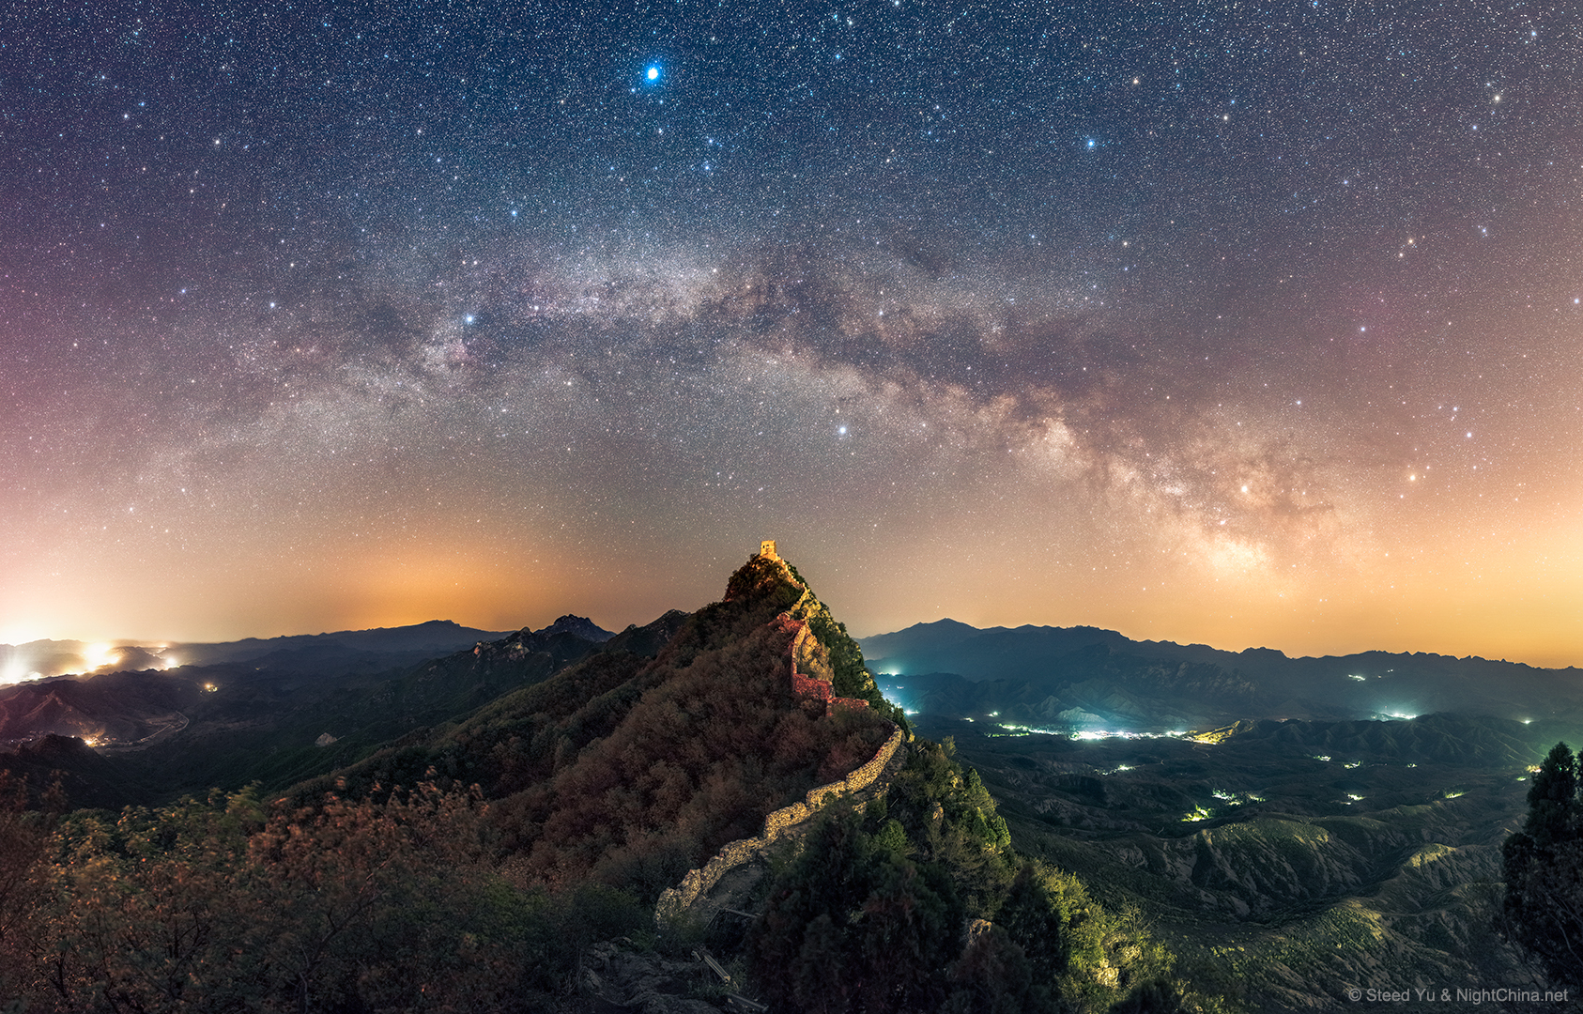
Game Time (My Favourite DSO)
Constellation – 3, Star Name (Common Name) – 1, Asterism – 2, DSO – 4, anything else - 1

Slide 18
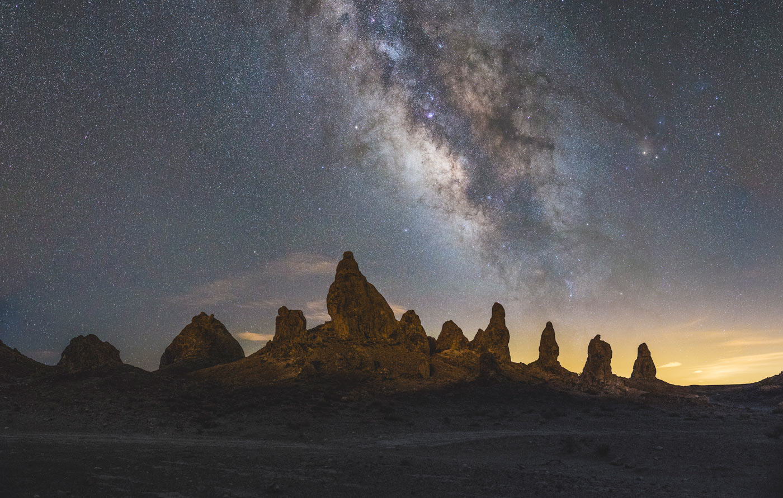
Game Time (Orion’s Nemesis)
Constellation – 3, Star Name (Common Name) – 1, Asterism – 2, DSO – 4, anything else - 1

Slide 19
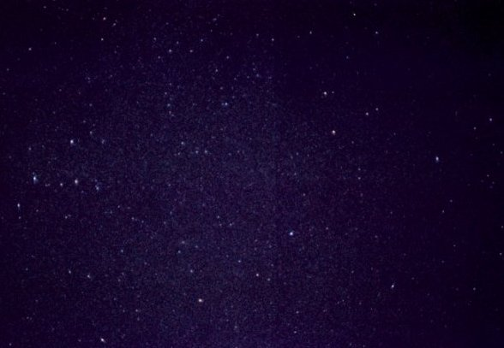
Game Time (I hate you all)
Constellation – 3, Star Name (Common Name) – 1, Asterism – 2, DSO – 4, anything else - 1

Slide 20
Thanks a lot for coming
Feel free to ask any questions :D

