Slide 1

GETTING THE W
Substantiating the rate variable, W, introduced by Kawaguchi et al. to model F₁-ATPase
SP2271 Assignment 2
Kushagra Shrivastava
A0281477U

Slide 2
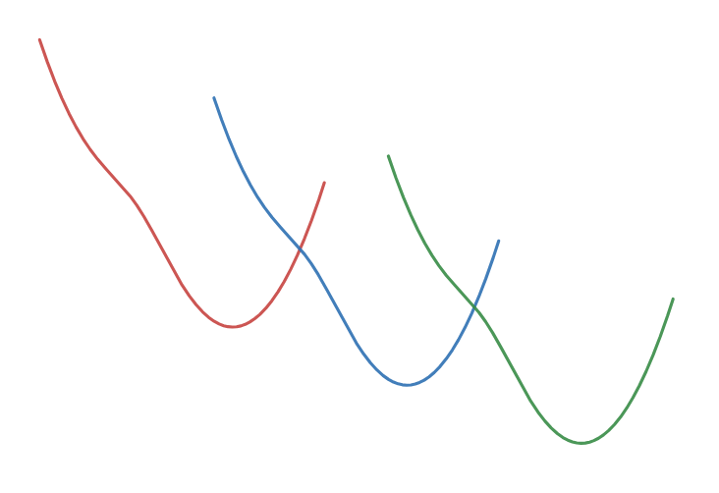
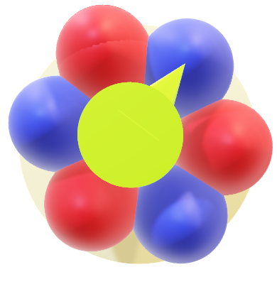

Content
$$R_{n}^{±}\left(x\right)=Wf_{n}^{±}\left(x\right)$$
What is ATPase?
The TASAM Model
Substantiating W

Slide 3
SECTION I
What is ATPase?
Understanding the F₁ component and its High Efficiency

Slide 4
Energy of Cell
Adenosine Diphosphate
Adenosine Triphosphate
ADP + P_{i} ⇋ ATP
Inorganic Phosphate
What is ATPase?
The TASAM Model
Substantiating the W

Slide 5
Energy of Cell
ATP Synthesis
ADP + P_{i} ⇋ ATP
ATP Hydrolysis
What is ATPase?
The TASAM Model
Substantiating the W

Slide 6
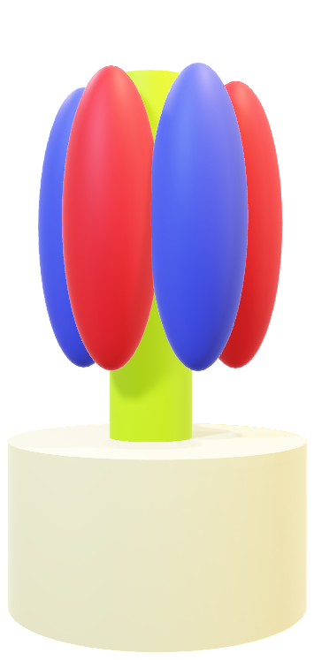
ATPase: The Molecular Motor
ATP Synthesis
ADP + P_{i} ⇋ ATP
ATP Hydrolysis
ATPase*
(Made in Microsoft Paint3D)
What is ATPase?
The TASAM Model
Substantiating the W
*Multiple components are not drawn for simplicity

Slide 7
ATPase: The Molecular Motor
F₁ component
(Enzymatic Activity Site)
F₀ component
(Rotatory Motor)
ATPase*
(Made in Microsoft Paint3D)
What is ATPase?
The TASAM Model
Substantiating the W
*Multiple components are not drawn for simplicity

Slide 8




F₁-ATPase
$α$-subunits
$γ$-subunit
$β$-subunits
ATPase*
(Made in Microsoft Paint3D)
What is ATPase?
The TASAM Model
Substantiating the W
*Multiple components are not drawn for simplicity

Slide 9

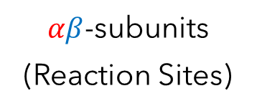
F₁-ATPase
Rotation of $γ$ shaft → Conformational change in $αβ$ subunits → Reaction
$αβ$-subunits
(Reaction Sites)
$γ$-subunit
ATPase*
(Made in Microsoft Paint3D)
What is ATPase?
The TASAM Model
Substantiating the W
*Multiple components are not drawn for simplicity

Slide 10
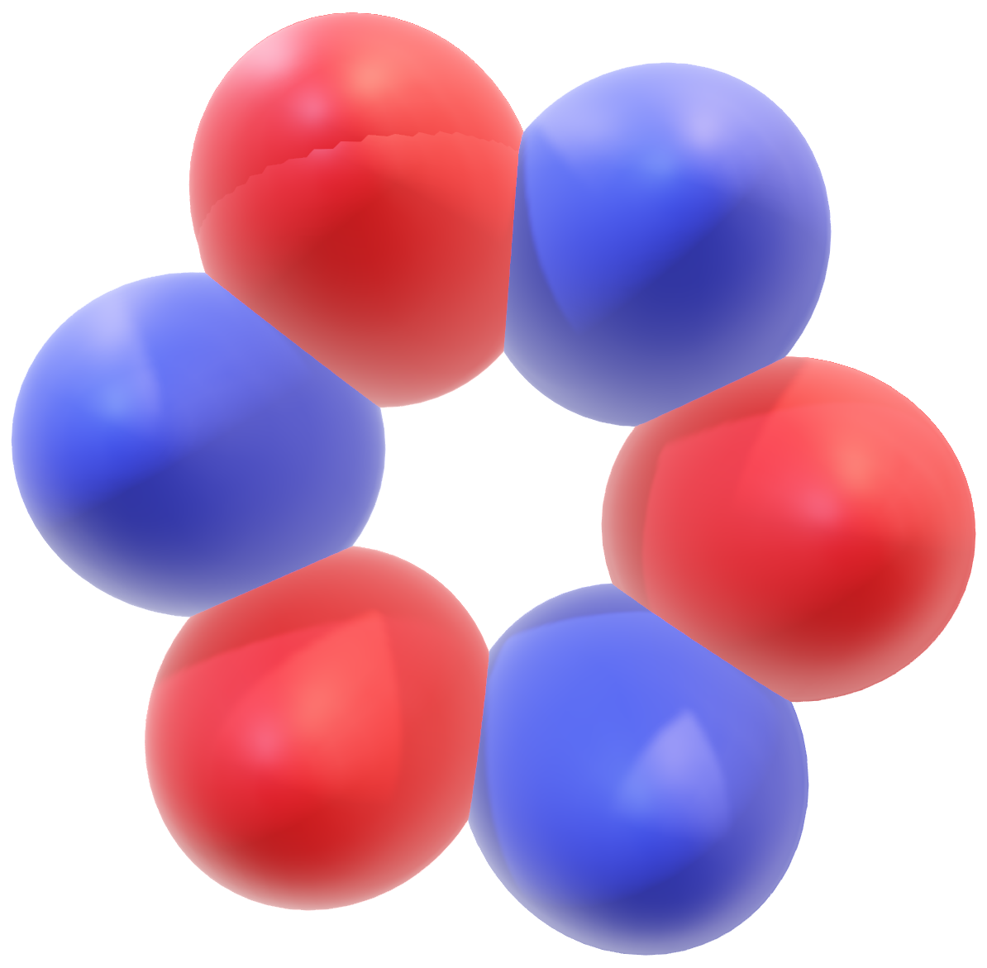

F₁-ATPase: Gamma Shaft’s Rotational Motion
ATP Hydrolysis
Clockwise Rotation
F₁-ATPase*
(Made in Microsoft Paint3D)
What is ATPase?
The TASAM Model
Substantiating the W
*Multiple components are not drawn for simplicity

Slide 11
F₁-ATPase: Gamma Shaft’s Rotational Motion
ATP Synthesis
$γ$-subunit
Counter-Clockwise Rotation
F₁-ATPase*
(Made in Microsoft Paint3D)
What is ATPase?
The TASAM Model
Substantiating the W
*Multiple components are not drawn for simplicity

Slide 12
F₁-ATPase: 120° Step Rotation
$γ$-subunit
120°
F₁-ATPase*
(Made in Microsoft Paint3D)
What is ATPase?
The TASAM Model
Substantiating the W
*Multiple components are not drawn for simplicity

Slide 13
F₁-ATPase: 120° Step Rotation
$γ$-subunit
120°
F₁-ATPase*
(Made in Microsoft Paint3D)
What is ATPase?
The TASAM Model
Substantiating the W
*Multiple components are not drawn for simplicity

Slide 14
F₁-ATPase: 120° Step Rotation
$γ$-subunit
120°
F₁-ATPase*
(Made in Microsoft Paint3D)
What is ATPase?
The TASAM Model
Substantiating the W
*Multiple components are not drawn for simplicity

Slide 15
F₁-ATPase: 120° Step Rotation
$γ$-subunit
3 ATP hydrolysed per 360° rotation by ATPase
120°
F₁-ATPase*
(Made in Microsoft Paint3D)
What is ATPase?
The TASAM Model
Substantiating the W
*Multiple components are not drawn for simplicity

Slide 16

Thermodynamics of ATPase
$$Δμ=Q_{int}+Q_{ext}$$
What is ATPase?
The TASAM Model
Substantiating the W

Slide 17

Thermodynamics of ATPase
$$Δμ=Q_{int}+Q_{ext}$$
Energy released by hydrolysis of ATP
What is ATPase?
The TASAM Model
Substantiating the W

Slide 18


Thermodynamics of ATPase
$$Δμ=Q_{int}+Q_{ext}$$
Mechanical energy in changing the conformation of $αβ$ subunits
What is ATPase?
The TASAM Model
Substantiating the W

Slide 19


Thermodynamics of ATPase
$$Δμ=Q_{int}+Q_{ext}$$
Rotational energy of the $γ$ shaft
What is ATPase?
The TASAM Model
Substantiating the W

Slide 20
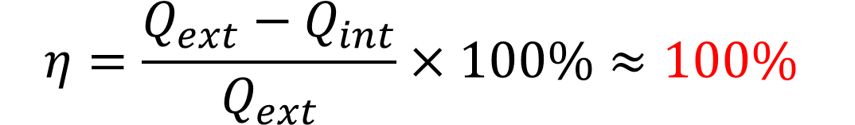

Thermodynamics of ATPase
Experimentally,
$Δμ≈Q_{ext}⇒Q_{int}≈0$
Therefore,
$$η=\frac{Q_{ext}−Q_{int}}{Q_{ext}}×100\%≈100\%$$
Holy Grail?
What is ATPase?
The TASAM Model
Substantiating the W

Slide 21
SECTION II
Totally ASymmetric Allosteric Model (TASAM)

Slide 22
Breaking the Model Down
Totally ASymmetric Allosteric Model
What is ATPase?
The TASAM Model
Substantiating the W

Slide 23
Breaking the Model Down
Totally ASymmetric Allosteric Model
$γ$ shaft’s position affecting the $αβ$ subunit’s activity
What is ATPase?
The TASAM Model
Substantiating the W

Slide 24
Breaking the Model Down
TASAM
Explain $Q_{int}≈0$ at High and Low [ATP]
What is ATPase?
The TASAM Model
Substantiating the W

Slide 25
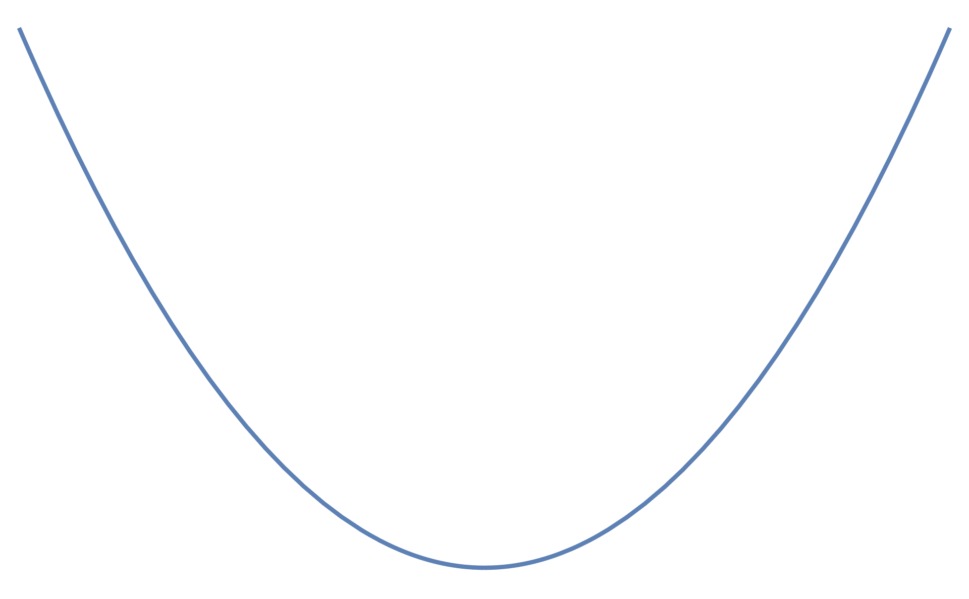


Modelling the F₁ : Funny Rotating Springs
Harmonic Oscillators (simple spring)
$$E=\frac{1}{2}kx^{2}$$
$$E$$
$$x$$
What is ATPase?
The TASAM Model
Substantiating the W

Slide 26
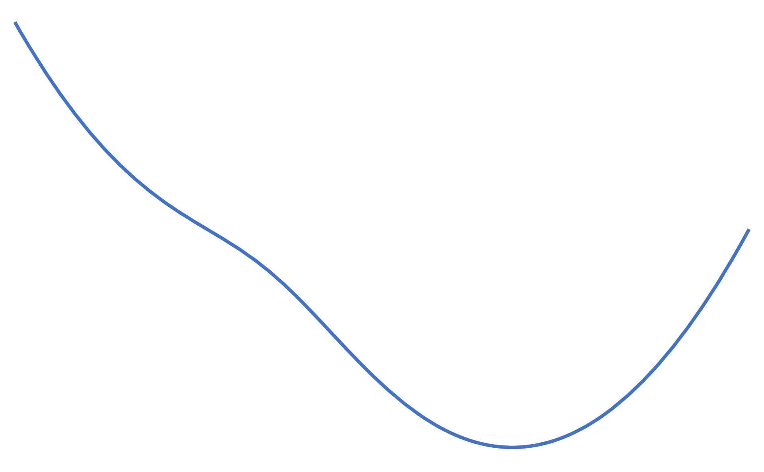
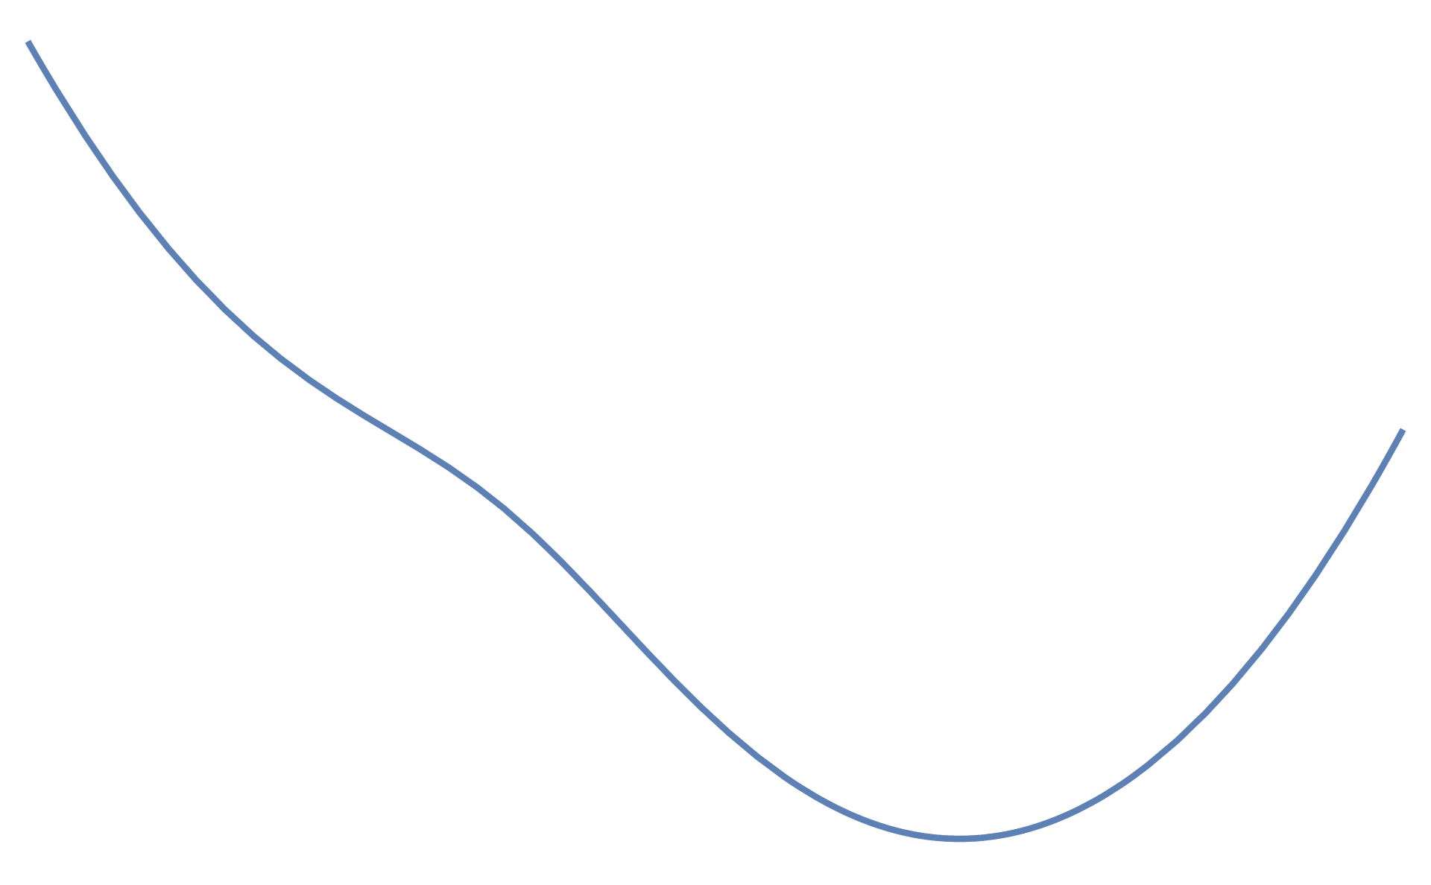

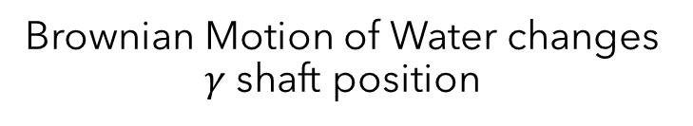


Modelling the F₁ : Funny Rotating Springs
Harmonic Oscillators (rotating springs)
$$E$$
$$U_{n}(x)$$
Brownian Motion of Water changes $γ$ shaft position
$$x/∘$$
0
What is ATPase?
The TASAM Model
Substantiating the W

Slide 27
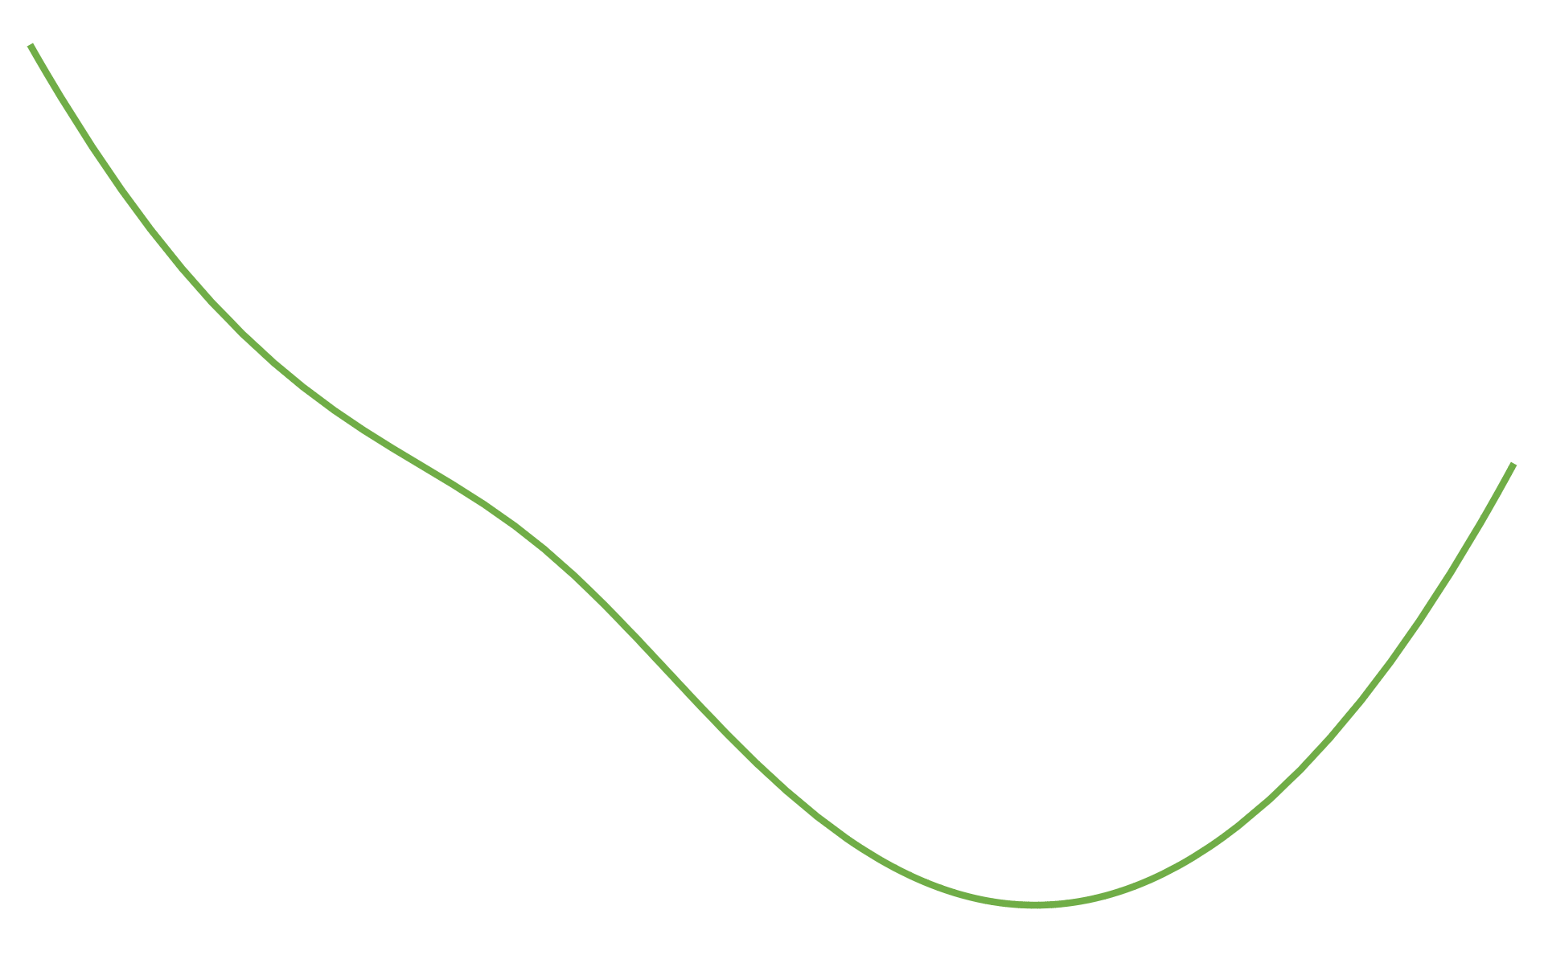



Modelling the F₁ : Funny Rotating Springs
ATP consumed → Decrease in Free Chemical Energy
$$E$$
$$U_{n}(x)$$
$$U_{n+1}(x)$$
$$Δμ$$
$$x/∘$$
0
What is ATPase?
The TASAM Model
Substantiating the W

Slide 28

Modelling the F₁ : Funny Rotating Springs
1 ATP hydrolysed → 120° step
$$E$$
$$U_{n}(x)$$
$$U_{n+1}(x)$$
$$Δμ$$
$$x/∘$$
0
120
What is ATPase?
The TASAM Model
Substantiating the W

Slide 29

High [ATP] Scenario
$$E$$
$$U_{n}(x)$$
Downward transition when ATP hydrolyses
$$U_{n+1}(x)$$
$$Q_{int}$$
$$x/∘$$
What is ATPase?
The TASAM Model
Substantiating the W

Slide 30

High [ATP] Scenario
$$E$$
$$U_{n}(x)$$
$$U_{n+1}(x)$$
When [ATP] is high, hydrolyses takes place immediately
$$Q_{int}≈0$$
$$x/∘$$
What is ATPase?
The TASAM Model
Substantiating the W

Slide 31
High [ATP] Scenario
But what about low [ATP]?
$$E$$
$$U_{n}(x)$$
$$U_{n+1}(x)$$
$$x/∘$$
What is ATPase?
The TASAM Model
Substantiating the W

Slide 32

Low [ATP] Scenario
Dependent on [ATP]
$$R_{n}^{±}\left(x\right)=Wf_{n}^{±}\left(x\right)$$
Function related to ratios of [ATP] and [ADP]
Rate of Reaction
What is ATPase?
The TASAM Model
Substantiating the W

Slide 33
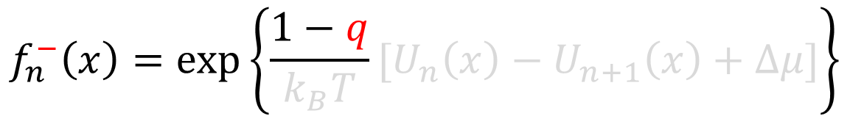
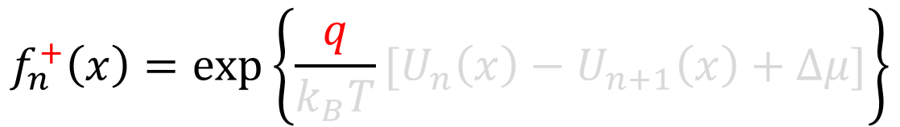
Low [ATP] Scenario: Introducing the Asymmetry
$$f_{n}^{+}\left(x\right)=\exp\left\{\frac{q}{k_{B}T}[U_{n}\left(x\right)−U_{n+1}\left(x\right)+Δμ]\right\}$$
Hydrolysis Reaction:
$$f_{n}^{−}\left(x\right)=\exp\left\{\frac{1−q}{k_{B}T}[U_{n}\left(x\right)−U_{n+1}\left(x\right)+Δμ]\right\}$$
Synthesis Reaction:
What is ATPase?
The TASAM Model
Substantiating the W

Slide 34
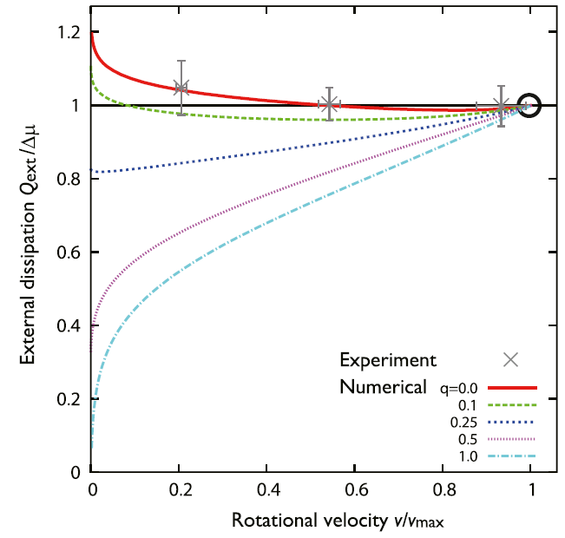
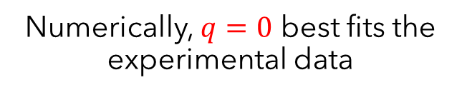
Low [ATP] Scenario: Introducing the Asymmetry
Numerically, $q=0$ best fits the experimental data
What is ATPase?
The TASAM Model
Substantiating the W

Slide 35


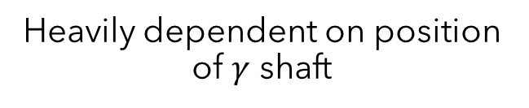
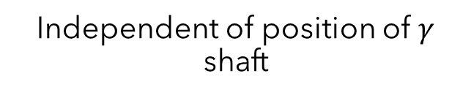
Implication of q=0
Hydrolysis Reaction
Synthesis Reaction
$$R_{n}^{+}\left(x\right)=W$$
$$R_{n}^{−}\left(x\right)=Wf_{n}^{−}(x)$$
Independent of position of $γ$ shaft
Heavily dependent on position of $γ$ shaft
Model is Totally ASymmetrical
What is ATPase?
The TASAM Model
Substantiating the W

Slide 36
SECTION III
Filling the gaps of the rate variable, W

Slide 37
Need for W
“…The low velocity dependence of Q_{ext} could be understood through the existence of time scale which determines the minimal value of W…”
But what is W?
What is ATPase?
The TASAM Model
Substantiating the W

Slide 38
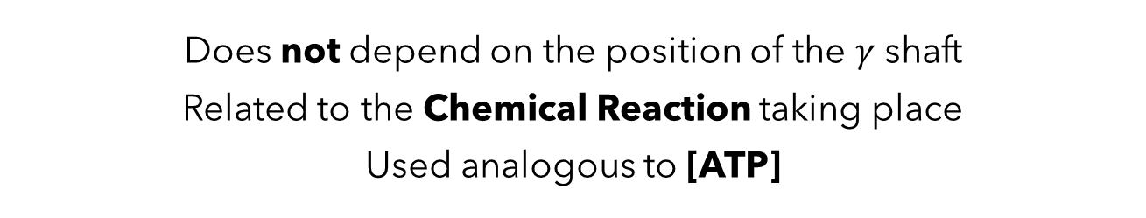

Analysing W
$$R_{n}^{±}\left(x\right)=Wf_{n}^{±}\left(x\right)$$
Does not depend on the position of the $γ$ shaft
Related to the Chemical Reaction taking place
Used analogous to [ATP]
What is ATPase?
The TASAM Model
Substantiating the W

Slide 39


Satisfying the Detailed Balance Equation
$$R_{n}^{±}\left(x\right)=Wf_{n}^{±}\left(x\right)$$
$$\frac{R_{n}^{+}(x)}{R_{n}^{−}(x)}=\exp\left\{\frac{1}{k_{B}T}\left[U_{n}\left(x\right)−U_{n+1}\left(x\right)+Δμ\right]\right\}$$
$W$ is the same for hydrolysis and synthesis
The rate of chemical reaction is same
What is ATPase?
The TASAM Model
Substantiating the W

Slide 40
Reaction Kinetics
ATP + H₂O → ADP + P_{i}
W could be Rate
(with enzymatic activity)
Rate = k[ATP]
Units of Rate: s⁻¹
Reaction is first order with respect to [ATP] ^{[1]}
[1] Moeller, C.; Schmidt, C.; Guyot, F.; Wilke, M. Hydrolysis rate constants of ATP determined in situ at elevated temperatures. Biophys. Chem. 2022, 290. DOI: 10.1016/j.bpc.2022.106878.
What is ATPase?
The TASAM Model
Substantiating the W

Slide 41

Future Possibility
Finding the variables that $R_{n}^{±}(x)$ depends on
Biomimicry (?)
What is ATPase?
The TASAM Model
Substantiating the W

Slide 42
References
[1] Moeller, C.; Schmidt, C.; Guyot, F.; Wilke, M. Hydrolysis rate constants of ATP determined in situ at elevated temperatures. Biophys. Chem. 2022, 290. DOI: 10.1016/j.bpc.2022.106878.
[2] Sobti, M.; Ueno, H.; Noji, H.; Stewart, A. G. The six steps of the complete F1-ATPase rotary catalytic cycle. Nat. Com. 2021, 12 (1) DOI: 10.1038/s41467-021-25029-0.
[3] Kawaguchi, K.; Sasa, S.; Sagawa, T. Nonequilibrium dissipation-free transport in F1-ATPase and the thermodynamic role of asymmetric allosterism. Biophys. J. 2014, 106 (11), 2450–2457 DOI: 10.1016/j.bpj.2014.04.034.

Slide 43
Thank You
This text is to make the page look Totally Asymmetrical.

Slide 44
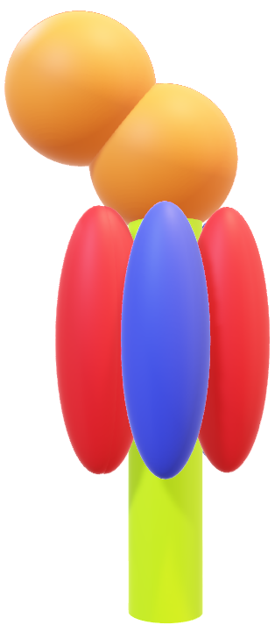
Probe Beads

Slide 45
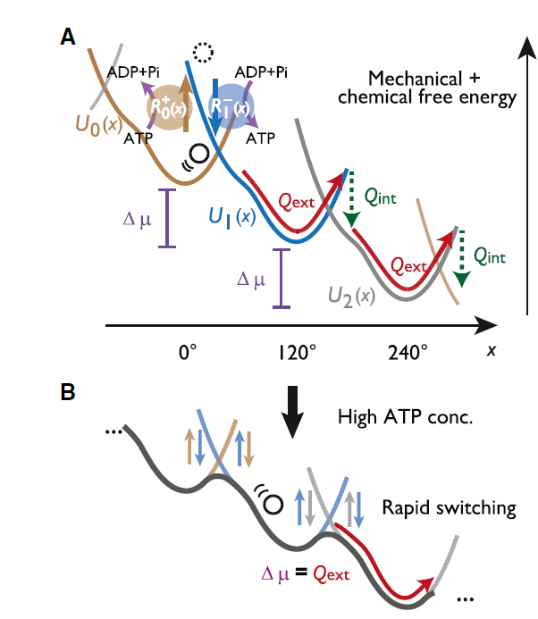
High [ATP] Switching Model

Slide 46
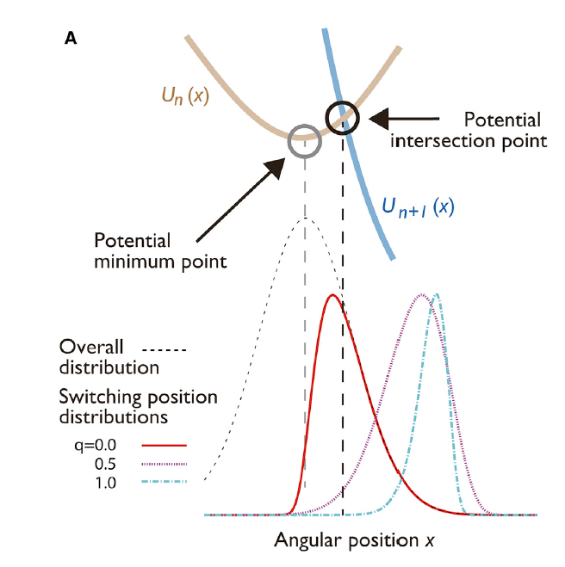
Switching Model with q

Slide 47
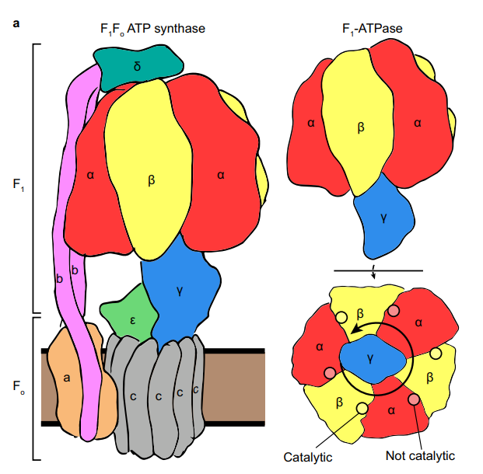
Structure of ATPase
Sobti, M.; Ueno, H.; Noji, H.; Stewart, A. G. The six steps of the complete F1-ATPase rotary catalytic cycle. Nature Communications 2021, 12 (1) DOI: 10.1038/s41467-021-25029-0.

Slide 48
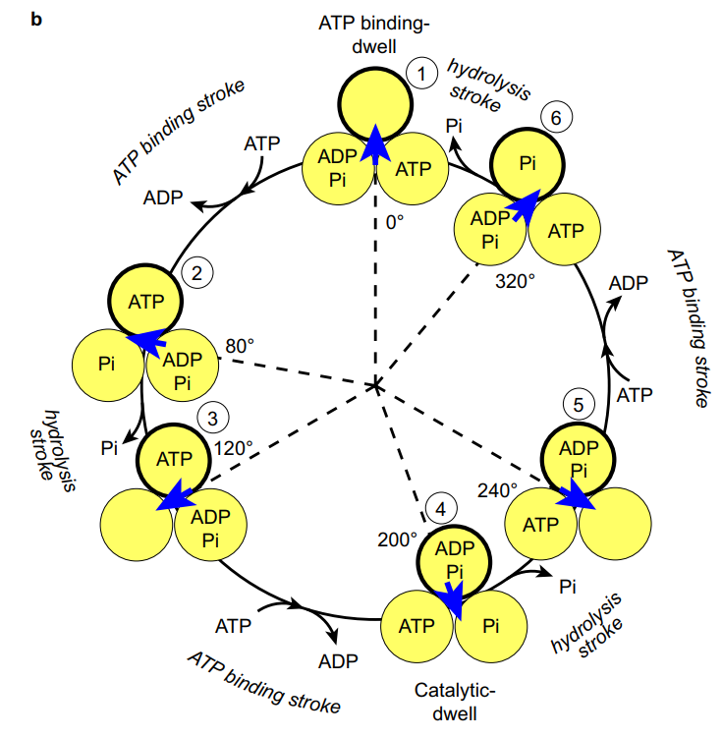
Full reaction scheme
Sobti, M.; Ueno, H.; Noji, H.; Stewart, A. G. The six steps of the complete F1-ATPase rotary catalytic cycle. Nature Communications 2021, 12 (1) DOI: 10.1038/s41467-021-25029-0.

