Slide 1

Fano-resonant metasurfaces for virus sensing application
H3 Oral Defence
Kushagra Shrivastava
Beertino Romerow Woe
National Junior College
Chu Hong-Son
IHPC, A*STAR

Slide 2
H3 Research
1
Kushagra Shrivastava
Contents
Introduction
Experiments and Methodology
Results and Discussion
Future Works

Slide 3
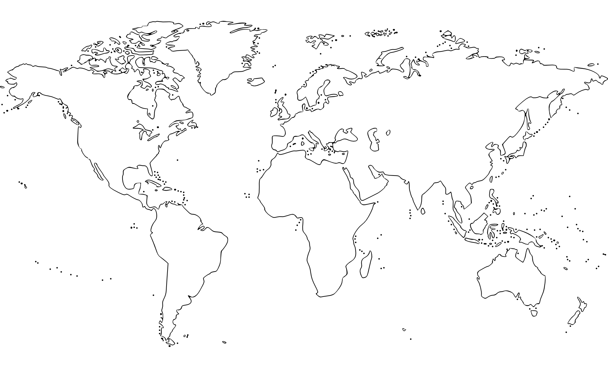
H3 Research
2
Kushagra Shrivastava
Deadly Viruses
COVID-19
SARS
Ebola
Introduction
Experiments and Methodology
Results and Discussion
Future Works

Slide 4
H3 Research
3
Kushagra Shrivastava
Methods of Virus Detection
Reverse Transcription – Polymerase Chain Reaction
False
Results
4 – 6 hours analysis time
Introduction
Experiments and Methodology
Results and Discussion
Future Works
Afzal, A. (2020). Molecular diagnostic technologies for COVID-19: Limitations and challenges. Retrieved from: https://dx.doi.org/10.1016%2Fj.jare.2020.08.002
Notes:
ART test works on a similar idea

Slide 5
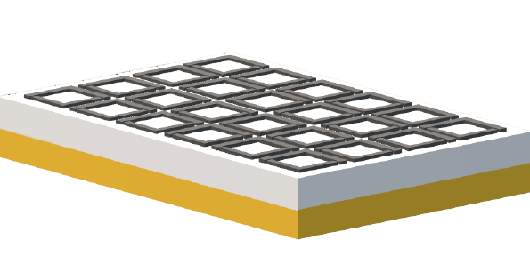
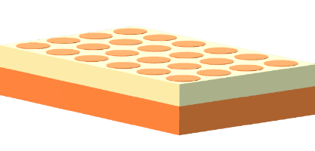
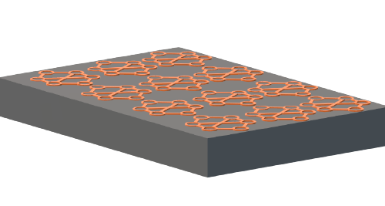
H3 Research
4
Kushagra Shrivastava
Metasurfaces
Subwavelength thickness
Optical antennae on top
Introduction
Experiments and Methodology
Results and Discussion
Future Works
Chen, H. T. (2016). A review of metasurfaces: physics and applications. Retrieved from: https://doi.org/10.1088/0034-4885/79/7/076401

Slide 6
H3 Research
5
Kushagra Shrivastava
Metasurfaces
Introduction
Experiments and Methodology
Results and Discussion
Future Works
Chen, H. T. (2016). A review of metasurfaces: physics and applications. Retrieved from: https://doi.org/10.1088/0034-4885/79/7/076401
Notes:
Binding the virus to the metasurface

Slide 7
H3 Research
6
Kushagra Shrivastava
Metasurfaces
Based on resonance due to structure
Small changes in the environment can have drastic effects
Introduction
Experiments and Methodology
Results and Discussion
Future Works
Chen, H. T. (2016). A review of metasurfaces: physics and applications. Retrieved from: https://doi.org/10.1088/0034-4885/79/7/076401

Slide 8
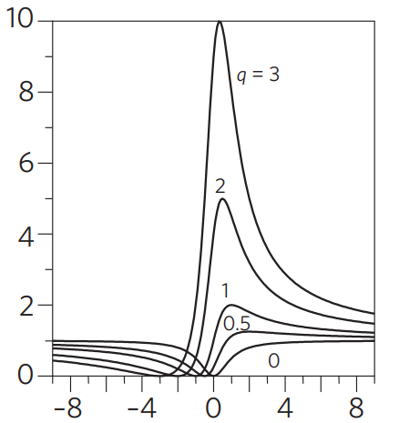
H3 Research
7
Kushagra Shrivastava
Fano Resonance
Introduction
Experiments and Methodology
Results and Discussion
Future Works
Limonov, M., Rybin, M., Poddubny, A., Kivshar, Y. (2017). Fano resonances in photonics. Retrieved from: http://dx.doi.org/10.1038/nphoton.2017.142

Slide 9
H3 Research
8
Kushagra Shrivastava
Fano Resonance
Sudden shift between a dip and rise
Sharp resonance peaks
Biosensing application
Introduction
Experiments and Methodology
Results and Discussion
Future Works
Limonov, M., Rybin, M., Poddubny, A., Kivshar, Y. (2017). Fano resonances in photonics. Retrieved from: http://dx.doi.org/10.1038/nphoton.2017.142

Slide 10
H3 Research
9
Kushagra Shrivastava
Aim
To create a structure that is highly sensitive to minute changes in refractive index in its local surroundings, so that it can quickly detect low concentrations of viruses using Fano resonance
Introduction
Experiments and Methodology
Results and Discussion
Future Works

Slide 11
Experiments and methodology

Slide 12
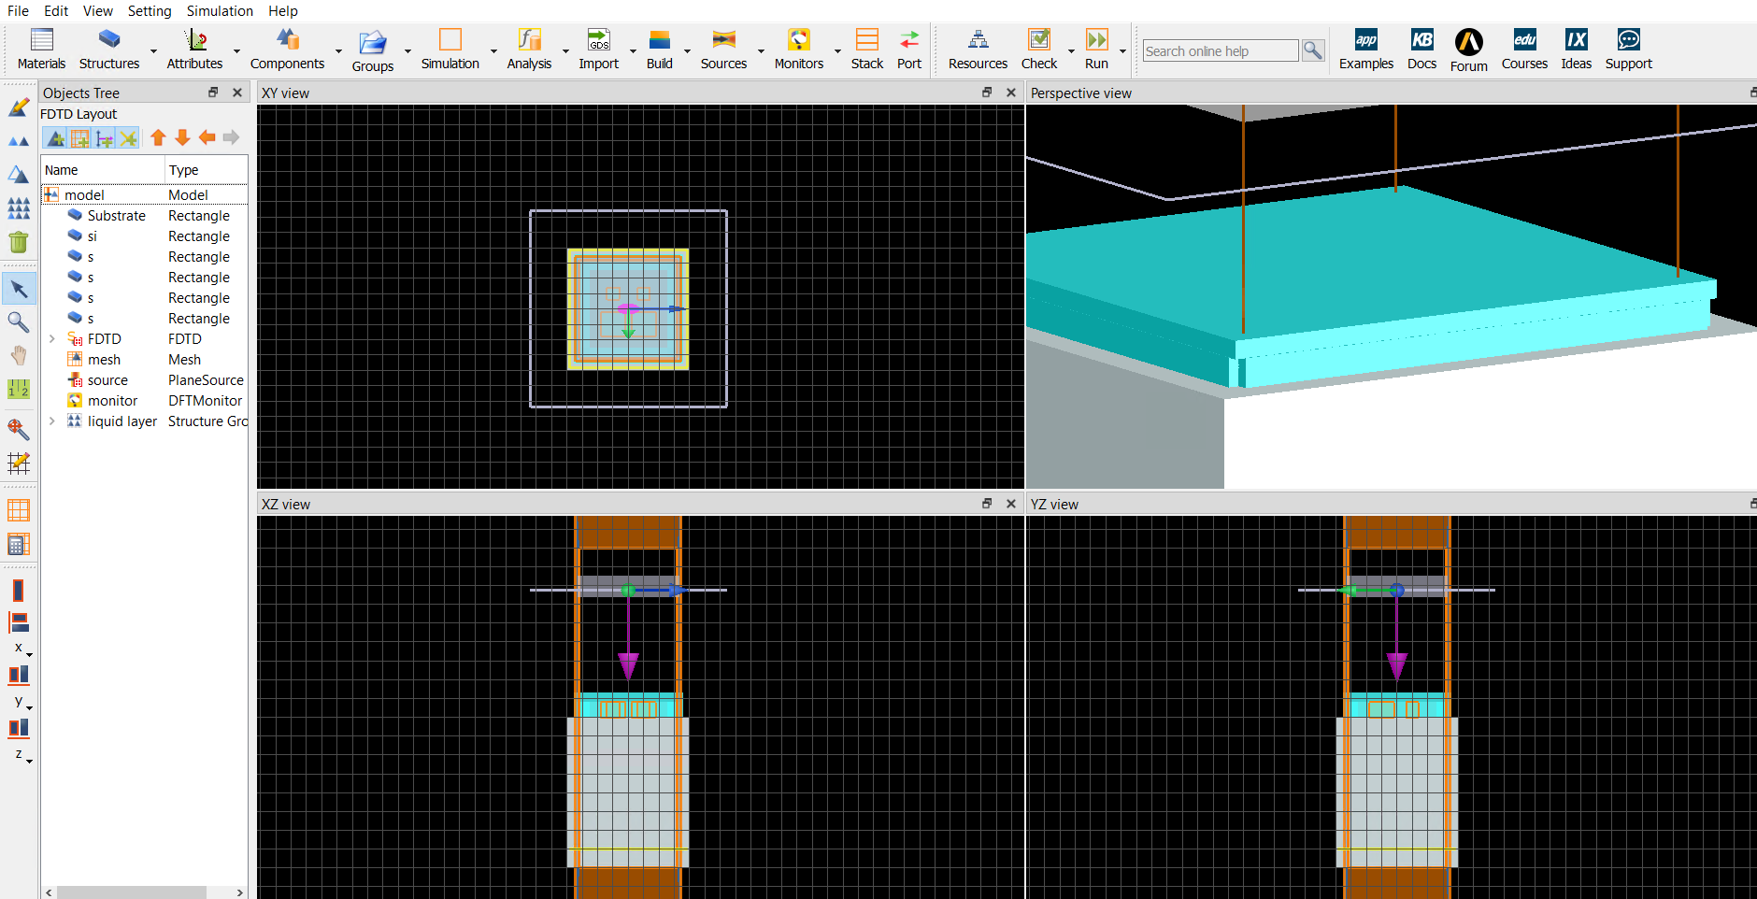
H3 Research
10
Kushagra Shrivastava
Lumerical-FDTD
Finite Difference Time Domain method is a computational method to solve Maxwell’s Equations
Introduction
Experiments and Methodology
Results and Discussion
Future Works
Taflove, A., & Hagness, S. (2010). Computational electrodynamics. Boston, Mass: Artech House.

Slide 13
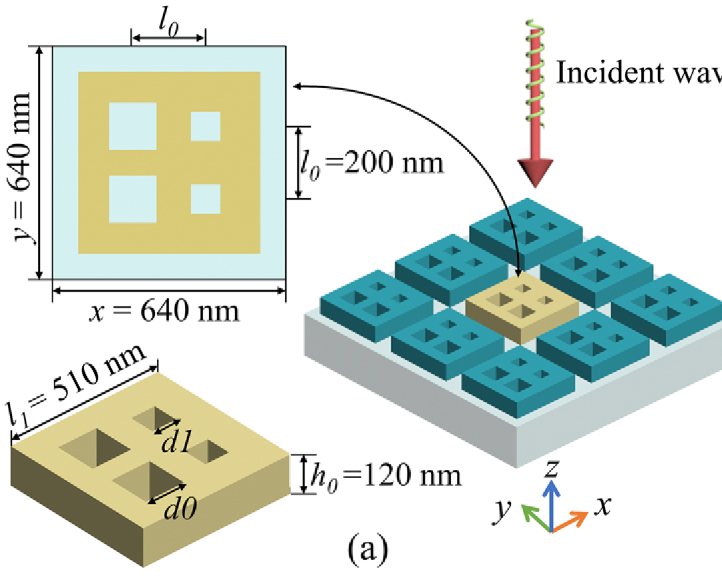
H3 Research
11
Kushagra Shrivastava
Structure Idea
Structure adopted from Yang et al.’s work on Fano resonance
Introduction
Experiments and Methodology
Results and Discussion
Future Works
Yang, L., Yu, S., Li, H., Zhao, T. (2021) Multiple Fano resonances excitation on all-dielectric nanohole arrays metasurfaces. Retrieved from: https://doi.org/10.1364/OE.419941
Notes:
Structure and wavelength relation

Slide 14
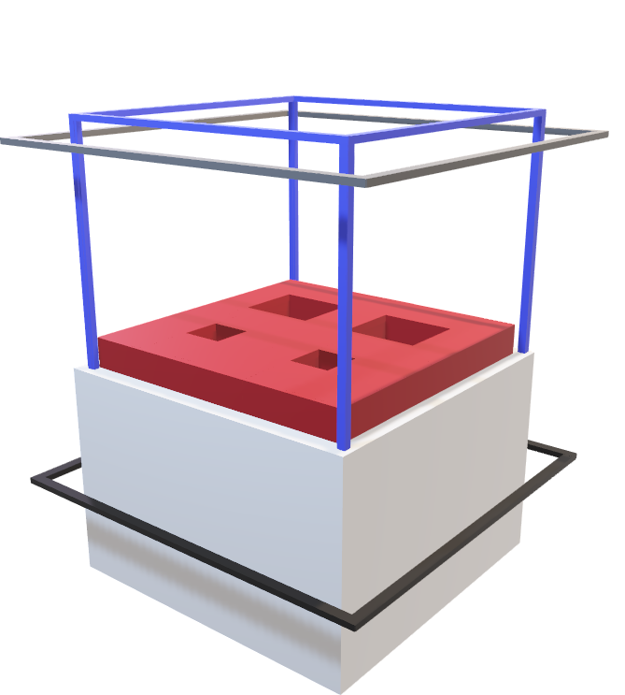
H3 Research
12
Kushagra Shrivastava
Experimental Metasurface
Plane wave source
Simulation Region
Refractive index:1.33
Etched Si Chip
SiO₂ Substrate
Transmission Monitor
Introduction
Experiments and Methodology
Results and Discussion
Future Works

Slide 15
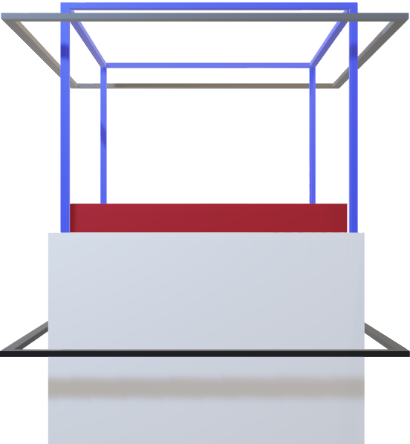
H3 Research
13
Kushagra Shrivastava
Experimental Metasurface
Runs on EM waves with wavelengths 900 nm to 1300 nm
Introduction
Experiments and Methodology
Results and Discussion
Future Works

Slide 16

H3 Research
14
Kushagra Shrivastava
Dimensions
Introduction
Experiments and Methodology
Results and Discussion
Future Works

Slide 17

H3 Research
14
Kushagra Shrivastava
Dimensions
510 nm
510 nm
Introduction
Experiments and Methodology
Results and Discussion
Future Works

Slide 18

H3 Research
15
Kushagra Shrivastava
Dimensions
h
h was altered from 60 nm to 160 nm
Introduction
Experiments and Methodology
Results and Discussion
Future Works

Slide 19

H3 Research
16
Kushagra Shrivastava
Dimensions
d_{l}
d_{l}
I
II
d_{l} was altered from 20 nm to 170 nm
d₀ was kept constant at 80 nm
d₀
d₀
III
IV
Introduction
Experiments and Methodology
Results and Discussion
Future Works

Slide 20
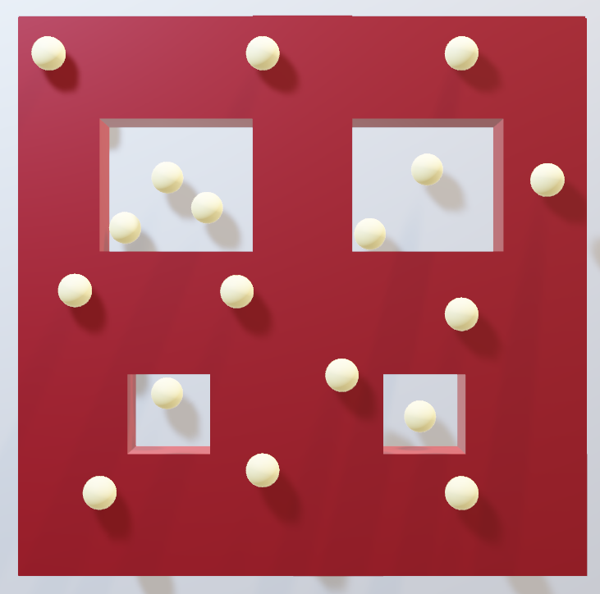
H3 Research
17
Kushagra Shrivastava
Virus simulation
Virus changes the local surface refractive index, causing a shift in resonant peaks
Introduction
Experiments and Methodology
Results and Discussion
Future Works

Slide 21
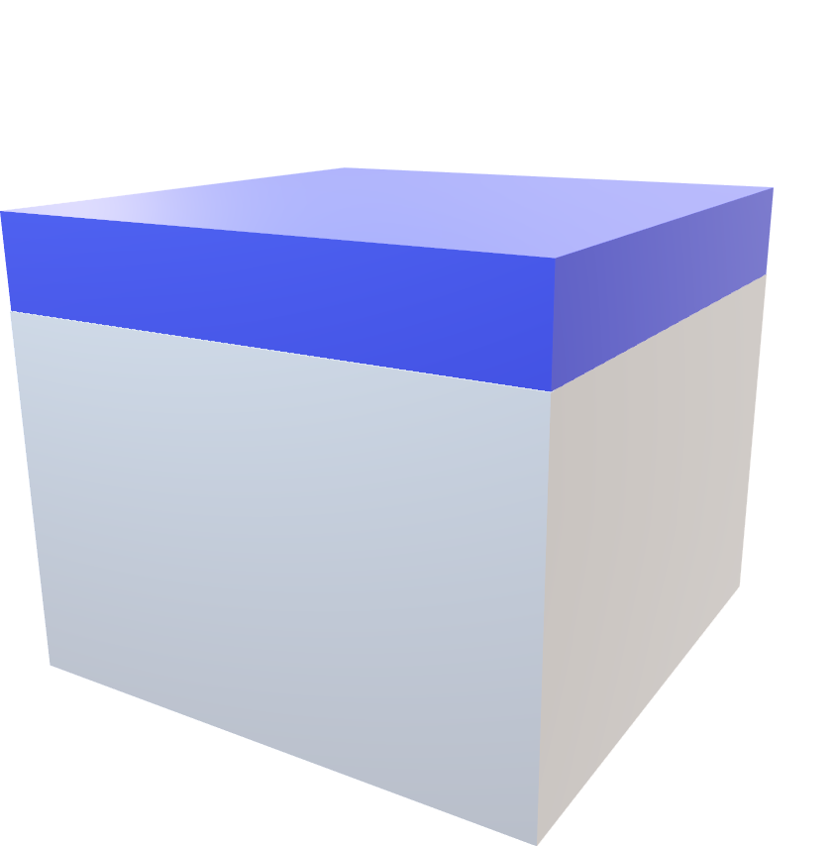
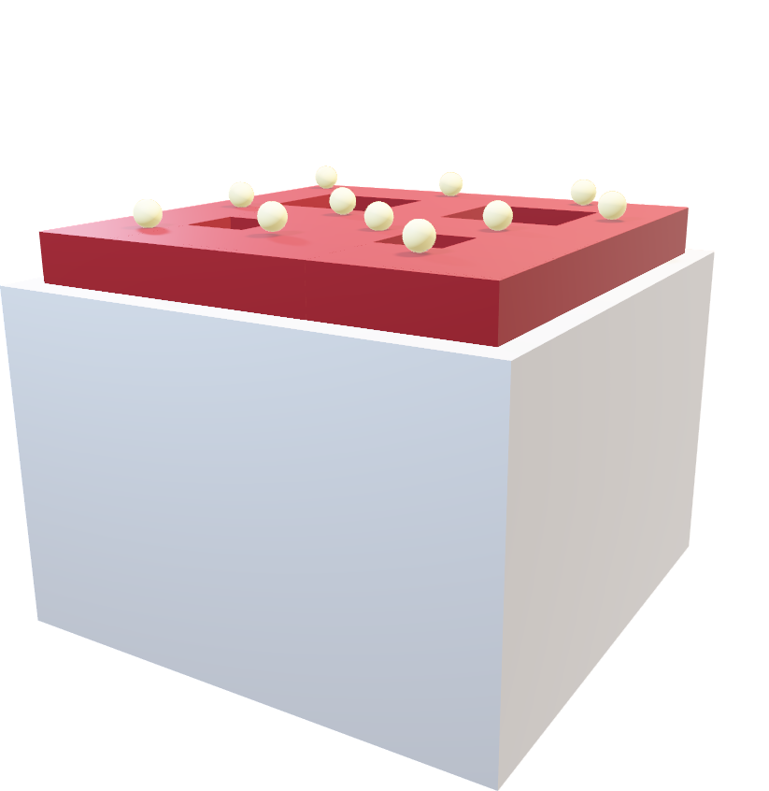
H3 Research
18
Kushagra Shrivastava
Liquid Layer
Δ Concentration of viruses ≡ Δ Refractive index of liquid layer
Varying Dimensions | Benchmark for best dimensions
1.34 | 1.34 – 1.40
Introduction
Experiments and Methodology
Results and Discussion
Future Works

Slide 22
Results and discussion

Slide 23

H3 Research
19
Kushagra Shrivastava
Principle of data analysis
Large shift in spectrum with sharp peaks
$$⇔$$
Better sensor
Introduction
Experiments and Methodology
Results and Discussion
Future Works

Slide 24
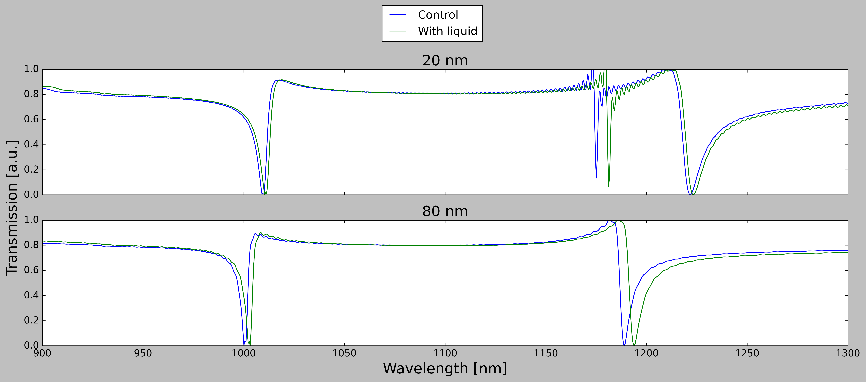
H3 Research
20
Kushagra Shrivastava
Altering d_{l}
Redshift increased as d_{l} increased
Introduction
Experiments and Methodology
Results and Discussion
Future Works

Slide 25
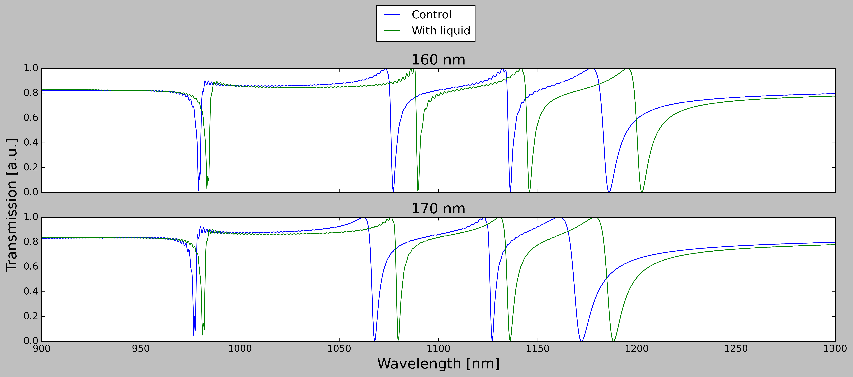
H3 Research
21
Kushagra Shrivastava
Altering d_{l}
Redshift decreased at 170 nm
d_{l} = 160 nm is better
4.28 nm
12.5 nm
9.80 nm
16.6 nm
4.26 nm
12.2 nm
9.20 nm
16.2 nm
Introduction
Experiments and Methodology
Results and Discussion
Future Works

Slide 26
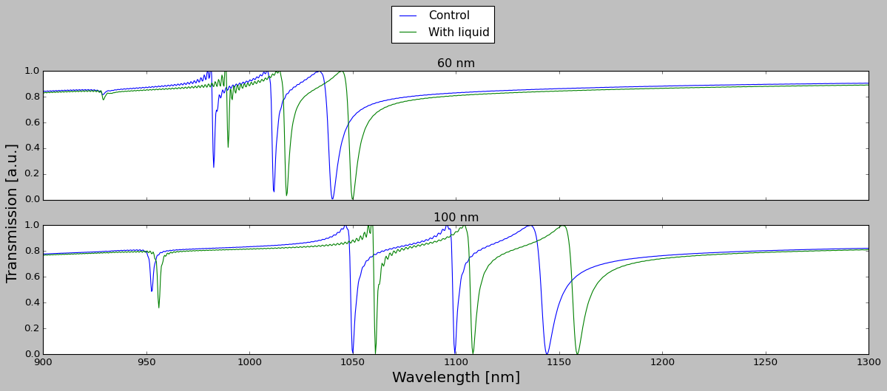
H3 Research
22
Kushagra Shrivastava
Altering h
No Fano resonance
Introduction
Experiments and Methodology
Results and Discussion
Future Works

Slide 27
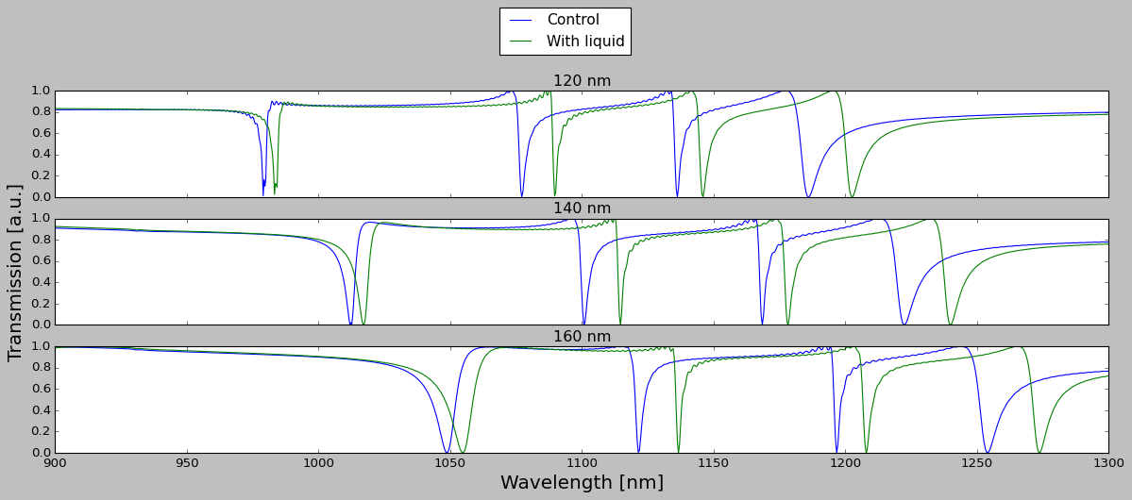
H3 Research
23
Kushagra Shrivastava
Altering h
Increasing width with similar redshift
h = 120 nm has the least peak width
Introduction
Experiments and Methodology
Results and Discussion
Future Works
Notes:
Overlaps between the peaks

Slide 28
H3 Research
24
Kushagra Shrivastava
Sensor dimensions
As per the last two experiments, h = 120 nm with
d_{l} = 160 nm will yield the best working sensor
Introduction
Experiments and Methodology
Results and Discussion
Future Works

Slide 29

H3 Research
25
Kushagra Shrivastava
Sensor Benchmarks (h = 120 nm, d_{l} = 160 nm)
Sensitivity
Measurement of how responsive sensor is to changes in refractive index
$$S=\frac{ⅆλ_{resonant}}{ⅆn_{surface}}$$
Resonant Wavelength
Local refractive index
Introduction
Experiments and Methodology
Results and Discussion
Future Works
Zhang, S., Wong, C., Zeng, S., Bi, R., Tai, K., Dholakia, K., & Olivo, M. (2020). Metasurfaces for biomedical applications: imaging and sensing from a nanophotonics perspective. Retrieved from: https://doi.org/10.1515/nanoph-2020-0373

Slide 30
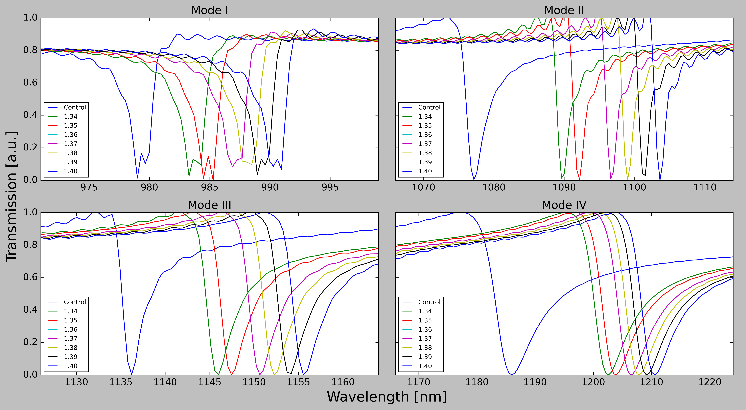
H3 Research
26
Kushagra Shrivastava
Sensor Benchmarks (h = 120 nm, d_{l} = 160 nm)
Sensitivity
Introduction
Experiments and Methodology
Results and Discussion
Future Works

Slide 31
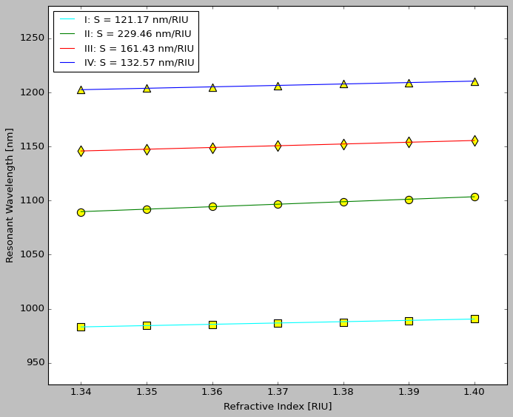
H3 Research
27
Kushagra Shrivastava
Sensor Benchmarks (h = 120 nm, d_{l} = 160 nm)
Sensitivity
Mode IV
Mode III
Mode II
Mode I
Introduction
Experiments and Methodology
Results and Discussion
Future Works

Slide 32

H3 Research
28
Kushagra Shrivastava
Sensor Benchmarks (h = 120 nm, d_{l} = 160 nm)
Figure of Merit (FOM)
Measures the resolution and sensing potential of the sensor
$$FOM=\frac{S}{FWHM}$$
Sensitivity
Full Width at Half Maximum
Introduction
Experiments and Methodology
Results and Discussion
Future Works
Afzal, A. (2020). Molecular diagnostic technologies for COVID-19: Limitations and challenges. Retrieved from: https://dx.doi.org/10.1016%2Fj.jare.2020.08.002
Notes:
Make reference to the benchmark for other tests

Slide 33
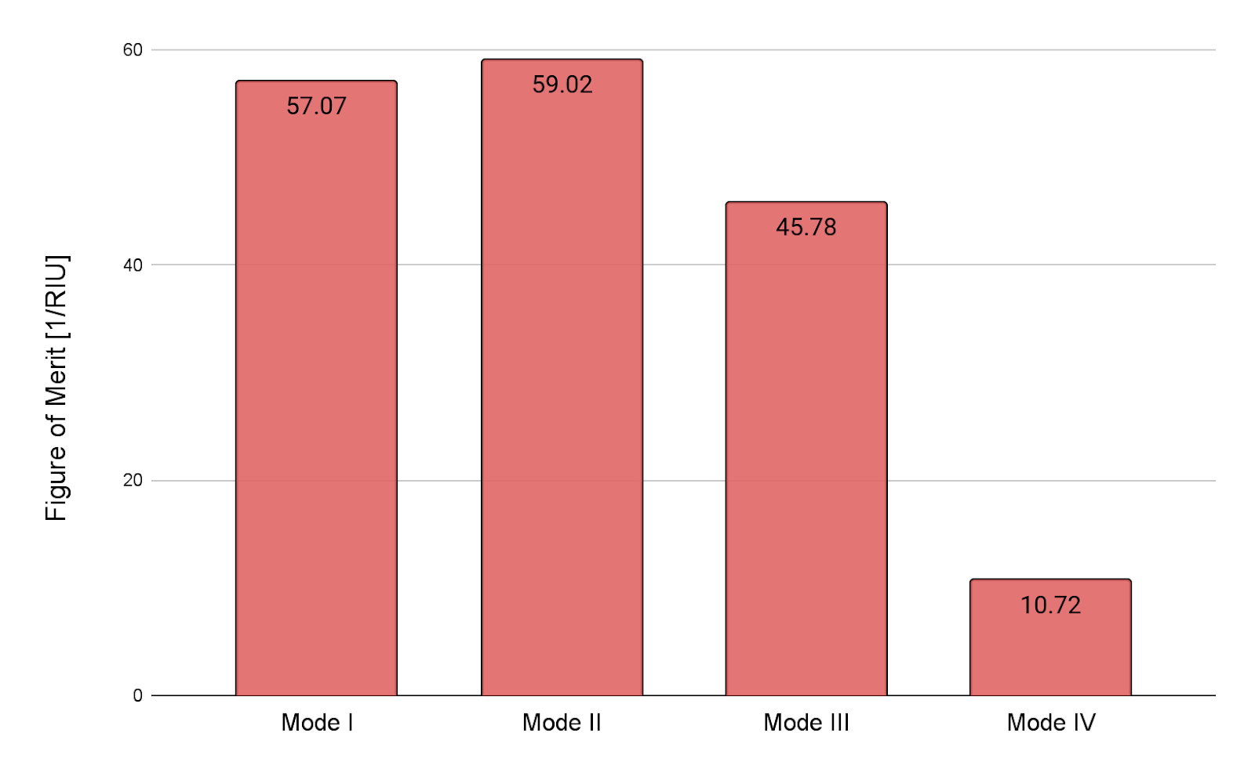
H3 Research
29
Kushagra Shrivastava
Sensor Benchmarks (h = 120 nm, d_{l} = 160 nm)
Figure of Merit (FOM)
Introduction
Experiments and Methodology
Results and Discussion
Future Works

Slide 34
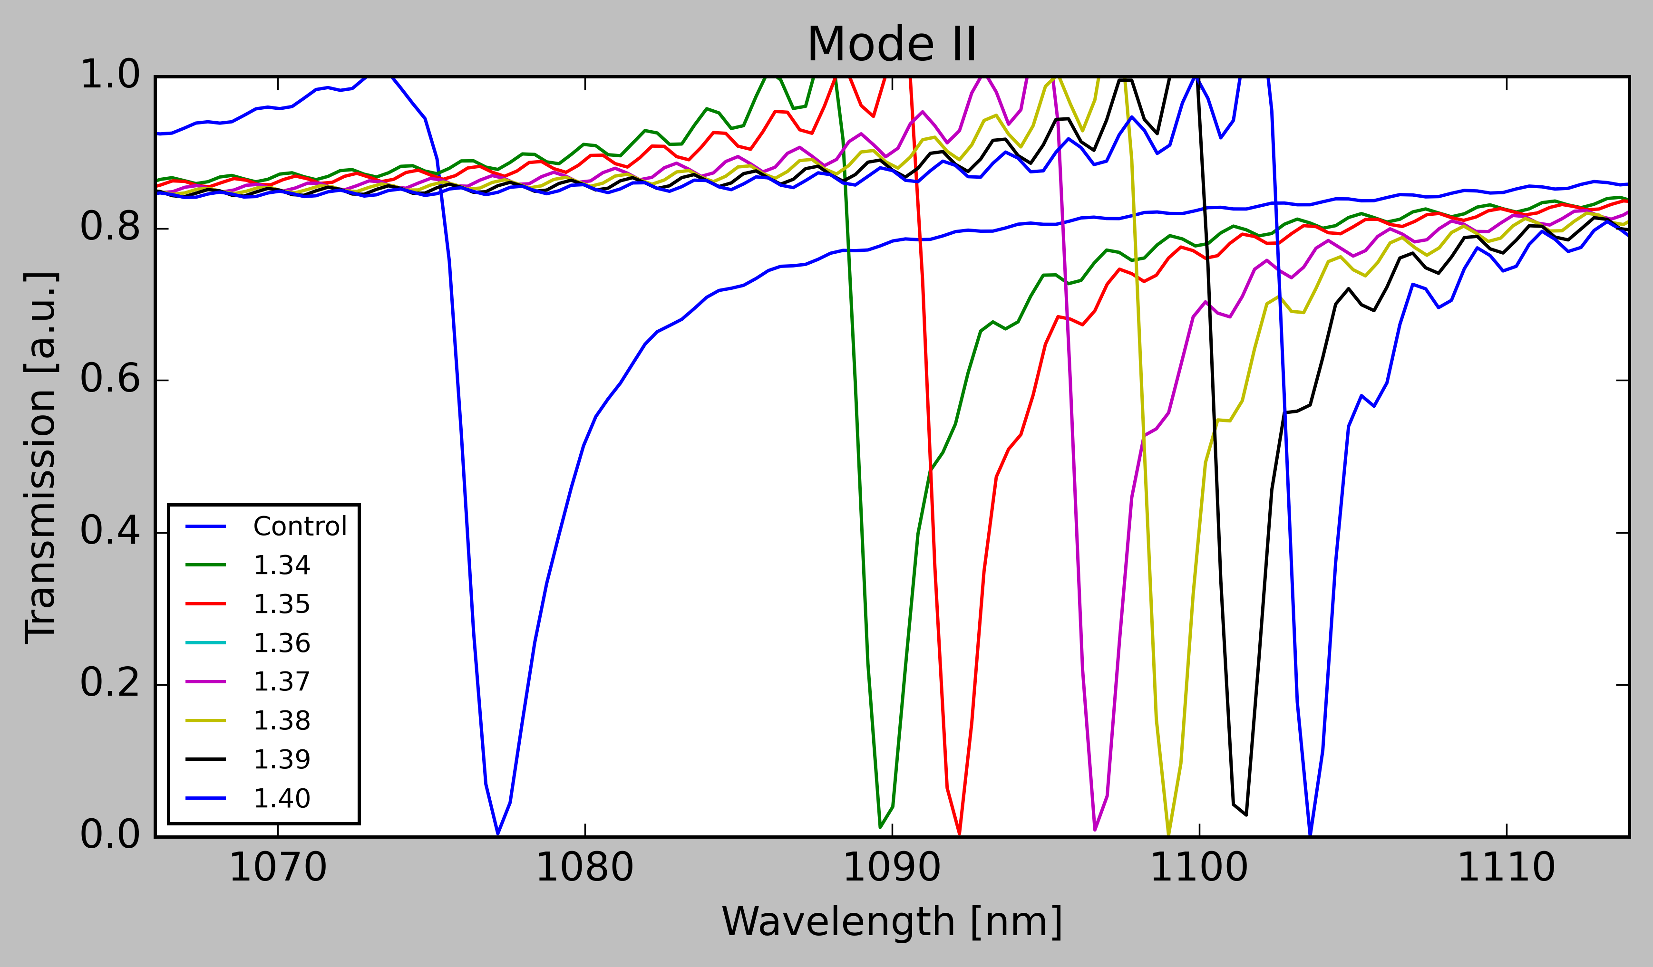
H3 Research
30
Kushagra Shrivastava
Analysis of the Benchmarks
Sensitivity: 229.46 nm/RIU
FOM: 59.04
Mode II is the best performing mode out of all the modes
Introduction
Experiments and Methodology
Results and Discussion
Future Works

Slide 35
H3 Research
31
Kushagra Shrivastava
Analysis of the Benchmarks
Other metasurface sensors have reached sensitivity up to 962 nm/RIU
Lower performance than other new sensors, but Si wafers cheaper and more efficient to manufacture (Si CMOS)
Introduction
Experiments and Methodology
Results and Discussion
Future Works
Lee, K., Huang, J., Chang, J., Wu, S., Weia, P. (2015). Ultrasensitive Biosensors Using Enhanced Fano Resonances in Capped Gold Nanoslit Arrays. Retrieved from: https://dx.doi.org/10.1038%2Fsrep08547
Li, N., Xu, Z., Dong, Y., Hu, T., Zhong, Q., & Fu, Y. et al. (2020). Large-area metasurface on CMOS-compatible fabrication platform: driving flat optics from lab to fab. From: https://doi.org/10.1515/nanoph-2020-0063

Slide 36
H3 Research
32
Kushagra Shrivastava
Overall Analysis
My research discovered sensor with d_{l}=160 nm and h=120 nm, working on wavelengths of mode II, was the best performing sensor, with high sensitivity and
Figure of Merit
Introduction
Experiments and Methodology
Results and Discussion
Future Works
Notes:
Make this more interesting

Slide 37
Future works

Slide 38
H3 Research
33
Kushagra Shrivastava
Future works
Engineering of the sensor with the abovementioned dimensions
Verification of the structure model by real experiment if possible
Introduction
Experiments and Methodology
Results and Discussion
Future Works
Notes:
Need to come out of the project – validation of the results

Slide 39
Thank you

Slide 40
References
[1] Page, J. (2021). In Hunt for Covid-19 Origin, Patient Zero Points to Second Wuhan Market. Retrieved from https://www.wsj.com/articles/in-hunt-for-covid-19-origin-patient-zero-points-to-second-wuhan-market-11614335404
[2] Adhanom, T. (2020). WHO Director-General's opening remarks at the media briefing on COVID-19. Retrieved from https://www.who.int/director-general/speeches/detail/who-director-general-s-opening-remarks-at-the-media-briefing-on-covid-19---11-march-2020
[3] Ozili, P., Arun, T. (2020). Spillover of COVID-19: Impact on the Global Economy. Retrieved from https://dx.doi.org/10.2139/ssrn.3562570
[4] Ritchie, H., Mathieu, E., Rodés-Guirao, L., Appel, C., Giattino, C., Ortiz-Ospina, E., Hasell, J., Macdonald, B., Beltekian, D., Roser, M. (2020). Coronavirus Pandemic (COVID-19). Retrieved from https://ourworldindata.org/coronavirus-data
[5] Mohapatra, R., Pintilie, L., Kandi, V., Sarangi, A., Das, D., Sahu, R., Perekhoda, L. The recent challenges of highly contagious COVID-19, causing respiratory infections: Symptoms, diagnosis, transmission, possible vaccines, animal models, and immunotherapy. Retrieved from https://dx.doi.org/10.1111%2Fcbdd.13761
[6] Jawerth, N. (2020). How is the COVID-19 virus detected using real time RT–PCR? Retrieved from: https://www.iaea.org/bulletin/infectious-diseases/how-is-the-covid-19-virus-detected-using-real-time-rt-pcr#:~:text=This%20technique%20allows%20scientists%20to,detecting%20the%20COVID%2D19%20virus.
[7] Afzal, A. (2020). Molecular diagnostic technologies for COVID-19: Limitations and challenges. Retrieved from: https://dx.doi.org/10.1016%2Fj.jare.2020.08.002
[8] GE Healthcare launches next generation Biacore (TM) molecular interaction analysis platform | GE News. (2016). Retrieved from https://www.ge.com/news/press-releases/ge-healthcare-launches-next-generation-biacoretm-molecular-interaction-analysis
[9] Label-Free Silicon Chip based Biosensing – Omega Optics. Retrieved from http://omegaoptics.com/technologies/label-free-silicon-chip-based-biosensing/
[10] Chen, H. T. (2016). A review of metasurfaces: physics and applications. Retrieved from: https://doi.org/10.1088/0034-4885/79/7/076401
[11] Escobedo, C. (2013). On-chip nanohole array based sensing: A review. Retrieved from: http://dx.doi.org/10.1039/c3lc50107h
[12] Amina, M., Siddiquia, O. Abutarbousha, H. Farhatb, M. Ramzanc, R. (2021). A THz graphene metasurface for polarization selective virus sensing. Retrieved from: https://doi.org/10.1016/j.carbon.2021.02.051
[13] Liu, L., Li, T., Liu, Z., Fan, F., Yuan, H., & Zhang, Z. et al. (2020). Terahertz polarization sensing based on metasurface microsensor display anti-proliferation of tumor cells with aspirin. Biomedical Optics Express. Retrieved from: https://doi.org/10.1364/boe.392056
[14] Li, Z., Zhu, Y., Hao, Y., Gao, M., Lu, M., Stein, A., Park, A., Hone, J., Lin, Q., Yu, N., (2019) Hybrid Metasurface-Based Mid-Infrared Biosensor for Simultaneous Quantification and Identification of Monolayer Protein. Retrieved from: https://doi.org/10.1021/acsphotonics.8b01470
[15] Limonov, M., Rybin, M., Poddubny, A., Kivshar, Y. (2017). Fano resonances in photonics. Retrieved from: http://dx.doi.org/10.1038/nphoton.2017.142
[16] Xu, R., Zhang, Z., Wieck, A., Jukam, M. (2020). Terahertz Fano resonances induced by combining metamaterial modes of the same symmetry. Retrieved from: https://doi.org/10.1364/OE.383713
[17] Pathania, P., Shishodia, M. (2021). Fano Resonance-Based Blood Plasma Monitoring and Sensing using Plasmonic Nanomatryoshka. Retrieved from: https://dx.doi.org/10.1007%2Fs11468-020-01343-z
[18] Lee, K., Huang, J., Chang, J., Wu, S., Weia, P. (2015). Ultrasensitive Biosensors Using Enhanced Fano Resonances in Capped Gold Nanoslit Arrays. Retrieved from: https://dx.doi.org/10.1038%2Fsrep08547
[19] Hajebifard, A., Berini, P. (2017). Fano resonances in plasmonic heptamer nano-hole arrays. Retrieved from: https://doi.org/10.1364/OE.25.018566

Slide 41
References
[20] Huang, T., Zeng, S., Zhao, X., Cheng, Z., Shum, P. (2018) Fano Resonance Enhanced Surface Plasmon Resonance Sensors Operating in Near-Infrared. Retrieved from: https://doi.org/10.3390/photonics5030023
[21] Yang, L., Yu, S., Li, H., Zhao, T. (2021) Multiple Fano resonances excitation on all-dielectric nanohole arrays metasurfaces. Retrieved from: https://doi.org/10.1364/OE.419941
[22] Palik, E. (1985). Handbook of optical constants of solids. Orlando: Academic Press.
[23] Ansys Insight: Diverging Simulations. (2021). Retrieved from https://forum.ansys.com/discussion/25566/ansys-insight-diverging-simulations
[24] Rumble, J. (2021). CRC HANDBOOK OF CHEMISTRY AND PHYSICS (102nd ed.). [S.l.]: CRC PRESS.
[25] Zhang, S., Wong, C., Zeng, S., Bi, R., Tai, K., Dholakia, K., & Olivo, M. (2020). Metasurfaces for biomedical applications: imaging and sensing from a nanophotonics perspective. Retrieved from: https://doi.org/10.1515/nanoph-2020-0373
[26] Mi, Q., Sang, T., Pei, Y., Yang, C., Li, S., Wang, Y., Ma, B. (2021). High-quality-factor dual-band Fano resonances induced by dual bound states in the continuum using a planar nanohole slab. Retrieved from: https://doi.org/10.1186/s11671-021-03607-x
[27] Li, N., Xu, Z., Dong, Y., Hu, T., Zhong, Q., & Fu, Y. et al. (2020). Large-area metasurface on CMOS-compatible fabrication platform: driving flat optics from lab to fab. Retrieved from: https://doi.org/10.1515/nanoph-2020-0063
[28] UCSB Science Line. (2014). Retrieved from http://scienceline.ucsb.edu/getkey.php?key=4527
[29] Barchiesi, D., Kessentini, S., Guillot, N., de la Chapelle, M., & Grosges, T. (2013). Localized surface plasmon resonance in arrays of nano-gold cylinders: inverse problem and propagation of uncertainties. Retrieved from: https://doi.org/10.1364/oe.21.002245

Slide 42
H3 Research
Kushagra Shrivastava
Fano Resonance
Strong damping
Weak damping
Introduction
Experiments and Methodology
Results and Discussion
Future Works
Limonov, M., Rybin, M., Poddubny, A., Kivshar, Y. (2017). Fano resonances in photonics. Retrieved from: http://dx.doi.org/10.1038/nphoton.2017.142

Slide 43
H3 Research
Kushagra Shrivastava
Fano Resonance
For metasurfaces, resonance is between the surface and external radiation
Introduction
Experiments and Methodology
Results and Discussion
Future Works
Limonov, M., Rybin, M., Poddubny, A., Kivshar, Y. (2017). Fano resonances in photonics. Retrieved from: http://dx.doi.org/10.1038/nphoton.2017.142

Slide 44
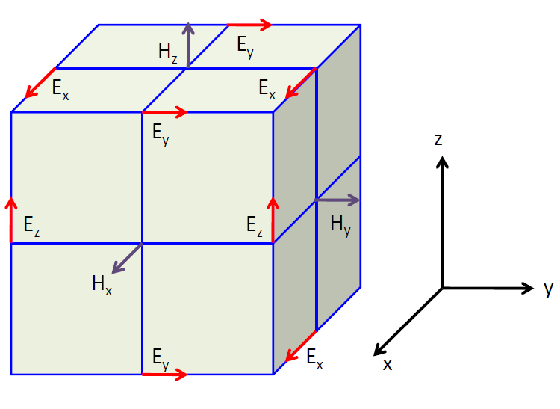
H3 Research
Kushagra Shrivastava
How does FDTD work? – Yee Cell
Introduction
Experiments and Methodology
Results and Discussion
Future Works
Taflove, A., & Hagness, S. (2010). Computational electrodynamics. Boston, Mass: Artech House.

Slide 45
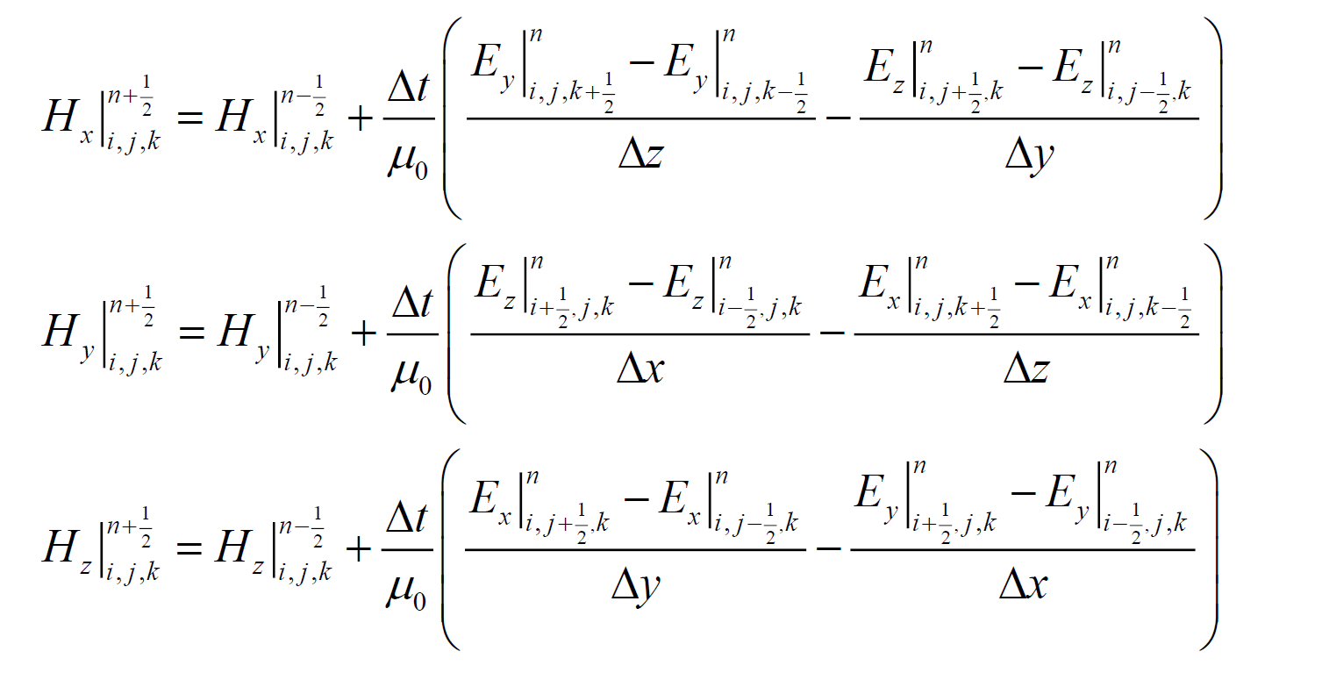
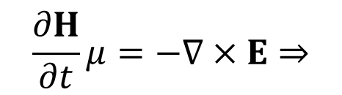
H3 Research
Kushagra Shrivastava
How does FDTD work? – Maxwell’s Curl Equations
$$\frac{∂H}{∂t}μ=−∇×E⇒$$
Introduction
Experiments and Methodology
Results and Discussion
Future Works
Taflove, A., & Hagness, S. (2010). Computational electrodynamics. Boston, Mass: Artech House.

Slide 46
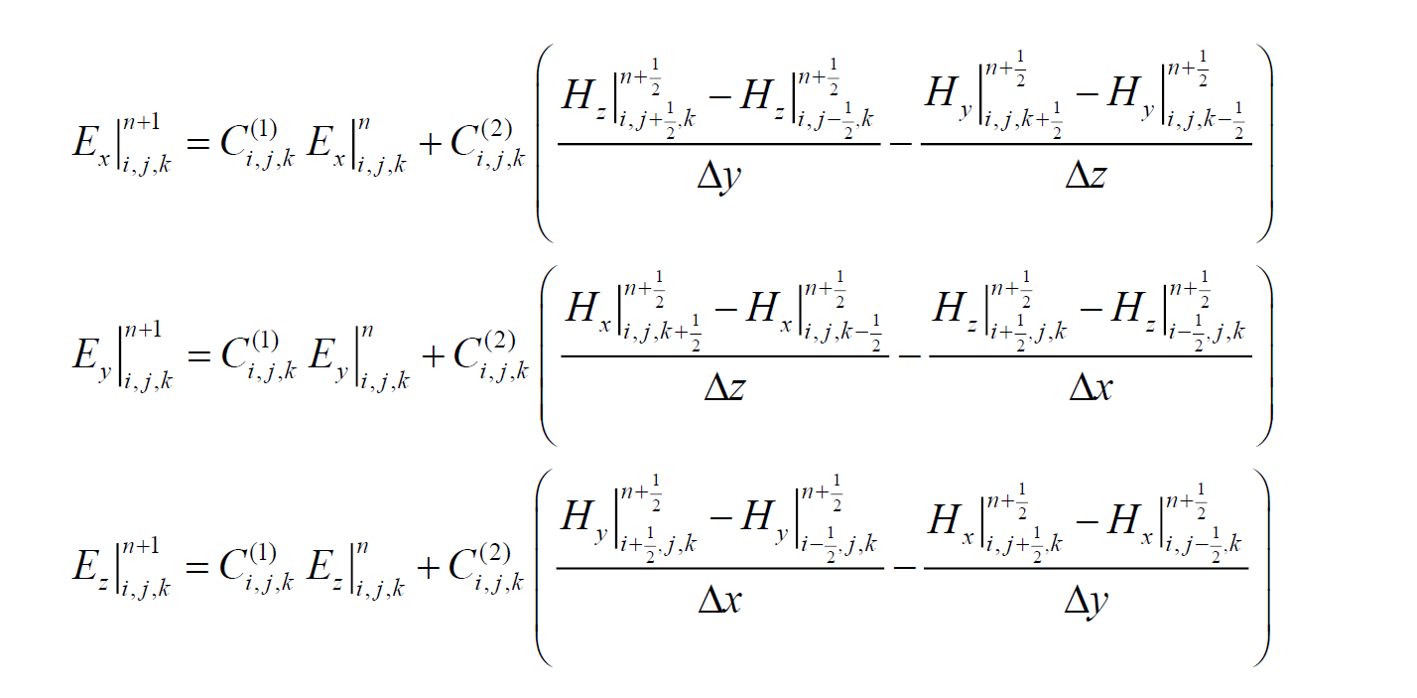
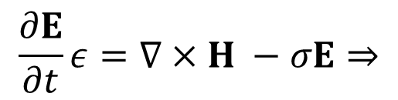
H3 Research
Kushagra Shrivastava
How does FDTD work? – Maxwell’s Curl Equations
$$\frac{∂E}{∂t}ε=∇×H −σE⇒$$
Introduction
Experiments and Methodology
Results and Discussion
Future Works
Taflove, A., & Hagness, S. (2010). Computational electrodynamics. Boston, Mass: Artech House.

Slide 47

H3 Research
Kushagra Shrivastava
How does Lumerical-FDTD calculate transmittance?
$$T\left(f\right)=\frac{\frac{1}{2}\int_{monitor}{Re \left(P\left(f\right)\right)⋅dS }}{sourcepower(f)}$$
$$P\left(f\right)=E(f)×H(f)$$
Introduction
Experiments and Methodology
Results and Discussion
Future Works
https://support.lumerical.com/hc/en-us/articles/360034405354-transmission-Script-command

Slide 48
H3 Research
Kushagra Shrivastava
Why does redshift occur?
Higher refractive index → Increase in dielectric function → Increase in polarization → Reduction in restoring force → Reduction in resonant frequency → Redshift of the spectrum
Introduction
Experiments and Methodology
Results and Discussion
Future Works
Duque, Johan. (2017). Re: Why does the peak of surface plasmon resonance shift to redder, longer wavelength with increasing the refractive index of the medium?. Retrieved from: https://www.researchgate.net/post/Why-does-the-peak-of-surface-plasmon-resonance-shift-to-redder-longer-wavelength-with-increasing-the-refractive-index-of-the-medium/58b60cf6eeae393cf93fdcd3/citation/download

Slide 49
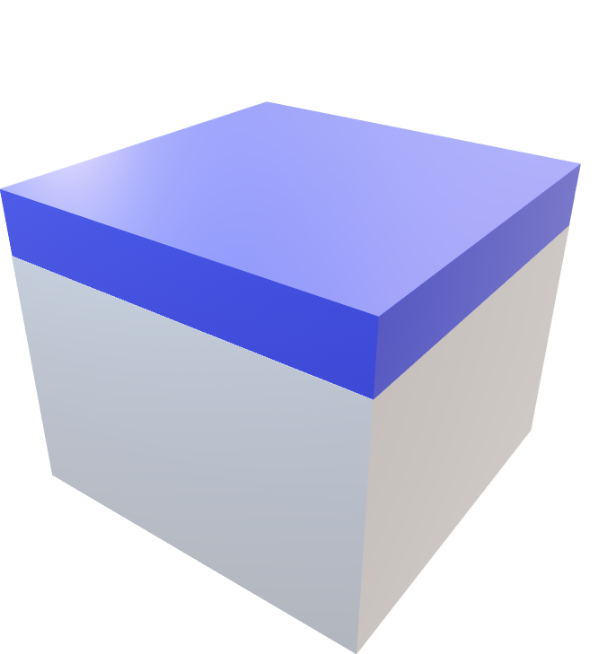
H3 Research
Kushagra Shrivastava
Liquid Layer
(50 + h) nm
50 nm
Introduction
Experiments and Methodology
Results and Discussion
Future Works

Slide 50
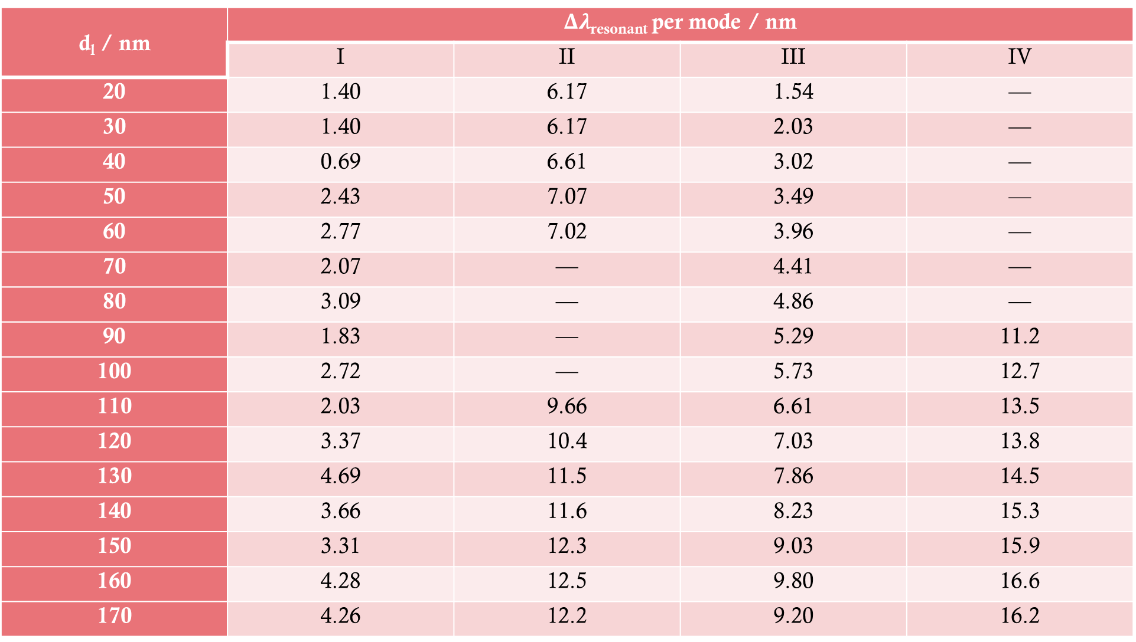
d_{l} / nm | $Δλ$_{resonant} per mode / nm
 | I | II | III | IV
20 | 1.40 | 6.17 | 1.54 | —
30 | 1.40 | 6.17 | 2.03 | —
40 | 0.69 | 6.61 | 3.02 | —
50 | 2.43 | 7.07 | 3.49 | —
60 | 2.77 | 7.02 | 3.96 | —
70 | 2.07 | — | 4.41 | —
80 | 3.09 | — | 4.86 | —
90 | 1.83 | — | 5.29 | 11.2
100 | 2.72 | — | 5.73 | 12.7
110 | 2.03 | 9.66 | 6.61 | 13.5
120 | 3.37 | 10.4 | 7.03 | 13.8
130 | 4.69 | 11.5 | 7.86 | 14.5
140 | 3.66 | 11.6 | 8.23 | 15.3
150 | 3.31 | 12.3 | 9.03 | 15.9
160 | 4.28 | 12.5 | 9.80 | 16.6
170 | 4.26 | 12.2 | 9.20 | 16.2

Slide 51
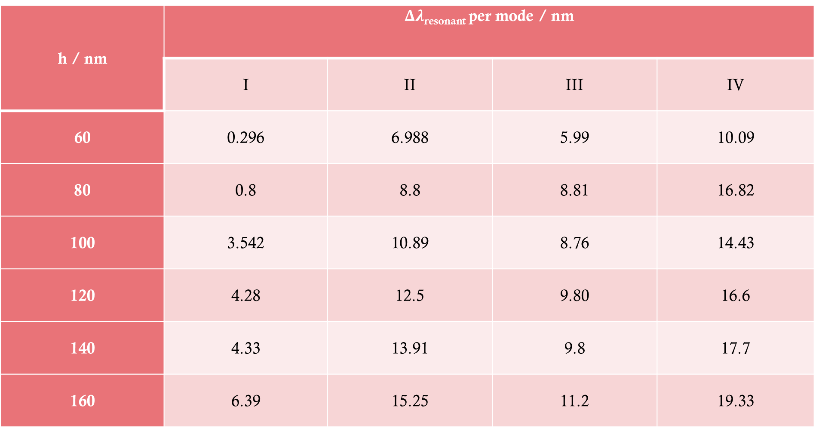
h / nm | $Δλ$_{resonant} per mode / nm
 | I | II | III | IV
60 | 0.296 | 6.988 | 5.99 | 10.09
80 | 0.8 | 8.8 | 8.81 | 16.82
100 | 3.542 | 10.89 | 8.76 | 14.43
120 | 4.28 | 12.5 | 9.80 | 16.6
140 | 4.33 | 13.91 | 9.8 | 17.7
160 | 6.39 | 15.25 | 11.2 | 19.33

Slide 52
Refractive index / RIU | Resonant wavelength per mode / nm
 | I | II | III | IV
1.34 | 983.284 | 1089.61 | 1146.02 | 1202.62
1.35 | 984.484 | 1092.19 | 1147.45 | 1203.90
1.36 | 985.686 | 1094.59 | 1149.05 | 1205.11
1.37 | 986.887 | 1096.60 | 1150.65 | 1206.31
1.38 | 987.688 | 1099.00 | 1152.25 | 1207.91
1.39 | 988.942 | 1101.11 | 1154.17 | 1209.09
1.40 | 990.954 | 1103.61 | 1155.54 | 1210.60
FWHM / nm | 2.123 | 3.888 | 3.526 | 12.363

Slide 53
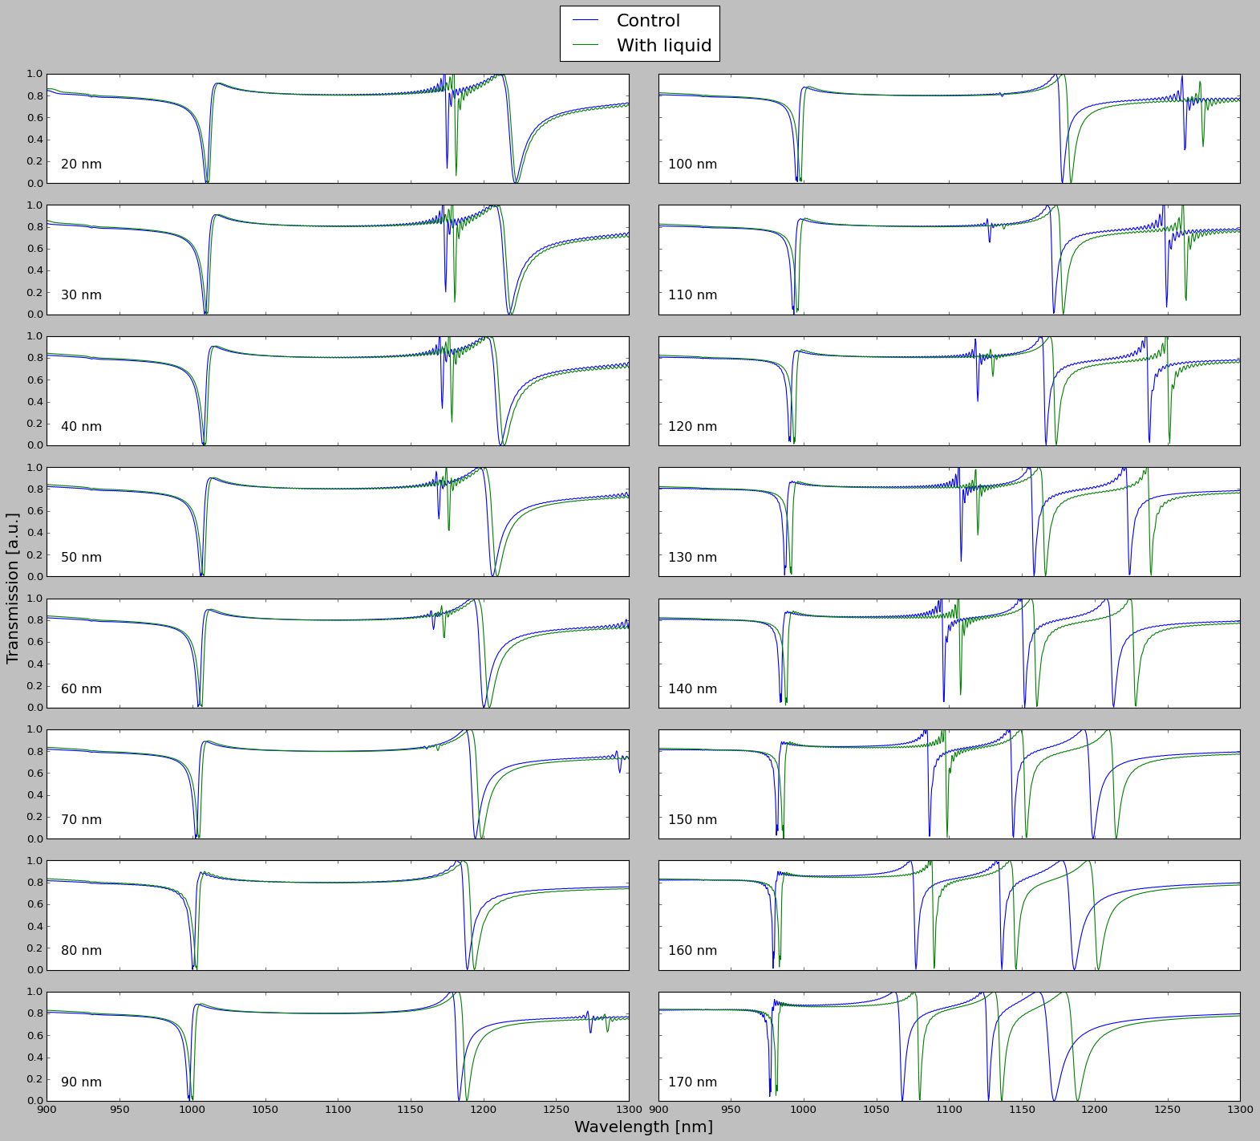

Slide 54
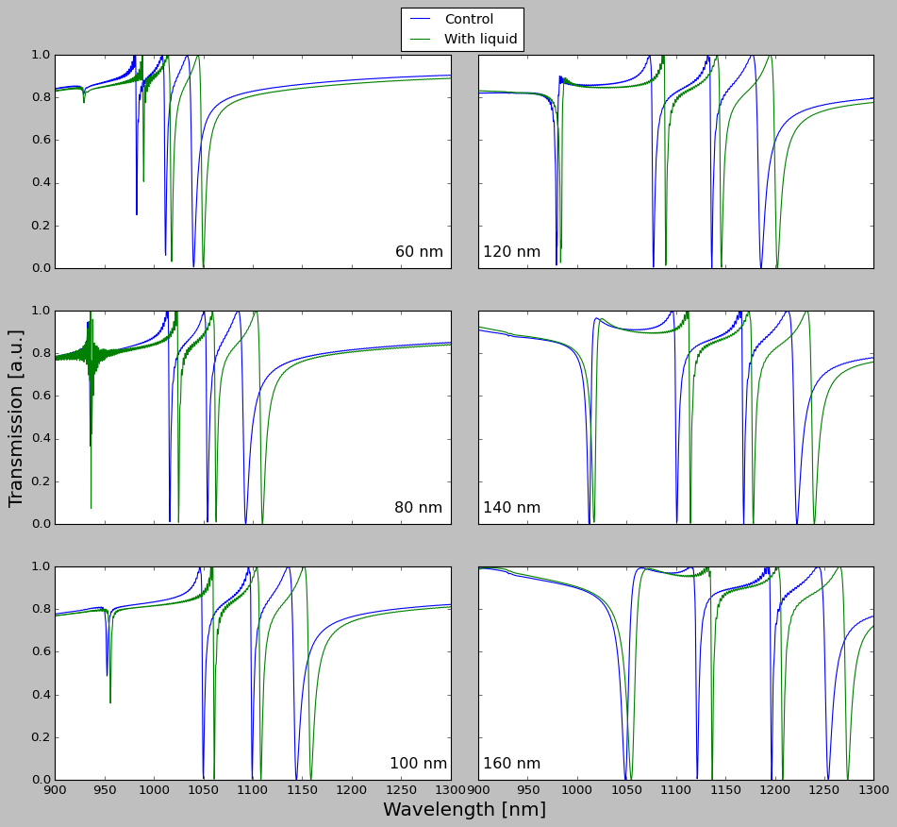

Slide 55
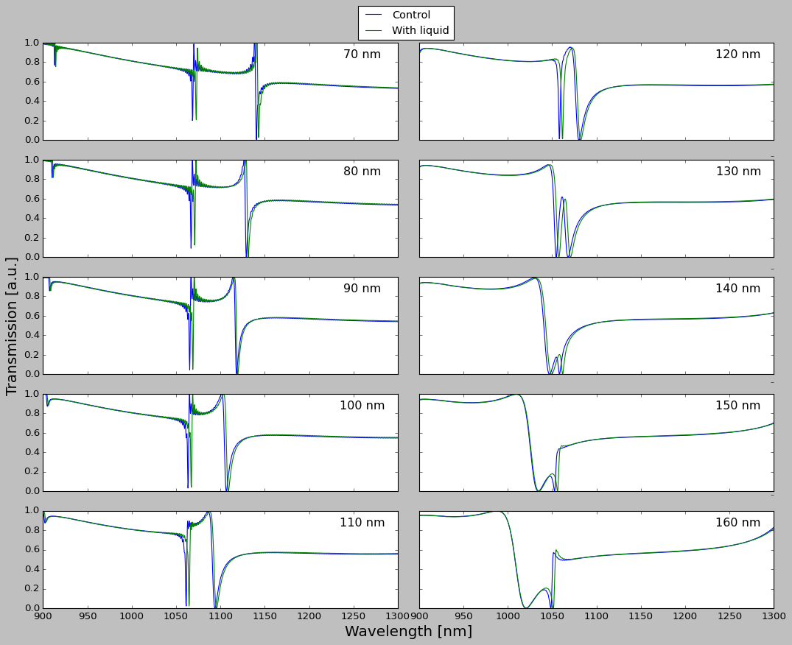
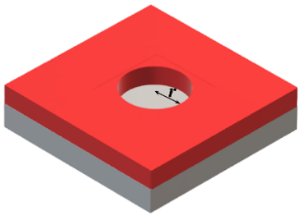
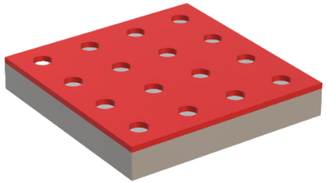

Slide 56
