Slide 1
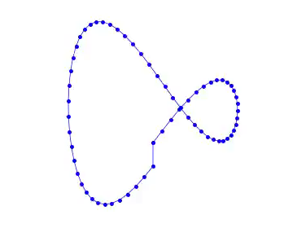
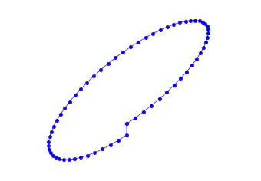
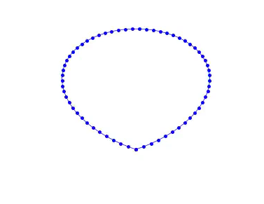
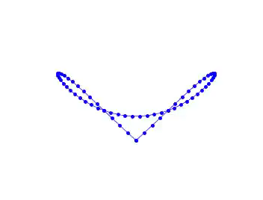
‘String’ Theory
Analysis of the Fermi-Pasta-Ulam-Tsingou Problem
Ting Jun Rui, Lu Xixun, Shrinjana Ghosh, Kushagra Shrivastava

Slide 2
Why FPUT?
Section 1
Enrico Fermi’s Brainchild

Slide 3
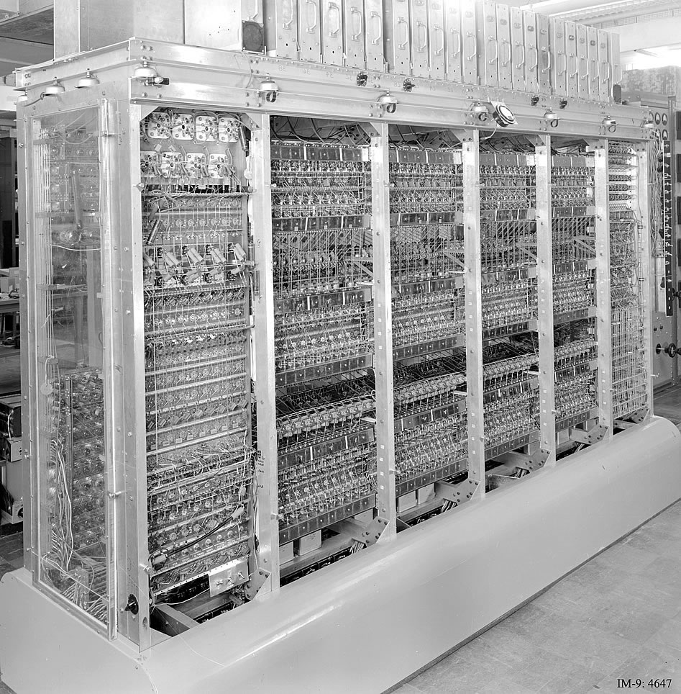
Epitome of CS in Science
A worthy opponent was needed!
MANIAC, Los Alamos Laboratory [1]
1
2
3
4
5
6
7

Slide 4
It has PASTA in its name.
1
2
3
4
5
6
7

Slide 5
Standing Waves
Section 2
Ut Tensio Sic Vis

Slide 6
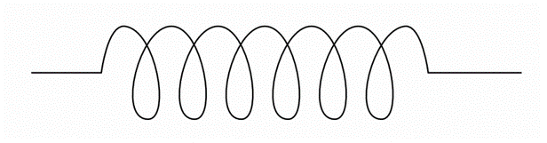

Hooke’s Law
$$F=−kx$$
1
2
3
4
5
6
7

Slide 7


Hooke’s Law
$$F=−kx$$
$$x$$
$$F$$
1
2
3
4
5
6
7

Slide 8

Hooke’s Law
$$F=−kx$$
$$x$$
$$F$$
1
2
3
4
5
6
7

Slide 9
Hooke’s Law
$$F=−kx$$
$$x$$
$$F$$
1
2
3
4
5
6
7

Slide 10
Hooke’s Law
$$F=−kx$$
$$x$$
$$F$$
1
2
3
4
5
6
7

Slide 11
Hooke’s Law
$$F=−kx$$
$$x$$
$$F$$
1
2
3
4
5
6
7

Slide 12
Chain of Springs
Assuming linear force only by neighboring masses
1
2
3
4
5
6
7

Slide 13
Chain of Springs
1
2
3
4
5
6
7

Slide 14
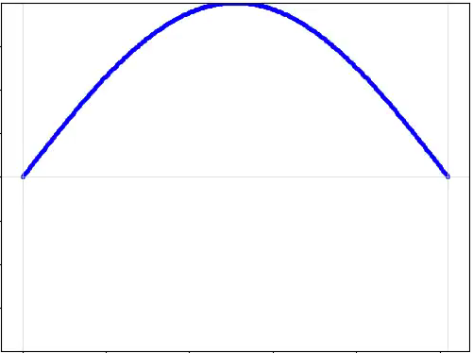
Fundamental Modes
1st Harmonic Mode
1
2
3
4
5
6
7

Slide 15
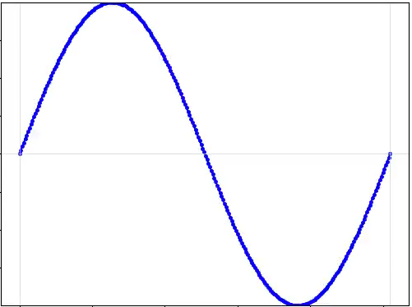
Fundamental Modes
What if we start the system like this?
1st Harmonic Mode
2nd Harmonic Mode
1
2
3
4
5
6
7

Slide 16
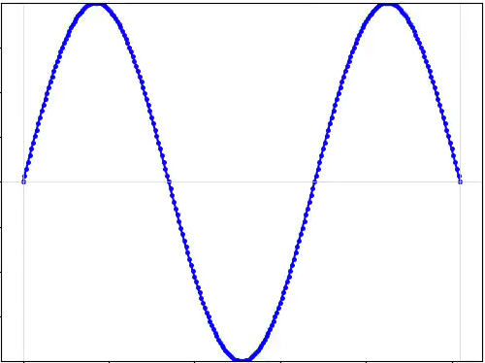
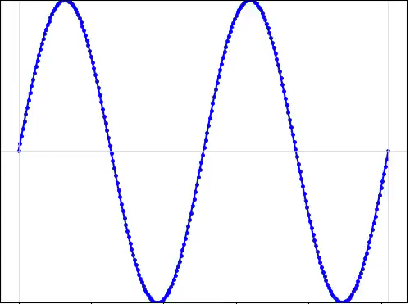
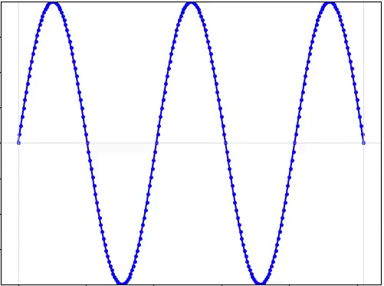
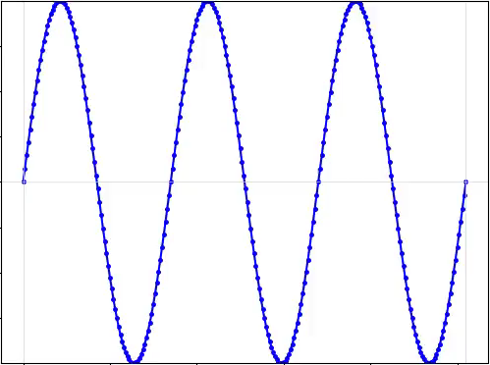
Fundamental Modes
1st Mode
2nd Mode
3rd Mode
4th Mode
5th Mode
6th Mode
1
2
3
4
5
6
7

Slide 17
Fermi-Pasta-Ulam-Tsinguo
Section 3
With all due respect to Tsinguo

Slide 18

Chain of Springs, but different
What if Hooke’s law is not linear? [2]
$$F=−kx−βx^{2}$$
Linear factor
Non-linear factor
1
2
3
4
5
6
7

Slide 19
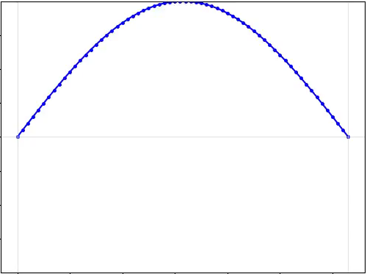
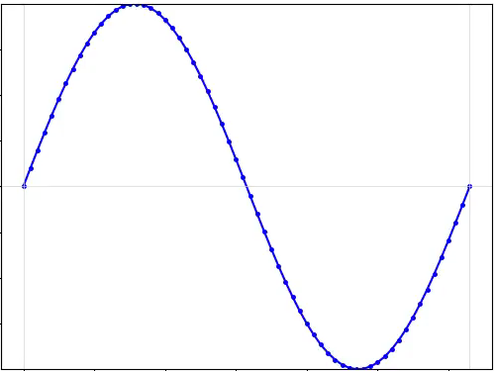
Coupled Oscillators
System will transfer energy between modes
…
N - Modes
1
2
3
4
5
6
7

Slide 20
Ergodic ‘Hypothesis’
If your states can interact with each other…
Hot
Cold
1
2
3
4
5
6
7

Slide 21
Ergodic ‘Hypothesis’
If your states can interact with each other… [2]
Lukewarm
1
2
3
4
5
6
7

Slide 22
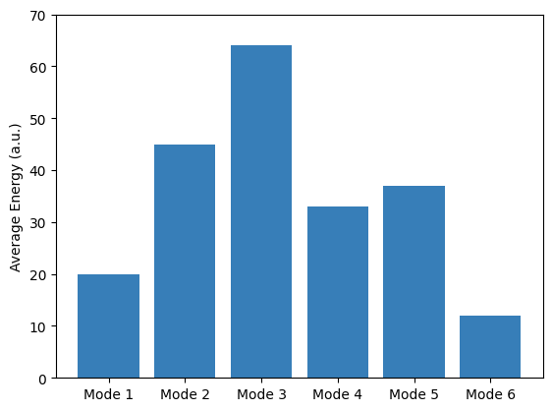
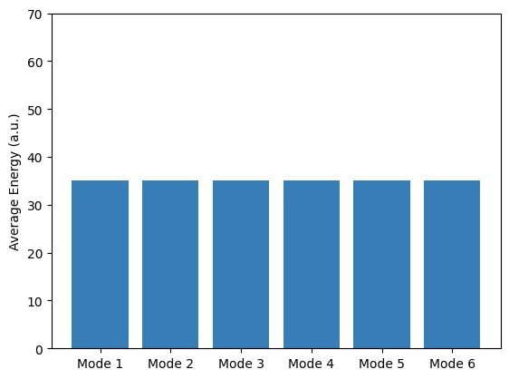
Ergodic ‘Hypothesis’
If your states can interact with each other…
When the system starts
Given ‘Enough’ time
1
2
3
4
5
6
7

Slide 23
Is the Ergodic Hypothesis correct?
1
2
3
4
5
6
7

Slide 24
Methodology
Section 4
Look what you made me do

Slide 25
FPUT is computationally complex
1
2
3
4
5
6
7

Slide 26
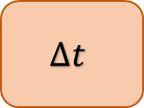
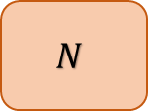
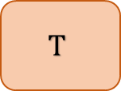
Constraints, Complexity, Computation
$$N$$
256 Particles
$$Δt$$
0.025 time units
10¹¹ operations
per simulation!
$$T$$
10⁵ time units
RK4
~50 vectorized operations
Model
20-30 vectorized operations
1
2
3
4
5
6
7

Slide 27


Programme Flow
INITIALIZATION
SIMULATION
GLOBALS & CONSTANTS
Compute Forces
Model Parameters
Initial Values
Calculate $y$ and $v$
DATA PROCESSING
& ANALYSIS
Increment $Δt$
METHODS
System Behavior
Numerical Integrator
Store results (whole/subset)
1
2
3
4
5
6
7

Slide 28
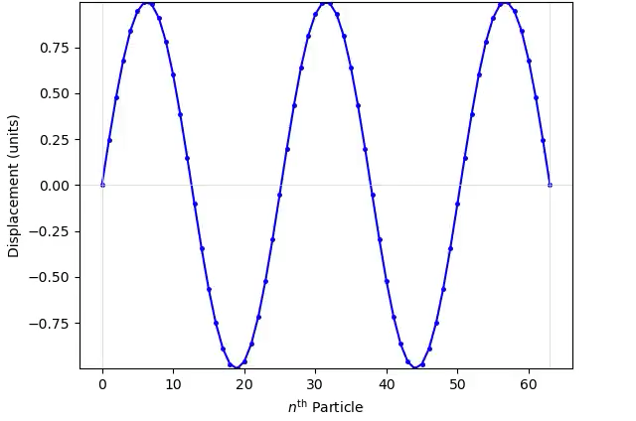





System Parameters & Initial Values
Model Parameters
Initial Values
System Behavior
Initial Energy Distribution
No. of modes (N_MODE)
e.g. 5 modes
Simulation time-span $T$
Number of particles $N$
Simulation time-step $Δt$
Linear coefficient $k$
Time-evolution model
Fixed
Periodic
Nonlinear coefficient $β$
1
2
3
4
5
6
7

Slide 29
Time-step Analysis
KEY IDEA
Less accurate time evolution
Shorter simulation time
Longer time-step
More accurate time evolution
Longer simulation time
Shorter time-step
1
2
3
4
5
6
7

Slide 30
Time-step Analysis
Shortest time-step
Longer time-step
Longest time-step
↓ scipy.odeint ↓
Shortest time-step
Longer time-step
Longest time-step
1
2
3
4
5
6
7

Slide 31
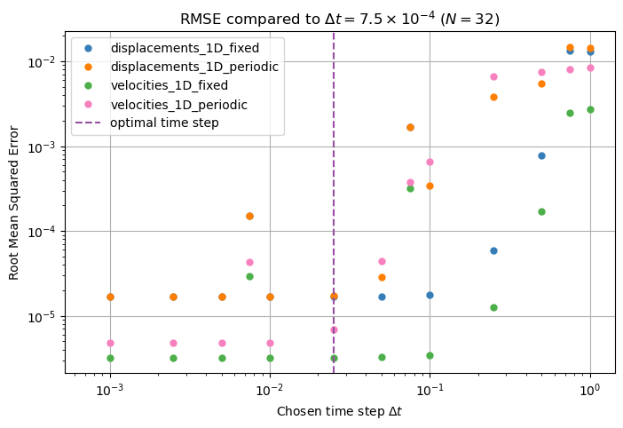
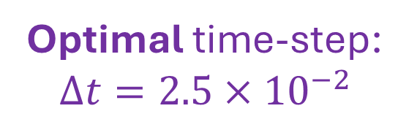
Time-step
Reference dataset:
Shortest time-step
Optimal time-step:
$$Δt=2.5×{10}^{−2}$$
1
2
3
4
5
6
7

Slide 32
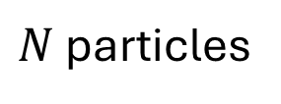
Boundary conditions
1
N
$N$ particles
1
2
3
4
5
6
7

Slide 33
Boundary conditions
Fixed
Periodic
1
N
1
N
1
2
3
4
5
6
7

Slide 34

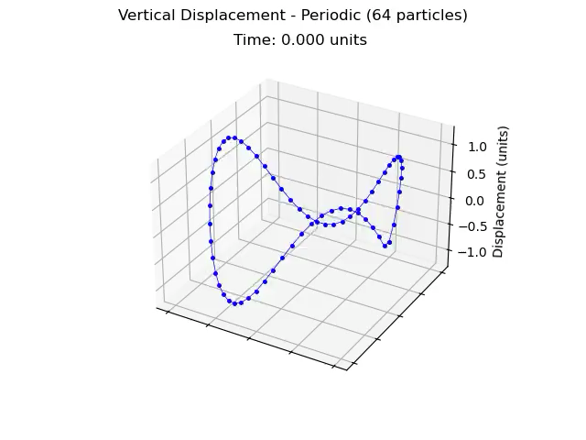

Boundary conditions
Fixed
Periodic
1
2
3
4
5
6
7

Slide 35
Numerical Integrator
Numerical Integrator
Efficiency
Accuracy
numpy/numpa friendly
Euler’s Method
Verlet Integration
Runge–Kutta 4 Method
scipy.odeint
1
2
3
4
5
6
7

Slide 36
Simulation Loop
INITIALISATION
Input parameters and initial values
ITERATION OVER EACH STEP
RETURNS THE RESULTS
Iterate over each time step and compute all values through Vectorized numpy operations
Returns: displacements and velocities for each step
Define the number of simulation and time step for each step
1
2
3
4
5
6
7

Slide 37
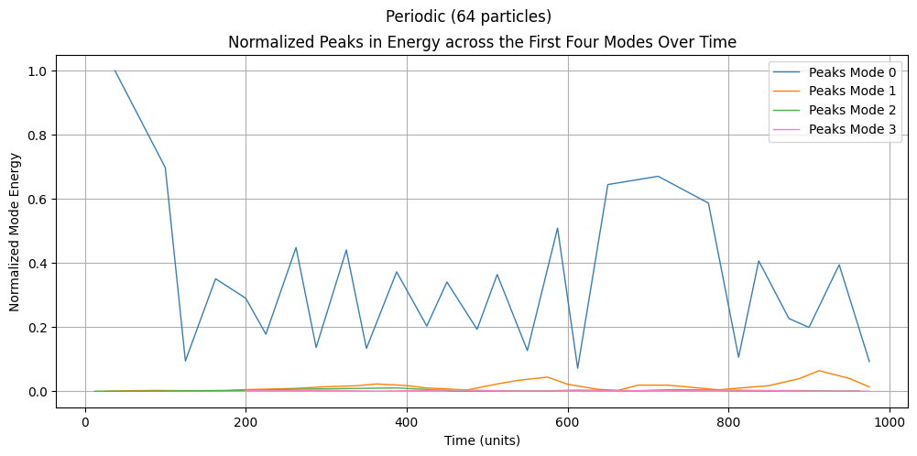
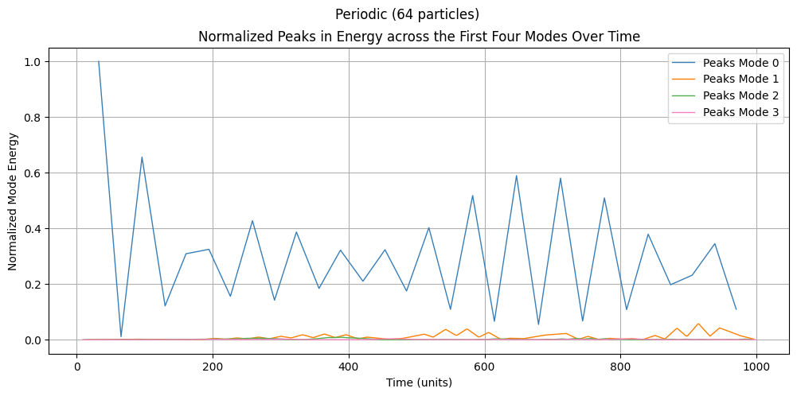
Data Selection
Subset
Complete
All displacement and velocity data
Sliced by step of 500
Complete Dataset
1
2
3
4
5
6
7

Slide 38
Analysing the Fixed BC
Section 5
So, what do we observe?

Slide 39
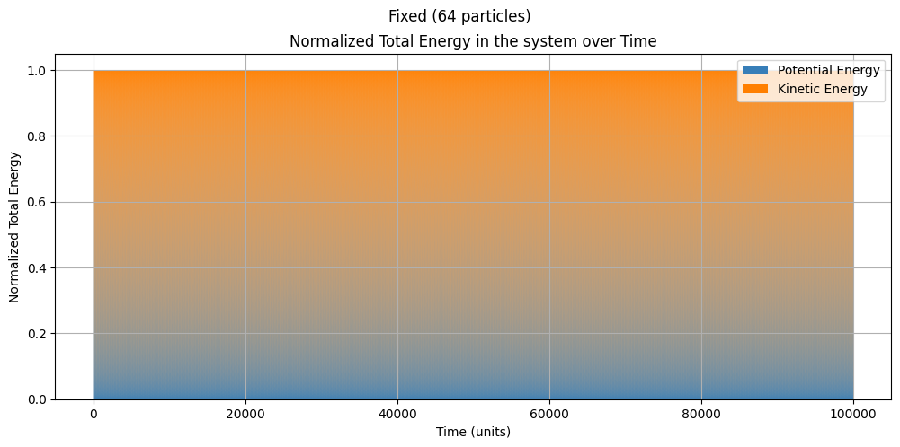
Is our Simulation working correctly…
The Total Energy is CONSTANT!
1
2
3
4
5
6
7

Slide 40
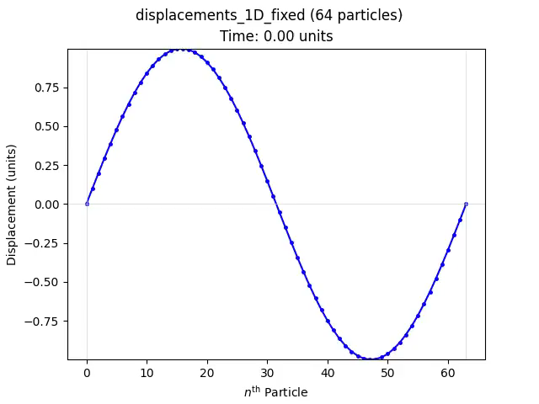
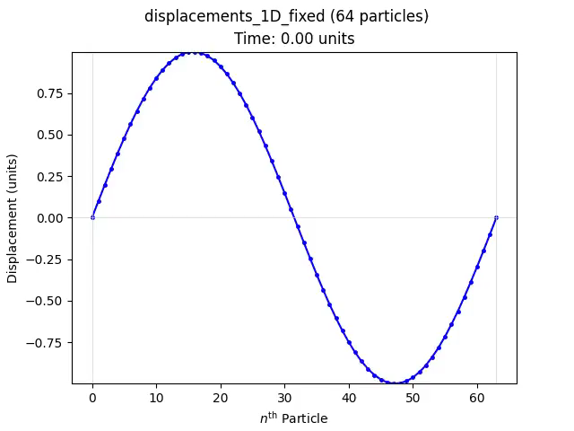
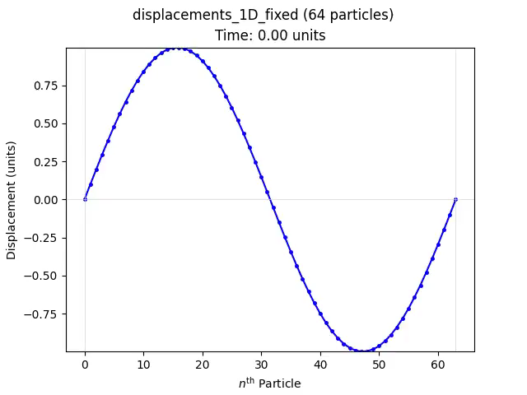



Chaotic behaviour
A greater non-linearity will result in greater chaos
$$β=0.0$$
$$β=0.2$$
$$β=1.0$$
1
2
3
4
5
6
7

Slide 41
Ergodic Hypothesis does not hold.
1
2
3
4
5
6
7

Slide 42
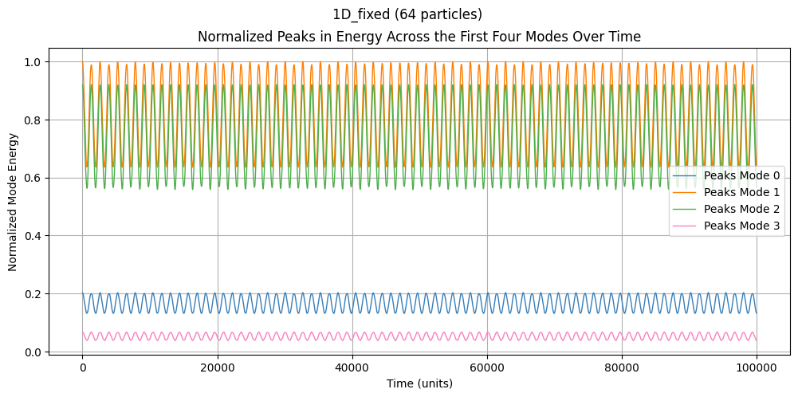
Energy of Modes
The energy is NOT distributed evenly in each mode overtime!
1
2
3
4
5
6
7

Slide 43
Analysing the Periodic BC
Section 6
Our Extension(s)

Slide 44
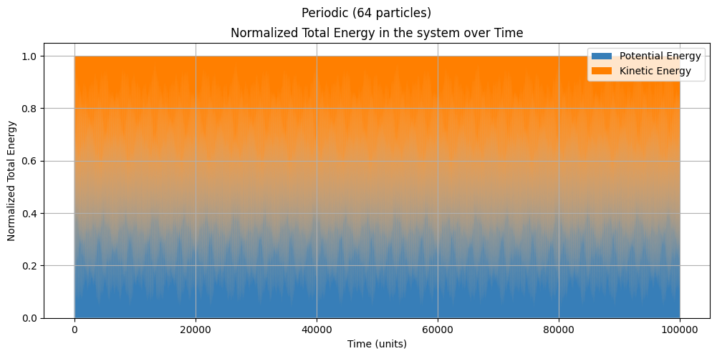
Is our simulation working correctly?
Total Energy is CONSTANT! (Again)
[which is unexpected since this was our idea!]
1
2
3
4
5
6
7

Slide 45
Physically,
This is how we interpret a periodic setup
but it is slightly hard to ‘science visually’
1
2
3
4
5
6
7

Slide 46
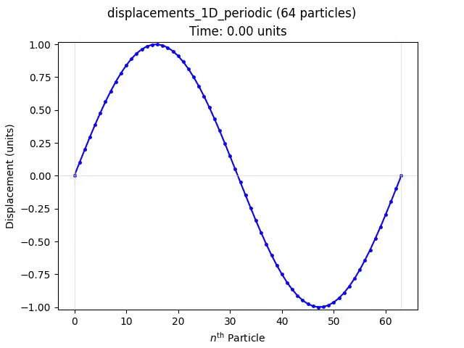
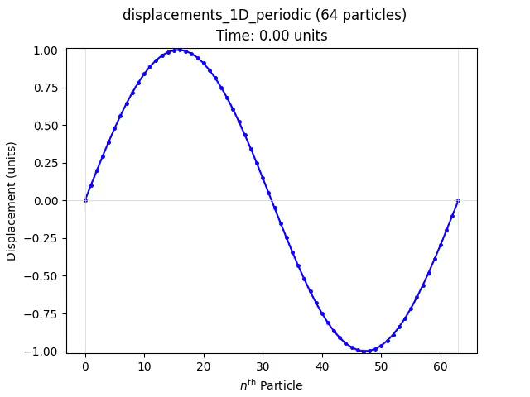
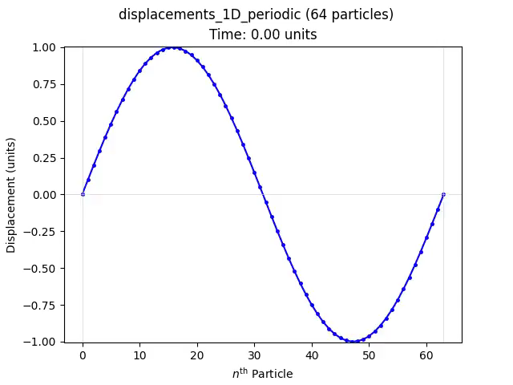
Chaotic behaviour
A greater non-linearity will result in greater chaos
$$β=0.0$$
$$β=0.2$$
$$β=1.0$$
1
2
3
4
5
6
7

Slide 47
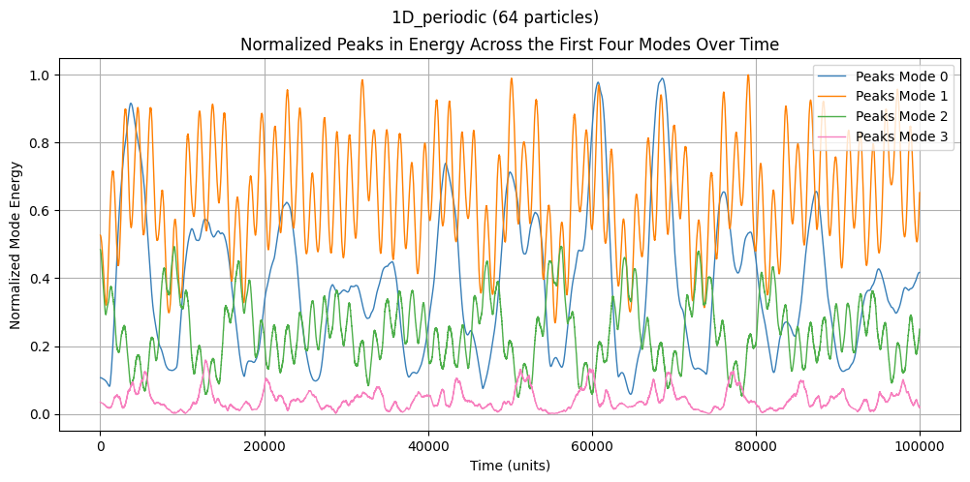
Energy of Modes
The energy is NOT distributed evenly in each mode!
1
2
3
4
5
6
7

Slide 48
2-Dimensional FPUT
Section 7
Because why stop at 1D?

Slide 49
Extension: 1D to 2D
1-Dimensional
2-Dimensional
1
2
3
4
5
6
7

Slide 50
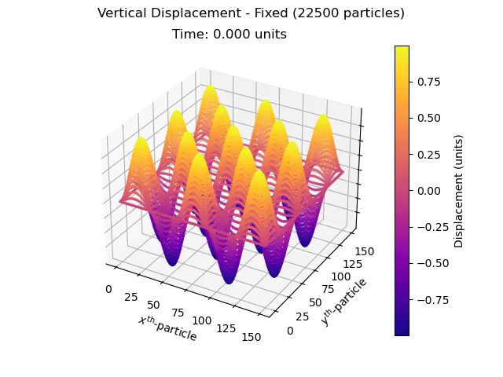
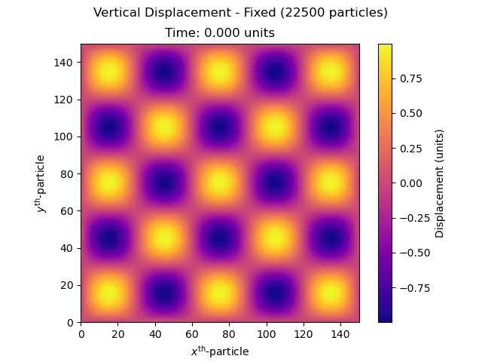
Extension: 2-Dimensional Fixed
Instead of one degree of freedom, let’s have two
1
2
3
4
5
6
7

Slide 51
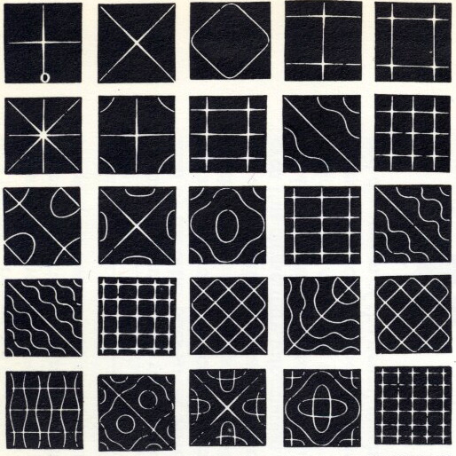
Application: 2-Dimensional Fixed
Chladni Patterns
1
2
3
4
5
6
7

Slide 52
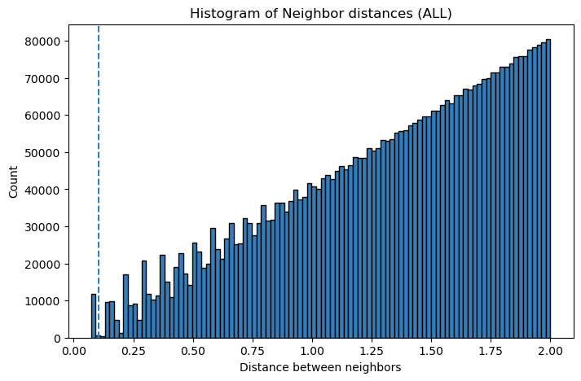
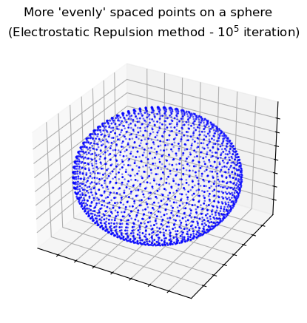
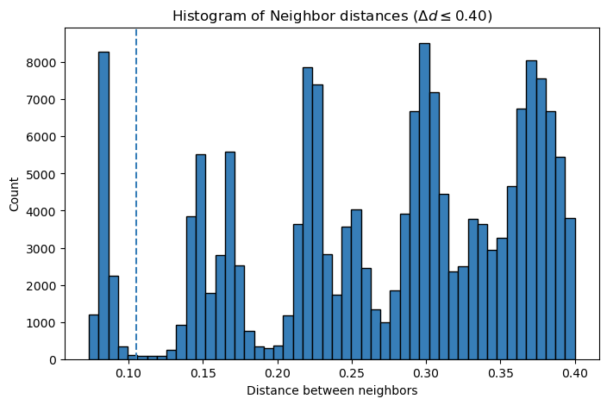
Extension: 2-Dimensional Periodic
1
2
3
4
5
6
7

Slide 53
Extension: 2-Dimensional Periodic
1
2
3
4
5
6
7

Slide 54
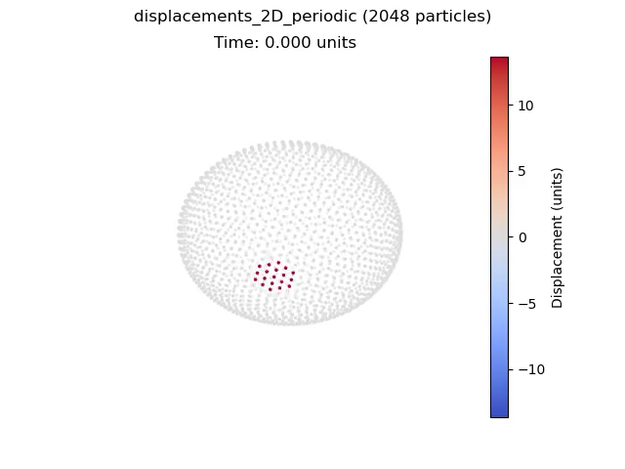
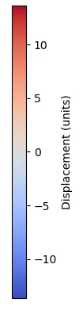

Application: 2-Dimensional Periodic
<sphere>
<seismic BOOM>
1
2
3
4
5
6
7

Slide 55
References
[1] Los Alamos National Laboratory. https://discover.lanl.gov/news/0412-maniac/ (accessed April 1st, 2024)
[2] Fermi, E; Pasta, J; Ulam, S; Studies of Non-Linear Problems. Document LA. 1955.

Slide 56

Thank You!
Section $−∞$
WHEEEEEEEEEEEE

