Slide 1




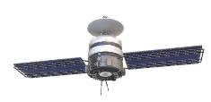
Optimisation of LEO satellites Doppler shift compensation by reducing TLE errors and improving trajectory prediction algorithms
SP3172 Final Presentation
Kushagra Shrivastava¹ & Rajvrat Thapliyal¹
Supervisor: A/Prof Abhishek Rai²
Lab Mentors: Ma Yuling², Yuan Fangxing², Fu Naifeng³
SPS Mentors: Lim Yi Zhen¹, Hillson Hung¹
¹ Special Program in Science (SPS), National University of Singapore, Singapore
² Satellite Technology and Research (STAR) Centre, National University of Singapore, Singapore
³ School of Marine Science and Technology, Tianjin University, China
*Stock 3D models

Slide 2
Overview
Section 1
Why did we do this research?

Slide 3


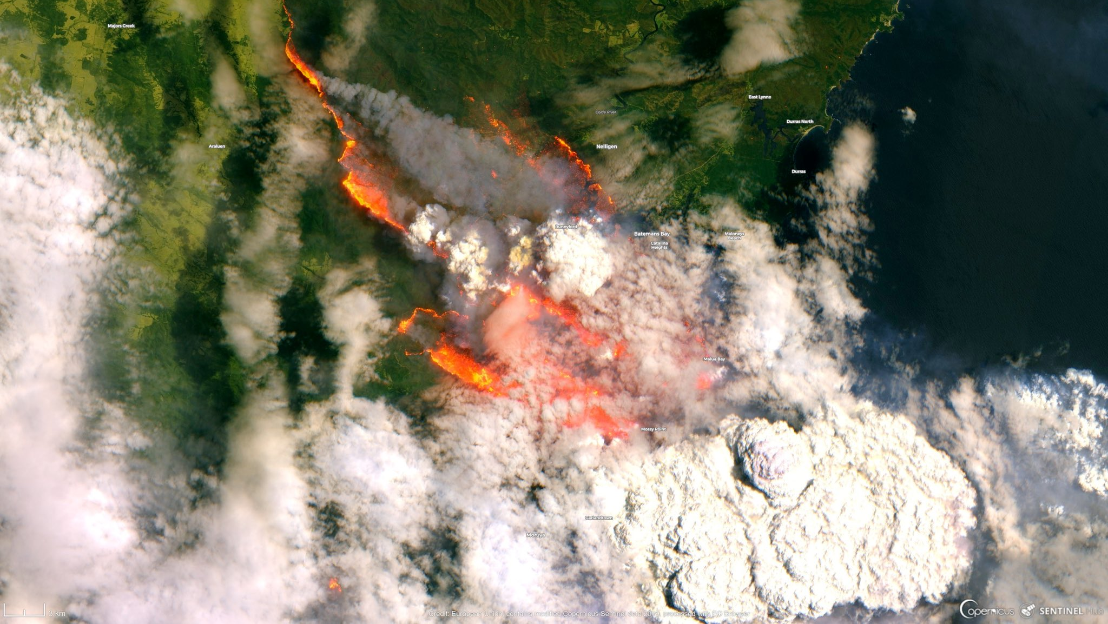
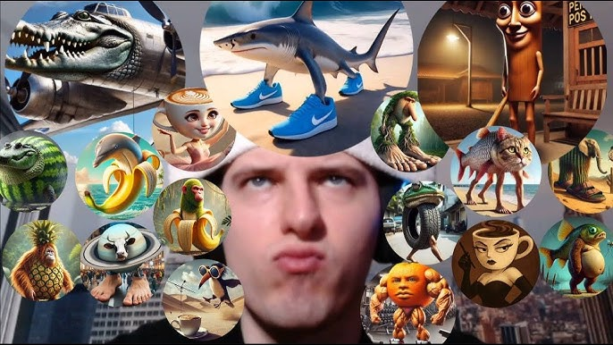
Why is Low-Earth Orbit (LEO) important?
Overview
If you want to…
Telecommunication
Disaster Management
Low-Earth Orbit Satellites
Orbits at least 6 times a day
Low Altitude (~500 km)
VERY high speed (~10 km/s)
Internet
Image Sources: https://www.swyvl.io/blog/the-role-of-satellite-imagery-in-disaster-management , https://www.youtube.com/watch?v=3gmogp5-xXA,
(Hoots et al. 1998)

Slide 4
The issue with LEO
Overview
“With great speed comes great problems”
Doppler Shift: Movement changes the communication frequency!
Satellite
Ground Station
If we cannot predict the doppler shift, we cannot communicate with the satellite!
Position and velocity prediction
Our research
(Yll, 2018)

Slide 5
Current methods for prediction: TLE
Overview
Two-Line Element
Epoch Year & Julian Day Fraction
Drag
STARLINK-11548
1 62829U 25019A 25054.47292006 .00001794 00000+0 13172-4 0 9998
2 62829 42.9999 73.2396 0001638 288.8584 71.2109 15.77857668 4220
Inclination
Eccentricity
Mean Anomaly
Mean motion
Right Ascension of the Ascending Node
Argument of Perigee
All the parameters to be used for predicting the orbit, with a time at which the TLE was made.
(Celestrak.org, 2025; NORAD, 2025)

Slide 6
Current Method for prediction: SGP4
Overview
Simplified General Perturbation Model 4 accounts for drag, solar radiation, Earth’s non-spherical shape, and the moon.
One TLE
One date at which we want to make a prediction, t
Magical Calculations
Position at t
Velocity at t
Input parameters
SGP4
Output parameters
So what’s the issue?
TLE has inherent errors and SGP4 accumulates error!
Our research explores two independent algorithms that can reduce this error.
(Hoots et al., 1988)

Slide 7
MCS Algorithm
Section 2
Our implementation and the results

Slide 8
What is the goal here?
MCS Algorithm
Reduce the inherent errors in TLE
A lot of TLEs
1 Optimised TLE
Reference TLE
2 variables: Number of TLEs and the reference TLE
(Liu et al., 2023)

Slide 9
Methodology Step 1: Loss Function
MCS Algorithm
Take N TLEs
TLE #1
t₁
TLE#2
t₂
TLE#3
t₃
…
TLE#N
t₄
Each TLE has a time associated with it
(Liu et al., 2023)

Slide 10
Methodology Step 1: Loss Function
MCS Algorithm
Using SGP4, calculate the position, x, and velocity, v, at that time
Take N TLEs
TLE #1
t₁
x_{t1}, v_{t1}
TLE#2
t₂
x_{t2}, v_{t2}
TLE#3
t₃
x_{t3}, v_{t3}
…
…
TLE#N
x_{tN}, v_{tN}
t_{N}
Each TLE has a time associated with it
(Liu et al., 2023)

Slide 11
Methodology Step 1: Loss Function
MCS Algorithm
Using SGP4, calculate the position, x, and velocity, v, at that time
Take N TLEs
TLE #1
t₁
x_{t1}, v_{t1}
x_{t1r}, v_{t1r}
t₁
TLE#2
t₂
x_{t2}, v_{t2}
x_{t2r}, v_{t2r}
t₂
TLE#3
t₃
x_{t3}, v_{t3}
x_{t3r}, v_{t3r}
t₃
TLE#3
…
…
…
…
TLE#N
x_{tN}, v_{tN}
x_{tNr}, v_{tNr}
t_{N}
t_{N}
Each TLE has a time associated with it
Choose a reference TLE, and calculate x and v at all times using SGP4
(Liu et al., 2023)

Slide 12
Methodology Step 1: Loss Function
MCS Algorithm
Subtract the two values together and square them
x_{t1}, v_{t1}
-
x_{t1r}, v_{t1r}
=
(Δx₁)², (Δv₁)²
x_{t2}, v_{t2}
-
x_{t2r}, v_{t2r}
=
(Δx₂)², (Δv₂)²
x_{t3}, v_{t3}
-
x_{t3r}, v_{t3r}
=
(Δx₃)², (Δv₃)²
…
…
…
x_{tN}, v_{tN}
-
x_{tNr}, v_{tNr}
=
(Δx₄)², (Δv₄)²
Respective TLEs
TLE#3
(Liu et al., 2023)

Slide 13
Methodology Step 1: Loss Function
MCS Algorithm
Create the loss function
Performed the best
Ideal case scenario
(Δx₁)², (Δv₁)²
L_{standard} = 0
Sum everything together, L_{standard}
(Δx₂)², (Δv₂)²
But that is near impossible, and thus we instead try to minimize it
Only sum position difference, L_{pos}
(Δx₃)², (Δv₃)²
Only sum velocity difference, L_{vel}
Change the reference TLE such that we can minimize L_{standard}
…
Weighted sum, L_{weighted}
(Δx₄)², (Δv₄)²
(Multiply all positions by 10⁻³)

Slide 14
Methodology 2: Monte-Carlo Simplex
MCS Algorithm
Algorithm to find the global minimum value of L_{standard}
L_{standard}
Local Minima
Global Minima
Parameters

Slide 15
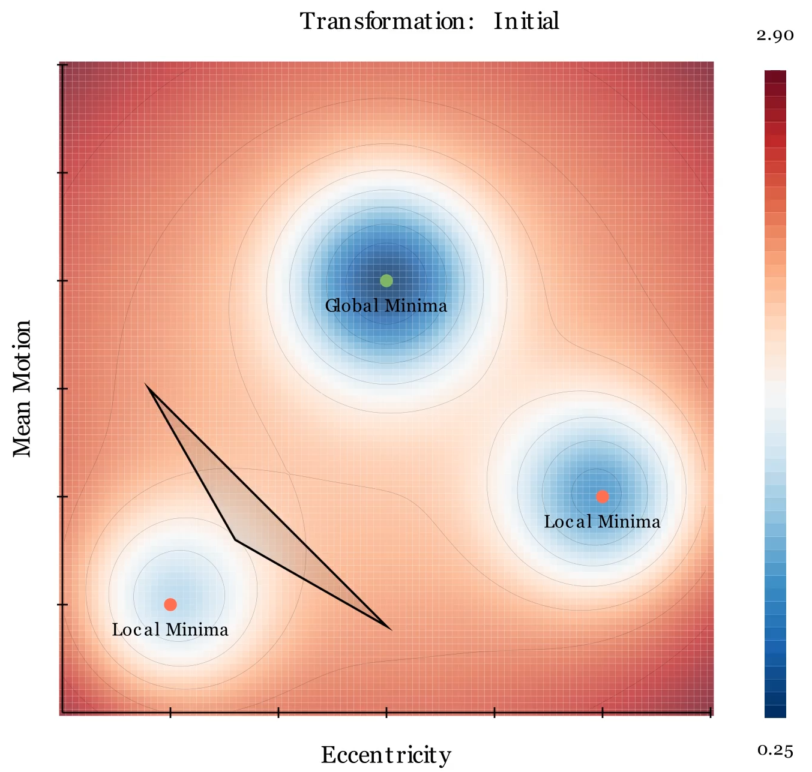
Methodology 2: Monte-Carlo Simplex
MCS Algorithm
Nelder-Mead Simplex
Take the reference TLE
Create vertices of simplex
(1 original and 7 perturbed)
Simplex transforms
L_{standard}
Finds minima
(a, b)
(a, b+1)
(a+1, b)
Animation created using Manim
(Liu et al., 2023)

Slide 16
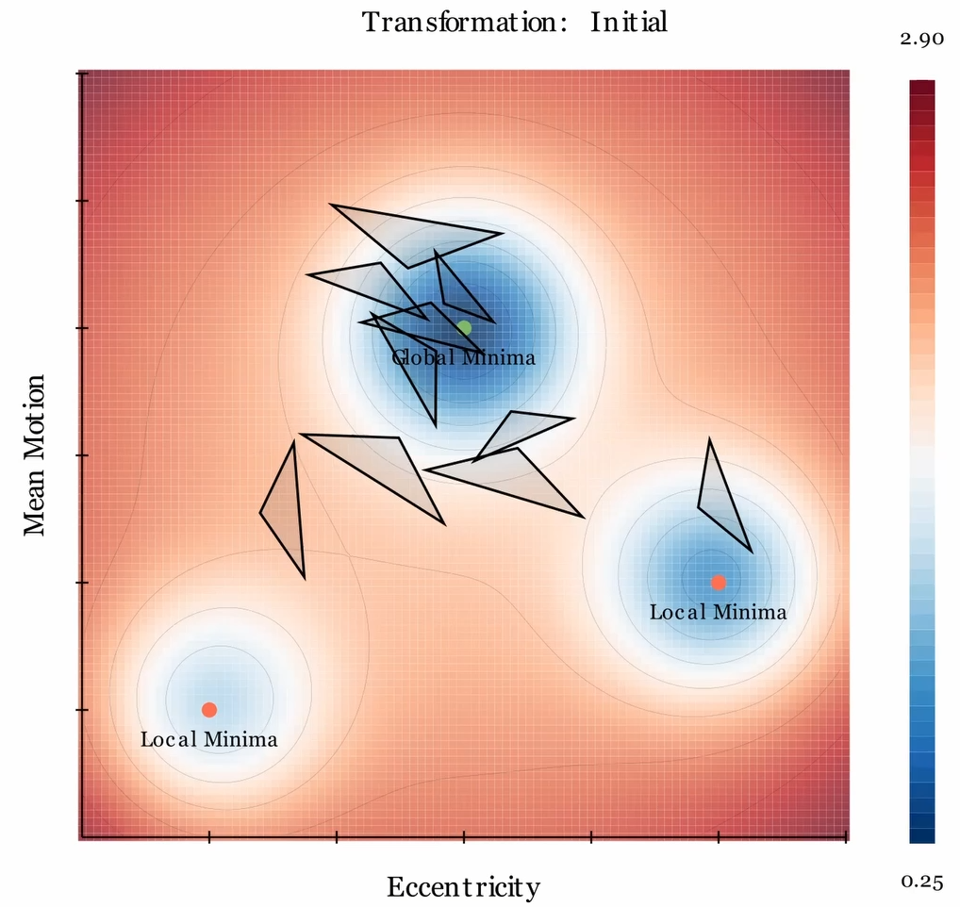
Methodology 2: Monte-Carlo Simplex
MCS Algorithm
Monte-Carlo Simplex
Take the reference TLE
Create vertices of simplex
(1 original and 7 perturbed)
Simplex transforms
L_{standard}
Finds minima
Repeat this 5000 times, changing the reference TLE a little bit for each run.
Animation created using Manim
(Liu et al., 2023)

Slide 17
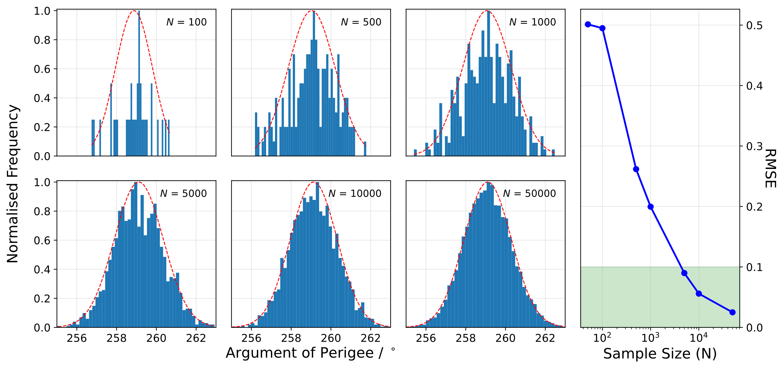
Methodology 2: Monte-Carlo Simplex
MCS Algorithm
Distribution of optimal values for 1 parameter
Mean of normal distribution is the final optimised value
(Liu et al., 2023)

Slide 18
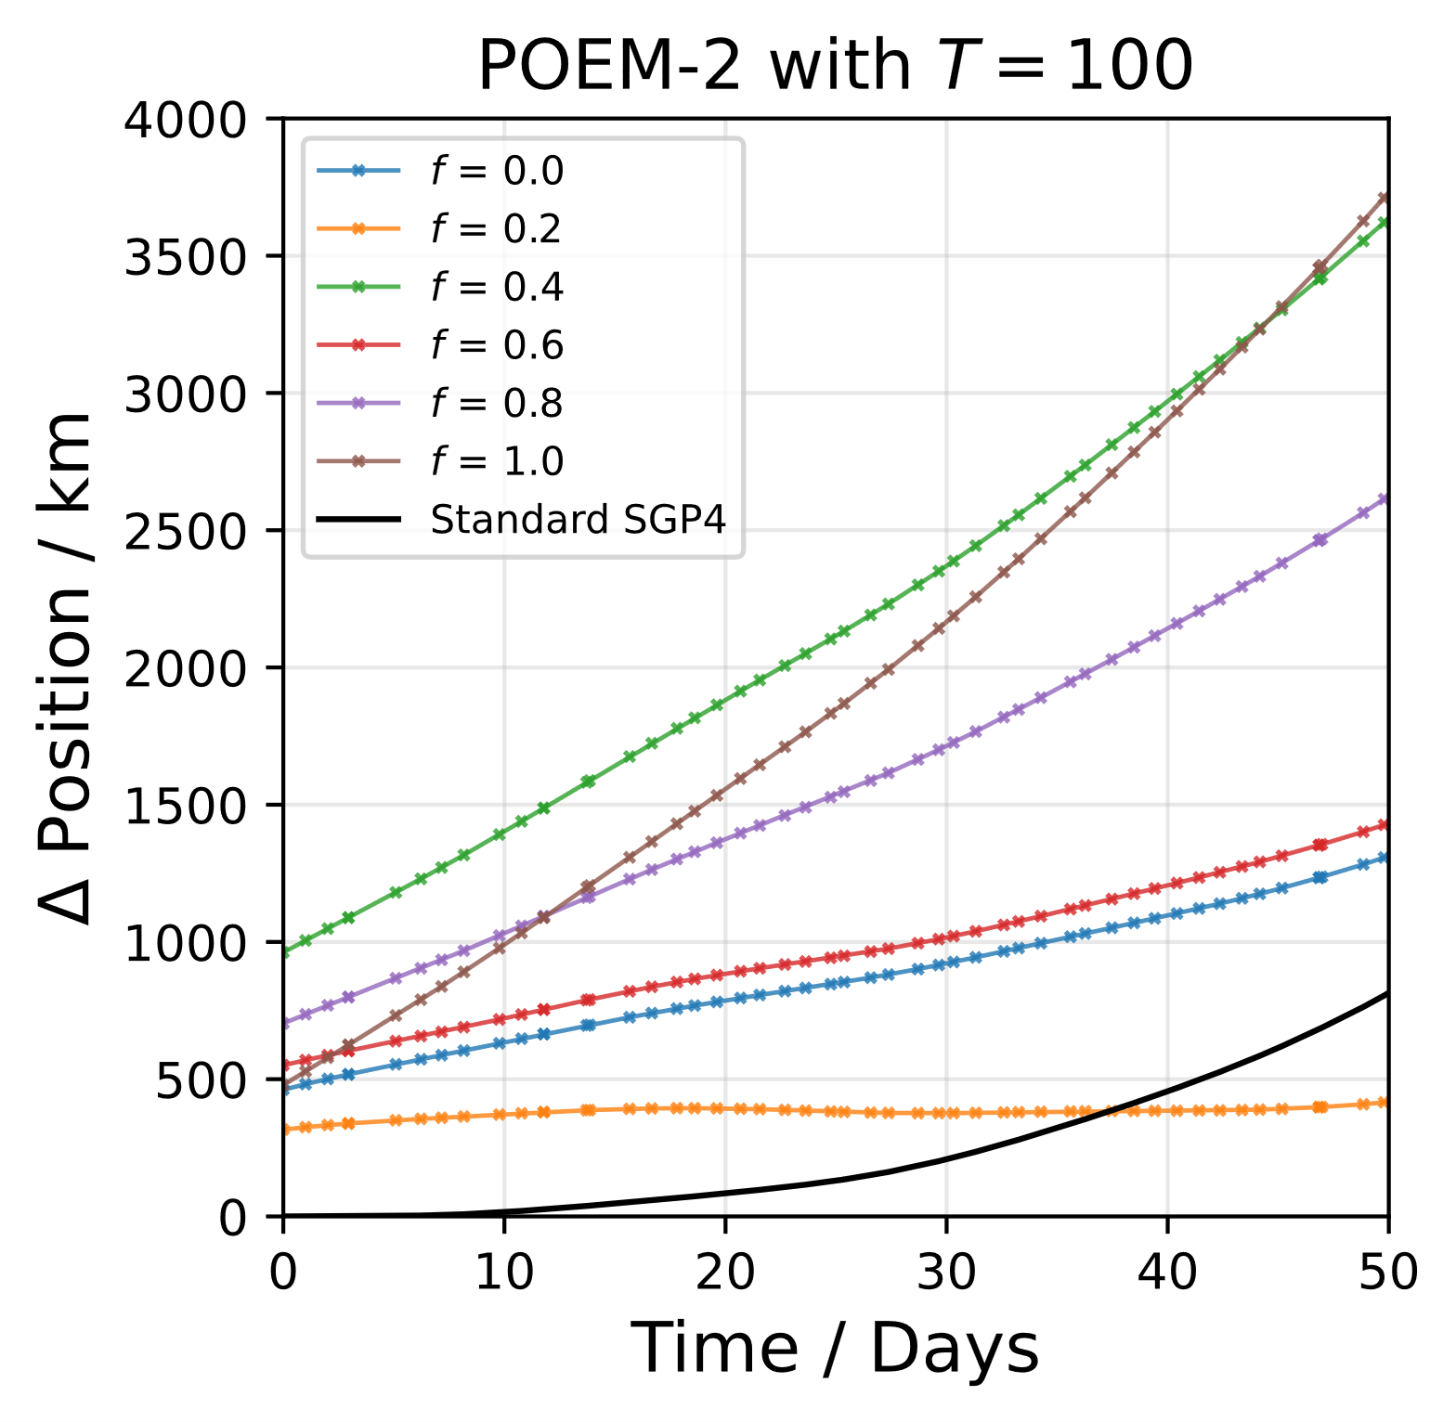
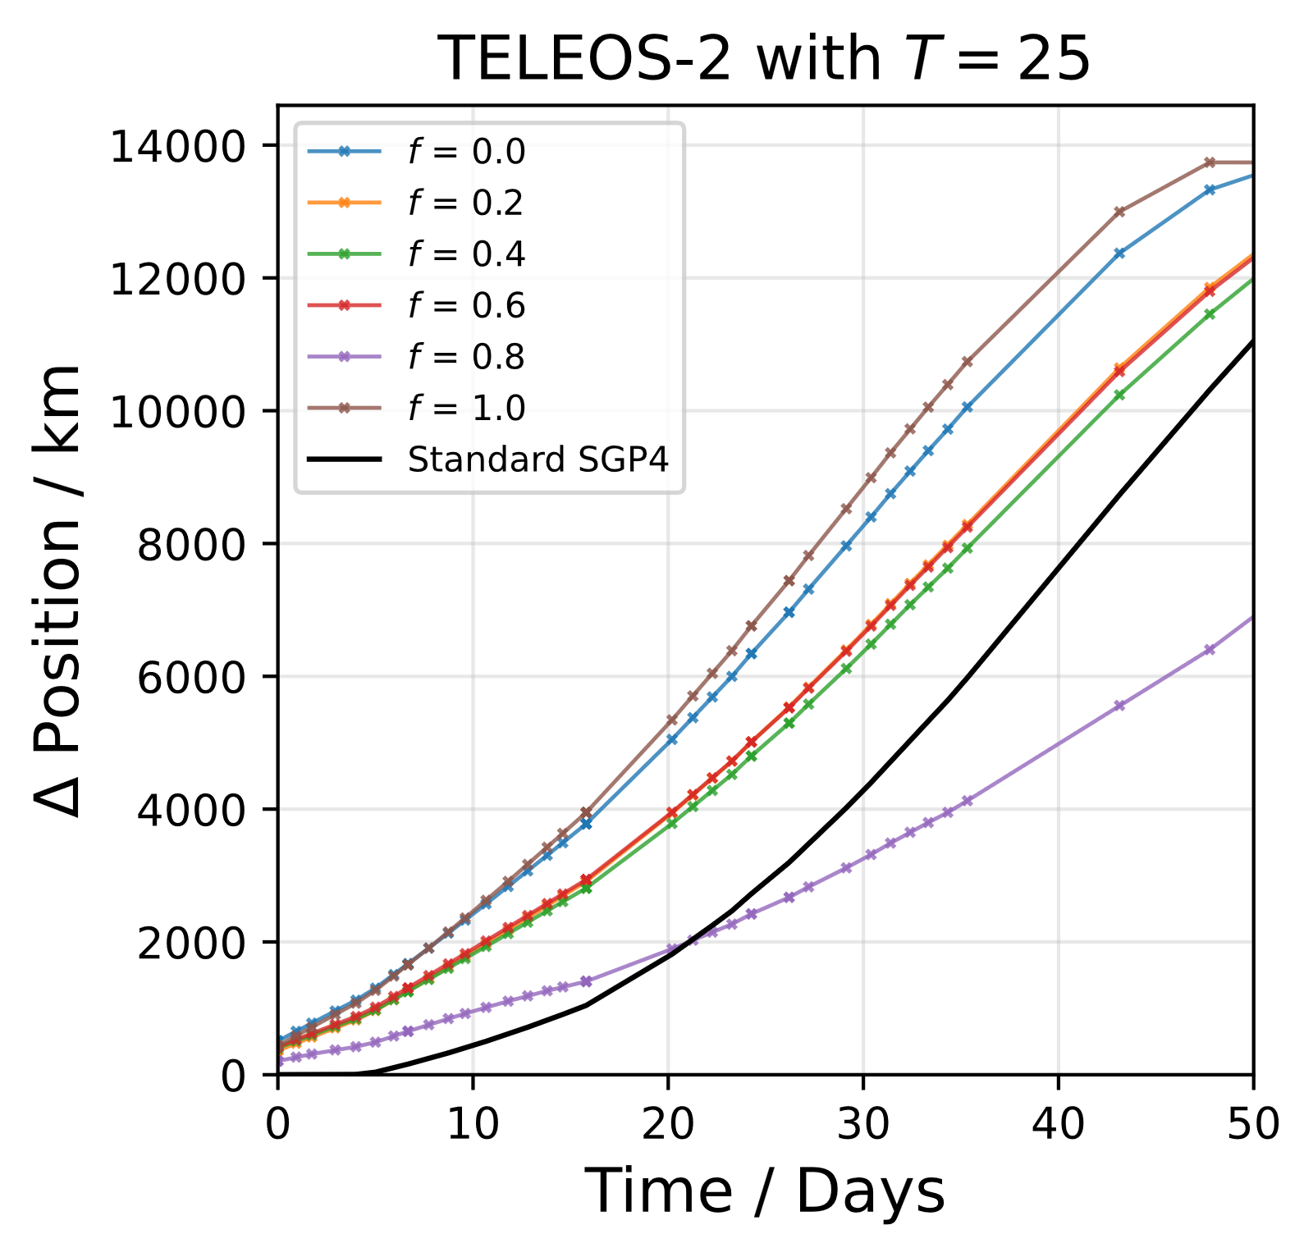
Results 1: Change reference TLE
X-axis is number of days AFTER the last TLE in the set.
MCS ALWAYS performs WORSE than simple SGP4.

Slide 19
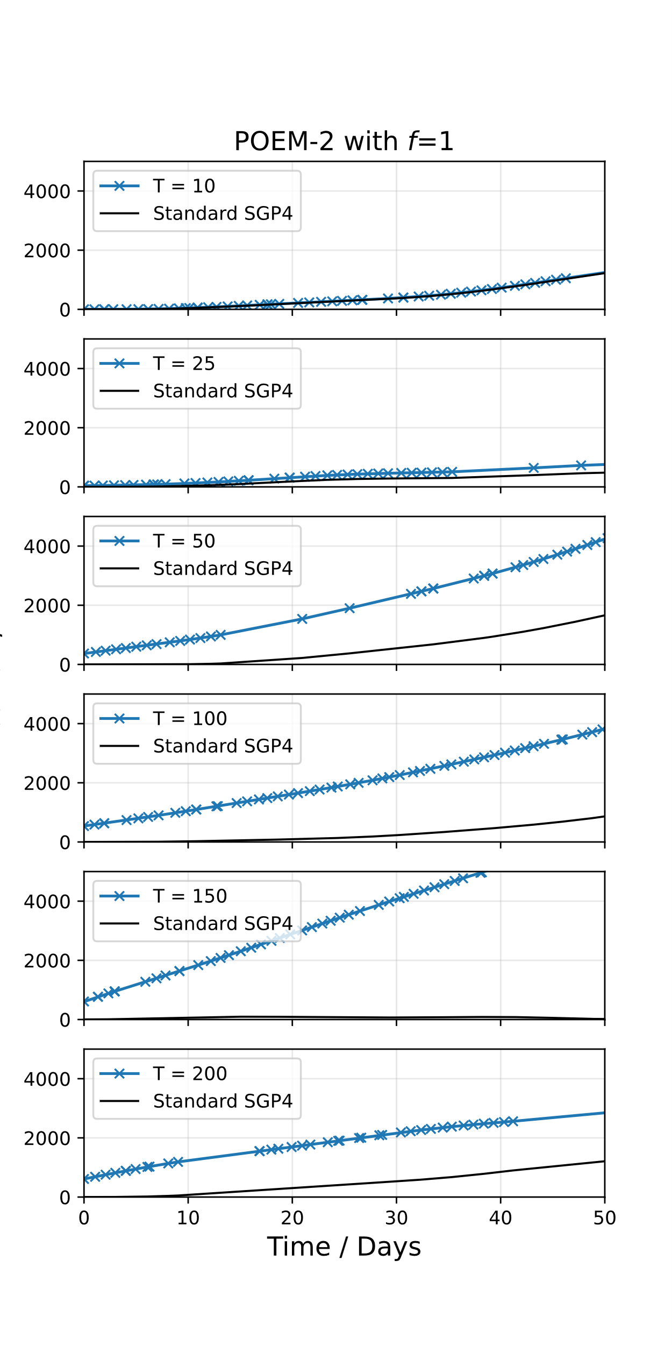
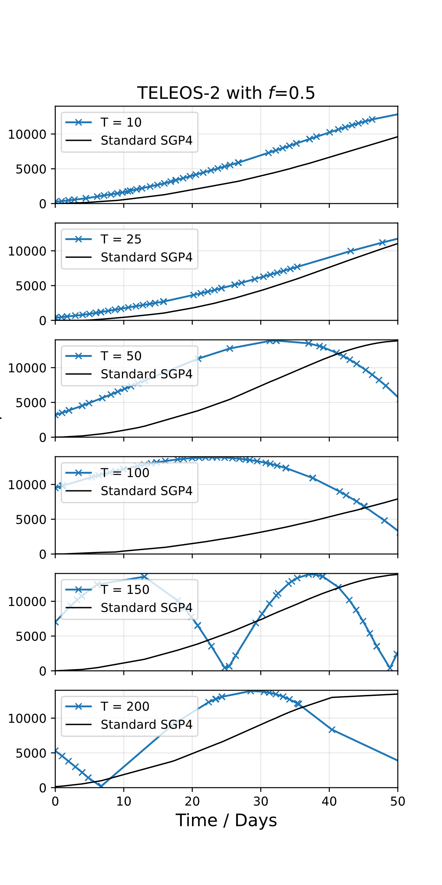
Results 2: Change number of TLEs
X-axis is number of days AFTER the last TLE in the set.
MCS ALWAYS performs WORSE than simple SGP4.

Slide 20

Why did it perform so bad?
Hypothesis 1: Physics uninformed
Hypothesis 2: TLE dataset issue
TLE #1
Time
Time when satellite was closest to Earth
$$M=n (t−τ)$$
TLE #3
Mean Anomaly: Speed of satellite if it had a circular orbit
Mean Motion: Number of revolutions in a day
Orbit of a satellite
TLE #5
MCS randomly changes parameters value without following any physical laws
TLE #4
TLE #2

Slide 21

ML-$∂$SGP4 Model
Section 3
Our implementation and the results
Notes:
Thank you kush, I will now introduce the ML-dSGP4 Model and our experiments with it

Slide 22
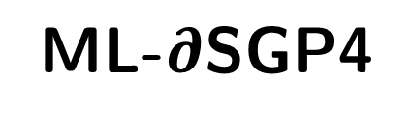

What is ML-$∂$SGP4?
SGP4
Neural Networks
The original algorithm
A common Machine Learning (ML) model
ML-$∂$SGP4
SGP4 integrated into an ML model
Notes:
So what is ML-dsgp4?
To understand this Model lets break it down into some simpler parts
Originally we had the SGP4 algorithm. Acciarini et al then created a differentiable version of SGP4 called dsgp4
This allows the dsgp4 to be implemented within Machine learning frameworks.
Acciarini et al then created ML-dsgp4, a machine learning model which integrates Dsgp4 Into its architectures, making it physics-aware **explain something about physics awareness**
ML-dsgp4 be the focus of our study.

Slide 23
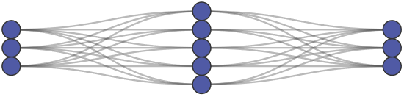




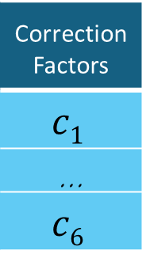
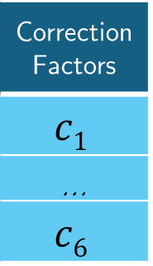
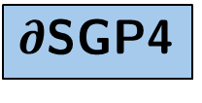
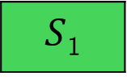
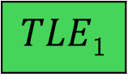
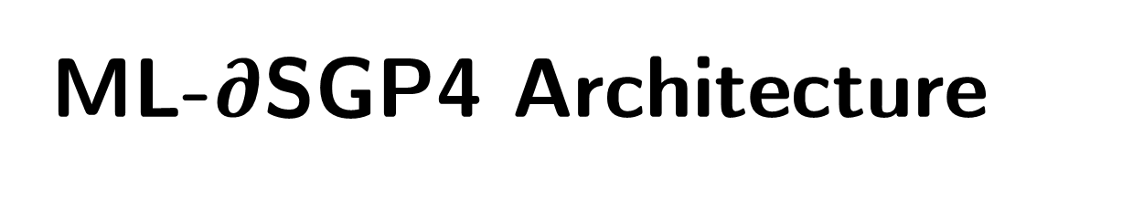
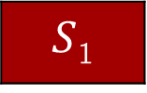
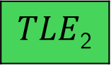
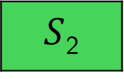



ML-$∂$SGP4 Architecture
TLE Correction Module
Unoptimized State vectors (S_{i})
dSGP4 Correction Module
Raw TLEs
Optimised State Vectors
Optimised TLEs
Neural Network 1
_{Correction Factors}
$$c1$$
…
$$c6$$
_{Correction Factors}
$$c1$$
…
$$c6$$
$$TLE3$$
Neural Network 2
Applied to TLE elements
$TLE$₃
$$S3$$
Applied to S_{i}’s elements
$$S3$$
Input
Output
Input
Output
$TLE$₂
$TLE$₂
$∂$SGP4
$$S2$$
$S$₂
$TLE$₁
$TLE$₁
$S$₁
$S$₁
(Acciarini et al., 2025)
Notes:
Now I’d like to walk you through the ML-dSGP4 architecture.
First we obtain our Raw unoptimized TLEs.
We feed the TLEs into the first neural network in ML-dSGP4.
The neural network will learn the errors in TLE and output the correction factors that will multiplicatively be multiplied with the original TLE elements to finally output the final optimised TLE.
Now you might have gotten lost through this explanation but for the purpose of this presentation you can simply replace all these components in the middle and interpret as a black box, where suboptimal tles are inputted and outputs optimal tles.

Slide 24




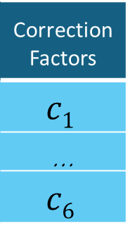
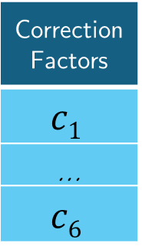
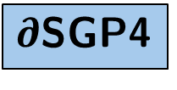
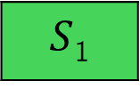
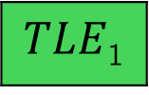

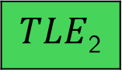
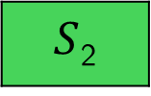



ML-$∂$SGP4 Architecture
TLE Correction Module
Unoptimized State vectors (S_{i})
dSGP4 Correction Module
Raw TLEs
Optimised State Vectors
Optimised TLEs
Neural Network 1
_{Correction Factors}
$$c1$$
…
$$c6$$
_{Correction Factors}
$$c1$$
…
$$c6$$
$$TLE3$$
Neural Network 2
Applied to TLE elements
$TLE$₃
$$S3$$
Applied to S_{i}’s elements
$$S3$$
Input
Output
Input
Output
$TLE$₂
$TLE$₂
$∂$SGP4
$$S2$$
$S$₂
$TLE$₁
$TLE$₁
$S$₁
$S$₁
(Acciarini et al., 2025)
Notes:
Now I’d like to walk you through the ML-dSGP4 architecture.
First we obtain our Raw unoptimized TLEs.
We feed the TLEs into the first neural network in ML-dSGP4.
The neural network will learn the errors in TLE and output the correction factors that will multiplicatively be multiplied with the original TLE elements to finally output the final optimised TLE.
Now you might have gotten lost through this explanation but for the purpose of this presentation you can simply replace all these components in the middle and interpret as a black box, where suboptimal tles are inputted and outputs optimal tles.

Slide 25





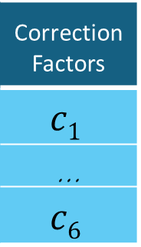
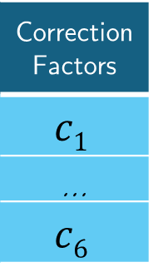

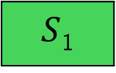
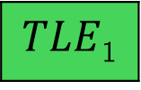


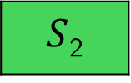



ML-$∂$SGP4 Architecture
TLE Correction Module
Unoptimized State vectors (S_{i})
$∂SGP4$ Correction Module
Raw TLEs
Optimised State Vectors
Optimised TLEs
Neural Network 1
_{Correction Factors}
$$c1$$
…
$$c6$$
_{Correction Factors}
$$c1$$
…
$$c6$$
$$TLE3$$
Neural Network 2
Applied to TLE elements
$TLE$₃
$$S3$$
Applied to S_{i}’s elements
$$S3$$
Input
Output
Input
Output
$TLE$₂
$TLE$₂
$∂$SGP4
$$S2$$
$S$₂
$TLE$₁
$TLE$₁
$S$₁
$S$₁
(Acciarini et al., 2025)
Notes:
Now I’d like to walk you through the ML-dSGP4 architecture.
First we obtain our Raw unoptimized TLEs.
We feed the TLEs into the first neural network in ML-dSGP4.
The neural network will learn the errors in TLE and output the correction factors that will multiplicatively be multiplied with the original TLE elements to finally output the final optimised TLE.
Now you might have gotten lost through this explanation but for the purpose of this presentation you can simply replace all these components in the middle and interpret as a black box, where suboptimal tles are inputted and outputs optimal tles.

Slide 26

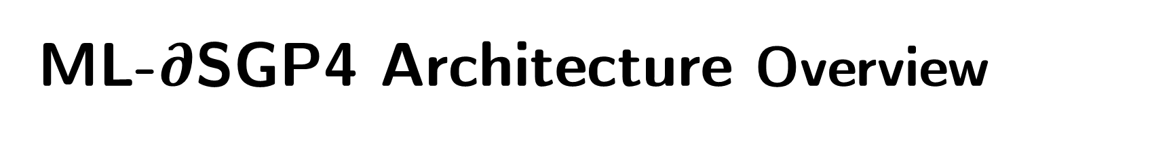


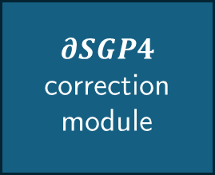




ML-$∂$SGP4 Architecture Overview
Optimised State Vectors
Raw TLEs
$$TLE3$$
TLE correction module
$∂SGP4$ correction module
$$S3$$
$TLE$₂
$∂$SGP4
$S$₂
$TLE$₁
$S$₁
Learns and corrects TLE error
Learns and corrects SGP4 propagation error
(Acciarini et al., 2025)
Notes:
Now I’d like to walk you through the ML-dSGP4 architecture.
First we obtain our Raw unoptimized TLEs.
We feed the TLEs into the first neural network in ML-dSGP4.
The neural network will learn the errors in TLE and output the correction factors that will multiplicatively be multiplied with the original TLE elements to finally output the final optimised TLE.
Now you might have gotten lost through this explanation but for the purpose of this presentation you can simply replace all these components in the middle and interpret as a black box, where suboptimal tles are inputted and outputs optimal tles.

Slide 27

Training ML- $∂$SGP4 from Scratch:
Set-up and Challenges

Slide 28
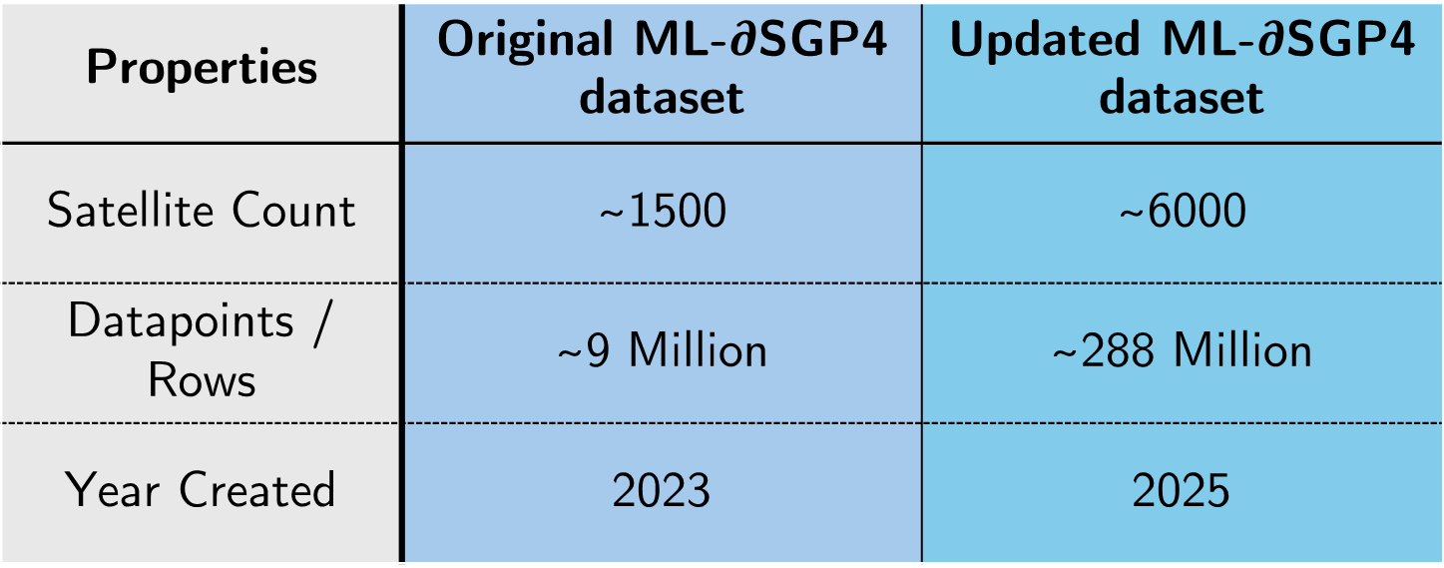
Preliminary Model: A larger Dataset
Generally…
Larger dataset = More accurate Model
Properties | Original ML-$∂$SGP4 dataset | Updated ML-$∂$SGP4 dataset
Satellite Count | ~1500 | ~6000
Datapoints / Rows | ~9 Million | ~288 Million
Year Created | 2023 | 2025
(Acciarini et al., 2025)
Notes:
Initially our goal was to make a better version of ML-Dsgp4 by using the same model template and training it on a larger updated version of the satellite dataset acciarani et al used to train their model on.
The original dataset only consisted of SPACEX’s Starlink satellites as they are considered LEO satellites and their data is opensource.
However in the year 2023, when the paper was published, acciarani et al’s dataset only included 1500 satellites, corresponding to about 9million rows of data in their original dataset.
Today there are over 6000 starlink satellites and we attempted to leverage the use of more satellites in the dataset to train a more accurace version of ml-dsgp4 as generally, ML models trained on more data will give better performance as the models can more accurately tune themselves with more data and make more accurate prediction.
We made use of NSCC’s supercomputer to train our model. However the projected training time was determined to be over 70 days, which made training the large model infeasible

Slide 29
Preliminary Model: Infeasible Training Time
12 hours of training on NSCC’s supercomputer
Preliminary Model:
~288 Million Datapoints
0.70% of training completed
Extrapolated Training Time:
~70 Days
Notes:
We made use of NSCC’s supercomputer to train our model. However the projected training time was determined to be over 70 days, which made training the large model infeasible

Slide 30
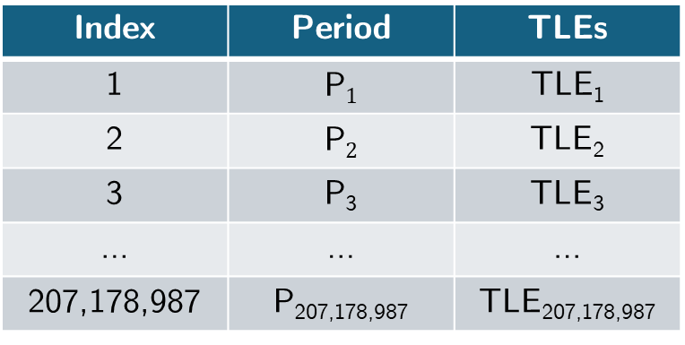
Preliminary Model: Inefficient Source Code
TLE Objects Data frame
Training Dataset
Index | Period | TLEs
1 | P$1$ | TLE₁
2 | P$2$ | TLE₂
3 | P₃ | TLE₃
… | … | …
207,178,987 | P_{207,178,987} | TLE_{207,178,987}
Python TLE Objects
TLE Object₁
TLE Object₂
TLE Object₃
…
TLE Object_{207,178,987}
Slow, iterative parsing of the training dataset
Notes:
We made use of NSCC’s supercomputer to train our model. However the projected training time was determined to be over 70 days, which made training the large model infeasible

Slide 31
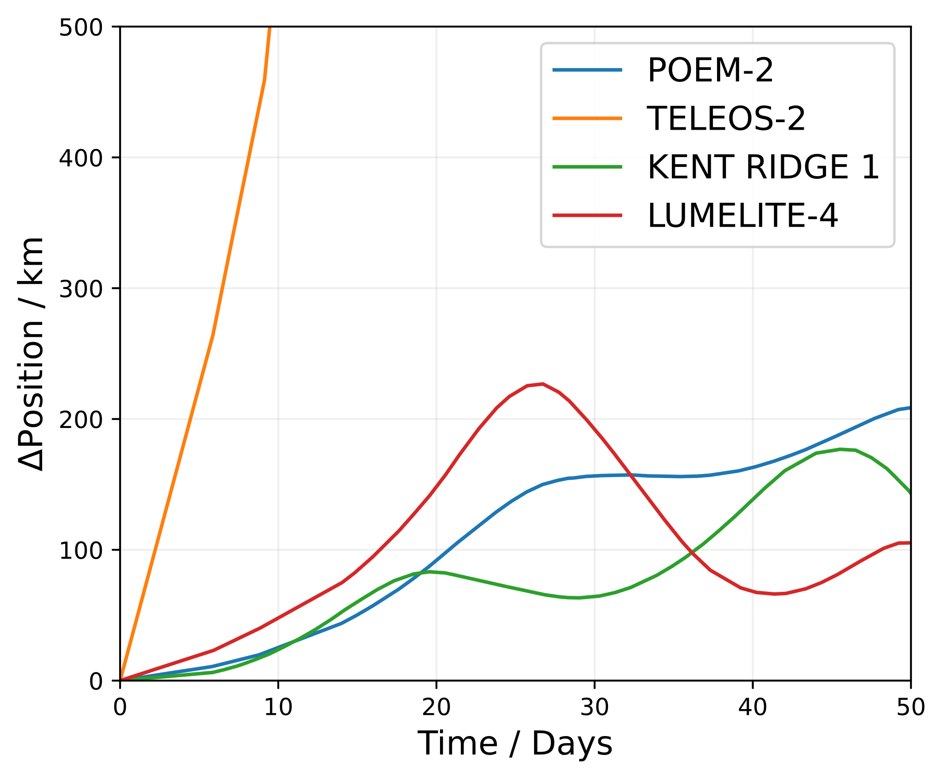
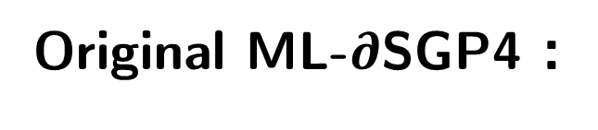
ML- $∂$SGP4: The suboptimal training scheme
Original ML-$∂$SGP4 :
Trains on a dataset with many satellites
But…
Not all satellites have the same error propagation pattern
Figure 2: Position error propagation over time for various satellites.

Slide 32
ML- $∂$SGP4: The suboptimal training scheme
Original ML-$∂$SGP4 :
Trains on a dataset with many satellites
Model’s Aggregated Fit
But…
Not all satellites have the same error propagation pattern
Figure 2: Position error propagation over time for various satellites.

Slide 33
ML- $∂$SGP4: The suboptimal training scheme
Original ML-$∂$SGP4 :
Trains on a dataset with many satellites
Model’s Aggregated Fit
But…
Not all satellites have the same error propagation pattern
Errors
Causing
Consistent Error reflected in Model
Figure 2: Position error propagation over time for various satellites.

Slide 34
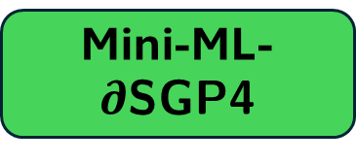
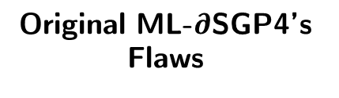
Mini-ML- $∂$SGP4: Overcoming Drawbacks
Original ML-$∂$SGP4’s Flaws
Impact on Performance
Our Solution
Inefficient Source Code
Slow training time
Use smaller datasets
Mini-ML-$∂$SGP4
Suboptimal training method
Limits model’s predictive accuracy
Train each Mini Model on a dataset for one satellite
(Acciarini et al., 2025)
Notes:
Therefore to overcome the long training time and to boost the accuracy of the model we propose Mini-ML-dSGP4
Mini Ml-dsgp4 makes use of the same ML-Dsgp4 architecture but trained on a dataset for only a single satellite. This allows the model to make Accurate predictions for its specific satellite while leveraging a far smaller dataset to reduce training time.
To evaluate the model’s performance across different satellites we use satellites with the highest orbital period, intermediate orbital period and lowest orbital period in the datasets.

Slide 35
Data Preparation
Satellite Selection Criteria
Datasets
Final Mini Models
STARLINK 2561 Mini Dataset
Rows | 25,926
STARLINK 2561 Mini Model
Minimum
Period Satellite
STARLINK 5350 Mini Dataset
Rows | 43,210
STARLINK 5350 Mini Model
Full Dataset
Rows | 288,305,762
Intermediate Period Satellite
STARLINK 6060 Mini Dataset
Rows | 77,779
STARLINK 6060 Mini Model
Maximum
Period Satellite

Slide 36
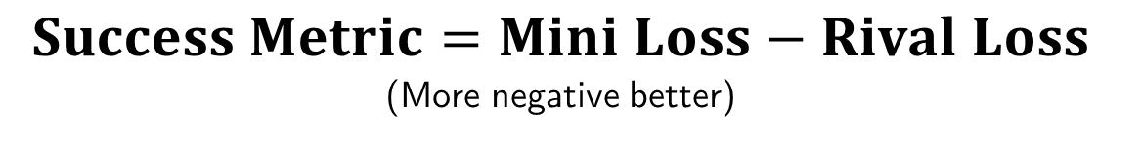
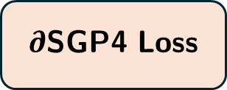
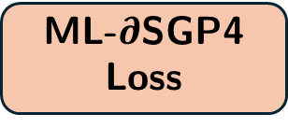

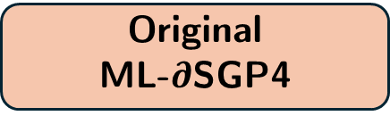
Evaluation set up
$$Success Metric=Mini Loss−Rival Loss$$
(More negative better)
STARLINK XXXX’s Mini Model
Prediction – True Ground
Mini Loss
Original
ML-$∂$SGP4
Prediction – True Ground
ML-$∂$SGP4 Loss
$∂$SGP4
Prediction – True Ground
$∂$SGP4 Loss
We finally get 2 success metric readings for each Mini Model
Notes:
We can now evaluate our models
We compare our models against the original SGP4 propagator and the pretrained ML-dsgp4 propagator by acciarani et al.
We compute the difference between the error of the mini model and the rival models and plot a histogram of the frequency of the observered error differences.

Slide 37
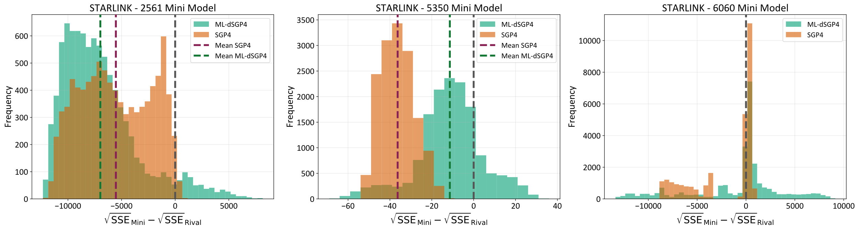
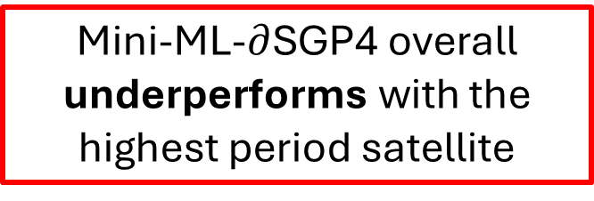
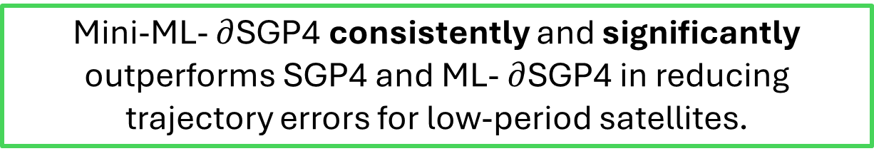
Results
Starlink - 2561 Mini Model
Starlink - 5350 Mini Model
Starlink - 6060 Mini Model
Mini-ML- $∂$SGP4 consistently and significantly outperforms SGP4 and ML- $∂$SGP4 in reducing trajectory errors for low-period satellites.
Mini-ML-$∂$SGP4 overall underperforms with the highest period satellite
Notes:
Here are our results.
On X axis we have the magnitude of the error difference observed. And on the y axis we have the count of that error difference observed.
For starlink 2561 and Starlink XXX, we observe that the area under the graph in the negative region is far larger than each of their graphs in the positive region. _> This indicates that their mini models perform consistently better than their rival models.
Moreover we observe that the mean magnitude of their errors are well into the negative values, indicating that the error reduction by our models on average is substantially larger than the error reduced by the rival models.
However we do observe that the satellite with the highest performs the worst. As seen by a relatively even spread of the distribution about the 0 value, indicating that the mini model can do equally good or bad in comparison with SGP4 .**************improve**************
Although we can get a rough gauge that our models tend to deprove in performance as satellite period increases, further studies will need to be done to create more mini models for each satellite and evaluate their performance to deterministically derive a pattern in the model’s performance across satellite periods.

Slide 38
Future Work and Conclusion
Section 4
So what next?

Slide 39
Final words
MCS might be trash
Mini ML-∂SGP4 has good potential
How can we make them better?
Breaking down MCS and ML-∂SGP4 into their smaller components to identify sources of error
Tune ML-∂SGP4’s original architecture to improve its performance and make it physics informed.

Slide 40
Acknowledgements
We would like to express our gratitude to STAR’s director, A/Prof Abhishek Rai, and Lab Mentors, Ma Yuling, Yuan Fangxing, and Dr Fu Naifeng for their constant support, feedback and patience throughout our journey. We also thank our SPS Mentors, Lim Yi Zhen and Hillson Hung, for constant and even last-minute feedback on the reports and presentations, and our SPS friends for the impromptu help in their specialized fields. Lastly, we would like to thank the National Supercomputing Centre (NSCC) Singapore for allowing us to use their resources.

Slide 41
References
Acciarini, G., Baydin, A. G., & Izzo, D. (2025). Closing the gap between sgp4 and high-precision propagation via differentiable programming. Acta Astronautica, 226, 694–701. https://doi.org/https://doi.org/10.1016/j.actaastro.2024.10.063
Ali, I., Al-Dhahir, N., & Hershey, J. E. (1998). Doppler characterization for leo satellites. IEEE Trans. Commun., 46, 309–313. https://api.semanticscholar.org/CorpusID:206409378
Asraf, A., Surayuda, R. H., Ribah, A. Z., Kamirul, & Mukhayadi, M. (2021). Determination of mean orbital elements using gps data for lapan satellite daily operation. 2021 IEEE International Conference on Aerospace Electronics and Remote Sensing Technology (ICARES), 1–6. https://doi.org/10.1109/ICARES53960.2021.9665177
Barinov, R., Gai, V., Kuznetsov, G., & Golubenko, V. (2023). Automatic evaluation of neural network training results. Computers, 12, 26. https://doi.org/10.3390/computers12020026
Einstein, A. (1905). Zur elektrodynamik bewegter korper. Annalen der Physik, 322(10), 891–921. https://doi.org/10.1002/andp.19053221004
European Space Agency, Space Debris Office. (2024). ESA’s Annual Space Environment Report (tech. rep. No. ESA/GEN-DB-LOG-00288-OPS-SD) (Accessed: 2025-03-27). European Space Agency. Darmstadt, Germany. https://www.sdo.esoc.esa.int/environment_report/Space_Environment_Report_latest.pdf
Hoots, F. R., & Roehrich, R. L. (1988). Models for propagation of norad element sets (tech. rep. No. Spacetrack Report No. 3). CelesTrak. https://celestrak.org/NORAD/documentation/spacetrk.pdf
Hussain, W., Merig´o, J. M., Gil-Lafuente, J., & Gao, H. (2023). Complex nonlinear neural network prediction with iowa layer. Soft Computing, 27, 4853–4863. https://doi.org/10.1007/s00500-023-07899-2
Jason, Z., Zhang, K., & Grenfell, R. (2004). On the relativistic doppler effects and high accuracy velocity determination using gps.
Kelso, T. S. (2022). Norad two-line element set format [Accessed: 30 March 2025]. https://celestrak.org/NORAD/documentation/tle-fmt.php
Leakyrelu — pytorch 1.11.0 documentation. (n.d.). pytorch.org. https://pytorch.org/docs/stable/generated/torch.nn.LeakyReLU.html
Liu, J., Long, W., Wu, Y., Xu, J., Sang, J., & Lei, X. (2023). TLE orbit determination using simplex method. Geodesy and Geodynamics, 14(5), 438–455. https://doi.org/10.1016/j.geog.2023.03.004
National University of Singapore. (2024a). Galassia-2 satellite built by nus students successfully launched [Accessed: 2025-03-31]. https://news.nus.edu.sg/galassia-2-satellite-built-by-nus-students-successfully-launched/
National University of Singapore. (2024b). Successful launch of lumelite-4 to enhance maritime communications [Accessed: 2025-03-31]. https://news.nus.edu.sg/successful-launch-of-lumelite-4-to-enhancemaritime-communications/
NVIDIA. (n.d.). What is pytorch? NVIDIA Data Science Glossary. https://www.nvidia.com/en-us/glossary/pytorch/
Olson, M., Wyner, A., & Berk, R. (2018). Modern neural networks generalize on small data sets. In S. Bengio, H. Wallach, H. Larochelle, K. Grauman,
N. Cesa-Bianchi, & R. Garnett (Eds.), Advances in neural information processing systems (Vol. 31). Curran Associates, Inc. https://proceedings.neurips.cc/paper_files/paper/2018/file/fface8385abbf94b4593a0ed53a0c70f-Paper.pdf
Rojas, R. (1996). The backpropagation algorithm. Neural Networks, 149–182. https://doi.org/10.1007/978-3-642-61068-4_7
Space-track.org. (n.d.). www.space-track.org. https://www.space-track.org/auth/login
Tanh — pytorch 1.13 documentation. (n.d.). pytorch.org. https://pytorch.org/docs/stable/generated/torch.nn.Tanh.html
Yll, D. N. (2018). Doppler shift compensation strategies for leo satellite communication systems [Ph.D. Dissertation]. Universitat Politecnica de Catalunya. https://upcommons.upc.edu/bitstream/handle/2117/123510/DanielNietoYll_Doppler_compensation_for_LEO.pdf

Slide 42
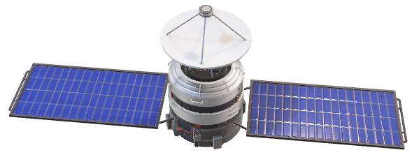
Thank you!
SP3172 Final Presentation
The template of this presentation was custom made in Microsoft PowerPoint 365
*Satellite is a free-to-use 3D stock model

Slide 43
Additional Slides
Section 5

Slide 44

How do we define our errors?
Important Note
We work with past year’s data.
Actual position/velocity
Predicted position/velocity
Position/Velocity
Error = |Prediction – Actual|
t₀
t₁
t₂
t₃
…
t_{N}

Slide 45
All TLE parameters
Overview
Two-Line Element
2nd derivative of mean motion
Element Number & checksum
Epoch Year & Julian Day Fraction
Satellite name
1st derivative of mean motion
Ephemeris Type
International Designator
Drag
STARLINK-11548
1 62829U 25019A 25054.47292006 .00001794 00000+0 13172-4 0 9998
2 62829 42.9999 73.2396 0001638 288.8584 71.2109 15.77857668 4220
Satellite Number
Inclination
Eccentricity
Mean Anomaly
Mean motion
Right Ascension of the Ascending Node
Argument of Perigee
Revolution number at epoch & checksum
(Celestrak.org, 2025; NORAD, 2025)

Slide 47
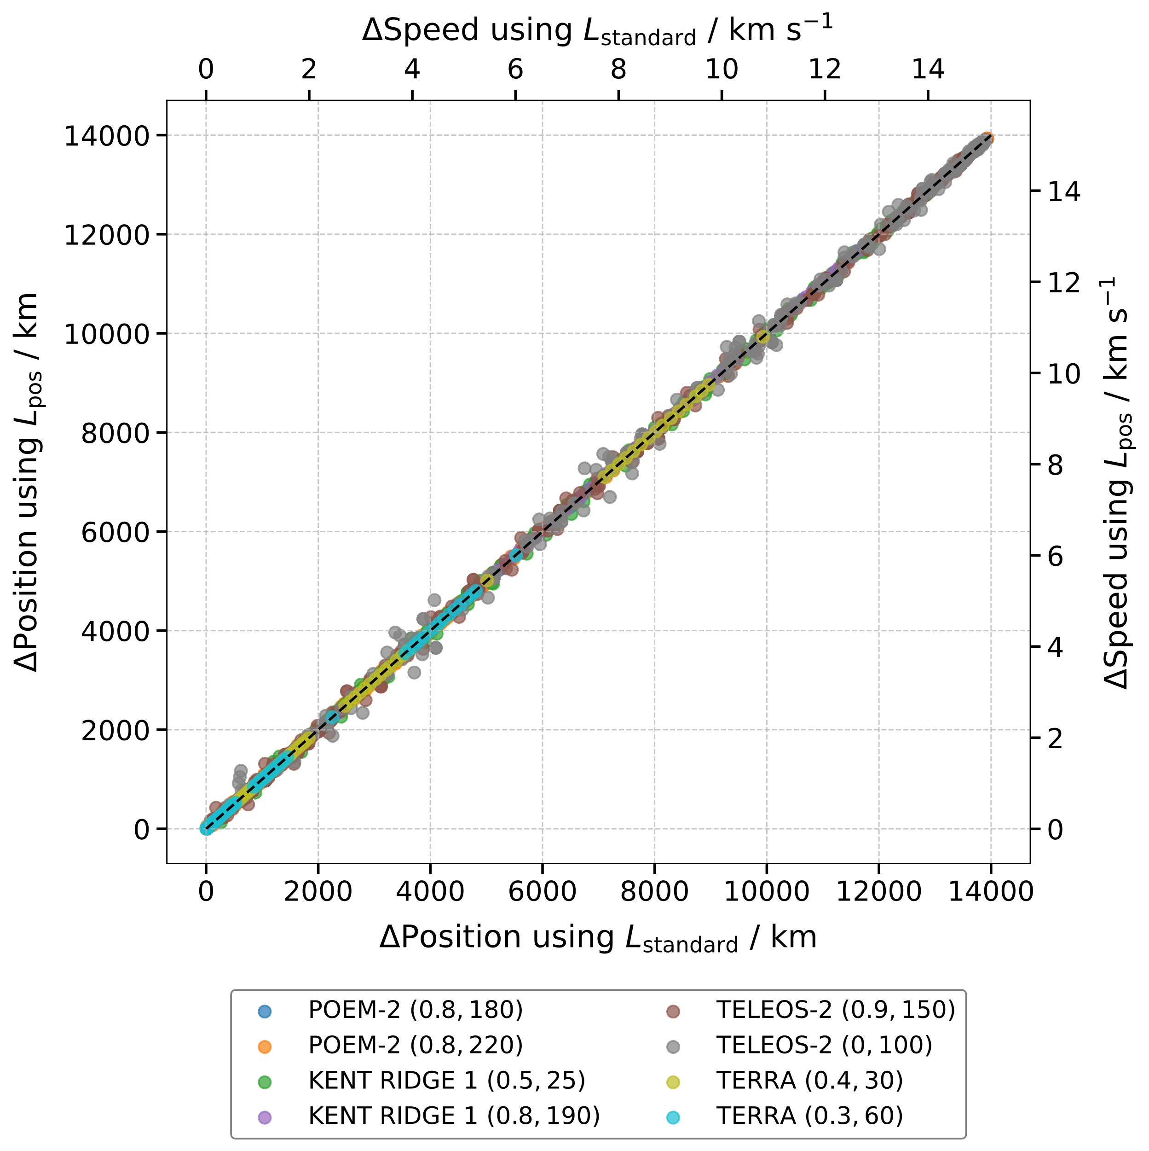


Slide 48


Slide 49


Slide 50


Slide 51
Full Dataset
Split | Attribute Details
Train | Rows | 207,178,987
 | Period Range (min) | 89.32 – 95.60
Validation | Rows | 40,189,621
 | Period Range (min) | 95.62 -96.23
Test | Rows | 40,937,154
 | Period Range (min) | 95.68 – 86.23
Medium Dataset
Split | Attribute Details
Train | Rows | 20742
 | Period Range (min) | 89.32 - 95.60
Validation | Rows | 4024
 | Period Range (min) | 95.62 - 96.23
Test | Rows | 4099
 | Period Range (min) | 95.68 – 96.23
Randomly sample 1% of each spit
Filter for the satellite with maximum period
Randomly select a satellite with a period between minimum and maximum
Filter for the satellite with minimum period
“STARLINK 6060” - Mini Dataset
Split | Rows
Train | 50556
Validation | 13654
Test | 13569
“STARLINK 5350” - Mini Dataset
Split | Rows
Train | 28086
Validation | 7539
Test | 7585
“STARLINK 2561” - Mini Dataset
Split | Rows
Train | 16852
Validation | 4477
Test | 4597

Slide 52
 | SGP4 vs Mini Model |  | ML-dSGP4 vs Mini Model
Satellite | Mini Model Better | Mini Model Worse | Mini Model Better | Mini Model Worse
STARLINK - 2561 | 4200.88 | 842.65 | 4810.56 | 1122.51
STARLINK - 5350 | 34.32 | N/A | 16.86 | 8.26
STARLINK 6060 | 3803.40 | 218.39 | 4495.74 | 867.87

